Slide 1
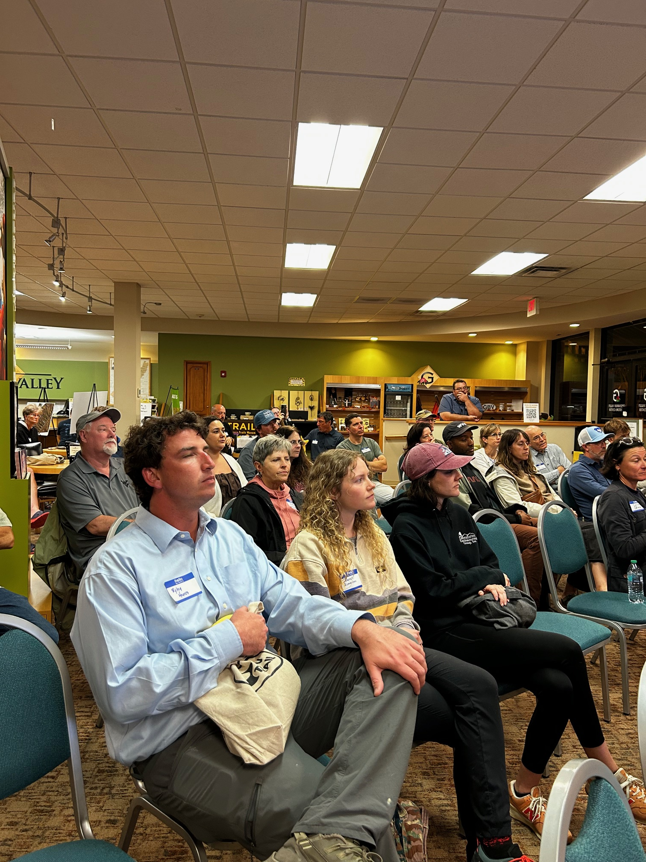
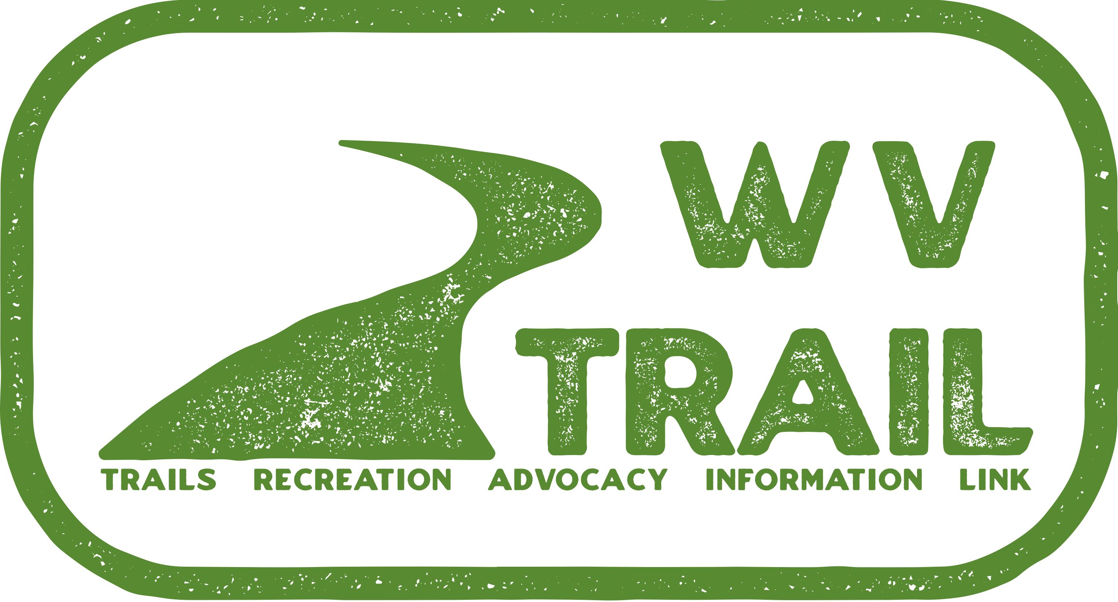
West Virginia’s Statewide Trail Plan Renewal –
A Framework for the Future
Building on the WV trails movement

Slide 2
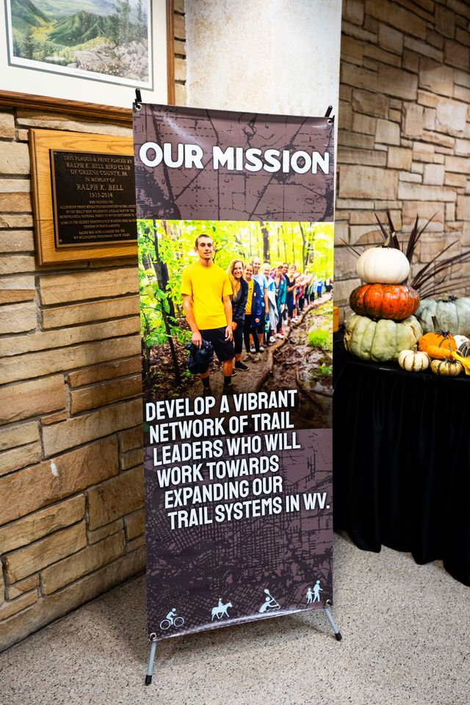
As West Virginia’s only statewide organization focused on promoting, expanding, and maintaining non-motorized trails, WV TRAIL is laying the groundwork to organize the trails community. WV TRAIL is not a trail building organization. Instead, we’re working to unite and mobilize the trail community. We do this through advocacy and information sharing.
Building on the WV trails movement

Slide 3
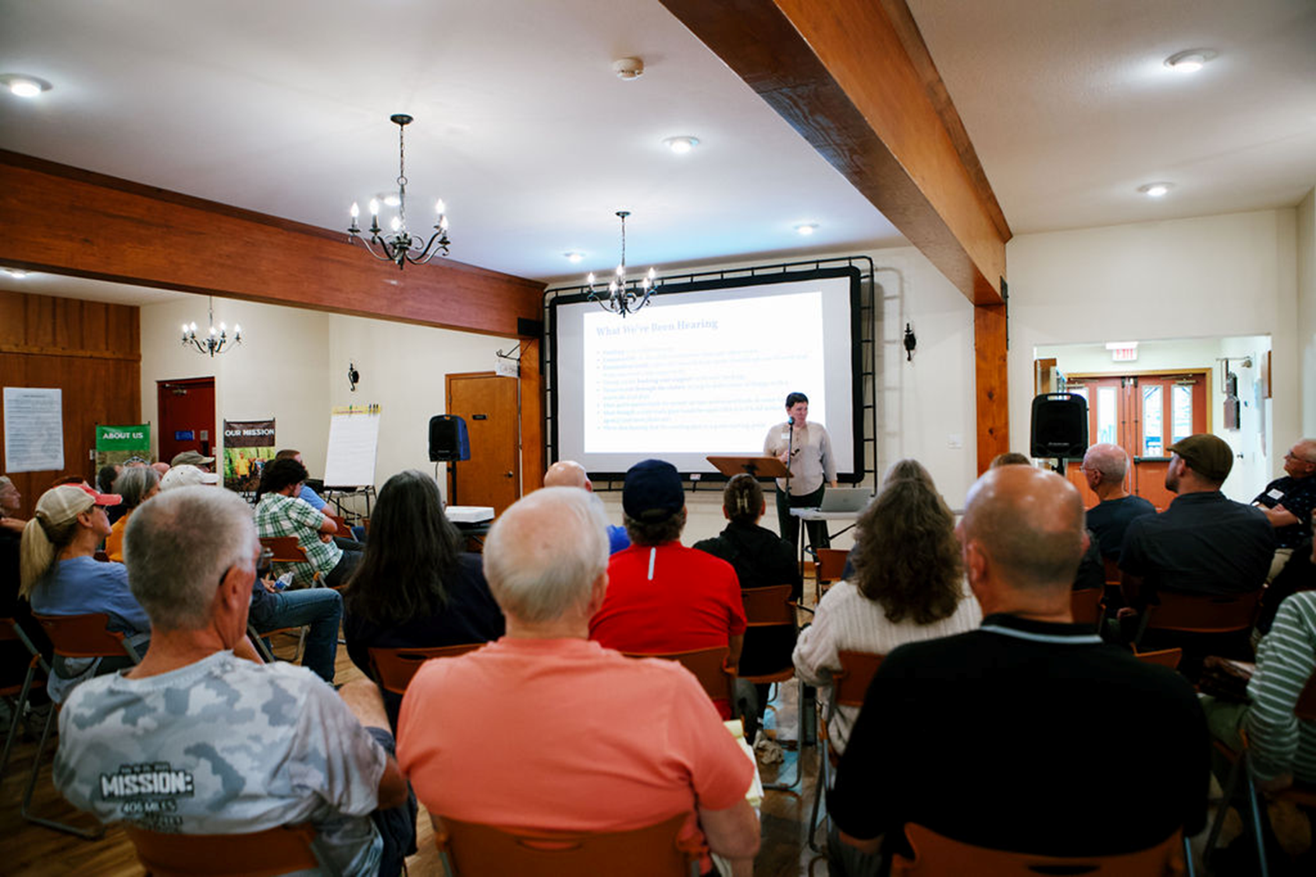
West Virginia’s current statewide trails plan = 25 years old.
How do we build a new plan?
Garner Support?
Building on the WV trails movement

Slide 4
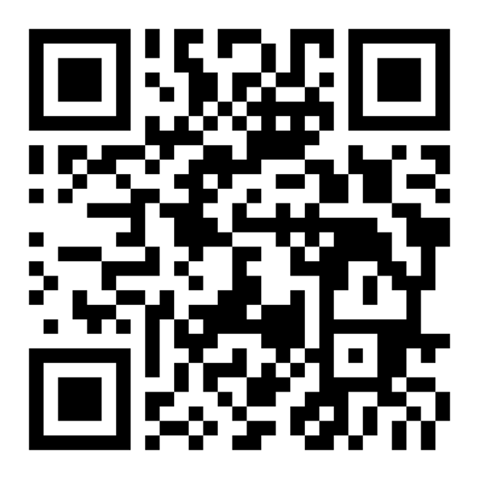
Scan For The Statewide Trail Plan Framework
Building on the WV trails movement

Slide 5
Brian Bolyard, WV DNR
Michael Dodd, WV DOH
Rich Edwards, WVU OEDC
Sam England, WV TRAIL
Nathan Hilbert, National Park Service RTCA
Fielding Moss, West Virginia Scenic Trails Association
Eric Oberg, Rails to Trails Conservancy
Kelly Pack , Rails to Trails Conservancy
Amanda Pitzer, Friends of Cheat, Flatwater Trail Commission
Dillard Price, WV State Parks
Tim Sedosky, WV Division of Highways
Breann Shell, WV Chapter of American Planning Association
Kent Spellman, Harrison Recreational Trails
Cory VanBibber, West Virginia Tourism
Andy Williamson, Brad and Alys Smith Outdoor Economic Development Collaborative
Lisa Maraffa (staff, WV TRAIL/Friends of the Cheat)
Advisory Committee
Building on the WV trails movement

Slide 6



Our Funders and Partners
Building on the WV trails movement

Slide 7
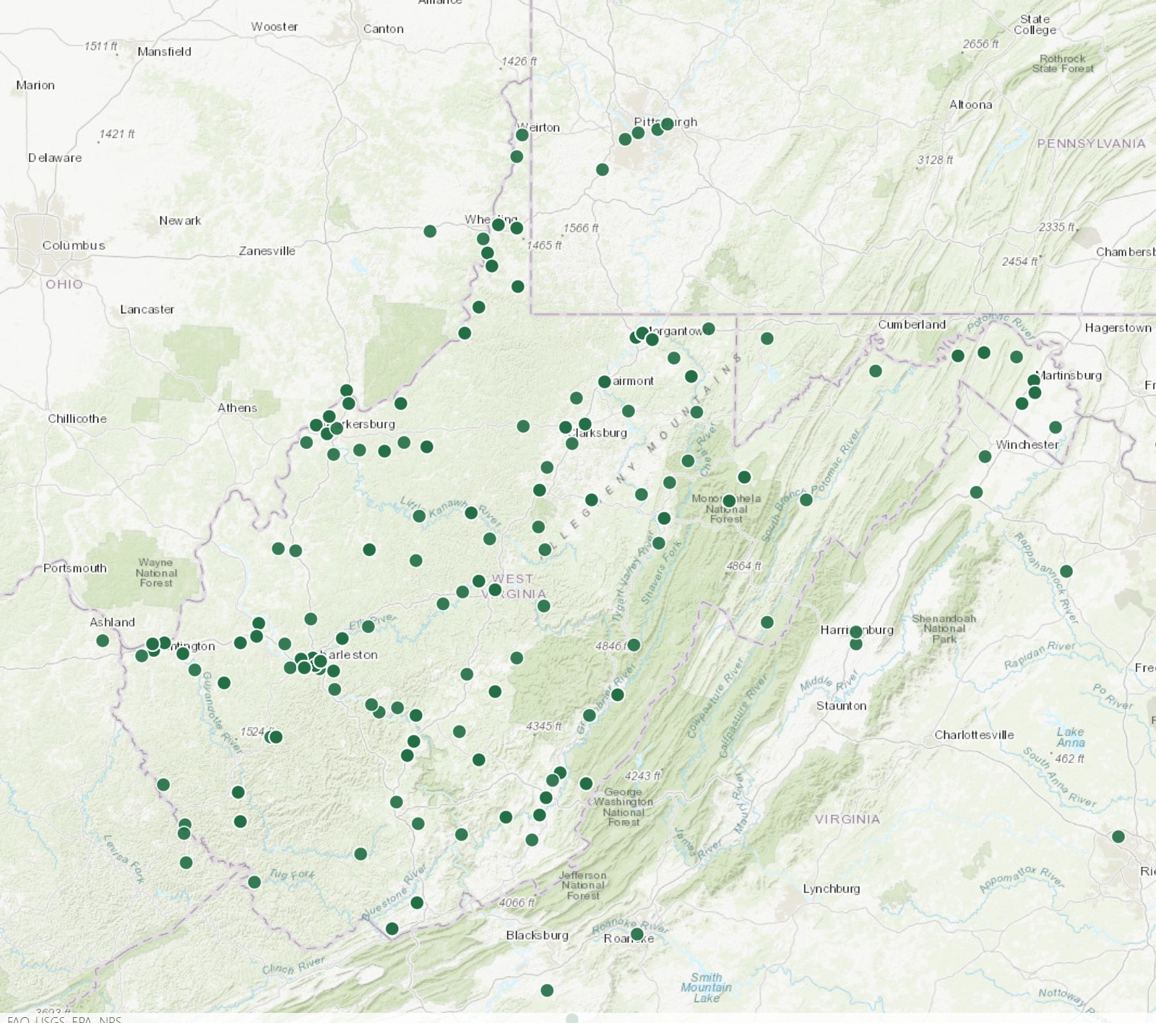
The Process Consisted of:
10 in-person workshops –listening sessions
1 virtual workshop
Stakeholder and Focus Group Interviews
Electronic Survey
Building on the WV trails movement

Slide 8
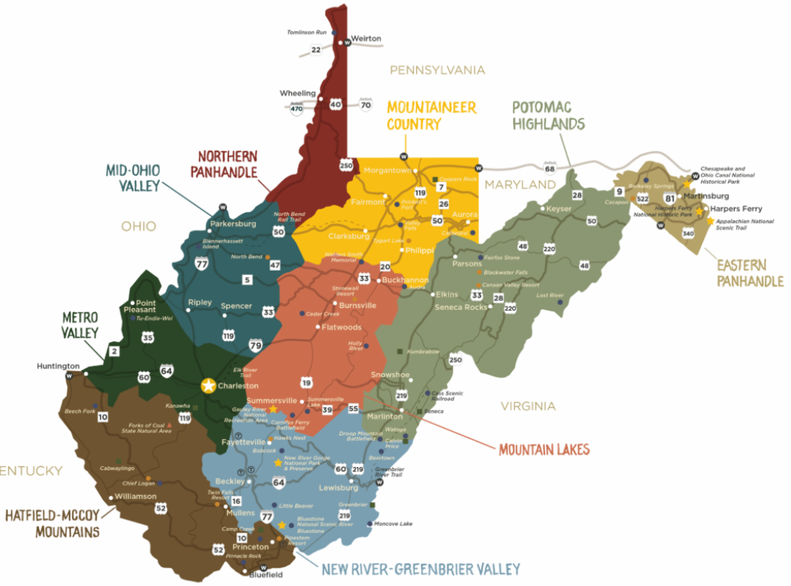
1 – Wheeling
2 – Prickett's Fort
3 – Blackwater
4 – Cacapon
5 – Parkersburg
6 – Flatwoods
7 – Hurricane
8 – Fayetteville
9 – Logan
10 – Lewisburg
1
4
2
5
3
6
7
8
10
9

Slide 9
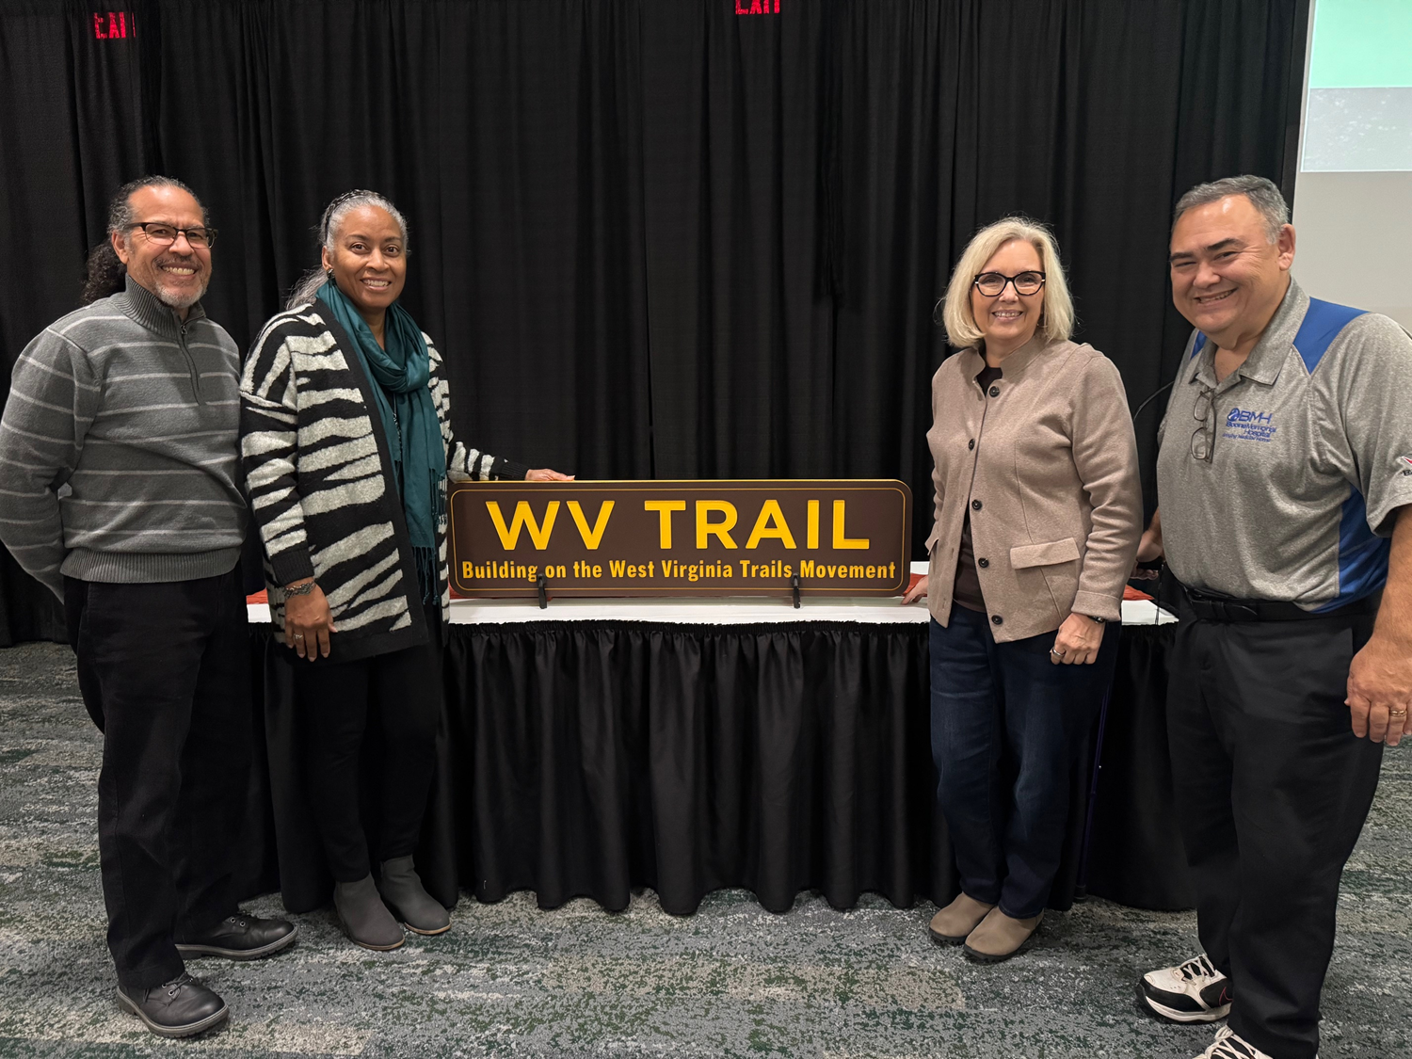
Workshop Co-Hosts
Accelerate Maidson
Beckley Area Trails
Beckley Outdoors
Braxton County EDA
Cacapon State Park Foundation
City of Fairmont
Elk River Trail Foundation
Fayette Trail Coalition
Friends of Cheat
Friends of the New River Gorge National Park
Friends of the Tug Fork
Gilmer County EDA
Greenbrier Environmental Group
Greenbrier Valley Off Road Biking Association (GVORBA)
Harrison Recreational Trails
Meeks Mountain Trail Alliance
Mon River Trails Conservancy
Mountaineer Trail Network Authority
Ohio Valley Trail Partners
Putnam County CVB
River Valley Mountain Bike Association
Tucker County CVB
USDA Rural Partners Network
Building on the WV trails movement

Slide 10
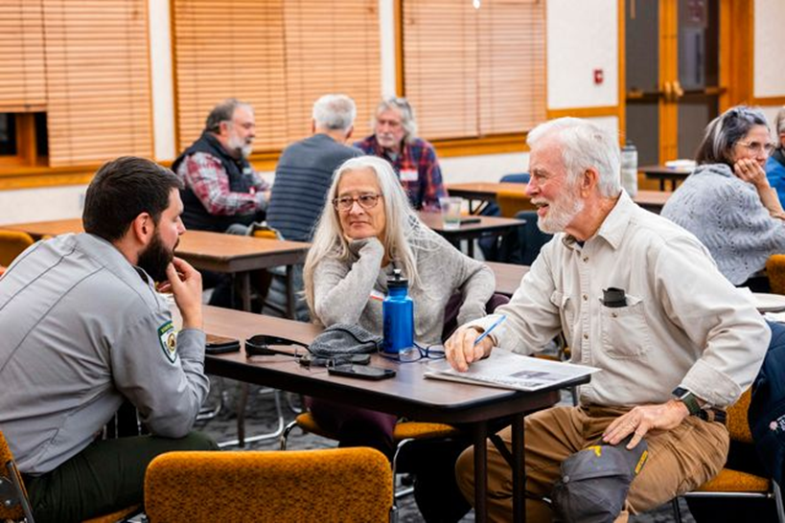
Over 1,000 responses recorded!
logging 2,000 miles across WV
333 survey responses
425 in-person participants
186 organizations
Building on the WV trails movement

Slide 11
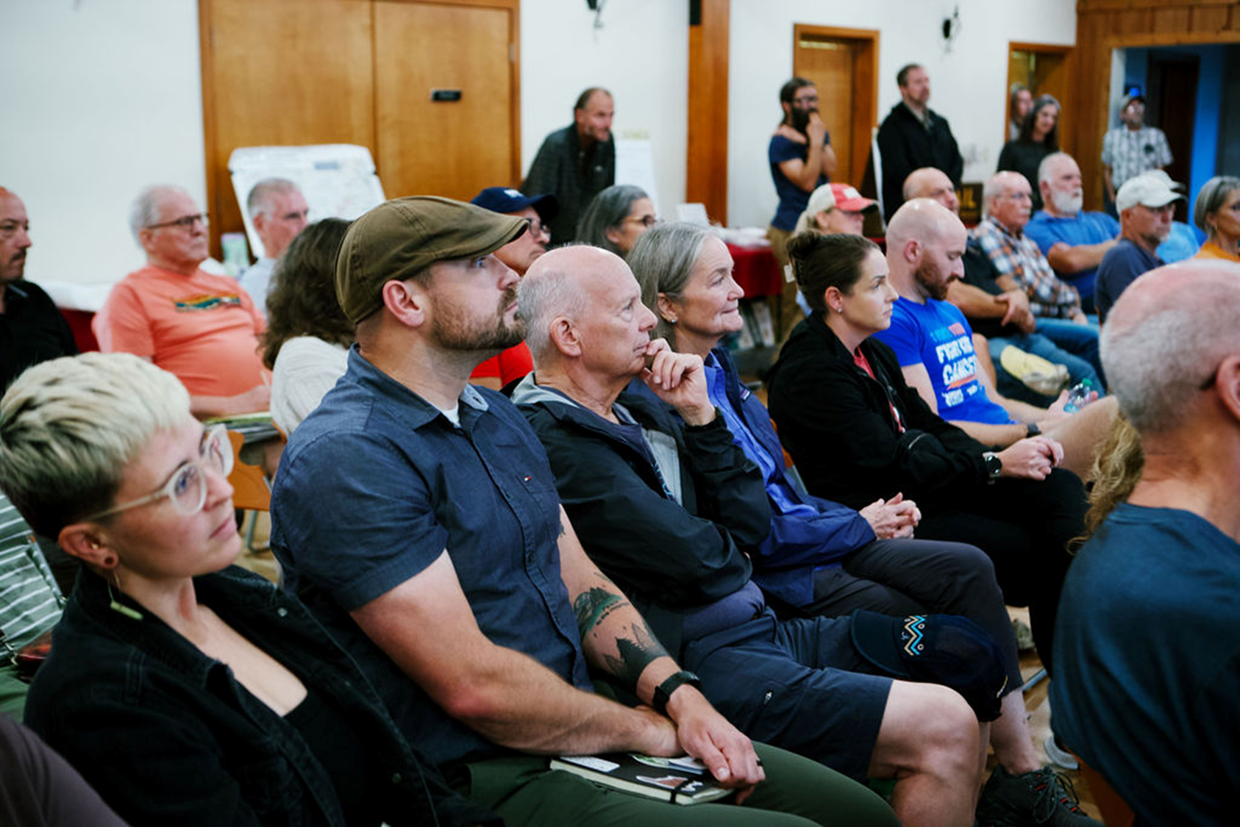
Fractured Community
Building on the WV trails movement

Slide 12
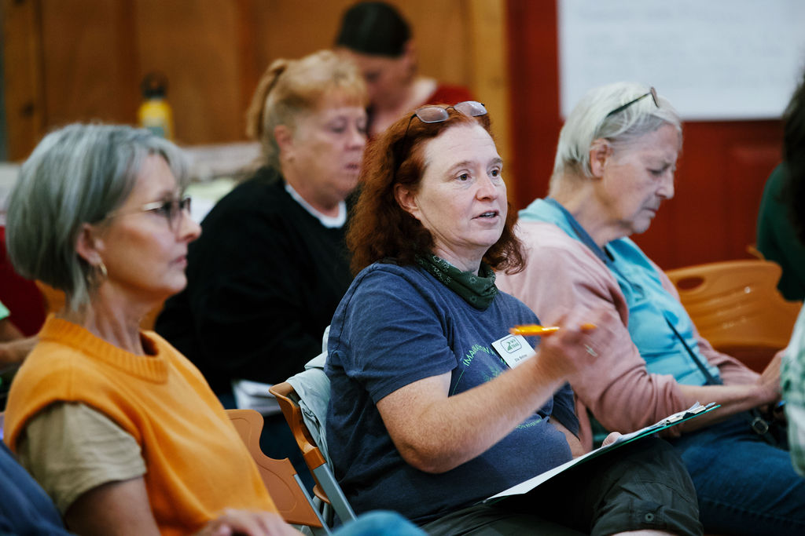
Findings
People say trails make a difference in their lives and want elected leaders to know as much.
93% of survey respondents believe an updated plan is important or critical.
88% of respondents believe that trails make a significant difference in their community’s quality of life.
Building on the WV trails movement

Slide 13
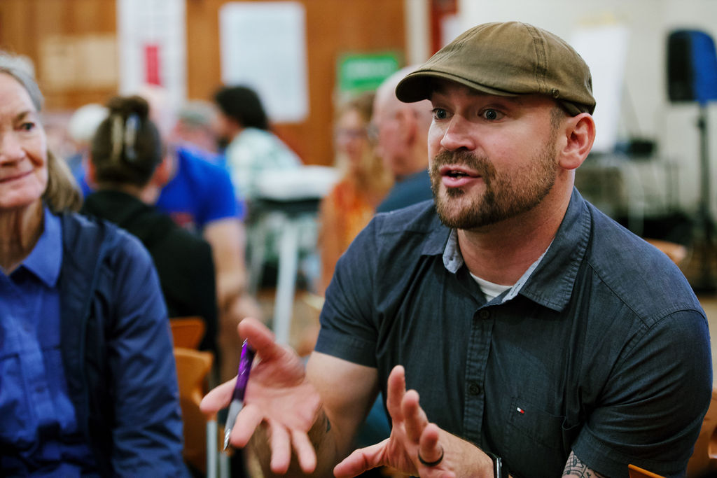
Findings
People want state leaders to hear that trails improve people’s lives, strengthen the economy, and require continued investment.
The top reported trail-related barriers are consistent across the state and across audiences.
Building on the WV trails movement

Slide 14
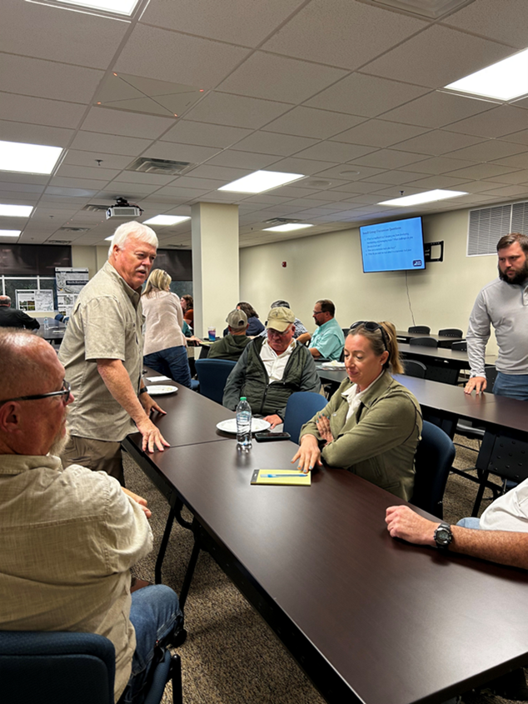
Findings
When asked what trail-related success looks like in a decade from now:
  Trails as a driver of economic vitality and community health
  Accessible, safe, and well-maintained trails for everyday use
  Connected trails that link people, communities, and regions
  Sustained leadership, funding, and stewardship
Building on the WV trails movement

Slide 15
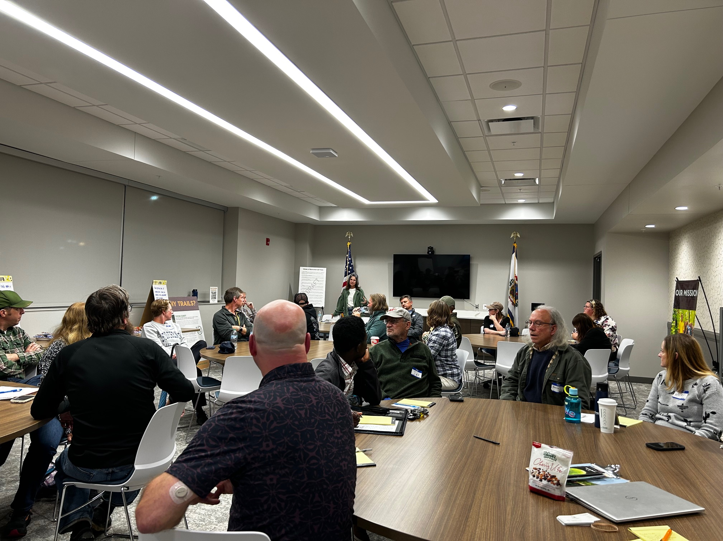
Findings
When you’re done with the plan, it’s just the start of what has to happen!
Building on the WV trails movement

Slide 16
Recommendations
Alignment
Articulate a Shared Vision that Mirrors WV Residents’ Hopes for Trails: A trail for WV by WV
Include Information on Trail-Related Successes; Folks want to hear about these successes and use them for their own success.
Include Definitions and Use Clear Vocabulary: to help with understanding among leadership and legislation.
Building on the WV trails movement

Slide 17
Recommendations
Collaboration and Governance
Develop a New Collaborative Management Model: a potential precedent setting opportunity for WV
Facilitate an ongoing engagement process. Not just a plan.
Include an Implementation Strategy
Address Barriers and Ways to Overcome Them
Provide Guidance to Help Improve Landowner/Manager Relationships – helping connections on both sides.
Building on the WV trails movement

Slide 18
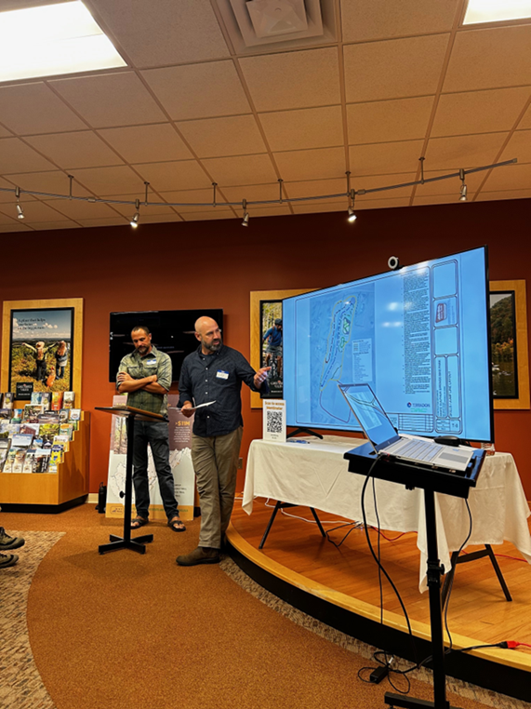
Recommendations
Infrastructure
Address Safety Improvement Opportunities
Prioritize Trail Maintenance
Prioritize Improved Trail Connections
Building on the WV trails movement

Slide 19
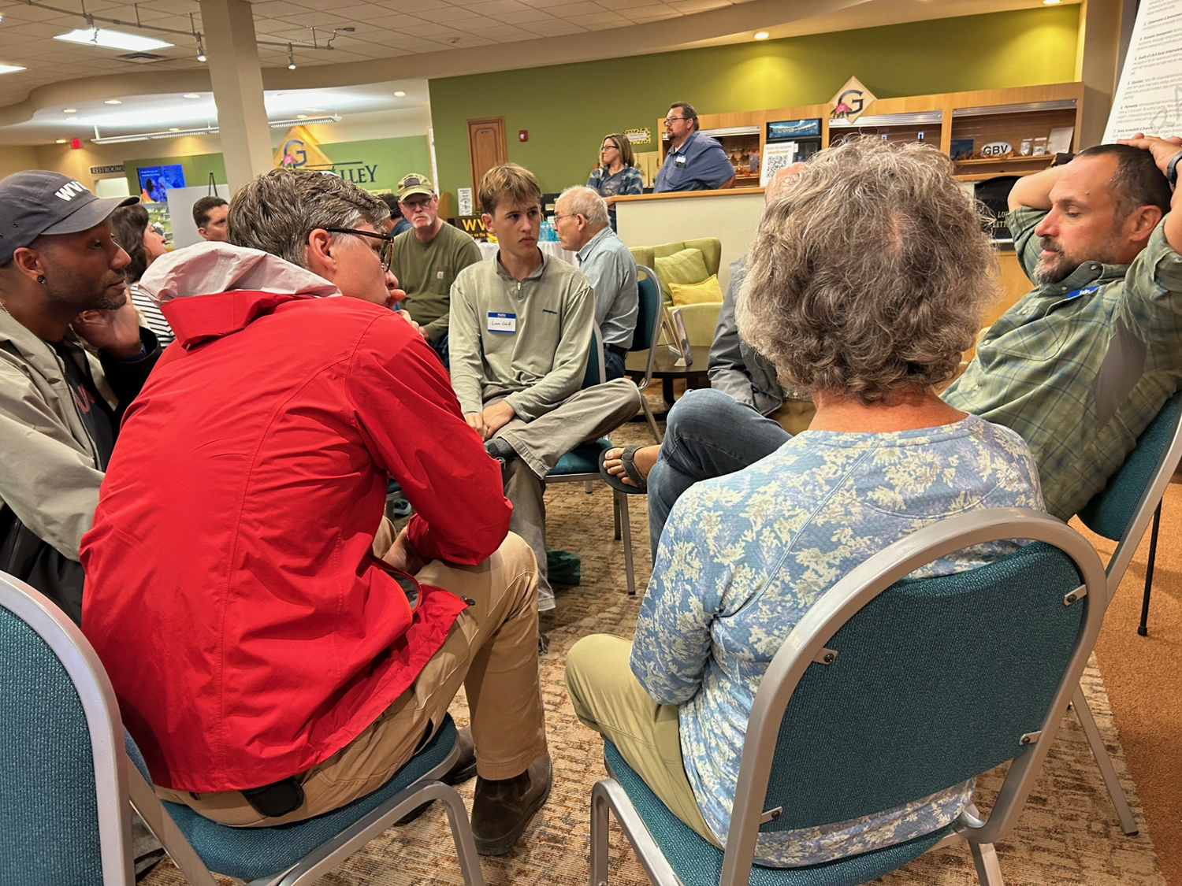
Take Aways
Trails Are Essential to Daily Life
West Virginians consistently affirm—and want state leadership to understand—that non-motorized trails are not luxuries. They are essential infrastructure that meaningfully improve quality of life across the state.
Building on the WV trails movement

Slide 20
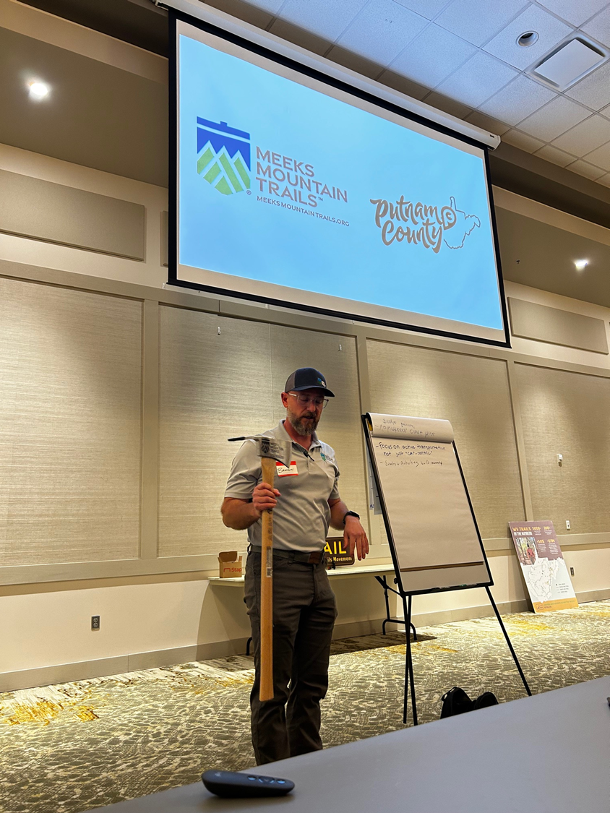
Take Aways
Trails Are Infrastructure—and Require Investment
Trails function as transportation assets, community connectors, and economic drivers. Like roads, water systems, and broadband, they require intentional planning, sustained funding, and long-term stewardship.
Building on the WV trails movement

Slide 21
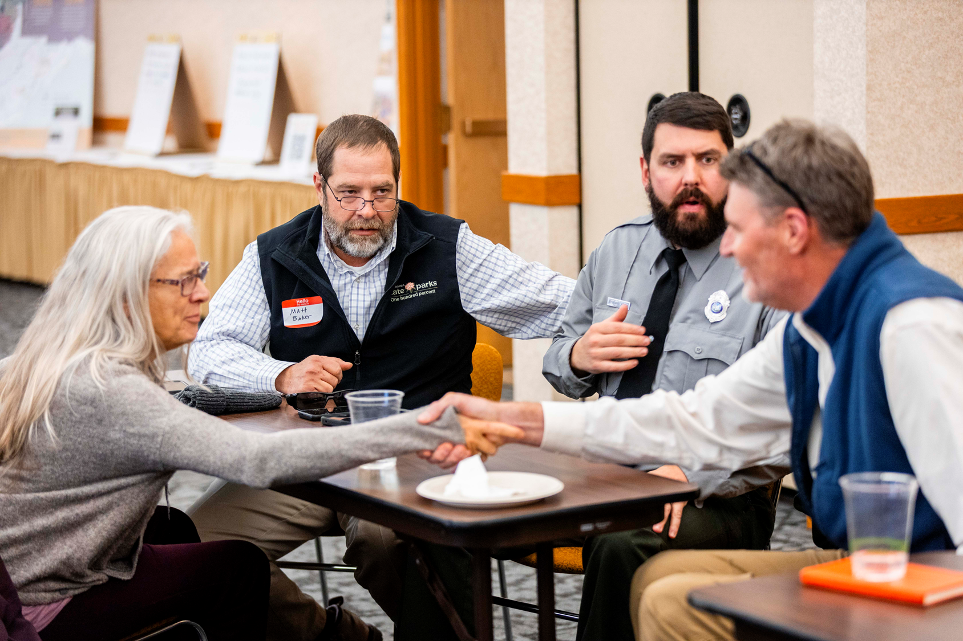
Take Aways
A Modern Transportation System Must Be Multimodal
West Virginia needs a comprehensive transportation system that includes safe, accessible active transportation options. Trails, sidewalks, and bike facilities expand mobility, reduce transportation barriers, support safe routes to schools, and strengthen community resilience.
Building on the WV trails movement

Slide 22
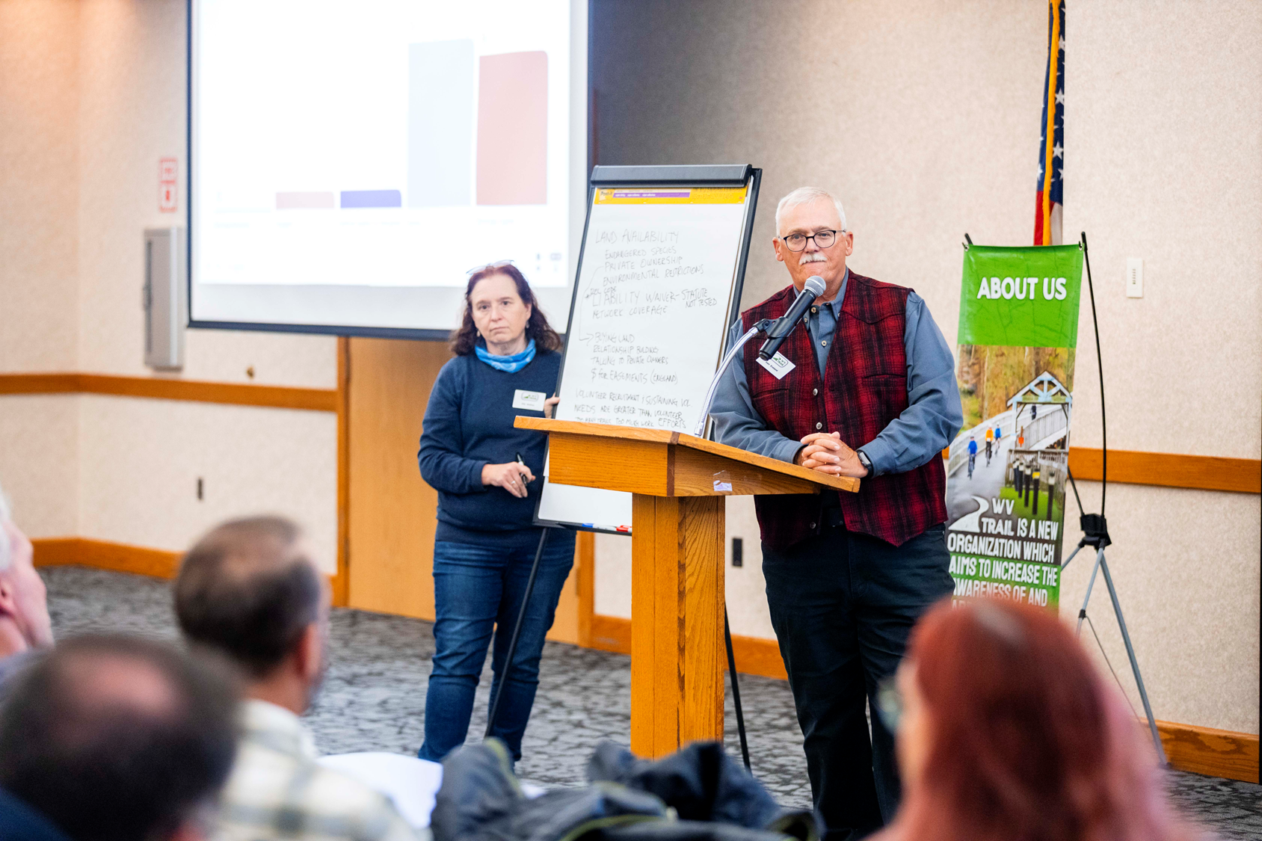
Take Aways
Trails Power Tourism and Outdoor Recreation
Outdoor recreation is one of West Virginia’s fastest-growing economic sectors. Trails—hiking, biking, paddling, and shared-use paths—are central to the visitor experience and critical to sustaining and expanding the state’s tourism economy.
Building on the WV trails movement

Slide 23
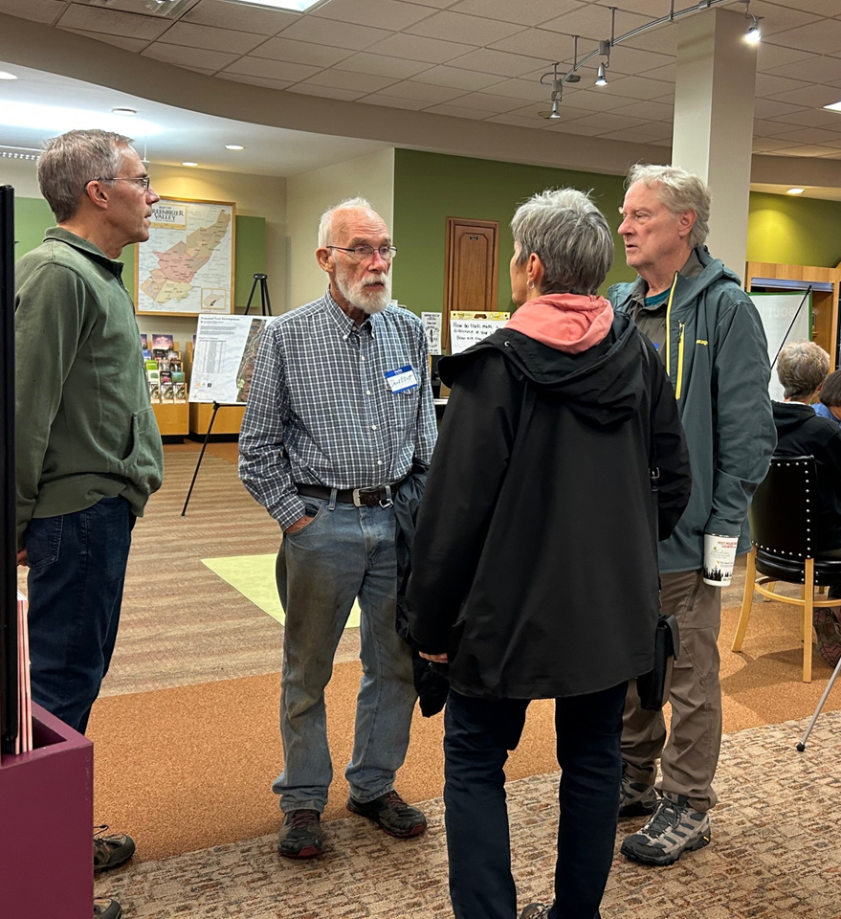
Take Aways
Trails Strengthen Communities and Support Growth
Quality of place is a deciding factor in where people live and work. Communities with strong outdoor assets attract businesses, workers, and investment. Trails help retain residents and draw new ones, including remote workers and young families.
Building on the WV trails movement

Slide 24
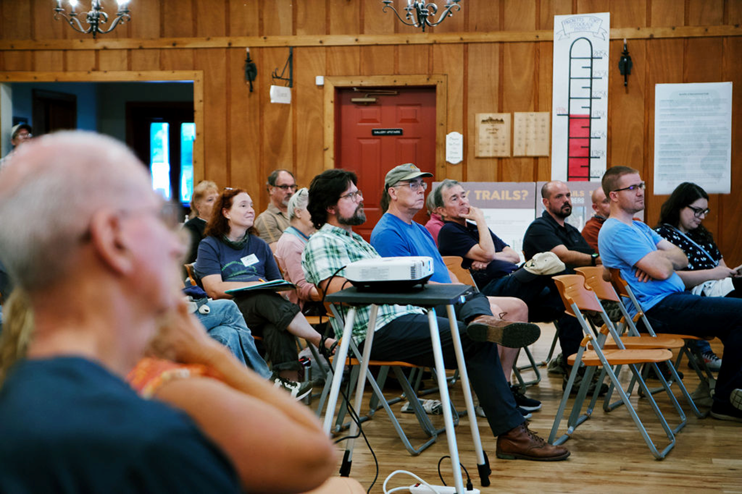
Take Aways
Trails Are a Public Health Solution
West Virginia faces some of the nation’s highest rates of chronic disease. Trails provide a low-cost, accessible opportunity for physical activity for people of all ages and abilities—especially important in communities with limited access to safe, affordable recreation.
Building on the WV trails movement

Slide 25
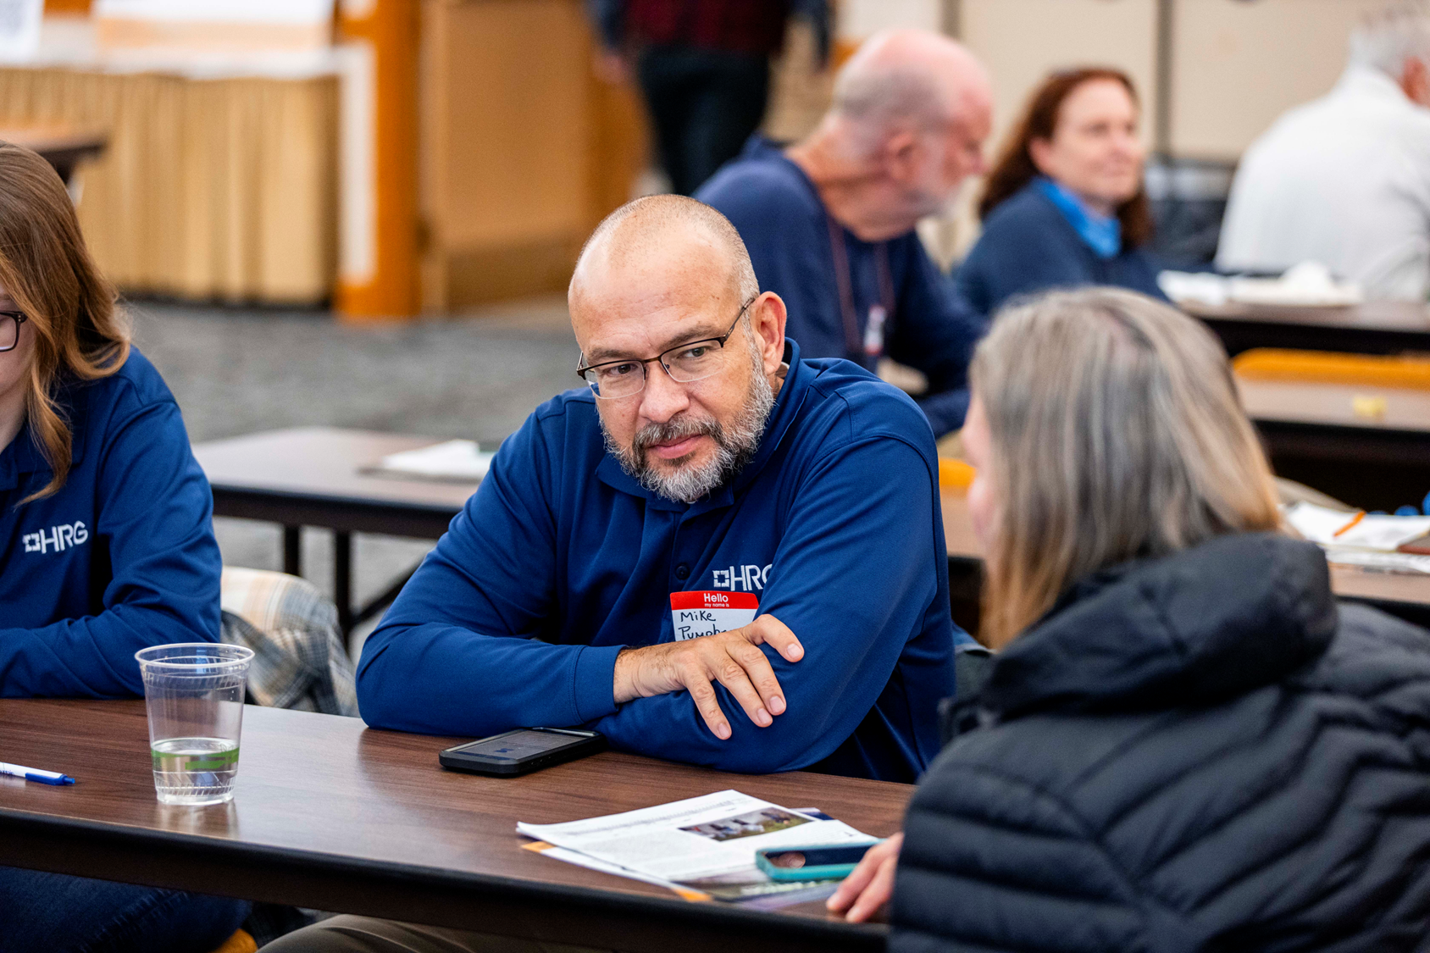
Take Aways
Trails Expand Opportunity and Access
Many of West Virginia’s most underserved communities lack safe places to be active. Investing in trails helps close this gap by providing free, local, year-round access to movement, connection, and well-being.
Building on the WV trails movement

Slide 26
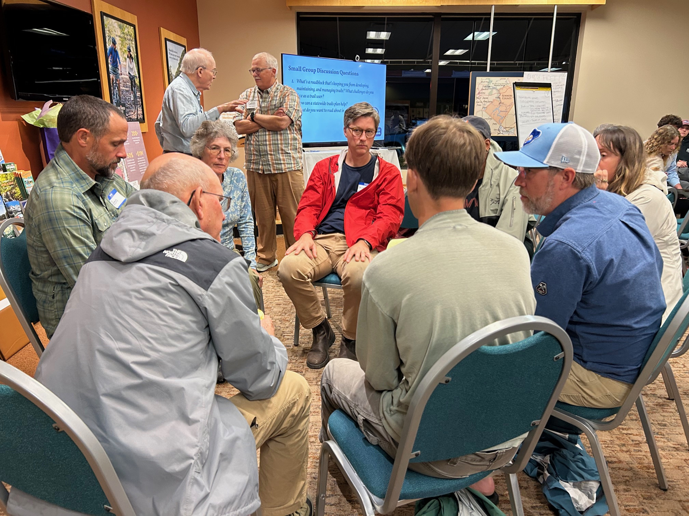
Take Aways
Trails Contribute to Higher Perceived Property Values and Community Attractiveness
Trails strengthen neighborhood appeal, support stable, long term community value and encourage reinvestment while bringing benefits to residents without undue burdens for existing residents.
Building on the WV trails movement

Slide 27
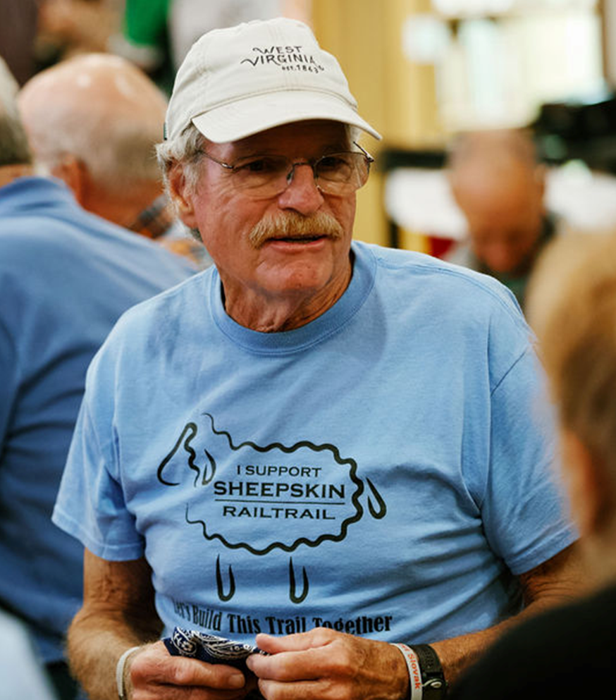
Take Aways
Statewide Leadership Is Needed to Unlock Full Potential
West Virginia’s trail community is passionate and committed, but efforts are fragmented. There is a clear opportunity for a statewide leadership to align priorities, coordinate investment, and build a unified, statewide approach that maximizes impact.
Building on the WV trails movement

Slide 28
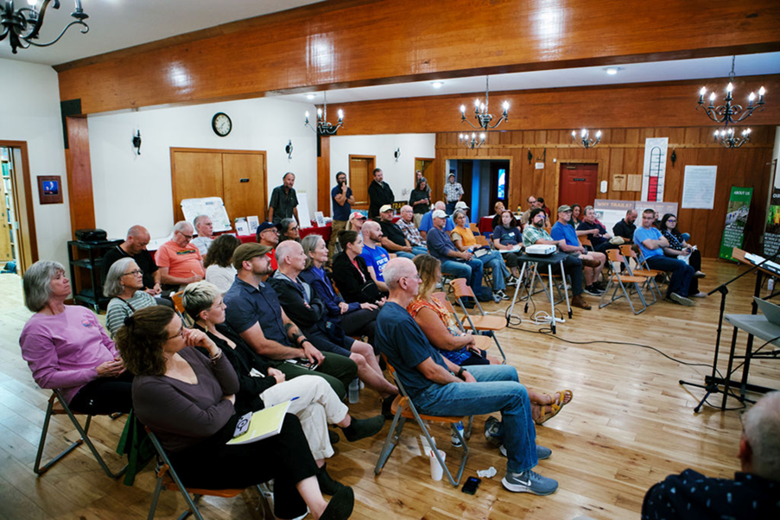
Take Aways
The Most Common Term We Heard:
Connection
Building on the WV trails movement

Slide 29
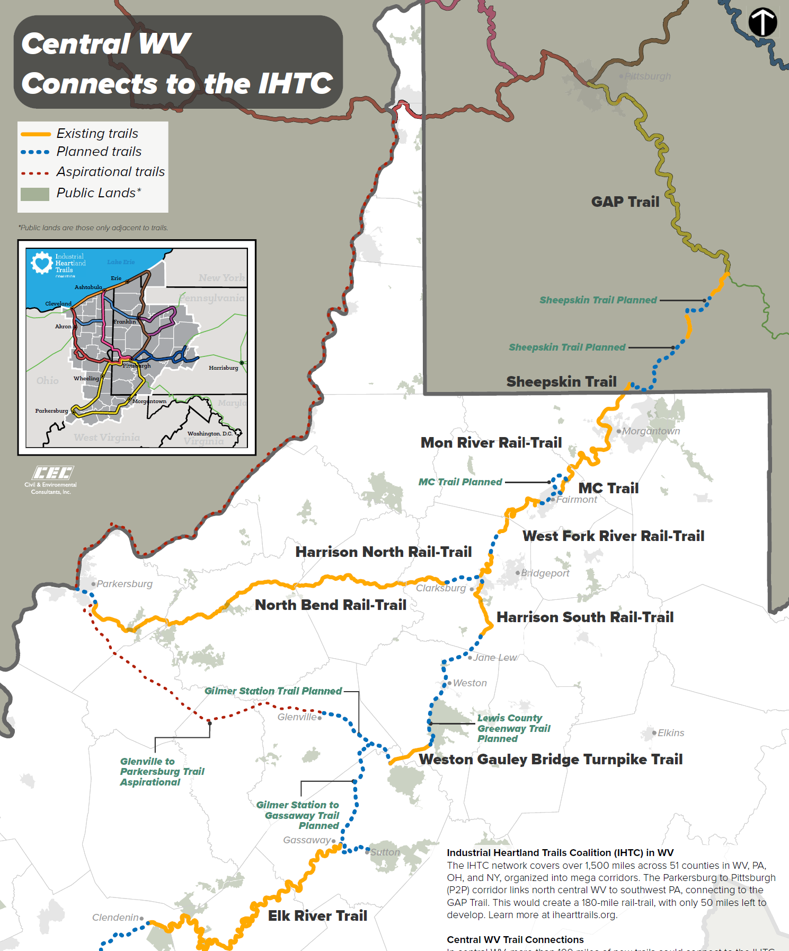
232 Miles – Charleston to Morgantown
60% is currently public trail
29% of gaps have an identified corridor
Only 25 miles need to identify a route
Current CDS – 6 miles connecting Gassaway to Sutton
Harrison, Lewis, Braxton, Kanawha Counties and Fairmont are actively closing gaps

Slide 30
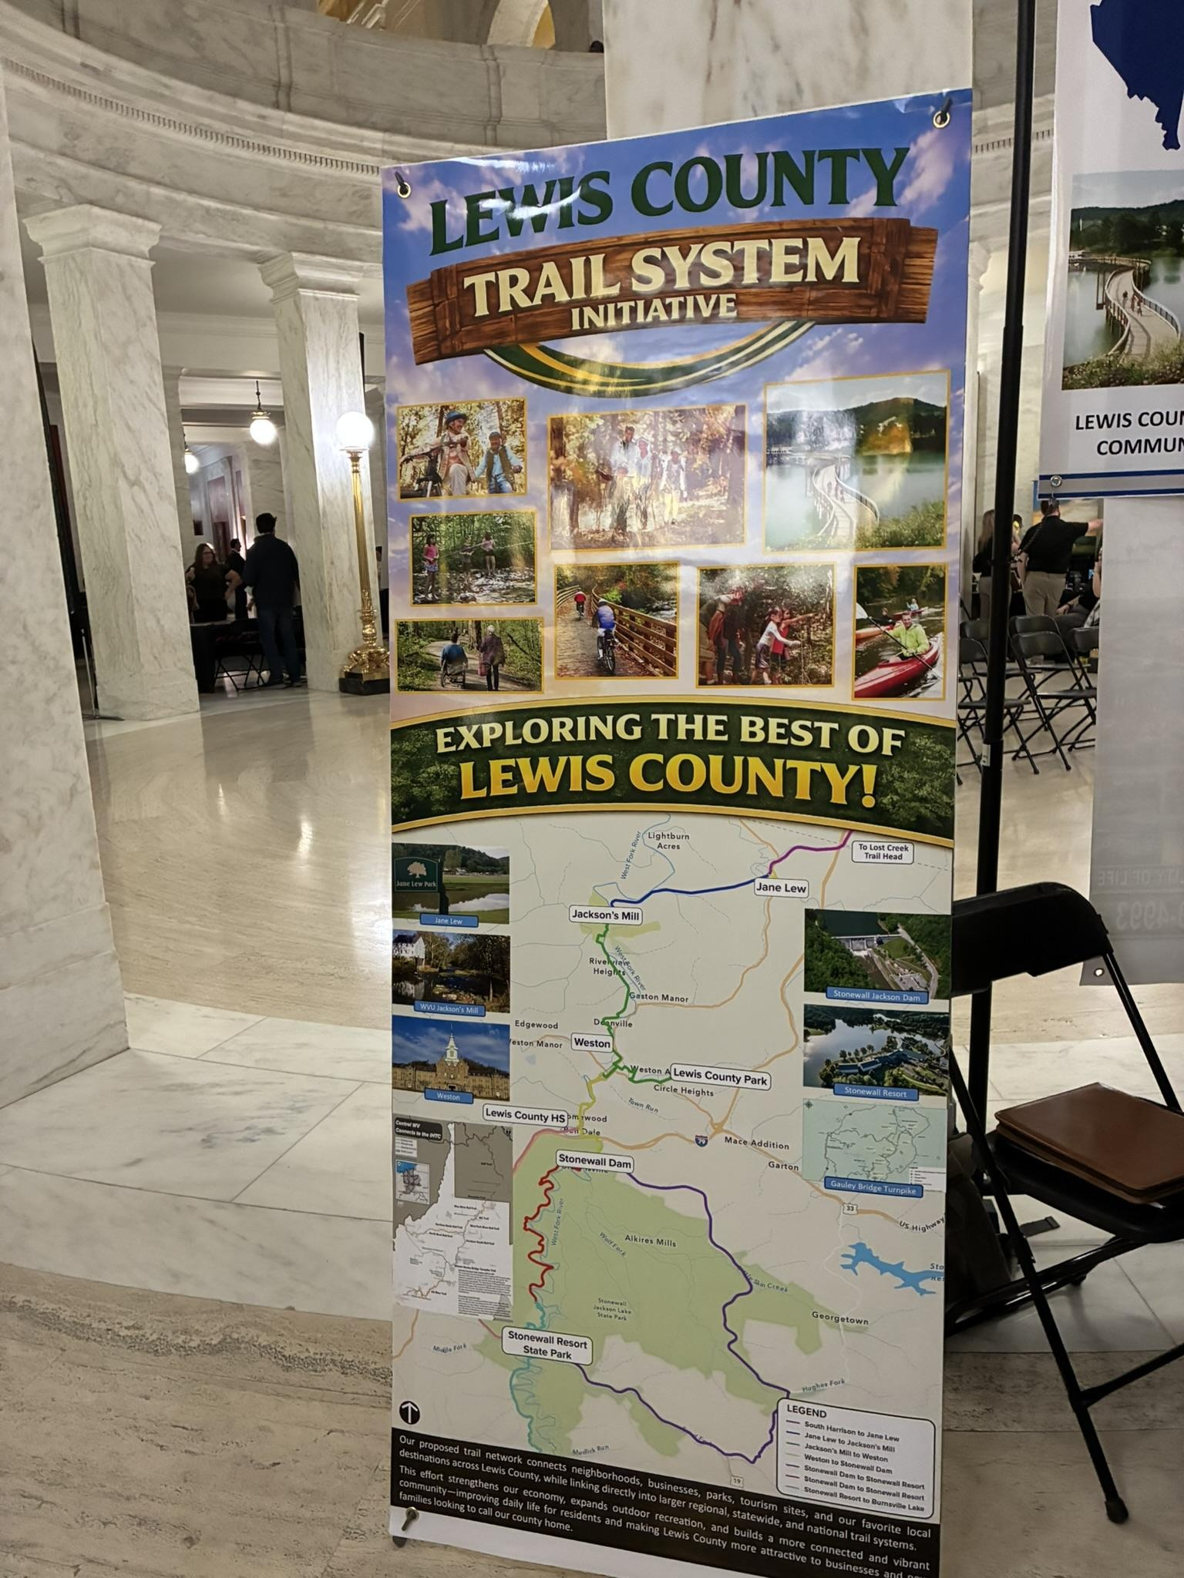
Harrison, Lewis, Braxton, Kanawha Counties and Fairmont are actively closing gaps
RTC selected Lewis and Braxton Counties for a Trail Nation Accelerator - to help communities plan, connect and activate multiuse trail networks that serve people and places equitably.

Slide 31
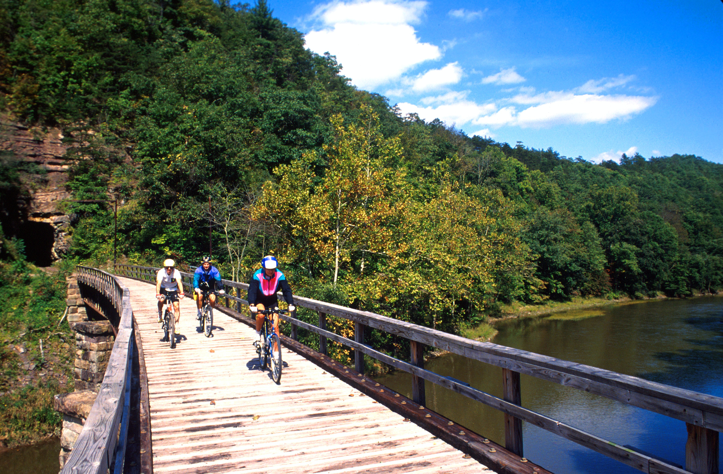
Surface Transportation Reauthorization
Current House Version
Transportation Alternatives (TA) - In, but vulnerable. Rollback of transfer protections makes it easier to shift funds. For states like WV, where TA and RTP are the only dedicated funding sources for active transportation, this introduces real risk to project delivery
Recreational Trails Program (RTP) – In, but not indexed to inflation.
Active Transportation Infrastructure Investment Program (ATIIP) - Out
Safe Streets and Roads for All - In
Surface Transportation Accelerator Grants – New but unproven. Currently lacks a structure that prioritizes multimodal, community-driven projects, raising concerns about whether trails, walking and biking projects will compete as successfully.
Building on the WV trails movement

Slide 32
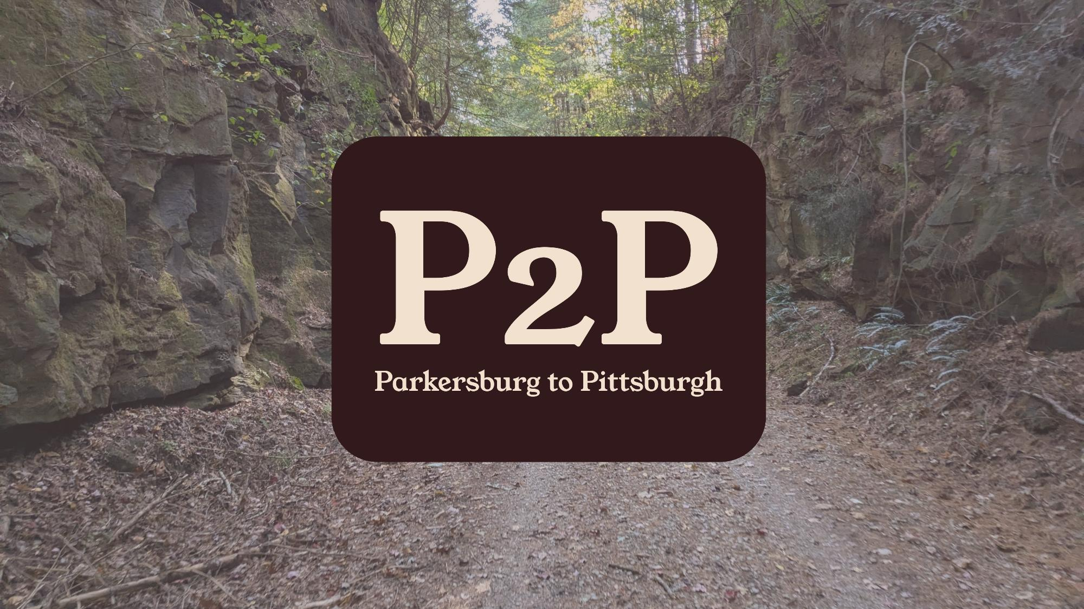
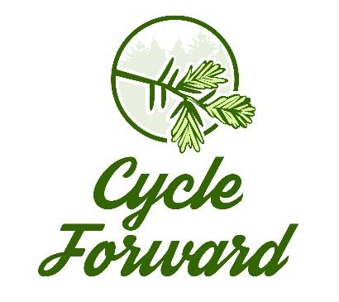

Slide 33
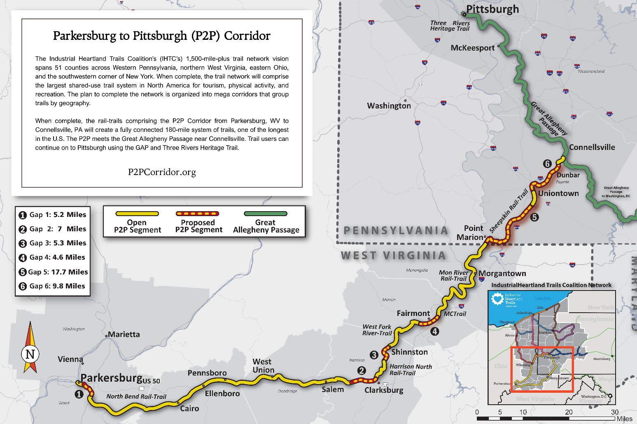
Notes:
I’ve been contemplating what I can share with a room full of transportation planners, and I think it’s this:
When complete, the P2P Corridor will connect to one of the best

Slide 34
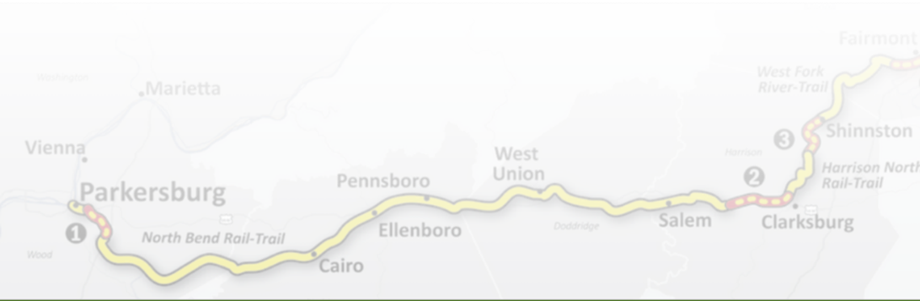
Project Area
The P2P Corridor is made up of six trails spanning seven counties across West Virginia and Pennsylvania:
  North Bend Rail-Trail
  Harrison North Rail-Trail
  West Fork River Trail
  MCTrail
  Mon River Rail-Trail
  Sheepskin Trail

Slide 35
P2P Corridor Regional Master Plan
Funded through an ARC ARISE grant with matching funds from the Just Transition Fund, Claude Worthington Benedum Foundation, and the City of Fairmont
Project partners:
  City of Fairmont
  Great Allegheny Passage Conservancy
  Harrison Recreation Trails, Inc.
  Mon River Trails Conservancy
  Morgantown Riverfront Revitalization Task Force
  National Road Heritage Corridor
  Pennsylvania Environmental Council
  WV TRAIL, Inc.

Slide 36
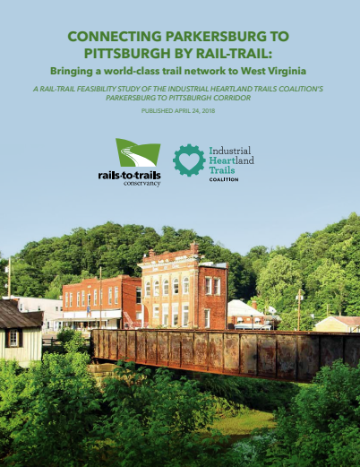
Builds on Past Successes
P2P and Sheepskin corridor studies
RTC’s “Unlocking” report
Years of IHTC and corridor-level collaboration

Slide 37
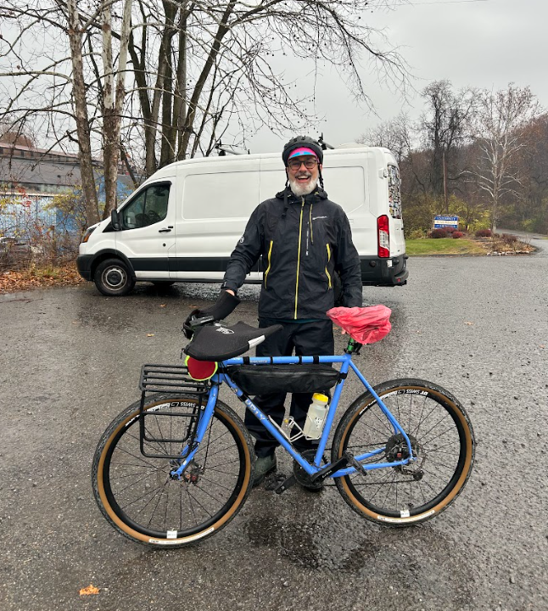
Project Components
Community engagement
Infrastructure, assets, & connectivity toolkit
Market research, marketing recommendations, & economic development strategies
Funding roadmap & sustaining the work

Slide 38
Why this Matters

Slide 39
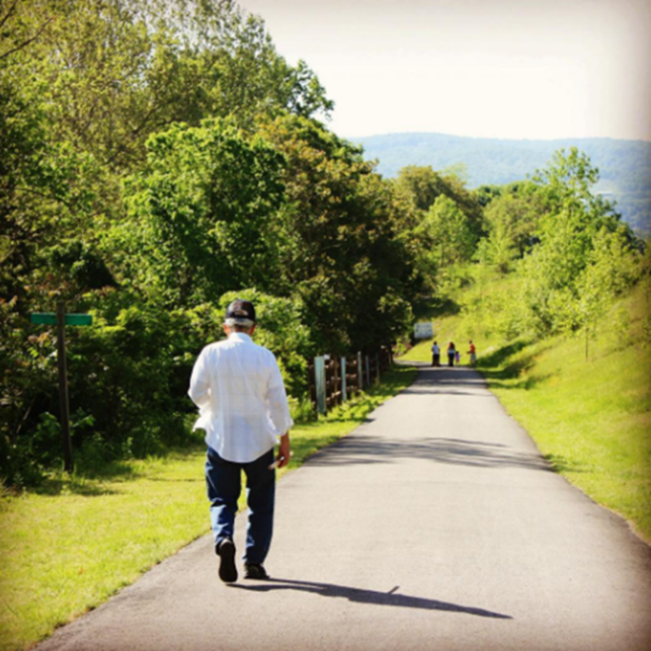
Trails Part of a $1.3T Outdoor Economy, but…
Economic benefit is not automatic
  It requires investment and intentionality
Trails are more than their economic output
  They contribute to:
    Quality of life
    Improved health outcomes
    Memorable trips/vacations
    Connectivity
    Land conservation
    An area’s competitiveness

Slide 40
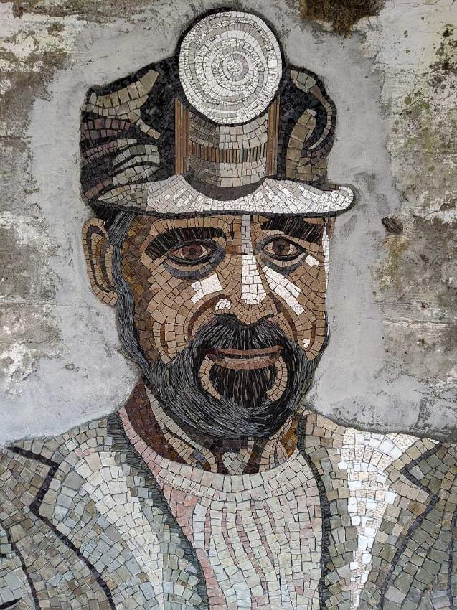
Naming What Exists
“People who have watched their places deteriorate often carry a low-grade unnamed grief.”
– Rachel Sager, The Ruins Project & author of Your Grandfather Worked Here
Artist: Margy Cottingham

Slide 41
Purpose
To develop a community-based implementation plan that will unlock the community and economic development potential of the P2P Corridor
An actionable blueprint for achieving and sustaining rural prosperity

Slide 42
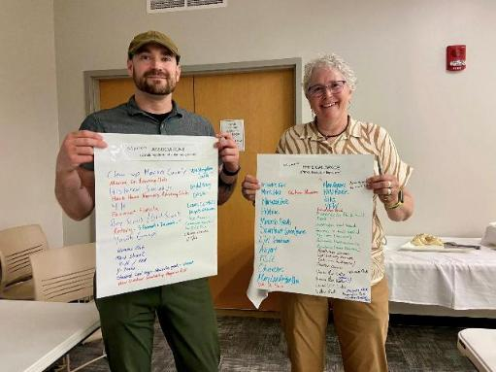
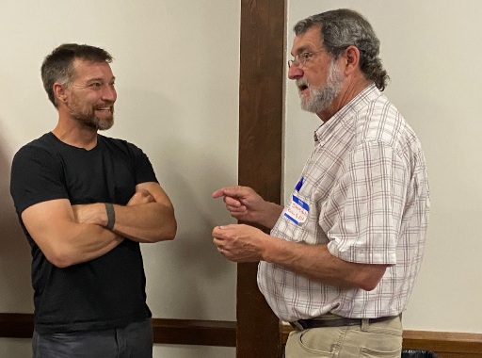
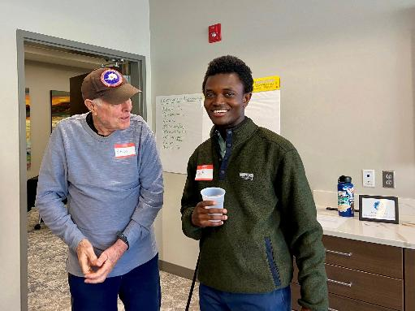
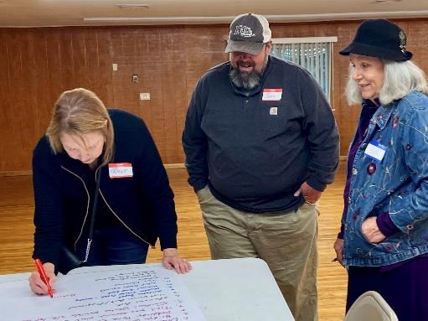
Community Engagement
24 indoor, outdoor, and virtual programs
6 community meetings + 6 virtual engagement sessions
~200 surveys received

Slide 43

Survey open through June 22

Slide 44
Four Thoughts…

Slide 45
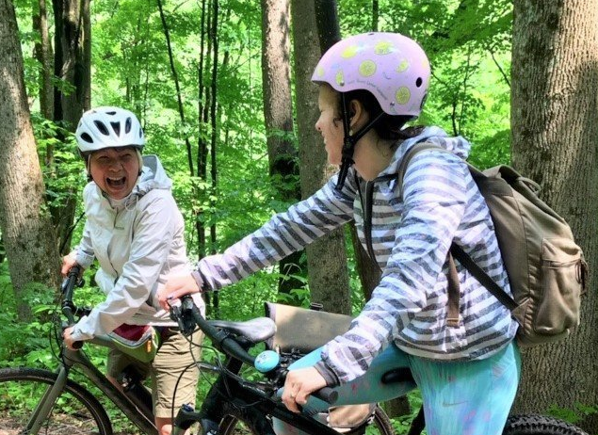
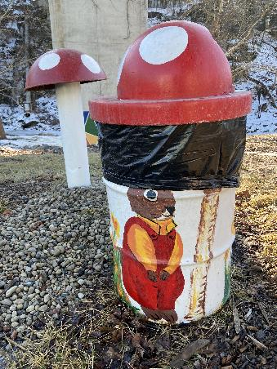
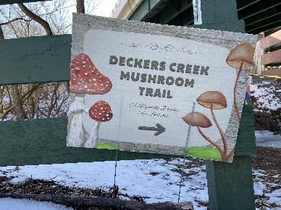
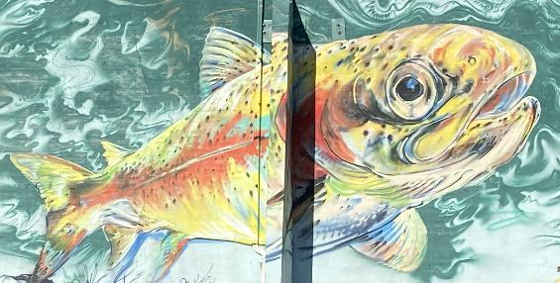
Multiple Benefits
Trails contribute to tourism, economic development, regional competitiveness, improved health outcomes, and quality of life.

Slide 46
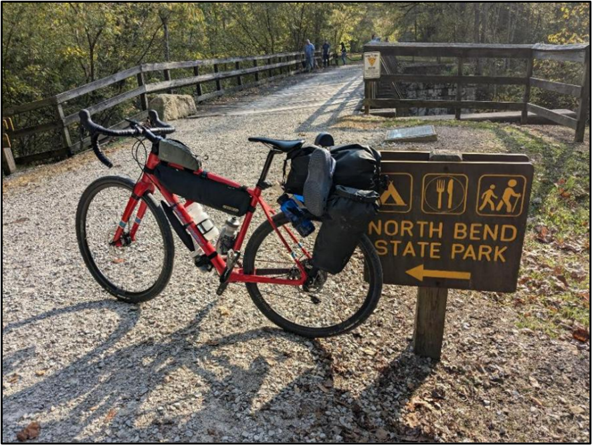
Enormous Connectivity Potential
When complete, the P2P Corridor will connect to one of the best performing trails in the country, creating 240 miles of connected trails.

Slide 47
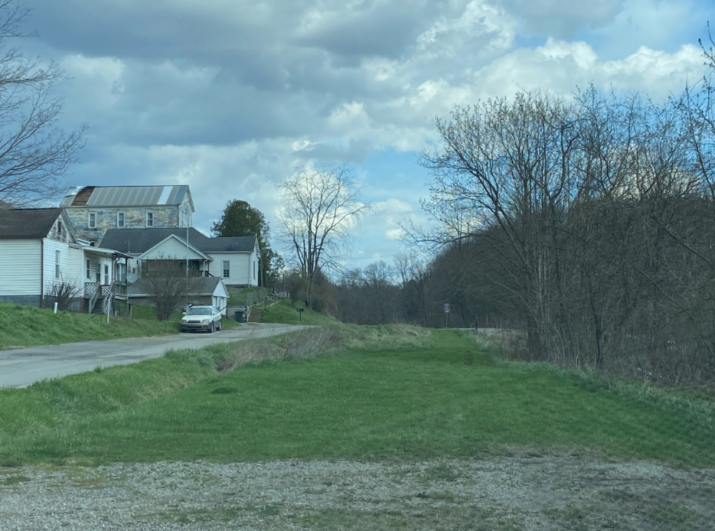
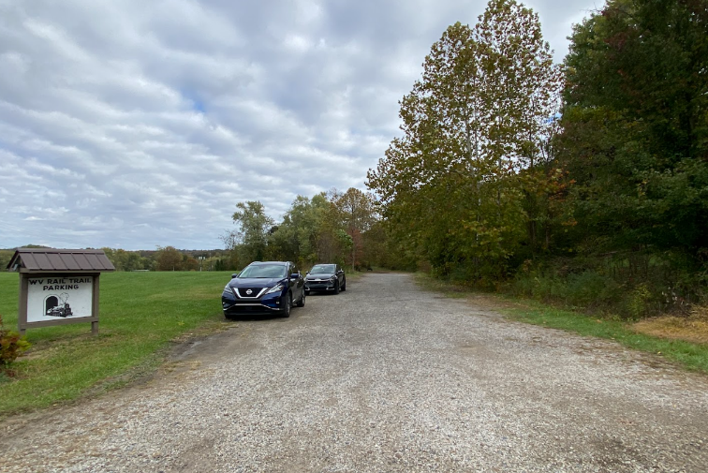
Filling the Gaps Amplifies Potential
There’s a lot we can do with what we already have, but the aspirational component relies upon connectivity.

Slide 48
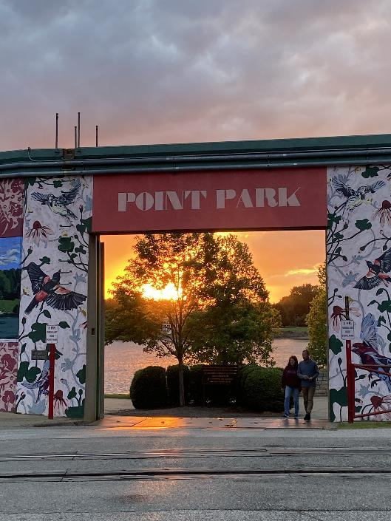
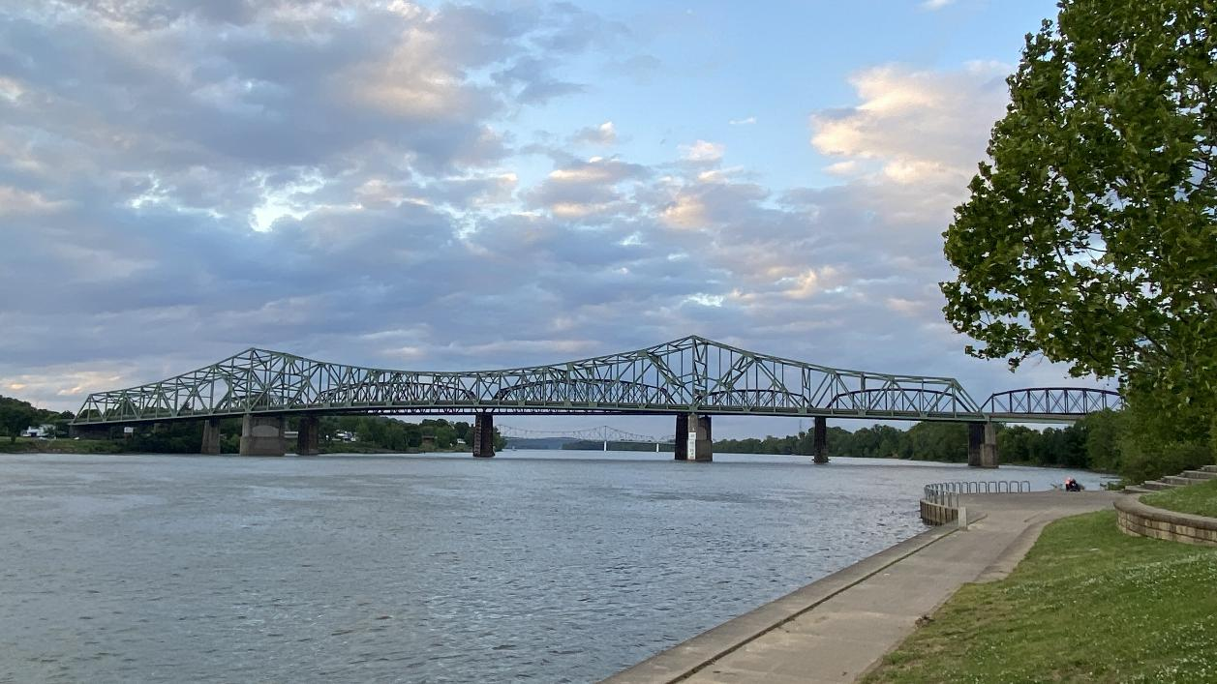
If the Connections are Made…
Notes:
Point Park to NBSP to Pricketts Fort SP, Ohiopyle State Park, Point State Park

Slide 49
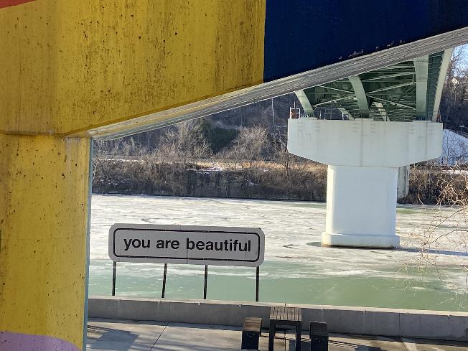
Varied Planning Needs
Planners can help with:
This isn’t just about addressing the trail gaps.
Trail-oriented development
Road connections
Well-maintained roads
Access points
Sidewalks
Bike lanes

Slide 50


Midway Survey Finding
Improved trail quality, amenities, and improved connectivity the path to regional prosperity

Slide 51

Thank you!
Amy Camp
Cycle Forward amy@cycleforward.org www.p2pcorridor.org

Slide 52

Statewide Trail Plan Framework
P2P Survey

Slide 53
Thank you
Building on the WV trails movement

