Slide 1
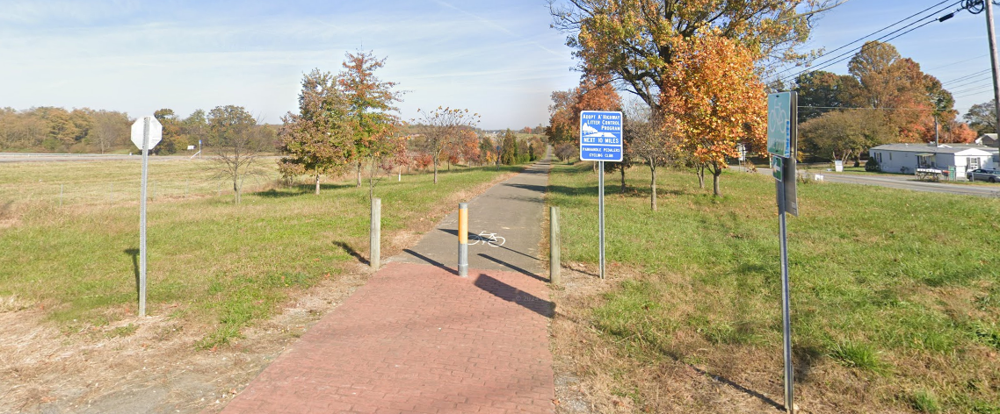
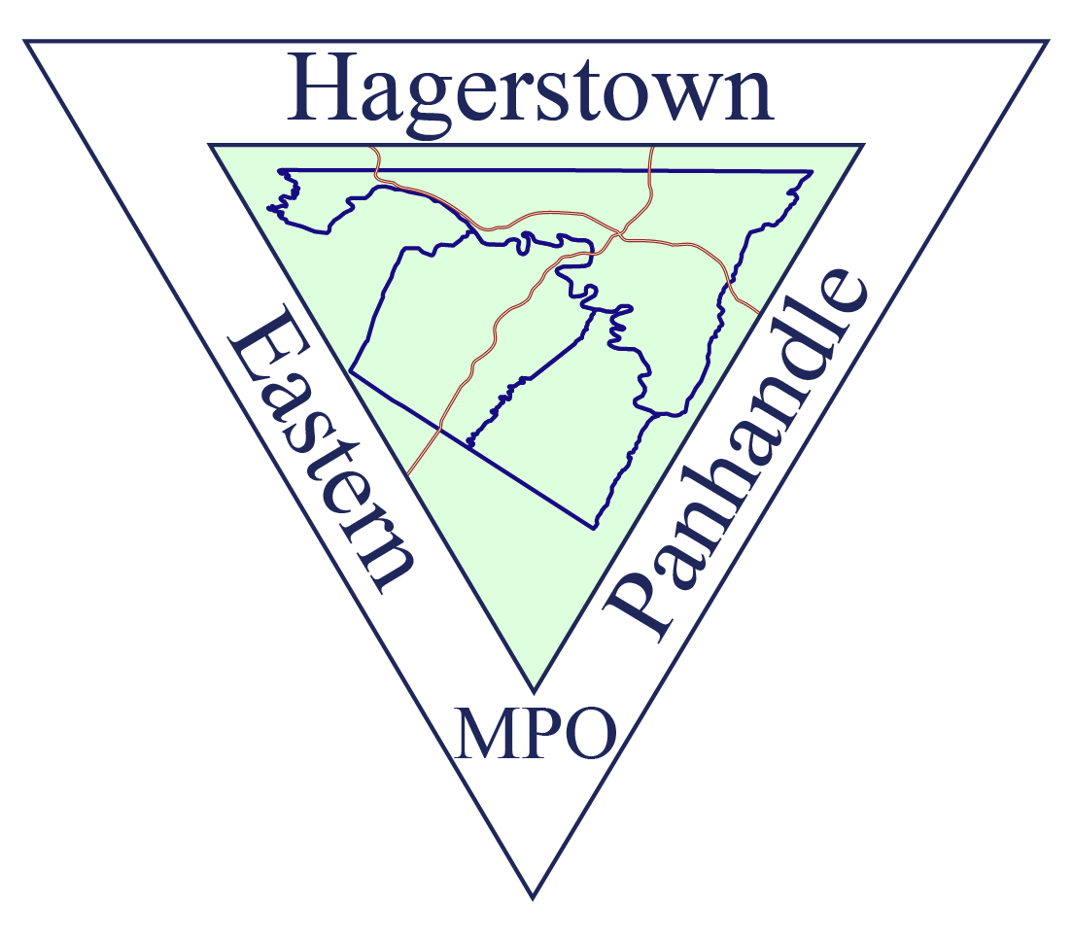

Matt Mullenax
Jim Frazier
WV Transportation Planning Conference
HEPMPO
WV Route 9 Bicycle Path Connectivity Plan
June 3, 2026

Slide 2
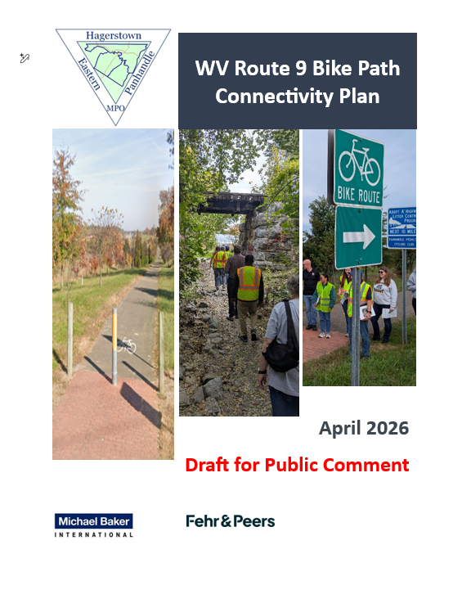
Agenda
1
Project Overview
2
Opportunities and Challenges
3
Public Outreach and Engagement
4
Panhandle Regional Connector Path
5
Questions and Contact Information
Notes:
Project team
Overview and tasks
FHWA Tool

Slide 3
Project Overview
3

Slide 4
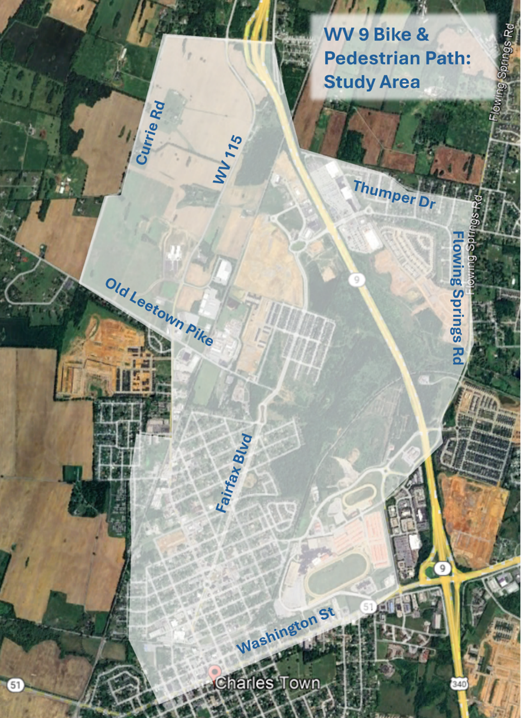
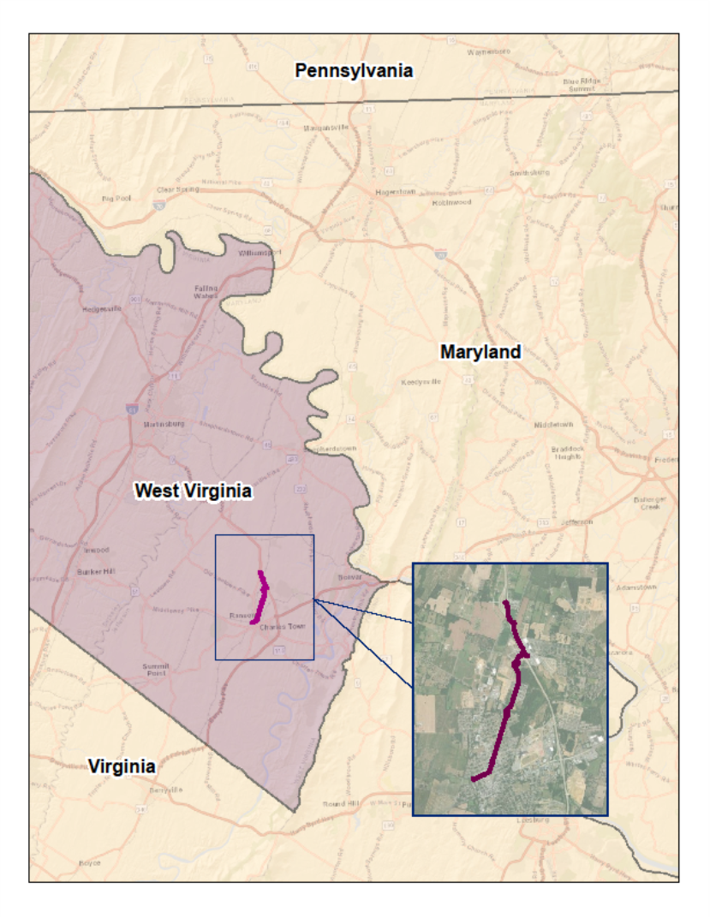
Study Area
Portions of Ranson and Charles Town, WV
Corridor formed by WV Route 9
Links key activity centers
Newer subdivisions
Shared urban core
4

Slide 5
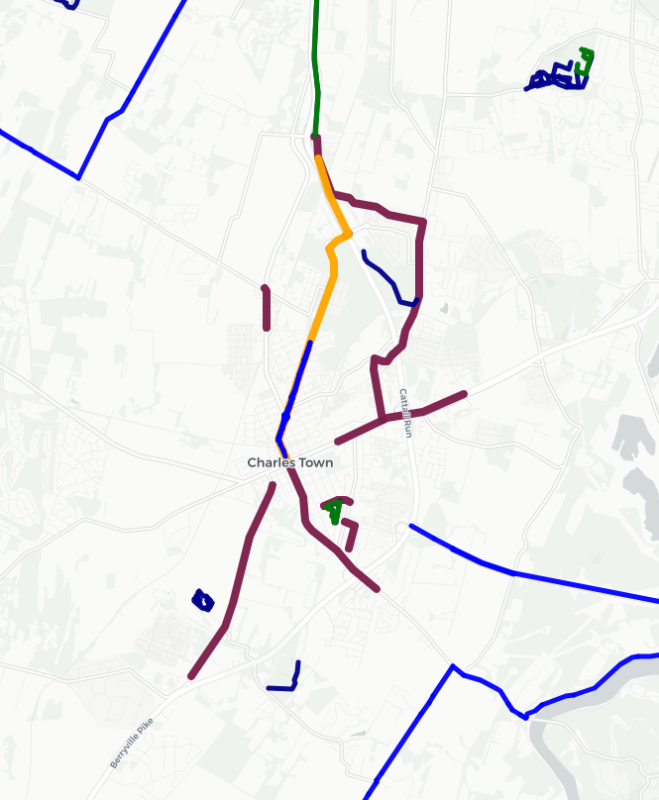
Project Overview
N
Builds upon HEPMPO Regional Bicycle and Pedestrian Plan Recommendation
  Extend existing bike path through Ranson or along Flowing Springs Road to Washington Street in Charles Town
Evaluate and propose solutions for extending the WV Route 9 Bike Path to Charles Town, WV.
Goal:
Enhance safety, accessibility, and connectivity
Promote sustainable transportation
Promote recreational opportunities
HEPMPO Shared Lane or Bicycle Route
HEPMPO Off Street Shared-Use Path
HEPMPO Trails
Fairfax Blvd Path Extension
Draft Project Ideas
5

Slide 6
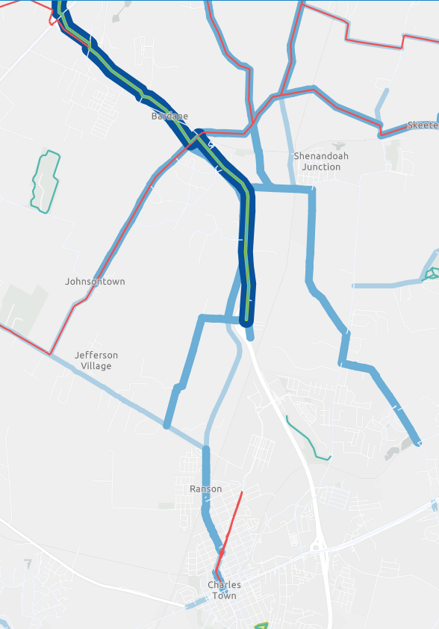
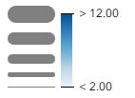
Existing Path Overview
WV 9 Route Bike Path
  Approx. 10.5 miles long
  Currie Road to Grapevine Road
Strava Data
HEPMPO Trails (Existing)
HEPMPO Shared Lane or Bicycle Route (Existing)
Route End Point
6

Slide 7
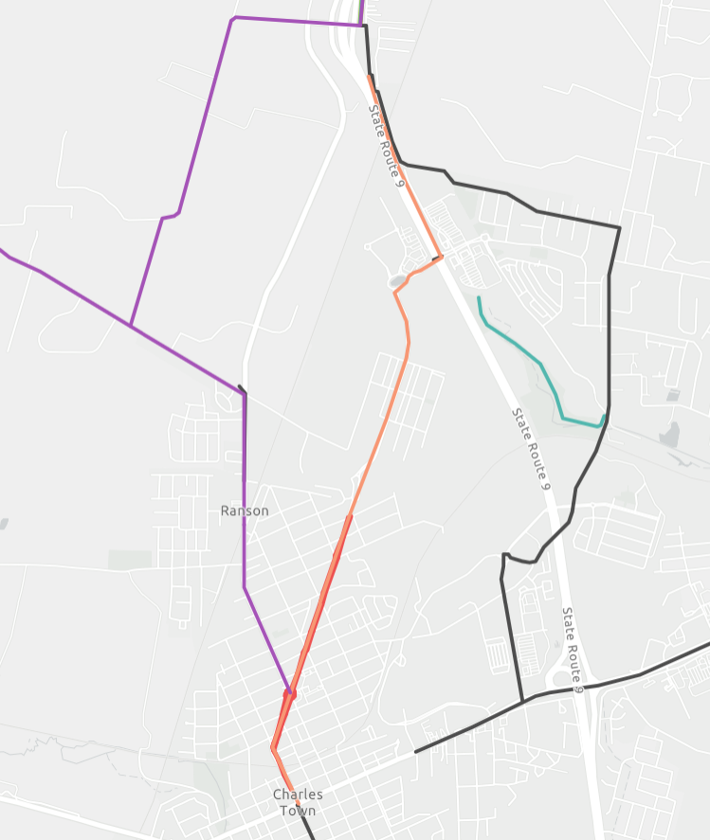
Bike Routes Identified in Previous Studies
N
Currie Rd
Legend
Currie Rd Path Extension (Recommendation)
Fairfax Blvd Path Extension (Recommendation)
Draft Projects Idea (Recommendation)
Trails (Existing)
Shared Lane or Bicycle Route (Existing)
Route Start and End Points
Railroad
Old Leetown Pike
Flowing Springs Rd
Mildred St
Fairfax Blvd
Washington St
7

Slide 8
On-going Activities
Studies & Plans
Developments
HEPMPO Regional Safety Action Plan
HEPMPO Regional Bicycle and Pedestrian Plan
HEPMPO LRTP
City of Ranson Pedestrian & Bicycle Bridge Feasibility Study
City of Ranson Comprehensive Plan
Jefferson County Comprehensive Plan
City of Charles Town Comprehensive Plan
Ranson Elementary School (Institutional)
Wawa Convenience Store (Commercial)
Potomac Towne Center (Commercial)
President's Point (Residential)
Strider Property (Residential)
Huntwell (Residential)
Shenandoah Springs (Residential)
Briar Run (Residential)
Ranson Heights (Residential)
Lakeland Place (Residential)
Red Clover Meadows (Residential)
Kable Townhomes (Residential)
West Branch Apartments (Residential)
Madison Greens (Residential)
8

Slide 9
Opportunities & Challenges
9

Slide 10
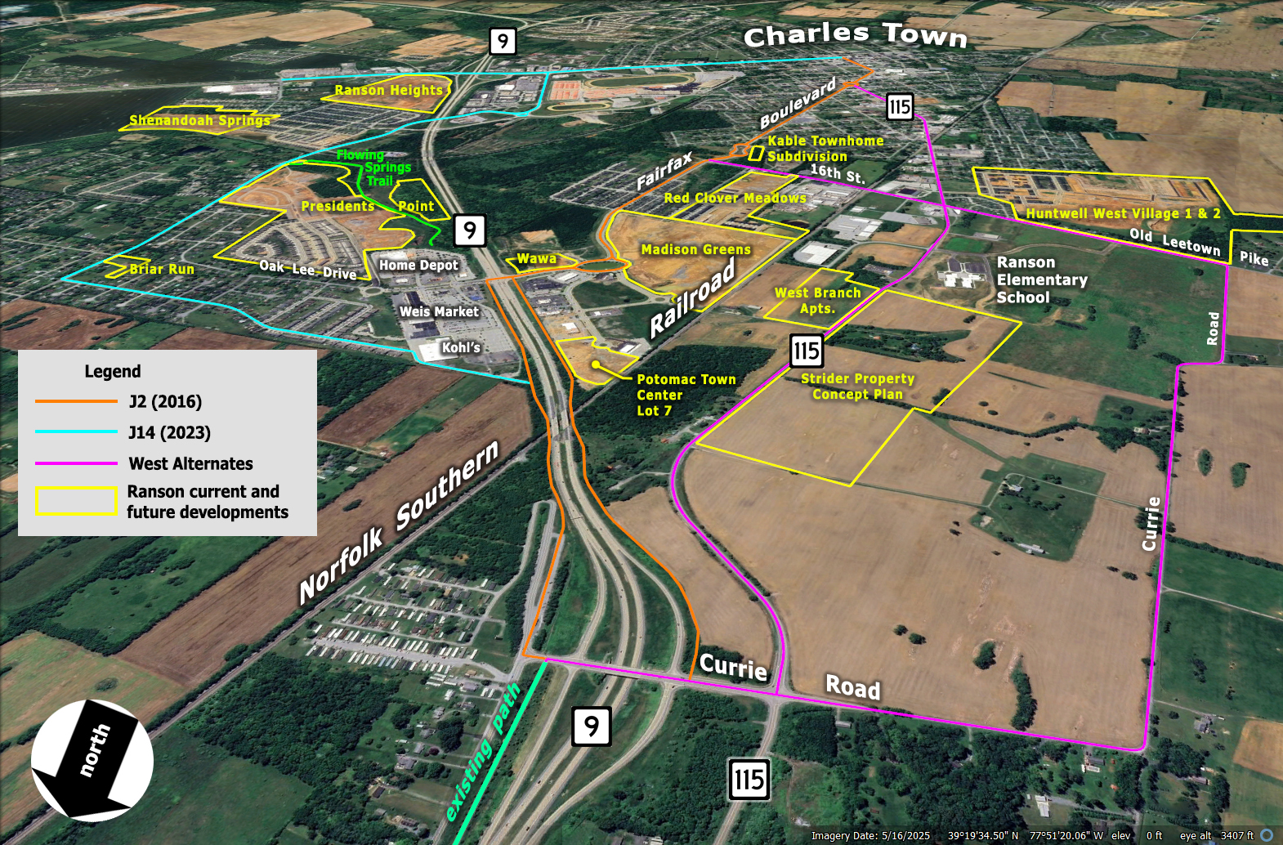
10

Slide 11
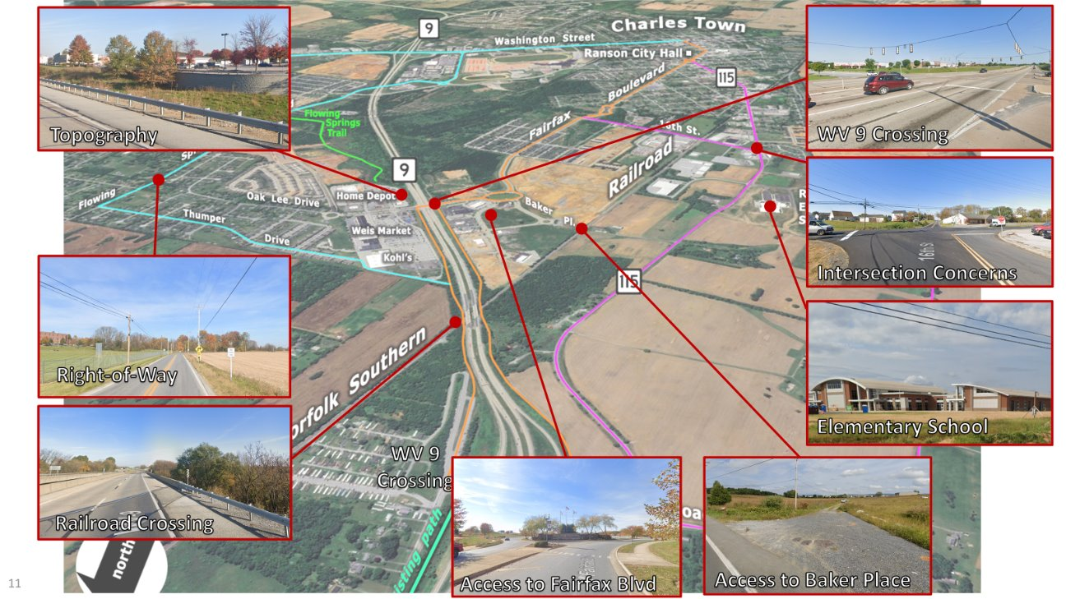
11
Access to Fairfax Blvd
Access to Baker Place

Slide 12
Public Outreach and Engagement
12

Slide 13
Steering Committee
Provided input & feedback
  Assess current bicycle network
Identified issues, concerns, improvements & opportunities
  Safety, connectivity, destinations
Identified four bike path alternatives
Comprised of key stakeholders
  State, local, regional government, community organizations, advocacy groups, businesses
13

Slide 14
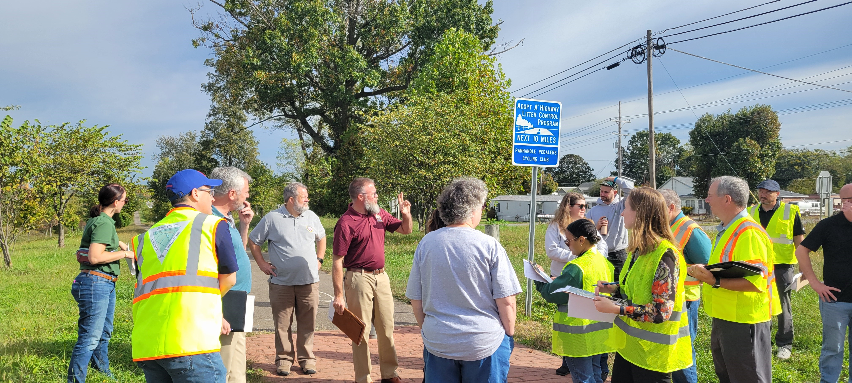
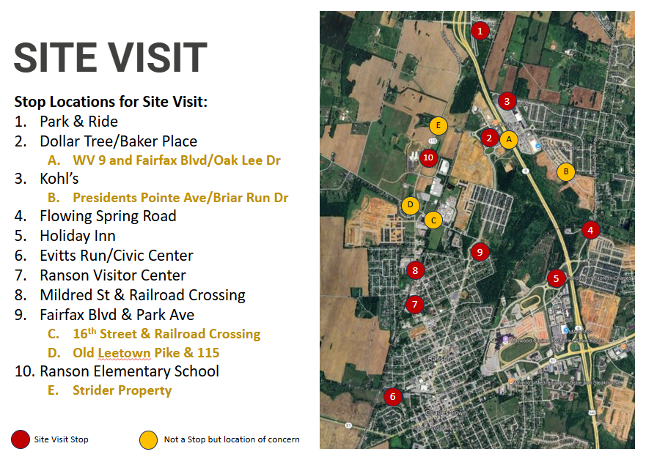
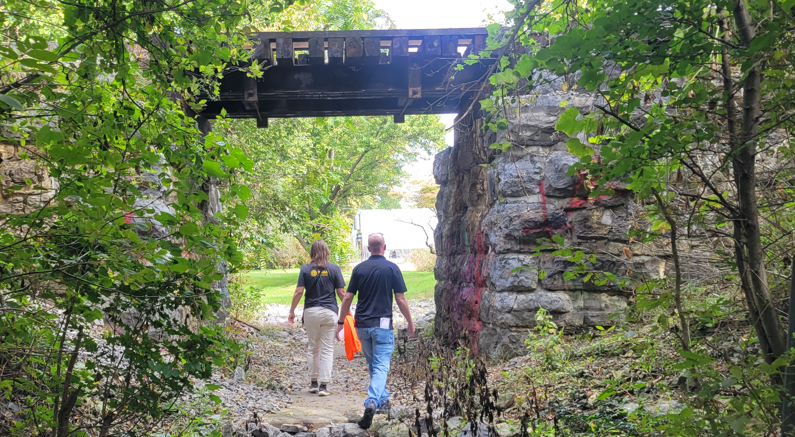
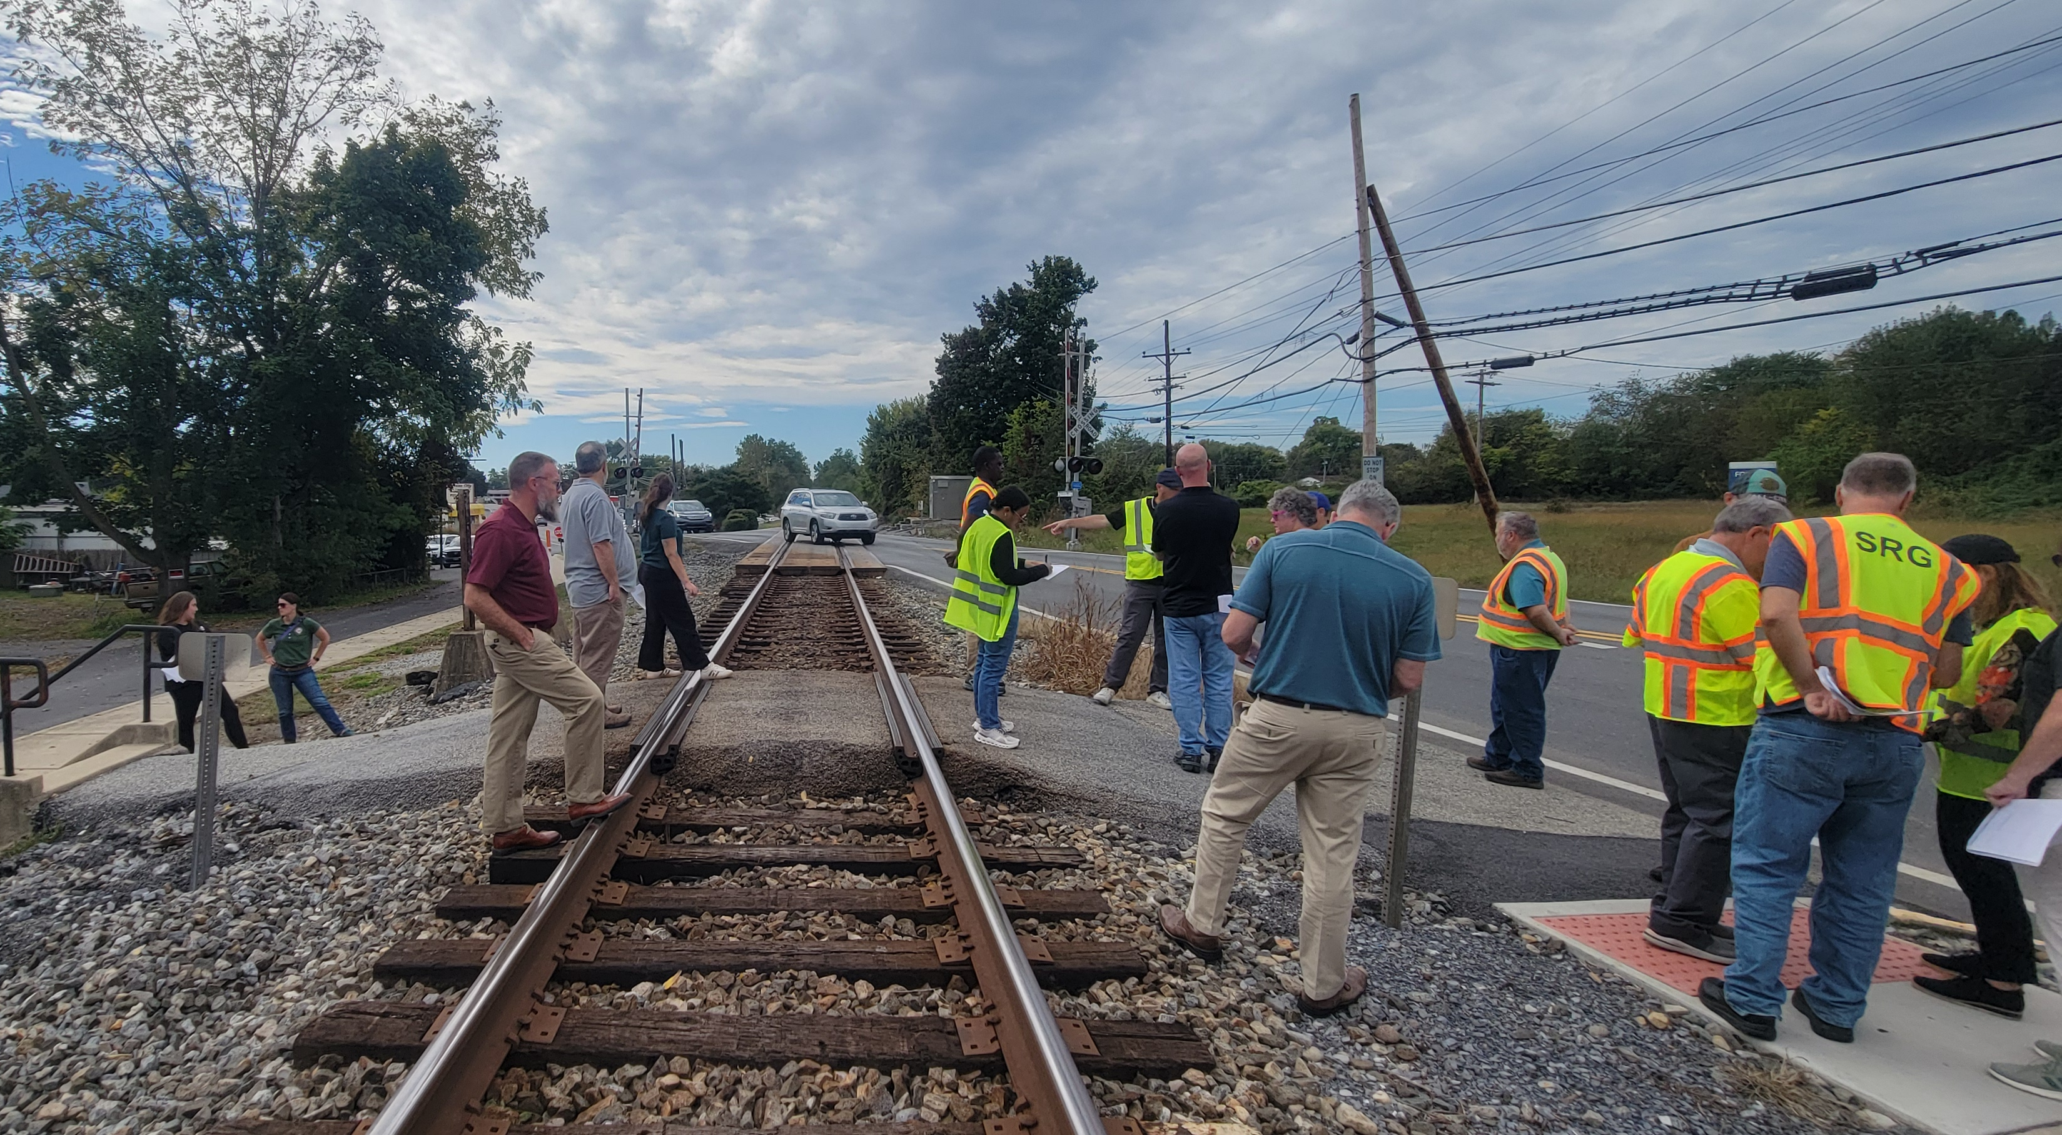
Site Visit
14

Slide 15
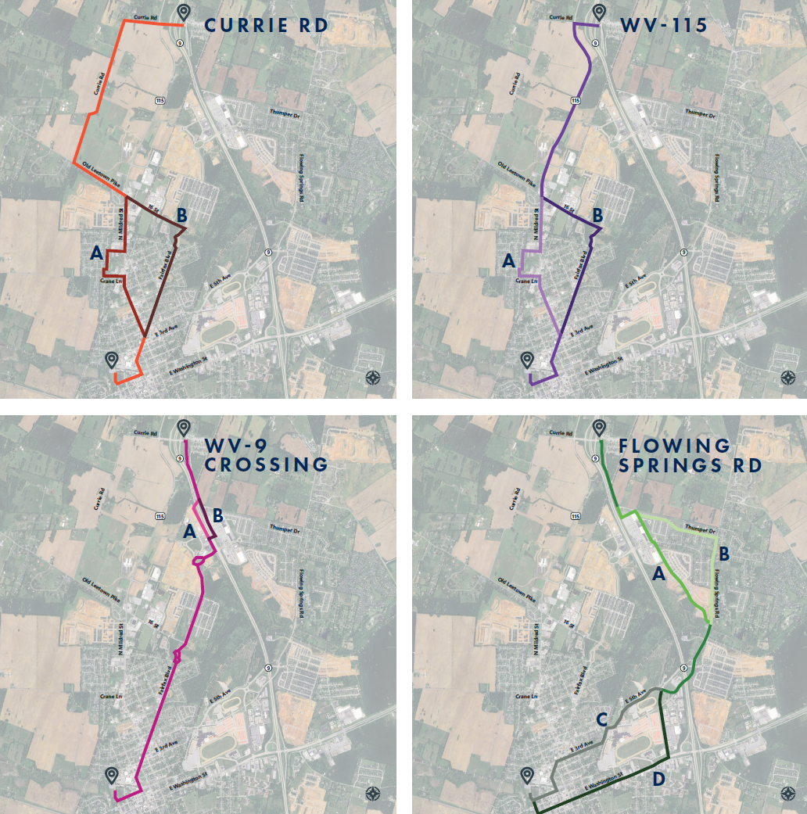
Route Alternatives
Four Route Alignments
  Currie Road
  WV 115
  WV 9 Crossing
  Flowing Springs Road
Each Alignment consists of:
  Primary Alignment
  At least 2 Alternative Alignments
15

Slide 16
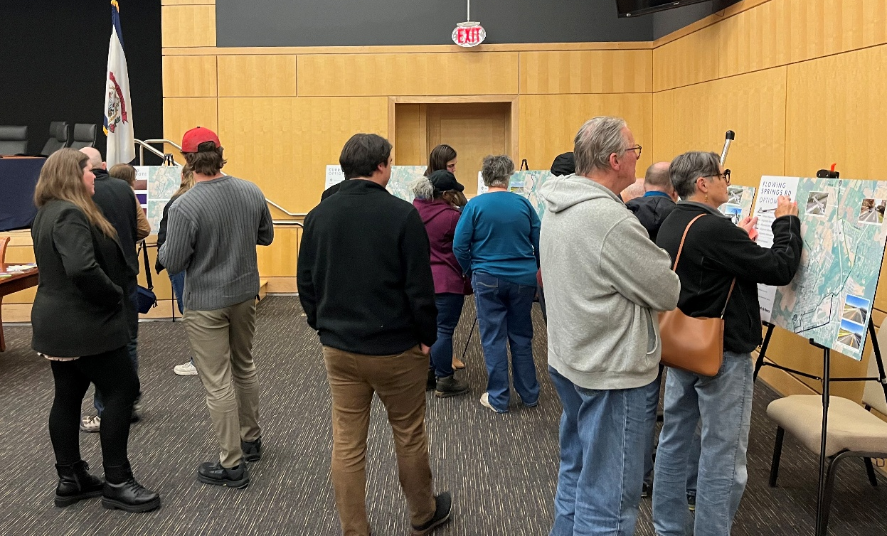
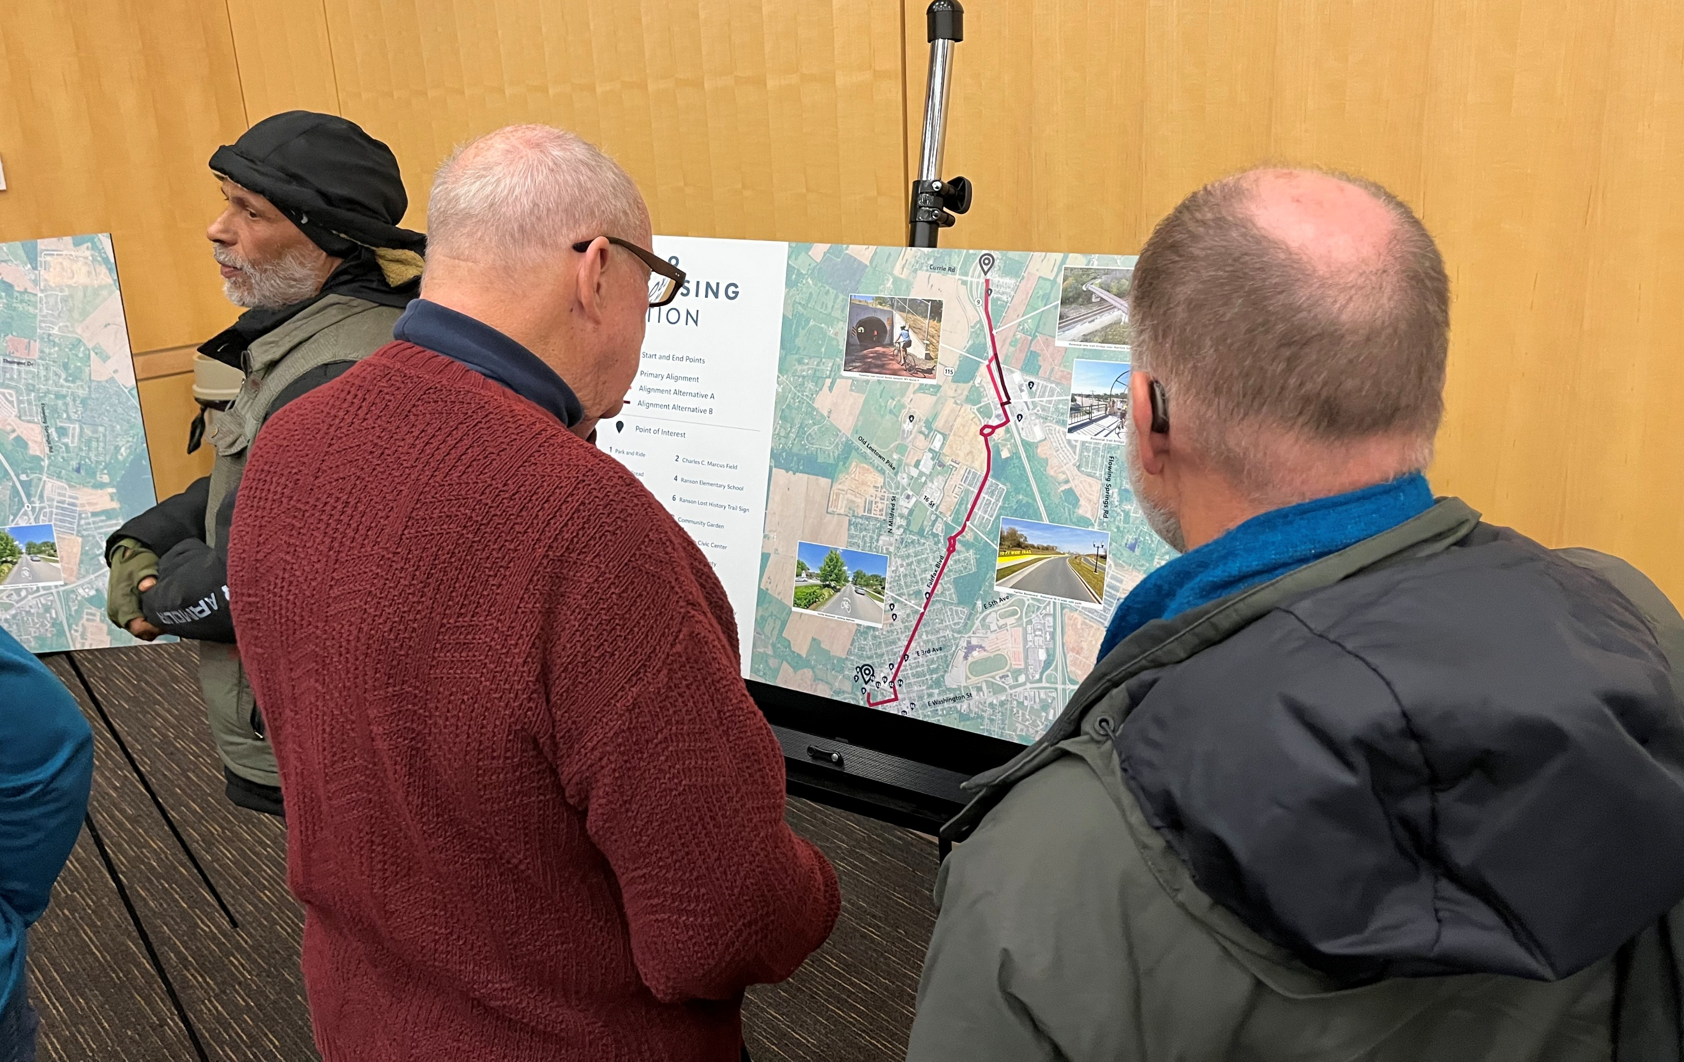
Public Workshop
Workshop - December 16, 2026
  Project Overview
  10 Route Alternatives
Public Comment Period
  Interactive Online Mapping
  December 15 – January 15
Purpose:
Provide feedback
Suggest alternative alignments
Vote for preferred alternative
16

Slide 17
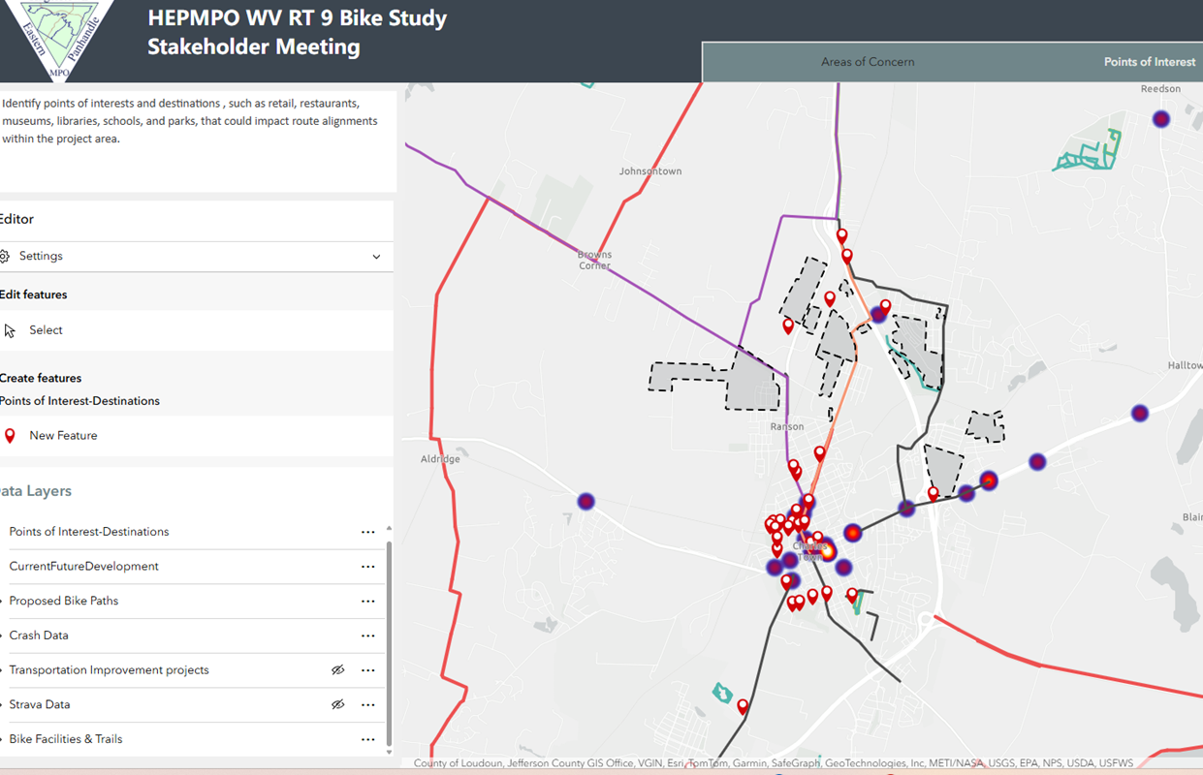
Stakeholder and Public Survey

Slide 18
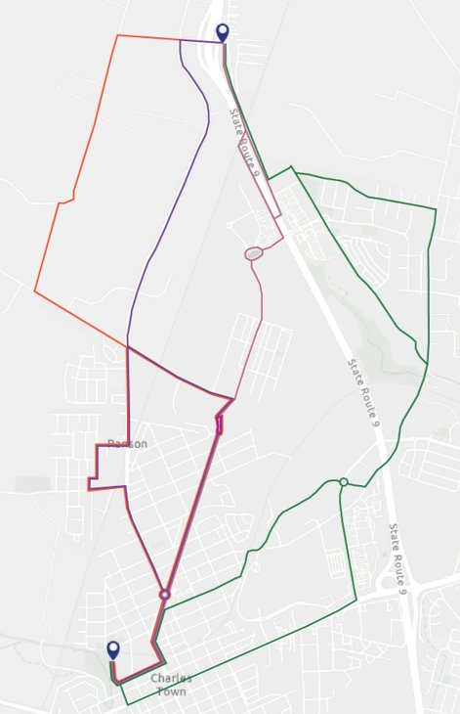
Public Feedback
Route Option | Alignment Options | Workshop Votes | First Ranking Survey Results | Total
Currie Road | Alternative A | 4 | 4 | 8
Currie Road | Alternative B | - | 1 | 1
WV 115 | Alternative A | 4 | 1 | 5
WV 115 | Alternative B | 1 | 3 | 4
WV 9 Crossing | Alternative A | 1 | 6 | 7
WV 9 Crossing | Alternative B | 6 | 9 | 15
Flowing Springs Road | Alternative A + Alternative C | 2 | 3 | 5
Flowing Springs Road | Alternative A + Alternative D | - | - | -
Flowing Springs Road | Alternative B + Alternative C | - | 1 | 1
Flowing Springs Road | Alternative B + Alternative D | - | 1 | 1
  Currie Road
  WV 115
  WV 9 Crossing
  WV 9 Crossing (Alt. B)
  Flowing Springs Road
18

Slide 19
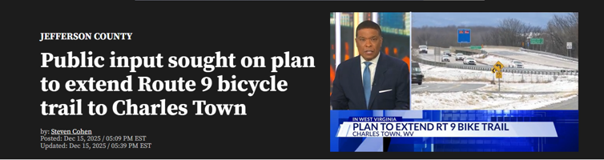
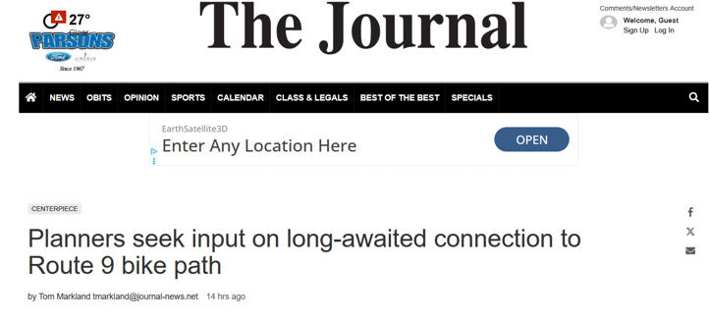
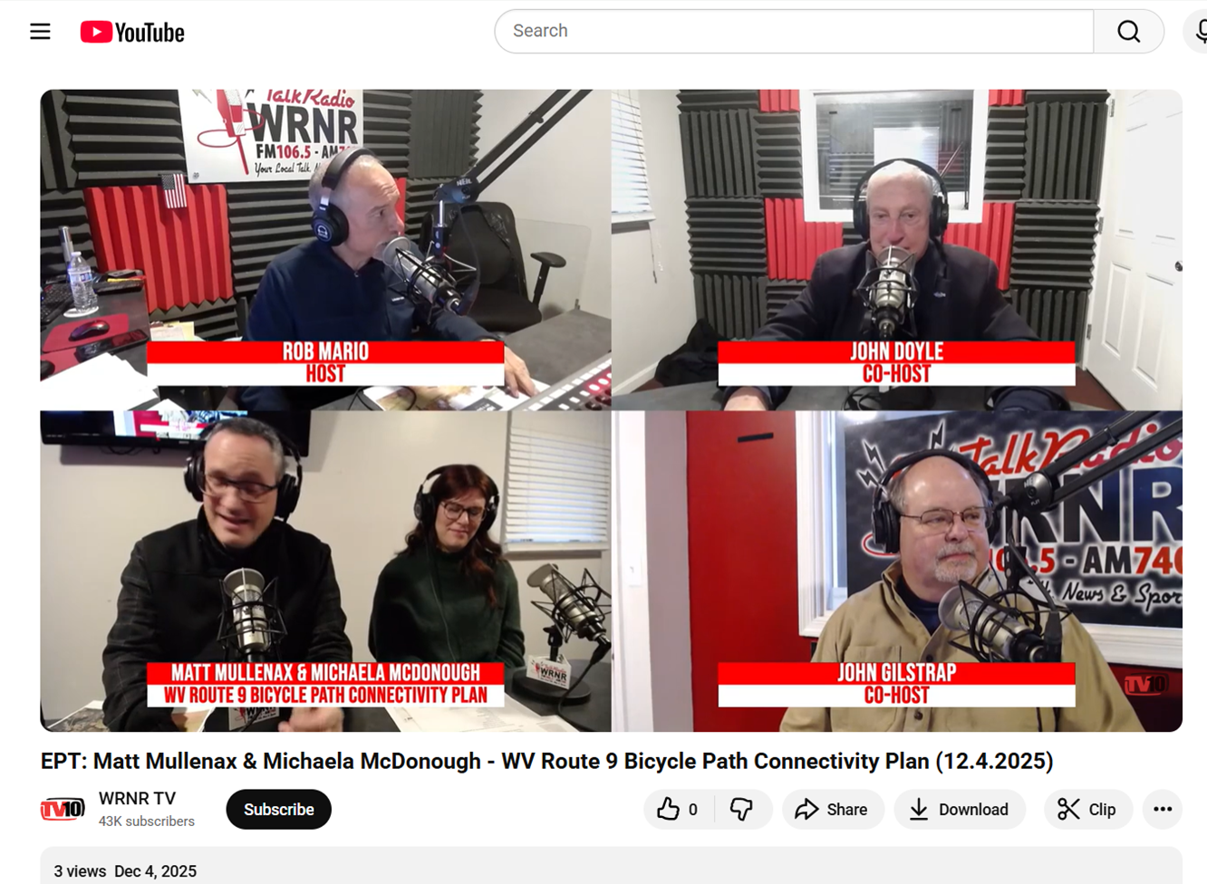
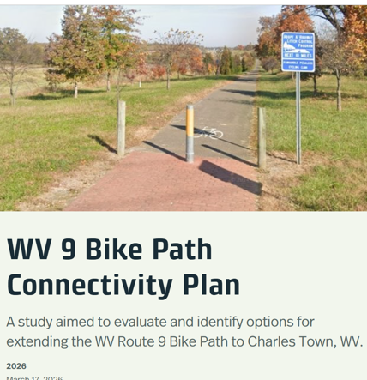
Public Engagement Efforts

Slide 20
Panhandle Regional Connector Path
20

Slide 21
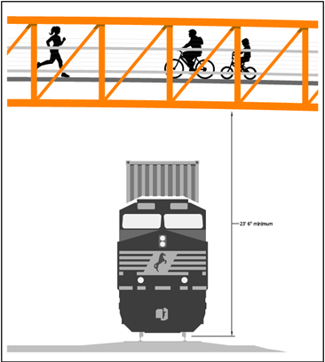
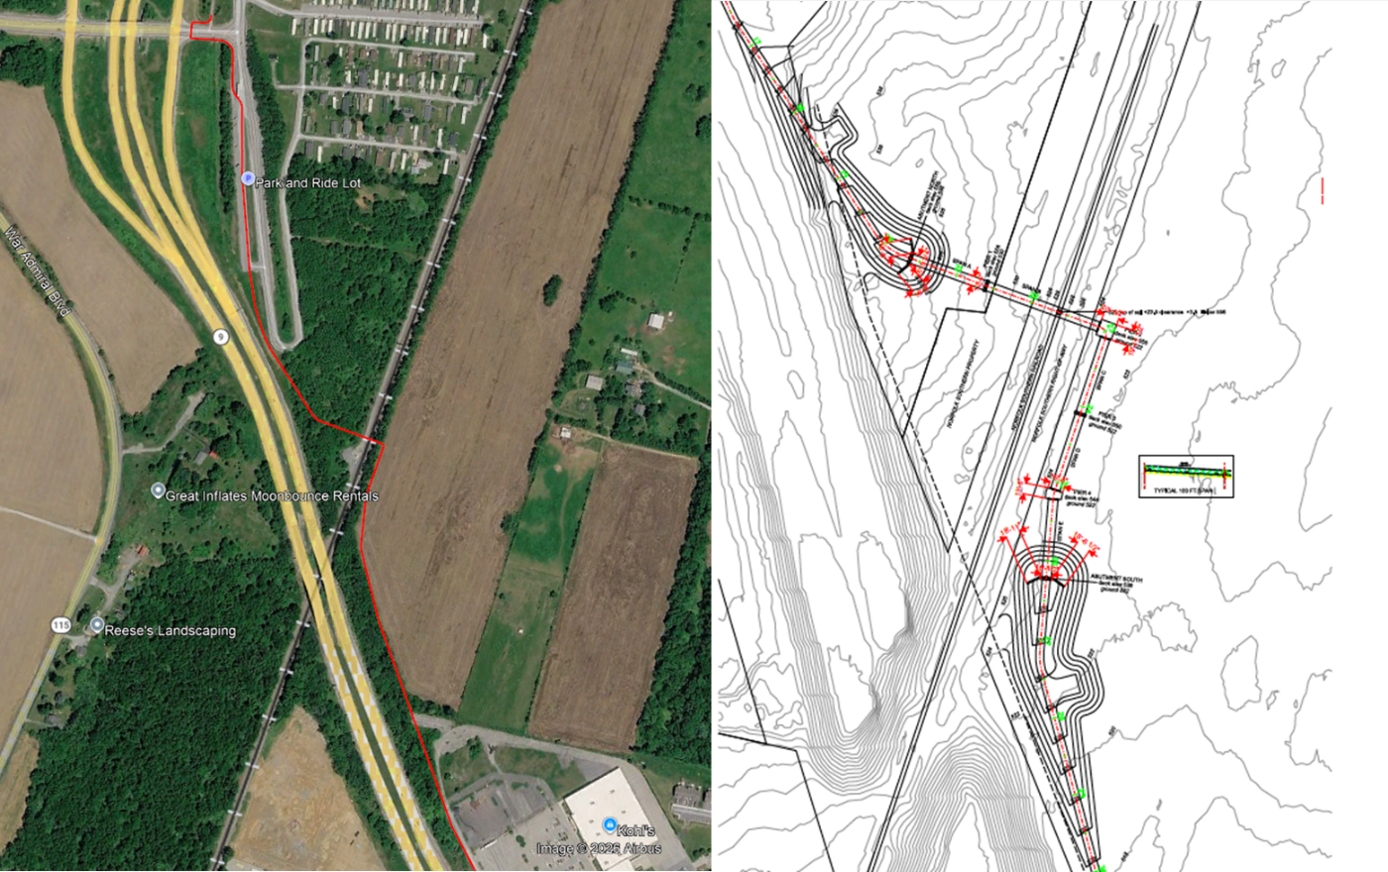
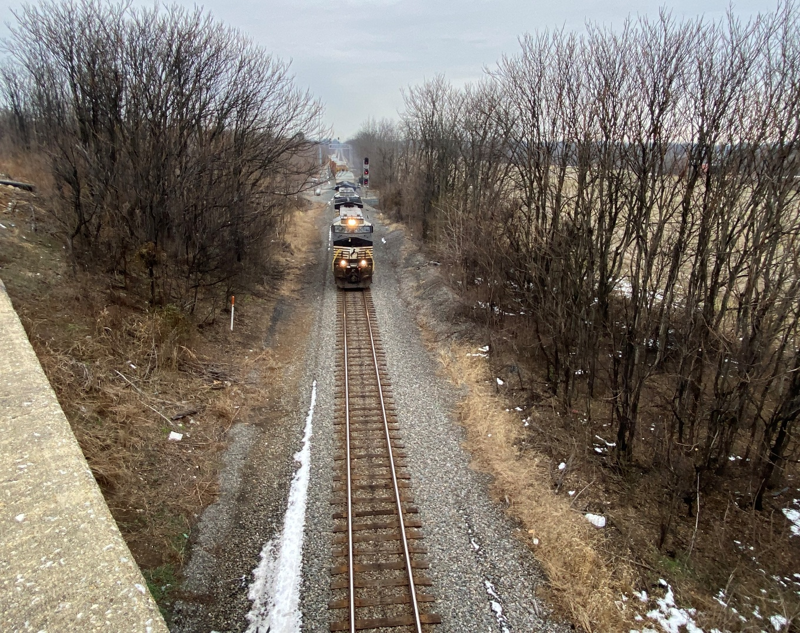
Barrier 1 - N/S Railroad
Railroad Bridge Crossing
  ADA-compliant ramps (extended approaches)
  Railroad vertical clearance constraints
  ROW Acquisition require
21

Slide 22
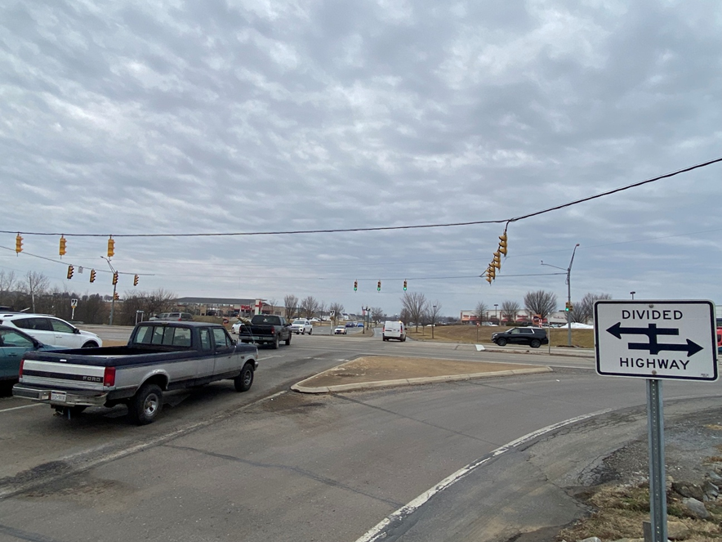
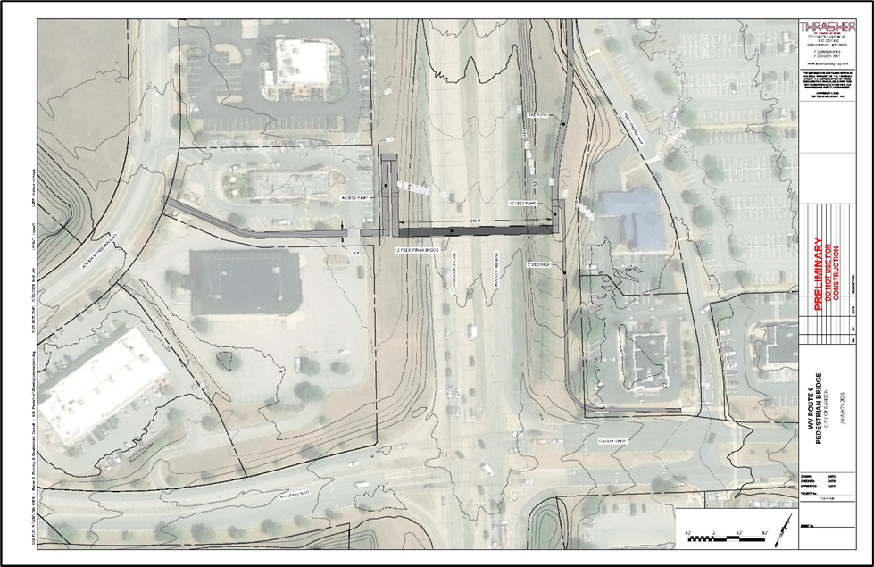
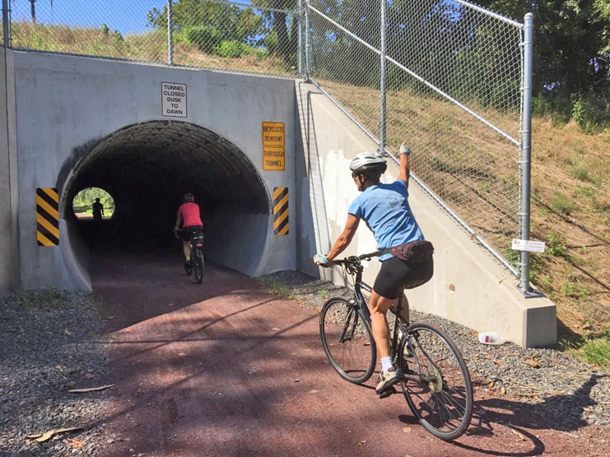
Barrier 2 – Crossing WV Route 9
  Signalized Intersections with 8-traffic lanes
  Crash rates compared to WV averages:
    >200% higher than WV’s serious injuries
    >75% higher death rate of similar road types
    >1,000% higher crash rate
  Requires ADA-compliant approach ramps
  Tunnel option not feasible
22
*Prepared by The Thrasher Group

Slide 23
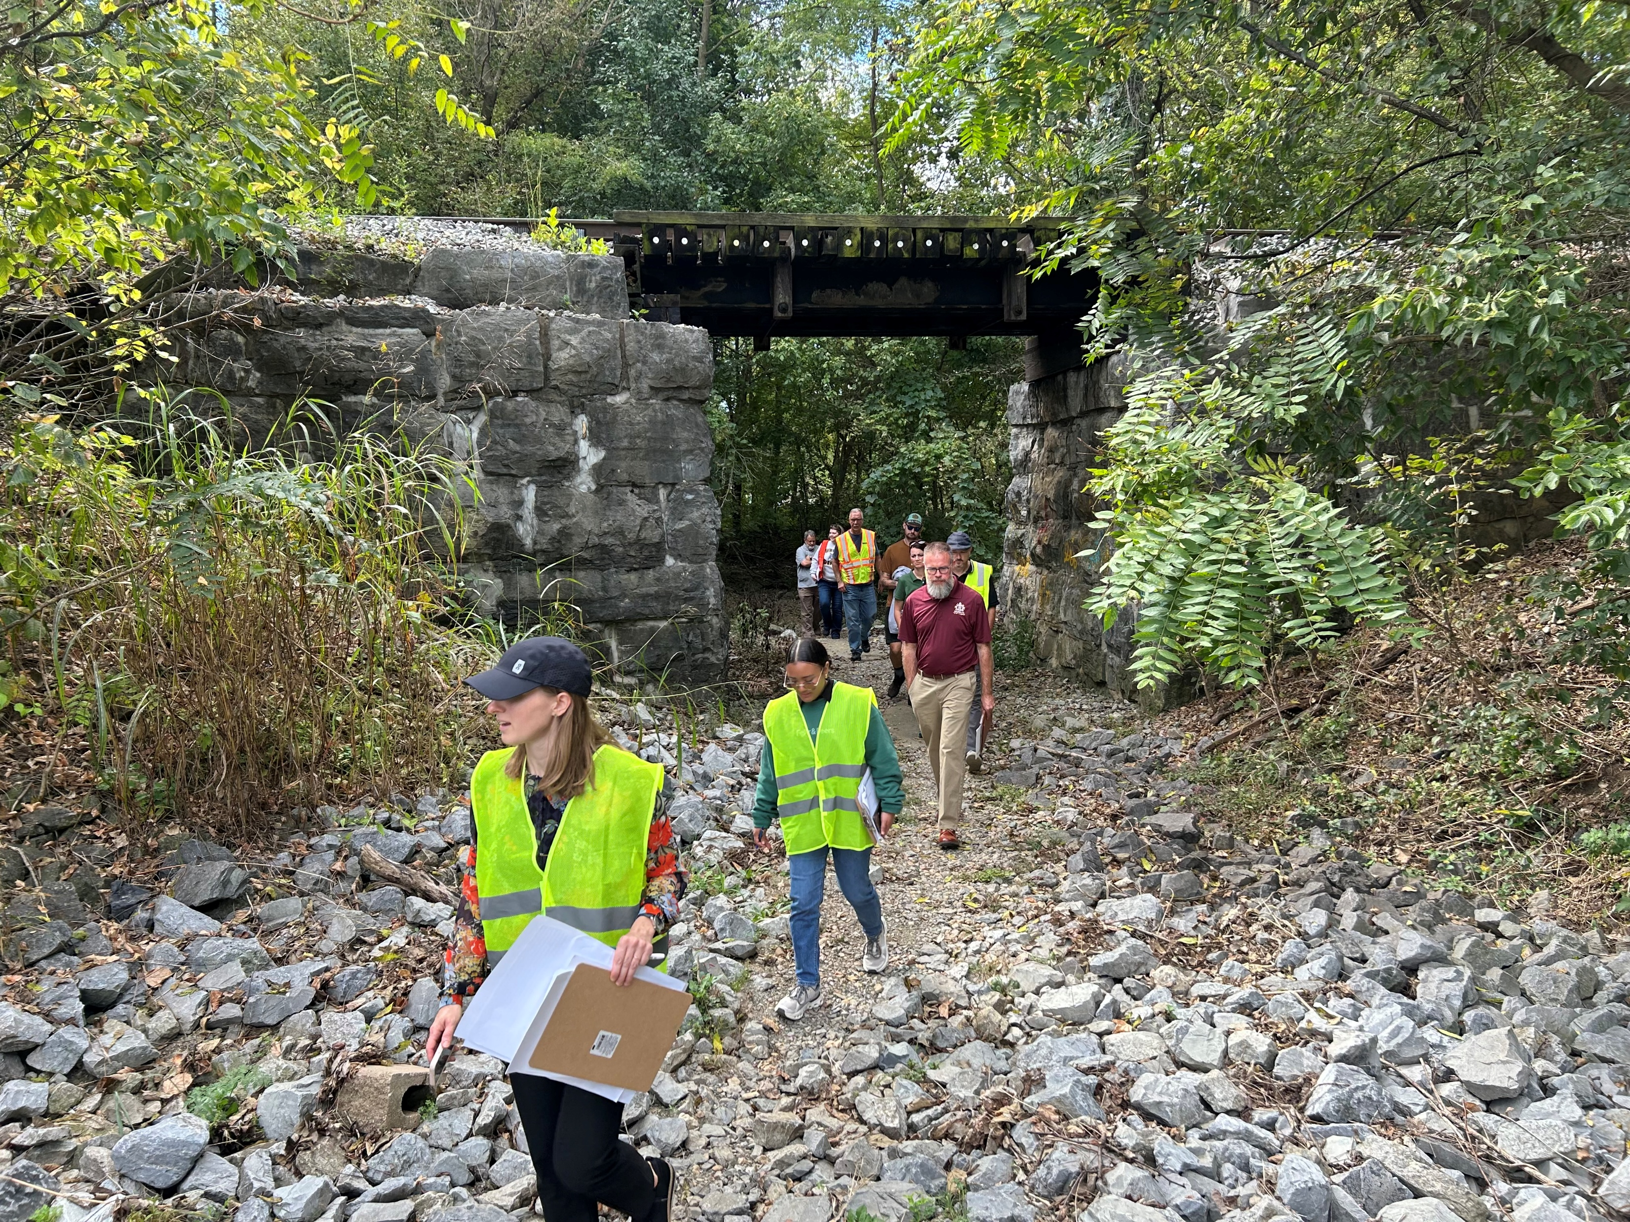
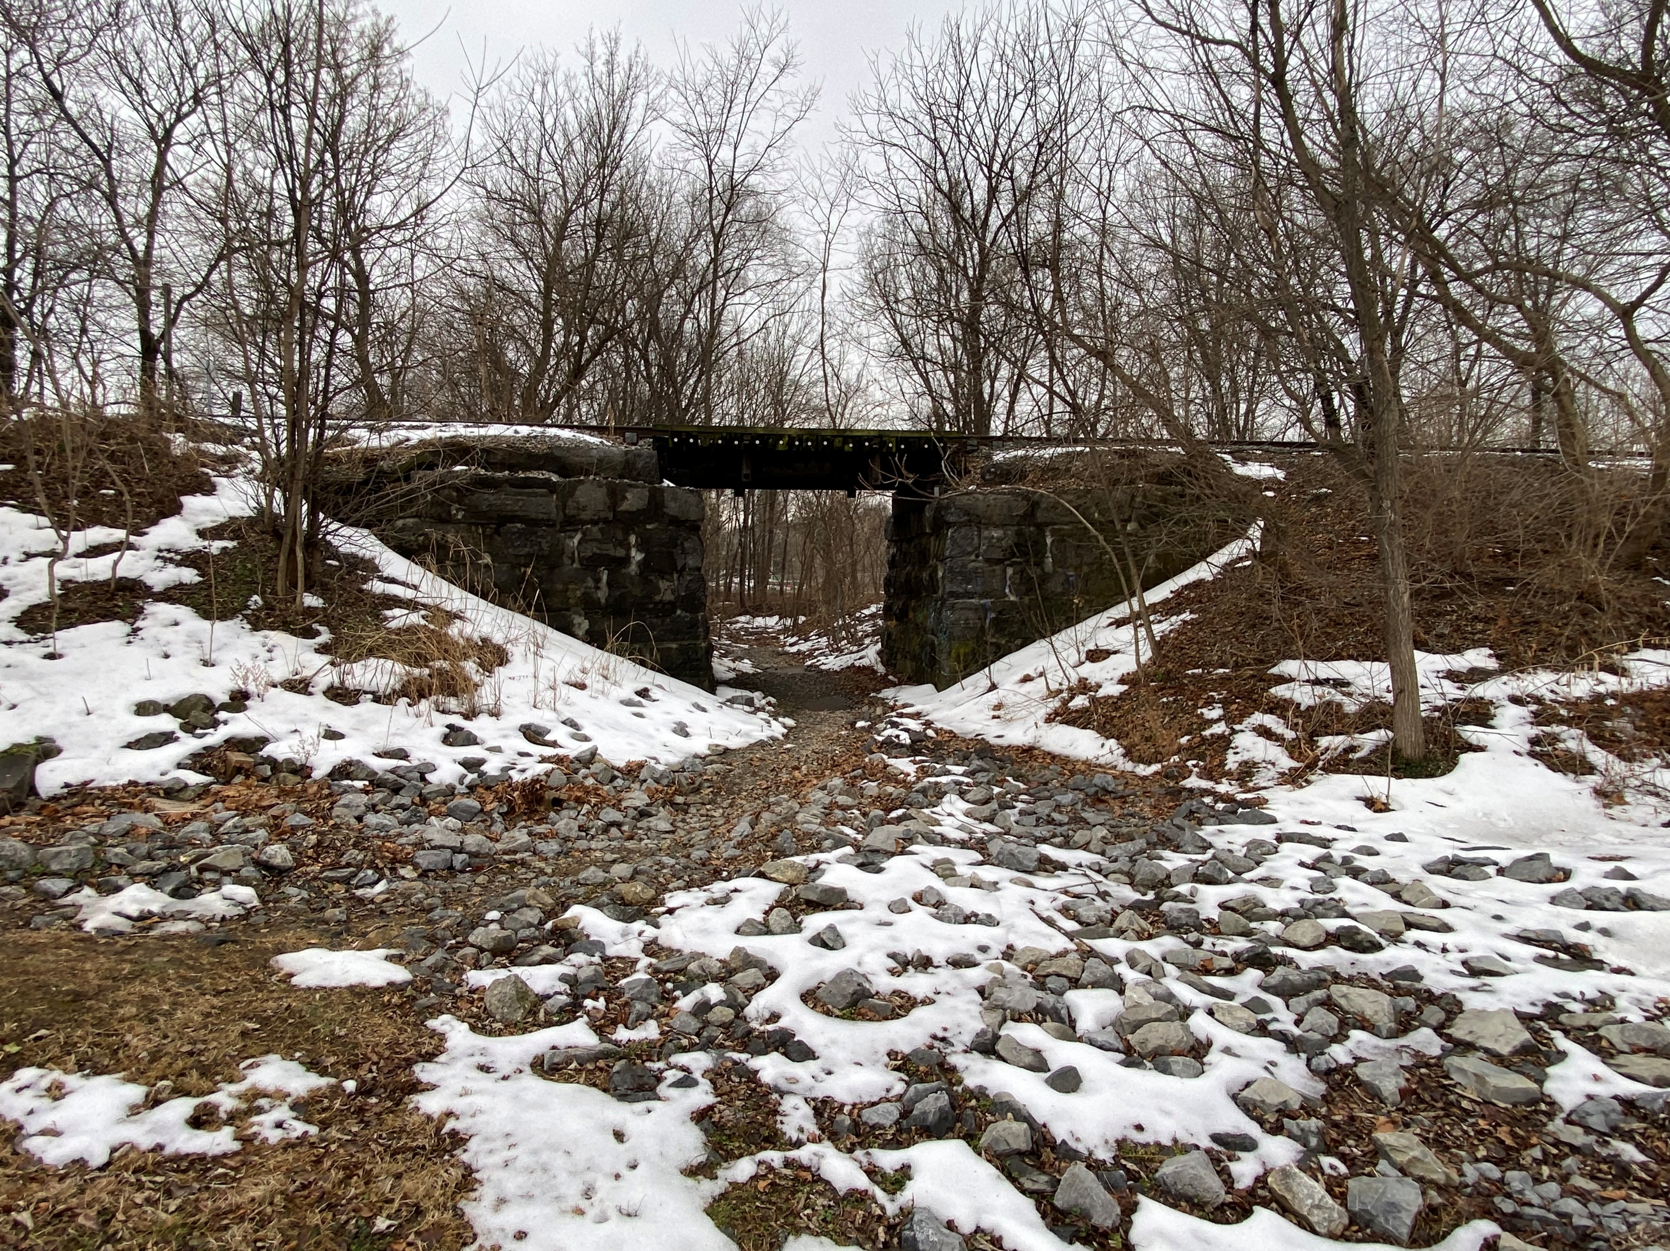
Barrier 3 – CSX Underpass
Safety & Significant Drainage Upgrades needed
Connects Ranson Civic Center & American Public University to Boys & Girls Club, Skate Park, & Augustine Trail
23

Slide 24
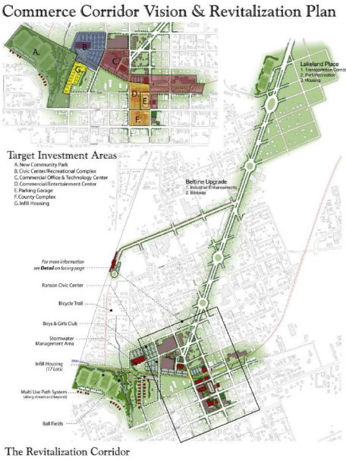
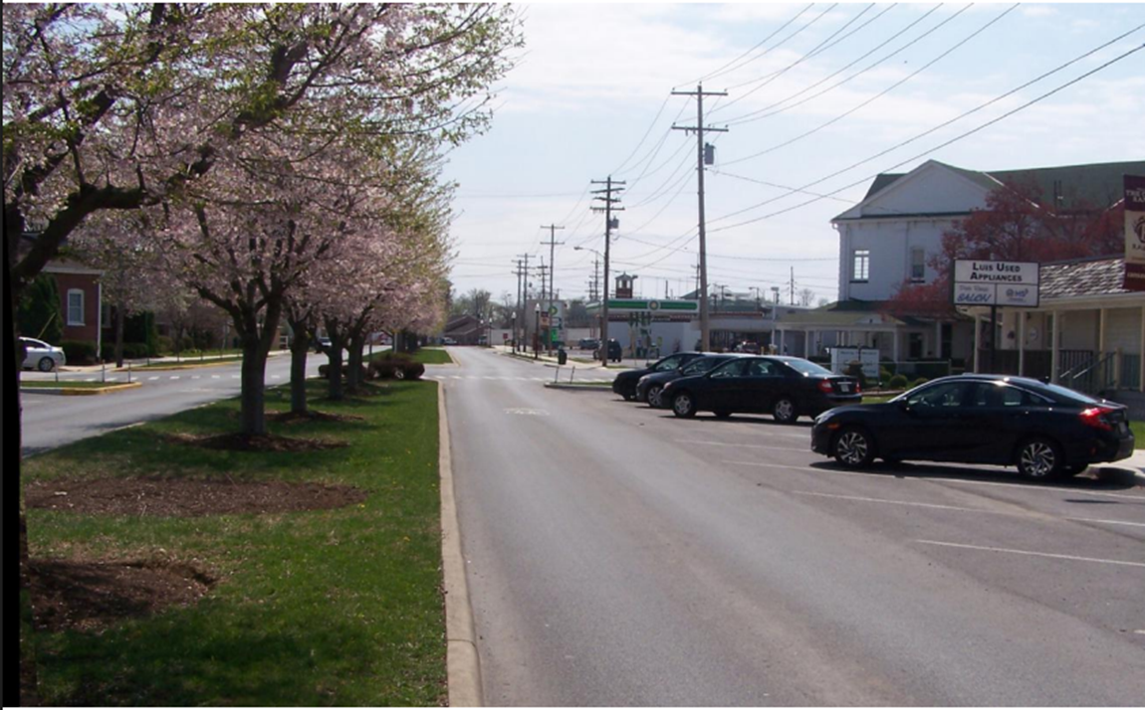
Fairfax Boulevard
City of Ranson Awarded TIGER grant in 2013

Slide 25
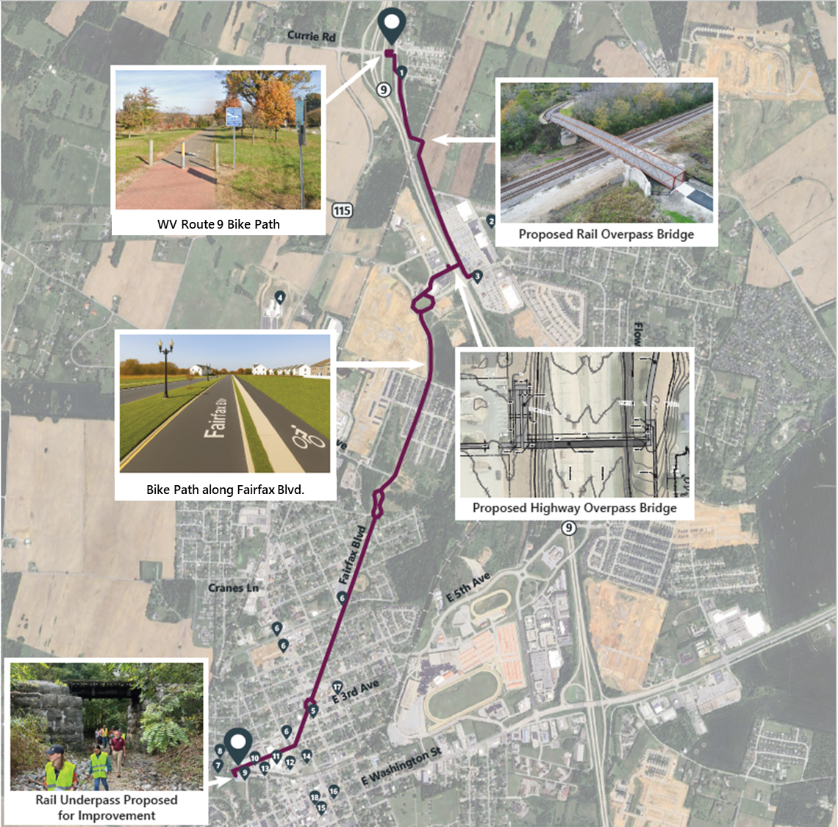
Panhandle Regional
Connector Path
3.33-Mile Shared-Use Trail Connection linking key regional facilities
Alignment: Follows WV 9 Crossing (Alternative B) with two bridge crossings
Northern Connection:
  Ties into 10.5-Mile WV Route 9 Bike Path (Existing)
Corridor Integration:
  Enhances Fairfax Boulevard Complete Street network
Southern Connection:
  4.5-Mile Augustine Trail (Under Construction)
25

Slide 26
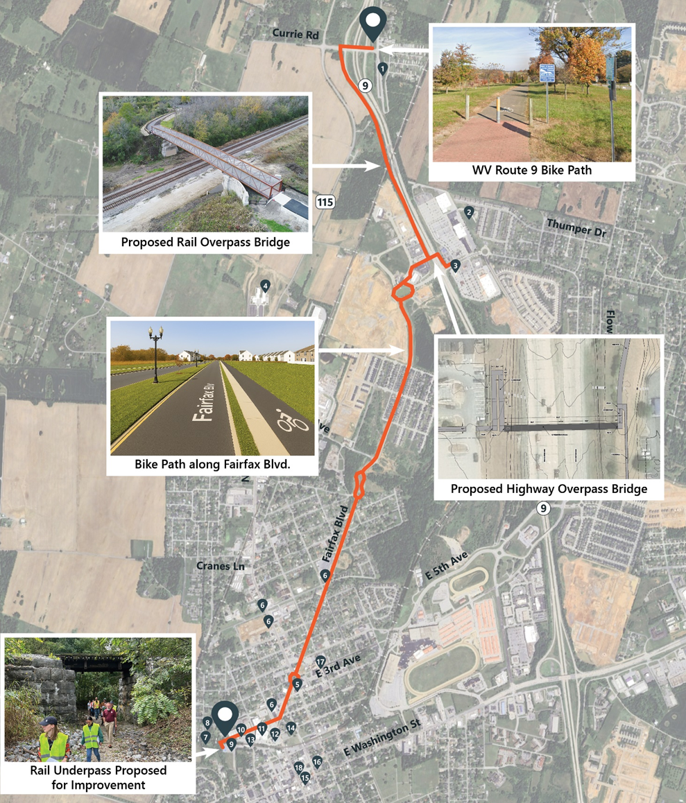
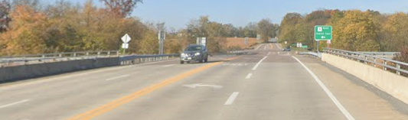
Alternative Trail
Alignment
Northern terminus connects to existing Route 9 Bike Path
Crosses Route 9 at Currie Road Interchange
Remains in the Route 9 ROW to Baker Place development
Requires N/S Railroad Crossing
Includes Route 9 Overpass Bridge to connect Potomac Marketplace
Continues along Fairfax Blvd to southern terminus
26

Slide 27

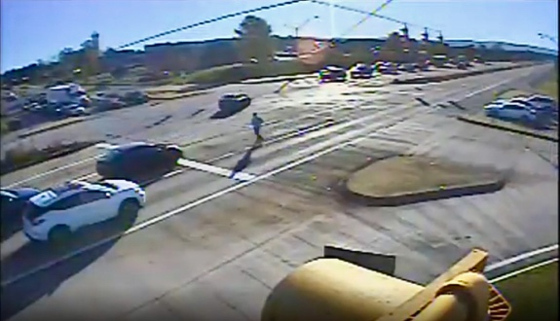
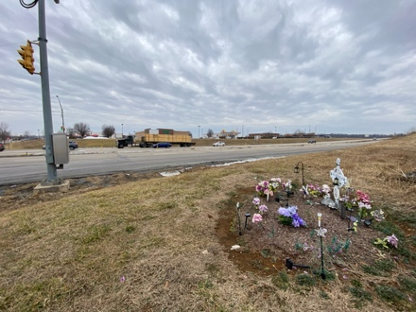
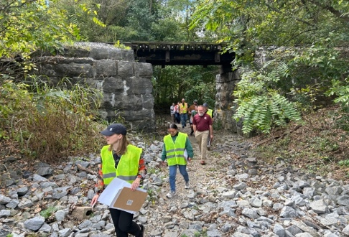
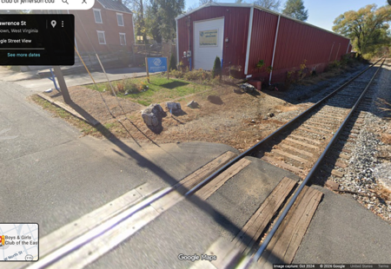
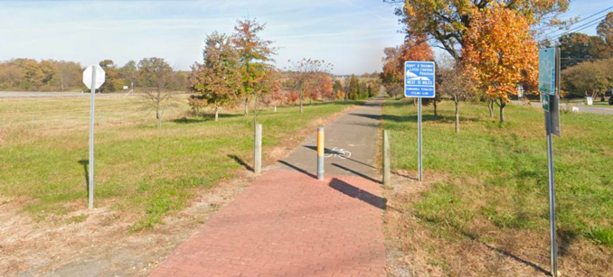
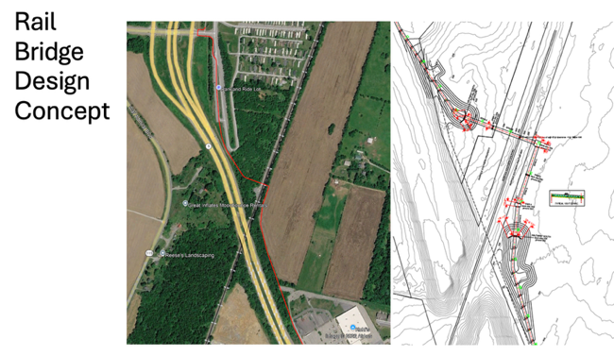
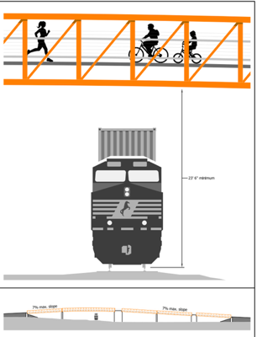
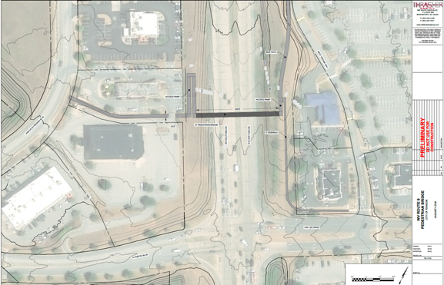
USDOT BUILD Grant
Multi-jurisdictional, multi-consultant team delivering coordinated regional solutions
Targets projects with significant local and regional impact on transportation infrastructure
Funding Request: $1.27M (100% federal) supporting engineering, design, and environmental review
Lead Applicant: HEPMPO
Administration: WVDOT (if awarded)
Strong Local Support: Unanimously endorsed by Ranson and Charles Town City Councils
Application Submitted: February 24, 2026
Awards Announcement Expected by June 28, 2026
27

Slide 28
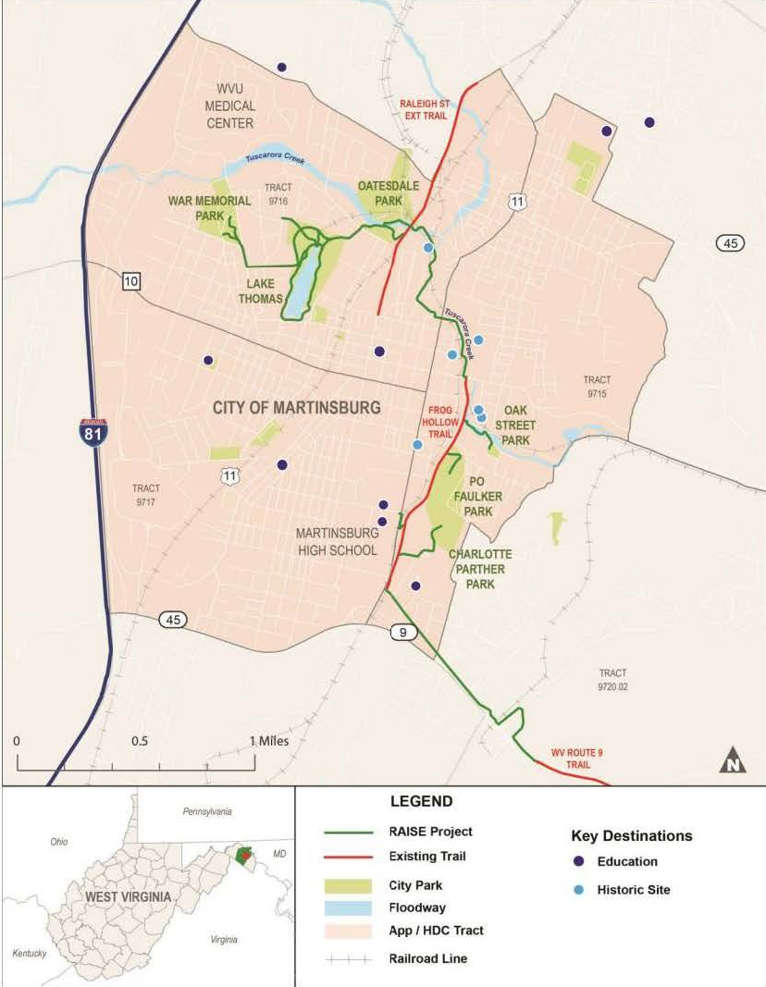
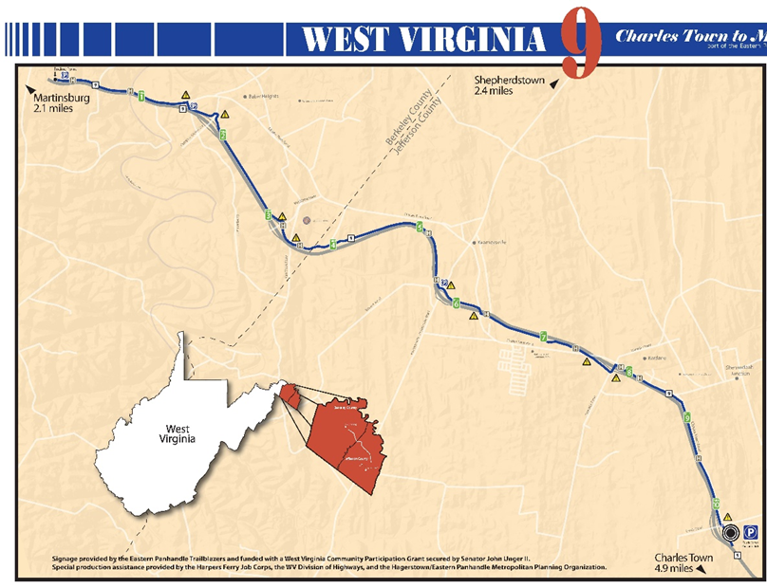
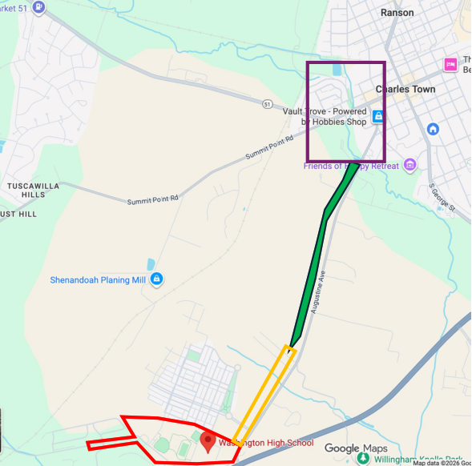
Connectivity in the Region
6.2 Mile Martinsburg Greenway Trail
  $20.8M RAISE Grant
  Multi-use path from Grapevine Road to War Memorial Park
10.5-Mile WV Route 9 Bike Path
Existing path built parallel to WV Route 9
Opened in 2010
4.5-Mile Augustine Trail
CDSR Earmark Funding
Phase 1 completed, Phase 2 under construction
Phase 1
Phase 2
Phase 3
28

Slide 29
Planning Level Cost Estimate
Total Project Cost for the Panhandle REC trail: $9.9 million
Bridge-Driven Costs: > 80% of the total cost attributed to two bridge structures
Cost includes:
  Trail pavement and surfacing
  Signage and pavement markings
  Structural elements
  Construction contingencies
Does not include:
  Right-of-way (ROW) acquisition
  Utility relocation
Trail Element | Cost
Bike Trail | $1,659,000
Railroad Truss Bridge | $3,702,000
Pedestrian Bridge | $4,544,228
Totals | $9,905,228
29

Slide 30
Funding Opportunities
Program | Level | Best For
Surface Transportation Block Grant (STBG) | Federal / State | Bicycle and pedestrian projects, planning studies, and trail connections
Highway Safety Improvement Program (HSIP) | Federal / State | Safety projects to achieve significant reductions in fatalities and serious injuries
Transportation Alternatives (TAP) | Federal / State | Sidewalks, bike lanes, shared-use paths
Recreational Trails Program (RTP) | Federal / State | Off-road trails
Better Utilizing Investments to Leverage Development (BUILD) | Federal | Large, regional trail corridors
Safe Streets for All (SS4A) | Federal | Safety planning & improvements
Congressional Directed Spending Request (CDSR) | Federal | Transportation and infrastructure improvements, economic development and community projects
Appalachian Regional Commission (ARC) | Federal / Regional | Trails + economic development
30

Slide 31
Questions and Contact Information
31

Slide 32

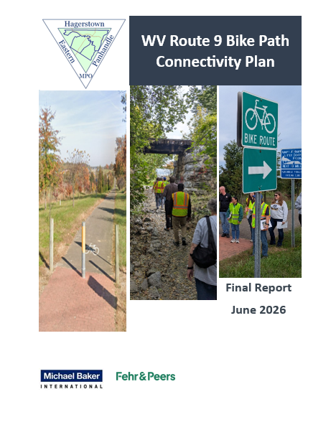
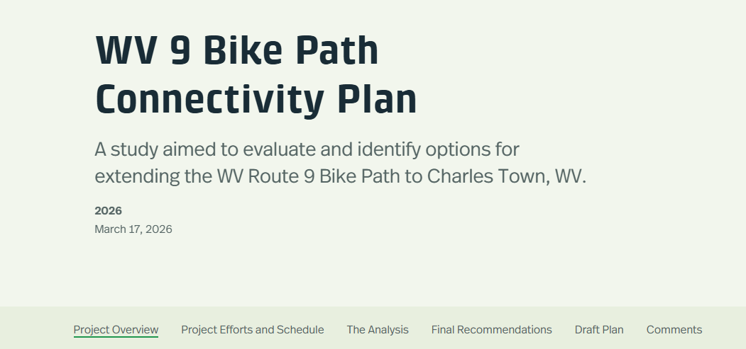
Q&As
Visit the HEPMPO Website @ www.hepmpo.com
Project StoryMap
32

Slide 33
Contact Information
Matt Mullenax
HEPMPO
Email: mmullenax@hepmpo.net
Jim Frazier
Michael Baker International
Email: jfrazier@mbakerintl.com
33

