Slide 1

Research Program Updates
West Virginia Department of Transportation
February 2026
Notes:
Thank you all for joining the Planning Conference, I am Dave Chappell
Dave introduces himself.
Over the past few years, the Research Program team and Mott Macdonald have worked to update and revitalize the Research Program here at the DOH. During this time, we have met and collaborated with university researchers, established an annual research cycle, worked with DOH staff to select research projects, and recently kicked-off the first group of new projects. With all the changes that have occurred over the last few years we wanted to take time to highlight some of the updates we have made.

Slide 2
Agenda
Introductions
Research Program Overview
Research Program Cycle and Updates
Research Projects
Pooled Funds
Upcoming Events
Notes:
During this presentation we will:
Introduce you to the Research Program team and the individuals at Mott Macdonald who have assisted with the program
Provide an overview of what the Research program is here at the DOH
Discuss the new project cycle and other updates to the program
Highlight active research projects
Provide an overview of the Research Program’s involvement in Transportation Polled Funds and which funds we are actively participating in
Discuss what is next for the Research Program and some of our upcoming events

Slide 3
Introductions
WVDOT – Research Program
David Chappell
Deisha Kelly
Brian Carr
Brian Chapman
Timothy Sedosky
Mott MacDonald
Larissa Blankenship
Chris Kinsey
Mark Young
Notes:
Introduce DOH team.
As I said, I am David Chappell, you don’t need to hear more about me.
Brian Carr is the statewide planning section leader which research falls under who has been very supportive as I have taken on my new role.
Brian Chapman
Tim Sedosky
For the past two years, Mott MacDonald has been contracted to assist with the management and update of the Research Program. Their team consist of Larissa Blankenship, Chris Kinsey, and Mark Young who have been helping with various aspects of the Research Program.

Slide 4
What is the WVDOT Research Program?
The WVDOH Research Program is a broad initiative by the Federal Highway Administration (FHWA) to conduct research and development for the nation's highway system, aiming to improve safety, efficiency, and sustainability
The WVDOT Research Program aims to:
Improve the processes, designs, and materials available for WVDOT and its customers through research partnerships
Deliver quality, applied research that meets the needs of the people and the state of West Virginia
Support the education and development of the next generation of Transportation, Bridge and Highway Engineers.
Notes:
What exactly is the Research program? The WVDOH Research Program is a part of the FHWA’s initiative to conduct research and development for the nation’s highway system to improve safety, efficiency, and sustainability. As part of the program, research projects are selected through an established review process focusing on transportation related topics. Funding for these projects comes from the state’s dedicated SP&R Part B funds. These funds are specifically earmarked for research and funds for each project are obligated through the annual work program.
The main goals of the WVDOT’s Research Program are to:
Improve the processes, designs, and materials available for the WVDOT and its stakeholders through research.
Deliver quality, applied research. One main component of a research project is that it should be beneficial to the WVDOH, the state of West Virginia as a whole.
Support the education and development of the next generation of engineers. Research projects are a great way for students to gain exposure and knowledge on the state’s infrastructure.

Slide 5


Calendar Year Outline
Research Problem Statements
Problem Statement Review
Proposal Solicitation
Technical Committee Review
Project Decisions and Notification
Project Start
April – May
June - July
August - September
October – November
January - February
August
Executive Committee Review
December-January
Training Webinars for Problem Statement Development
April
Notes:
As mentioned previously, the WVDOH Research Program has an established cycle for project idea submission and review. The cycle begins in April with the DOH and University Webinars. These webinars focus on the first step of the research cycle, Problem Statement submission. These webinars walk through the requirements for Problem Statement submission as well as provide examples of what makes a Problem Statement successful. We have an online form that is not yet open for new submissions this year, but if you want a copy of last year’s form we can send it to you so you can use it as an example, much of it will overlap.
The next step in the cycle is the Problem Statement submission window. This phase typically begins in early April and ends in May. During this time, WVDOH staff and university researchers can submit a Problem Statement through the submission form that I mentioned before. A Problem Statement is a formal submission of an idea that could be developed into a research project. For the current cycle we are in, FFY 2026, we received 22 Problem Statements. Keep in mind these are short and should not require much in terms of citations or general work. Simply “This is my idea”.
Once problem statements are received, they are reviewed by the Research Technical Committees. There are four Research Technical Committees: Materials, Structures & Geotech, Planning & Environmental, and Traffic & Engineering These committees review the submitted Problem Statements based on an established criteria and scoring system and meet to determine which Problem Statement that we would like to request proposals for. These reviews and meeting typically occur in June and July.
After the Research Technical Committees have selected which Problem Statements they wish to request proposals for, formal notification are sent out to the Problem Statement submitter. For selected Problem Statements submitted by DOT staff, a Request for Proposal will be distributed, and any interested researchers may submit a proposal. For problem statements submitted by outside agencies outside both a university and DOH a similar approach will be used. A RFP will be distributed and any interested researcher may submit a proposal. If a researcher submits a problem statement then they will be the one to submit their own proposal.
The Research Technical Committees will then review the proposals in October and meet in November to select which proposals they recommend be executed as research projects. These recommendations are shared with the Executive Committee, who will make the final decision on which proposals will be turned into projects. The Executive Committee is made up of division heads across the DOH. This committee typically meets in December or January. As you can see by the sticker, we are here. After the executive committee meets the final proposal selections are then submitted to the WVDOT Secretary for approval.
Once the proposal decisions have been made, formal notifications are sent to the proposal submitters (project PIs) in January or February. Over the next few months, Project Agreements will be drafted and sent for signature, project PIs will prepare to start research and compile their research teams. Projects will then start on August 1st to coincide with the beginning of the fall semester.
The entire research cycle takes about 18 months. For example, if a Problem Statement is submitted in April of 2026, if selected, the associated research project would begin in August of 2027. This timeframe is designed to account for any unexpected changes such as deadline extensions, time for any potential Project Agreement negotiations, and allows time for project PIs to find student assistance.

Slide 6
Problem Statements
Proposals
Project Agreements
Problem Statements submitted through the online form
Received 21 Problem Statements for the 2025 research cycle
Reviewed by Research Technical Committees
Notifications sent out
Proposals submitted through the online form
Requested 10 proposals for the 2025 research cycle
Reviewed by Research Technical Committees
Reviewed by Research Executive Committee
Notifications to be sent out after the Executive Committee meets
Project Agreements reviewed and signed by universities
8 Project Agreements signed for RP-2025 projects
Research projects start on
August 1st
Notes:
This slide further breaks down the Problem Statement to Project Agreement process. One important item to note is that not all Problem Statements will receive a request for proposal, and not all proposals will be turned into research projects. As an example, for the previous research cycle, FFY 2025, we received 21 Problem Statements. The Research Technical Committees requested 10 proposals and out of those proposals 8 were turned into projects.
It is also important to note that the research cycle is not the only way a research idea or proposal can be implemented as a project. In special circumstances a proposal can result in an “out-of-cycle project”. This can occur if an idea or proposal is presented as a solution to an immediate need of the DOT. This is not the norm and should only be used in rare circumstances. In most cases if the DOT is approached with a research idea, the creator will be asked to wait until the beginning of the next research cycle and submit their idea as a formal Problem Statement.

Slide 7
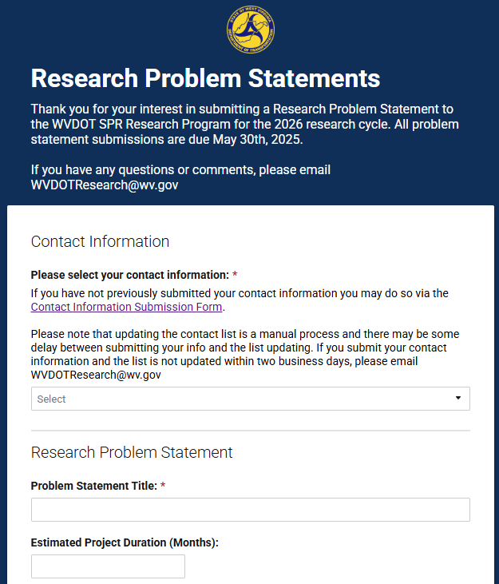
Qualities of Successful Problem Statements
Problem Statement Goals
    Provide a well thought out solution that would assist WVDOT in addressing a problem
    Result in research that is beneficial to both WVDOT and the residents of West Virginia
Successful Problem Statements
Please Note
    Any University or Externally submitted Problem Statements must have a WVDOT project sponsor
    Please keep written responses in the form concise
    Problem Statements can be submitted via the Research Problem Statement form.
    Describe a specific issue
    Include an overview of necessary tasks
    Concept is explained in a manner that is easily understood
    Proper grammar/well written
Notes:
As previously mentioned, a Problem Statement is a formal submission of a research idea that could result in a research project that would be beneficial to WVDOH and the residents of West Virginia. Problem Statements consist of a written explanation of the idea background, research objectives, and the potential application of the research findings. A good Problem Statement is one that is well thought out and describes a specific issue. Problem Statements should also focus on applied research, which is research that results in actionable solutions (i.e. not theoretical findings).
For any externally submitted Problem Statement (non-DOH staff), the submitter must have a Project Sponsor. A Project Sponsor is a DOT staff member who has discussed the Problem Statement idea with the author and supports its submission as a research idea. This requirement aims to prevent submissions of ideas that are not applicable to the DOT and guide the idea towards one that would be more beneficial. Discussion between researchers and DOT staff is encouraged. If you wish to submit a Problem Statement but do not know who to ask to be your Project Sponsor you may submit a request through the Project Sponsor request form. The Research Program team will review your request and find a Project Sponsor for your idea. Please note that you must discuss your idea with your project sponsor before submitting a Problem Statement. Any Problem Statement that does not have a Project Sponsor will be discarded.
DOT staff are also encouraged to submit a Problem Statement if they have a research idea. DOT staff do not need to have a Project Sponsor.
If you wish to see an example of the Problem Statement form so you may better prepare for the upcoming submission window, as I said before, please reach out to the Research Program team and we will share that information with you.
If you would like to be notified when the Problem Statement submission form is open, please fill out the contact information submission form. You can find this form by the QR code in the summit pamphlet.

Slide 8
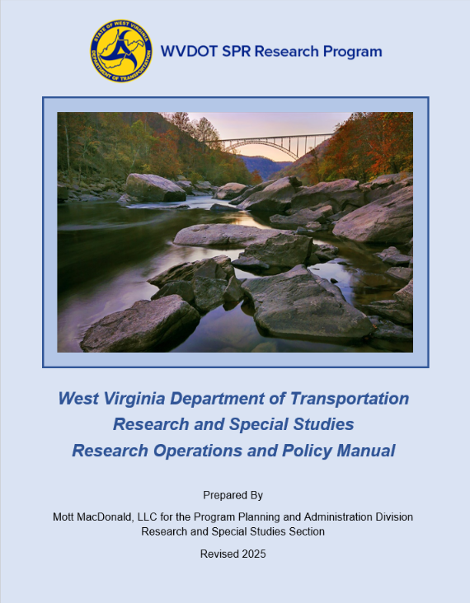
WVDOT Research Manual
The manual was last updated in 2012 and has since been updated and reviewed internally.
Updated manual includes:
Overview of the Research Program
Explanation of the funding process
Breakdown of the research project process and steps
Agreements
Reporting and deliverable requirements
The new manual will be reviewed by FHWA Staff before being finalized and implemented.
Notes:
As part of the overall update to the Research Program, we have also updated the Research Manual. The manual was last updated in 2012 and has since been revised and reviewed internally. The updated manual will serve a source of information on topics such as:
The research cycle
The funding process
Research Project process
Agreement documents
Reporting and deliverable requirements
The updated manual still needs to undergo a formal review by FHWA. Once the manual has been finalized it will be available on the Research Program website.

Slide 9
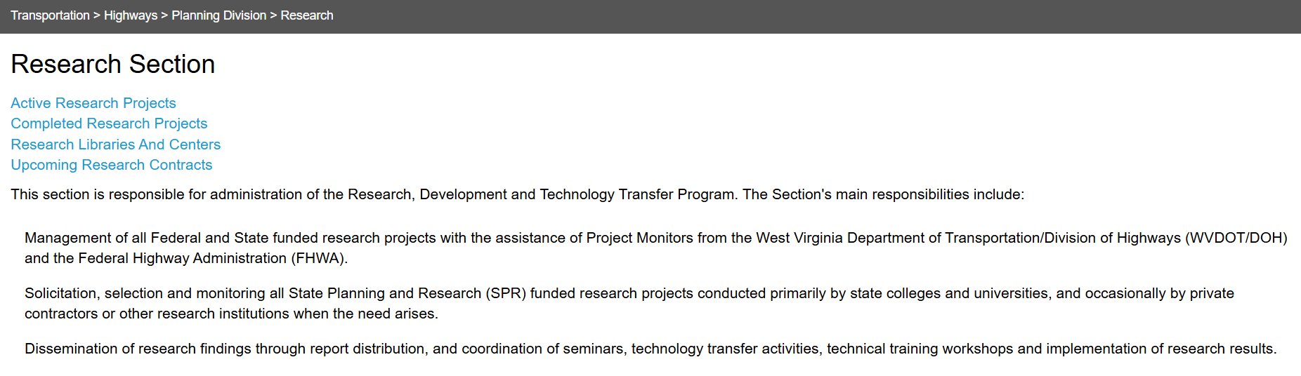
Research Program Website
We are making changes to the website
Currently under construction
Aim for the website to be the main hub for information and submissions
Simplify and clarify the site so information and resources are easy to find
The new website will house
The research project database
Links to submission forms and instruction documents
Notification of upcoming events and important dates
Newsletters
Notes:
Another update to the Research Program is the website. The site is currently under construction, so look out for updates in the near future. The new site will be the main hub for information and resources on the Research Program and the research cycle. We also aim to simplify the site and make it easier to find the information you need. Some highlights of the updated site include a database of historic and active research projects, links to submission forms and instruction documents, notification of upcoming events, important dates, and a place to house the Research Program newsletters. We hope we can have the first newsletter soon. Once started we are debating on if these newsletters should be quarterly or semiannually, please let me know your all's thoughts on that.

Slide 10
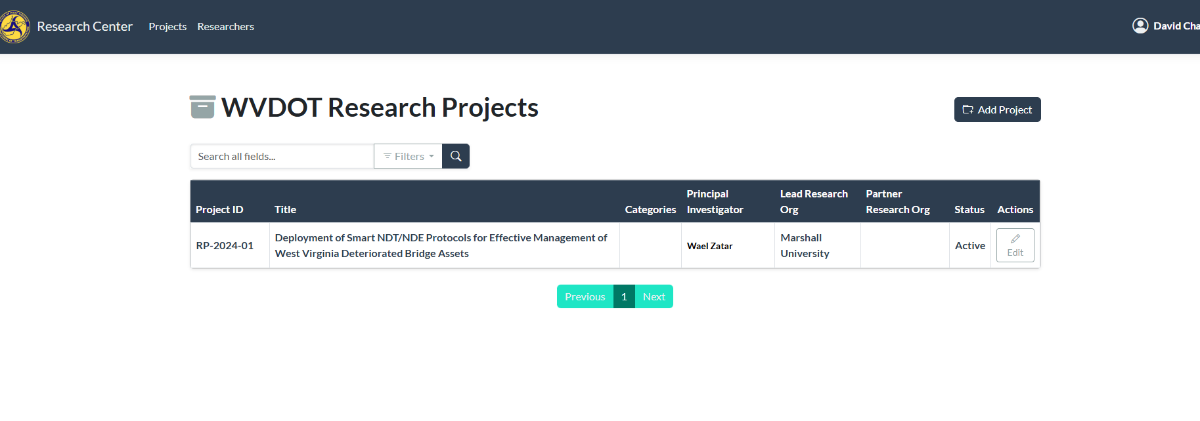
Research Program Website
Project Catalog-WIP screenshot
The catalog is meant to be a quick look at the list of projects and their status.
Search by:
Researcher
University
Status
Notes:
Another update to the Research Program is the website. The site is currently under construction, so look out for updates in the near future. The new site will be the main hub for information and resources on the Research Program and the research cycle. We also aim to simplify the site and make it easier to find the information you need. Some highlights of the updated site include a database of historic and active research projects, links to submission forms and instruction documents, notification of upcoming events, important dates, and a place to house the Research Program newsletters. We hope we can have the first newsletter soon. Once started we are debating on if these newsletters should be quarterly or semiannually, please let me know your all's thoughts on that.

Slide 11
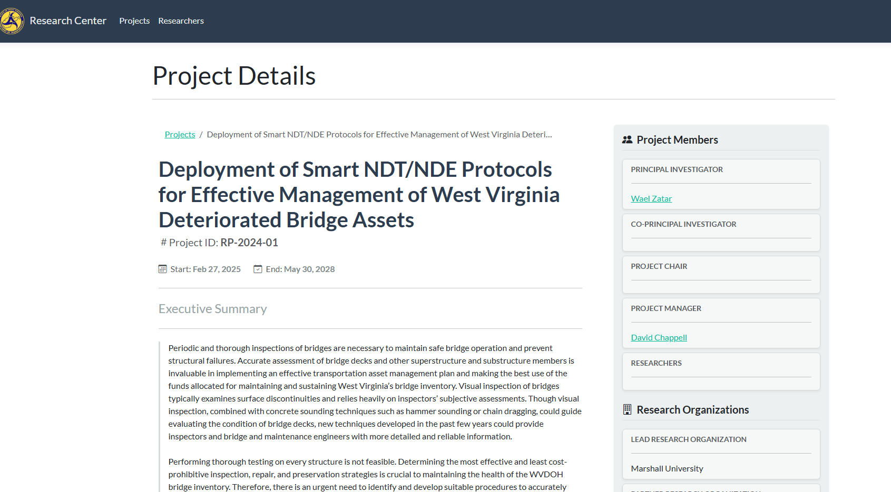
Research Program Website
Project Details-WIP screenshot
Notes:
Another update to the Research Program is the website. The site is currently under construction, so look out for updates in the near future. The new site will be the main hub for information and resources on the Research Program and the research cycle. We also aim to simplify the site and make it easier to find the information you need. Some highlights of the updated site include a database of historic and active research projects, links to submission forms and instruction documents, notification of upcoming events, important dates, and a place to house the Research Program newsletters. We hope we can have the first newsletter soon. Once started we are debating on if these newsletters should be quarterly or semiannually, please let me know your all's thoughts on that.

Slide 12
Master Agreements
Eight RP-2025 projects were implemented under these Master Agreements
Universities do not have to have a Master Agreement in place to do research with WVDOT
Master Agreements have been signed and executed with
WVU
Marshall University
7 projects with WVU
Individual “Long Form” Project Agreements would be utilized
1 project with Marshall University
Notes:
To streamline the project agreement process, the WVDOT Research Program has implemented Master Agreements. Master Agreements are an umbrella agreement established with a university to cover multiple research projects. These agreements establish guidelines and requirements for items such as project invoices, reporting, deliverables, and communications, Any project signed under the Master Agreement abides by these guidelines and requirements.
There are currently two Master Agreements in place, one with West Virginia University and one with Marshall University. There are eight projects from the FFY2025 cycle that fall under these agreements, seven are with WVU and one is with Marshall.
It is important to note that a university does not have to have a Master Agreement in place to conduct a research project in partnership with WVDOT. In this instance a “Long Form” Project agreement would be utilized. These agreements cover the same parameters as the Master Agreements, but only one project can be implemented under them. If DOH works frequently with another university we can discuss creating a master agreement with them as need arises.

Slide 13
What should a research project accomplish?
Improve agency processes and materials through quality research
Make a real and positive impact on agency programs and through the agency, the traveling public
Projects should be of good quality and produce useful, implementable and transferable results
Support student and workforce development
Engage agency staff to think creatively and develop relationships with key researchers
Notes:
So what exactly should a research project accomplish? As mentioned before, a research project should first and foremost focus on applied research. A project should also be quality research that is beneficial to the agency. Project should also support student and workforce development. They should also serve as an opportunity to develop relationships between academics and non-academics. We want to hear what your needs are and what challenges we can help with through research.

Slide 14
Active Projects
Proposal ID | Title | Principal Investigator | University
RP-2024-01 | Deployment of Smart NDT/NDE Protocols for Effective Management of West Virginia’s Deteriorated Bridge Assets | Dr. Wael Zatar | Marshall
RP-2025-02 | Mobile Bridge Rating and Inspection Center | Dr. Karl Barth | WVU
RP-2025-10 | Field Evaluation of Wrapped Bridge Piers and Beams and Specification Development for Wrap Installations | Dr. Hota Gangarao | WVU
RP-2025-15 | Edge AI- and Video-Assisted FHWA Vehicle Classification | Dr. Fei Dai | WVU
RP-2025-16 | AI Applications for Enhancing Pavement Management | Dr. James Bryce | WVU
RP-2025-17 | Moving Beyond Aggregate Properties in Determining Skid Resistance of Asphalt Mixtures | Dr. James Bryce | WVU
RP-2025-18 | Enhancing Road Construction Safety through Immersive Workforce Training and Realtime Monitoring Technologies | Dr. JuHyeong Ryu | WVU
RP-2025-19 | Hydraulic and statistical analysis of culvert maintenance and condition | Dr. Isaac Wait | Marshall
RP-2025-22 | Proposal for Mass Concrete - Thermal Stress Analysis of Abutments and Wingwalls | Dr. Hung-Liang Chen | WVU
Notes:
We currently have nine active projects under the Research Program. Eight of those projects were a part of the FFY 2025 cycle and the ninth was part of FFY 2024 cycle. Once NTP is issued for a project, a project kick-off meeting is scheduled within the first six weeks of the project to go over items such as project timelines and tasks, deliverables, and any information or assistance the PI may need from the DOT. Project kick-off meetings include the project PI and their research team, the project manager from the WVDOT Research Program, and the Technical Advisory Committee (TAC) members. The TAC consist of subject matter experts within the DOT who review progress and final reports and provide any needed technical guidance from the DOT side.
It should be noted that any future proposal submissions will be required to account for the cost of DOT assistance within the project budget. This will cover items such as the TAC members time assisting with the project, anytime spent on internal data gathering, and the DOTs participation in the implementation of project results and findings, this includes field work such as traffic control. The PI working on the proposal will need to coordinate with their project sponsor to determine this value.

Slide 15
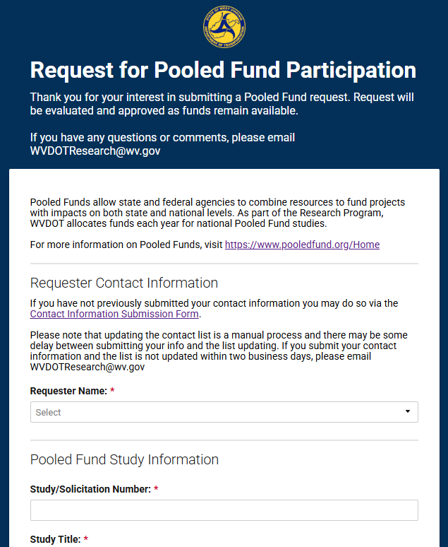
Transportation Pooled Funds
What is a Pooled Fund
    The Transportation Pooled Fund (TPF) Program is a collaborative program started in 1977 among the states to be administered by FHWA
    The TPF program creates opportunities for partners to pool funds, subject matter expertise, and resources to conduct high-priority research for a variety of shared transportation problems.
    More information can be found at https://pooledfund.org
Requesting a Pooled Fund
    WVDOT staff can submit a Pooled Fund requests at any time
    Request will be evaluated as they are received
    Funds are distributed on a first come first served basis while funding is available
    Pooled Fund requests can be submitted via the Request for Pooled Fund Participation form.
Notes:
Another aspect of the Research Program is the participation in Transportation Pooled Funds, I just call it The Pooled Fund, but that’s just me. The TPF program is administered by the FHWA and promotes collaboration between states on research projects. The program creates opportunities for states to partner and pool resources such as funds, subject matter expertise, and other resources to conduct research on shared transportation problems.
WVDOT staff are encouraged to submit a request form through the Research Program to participate in a Pooled Fund. Staff may submit this request via the Request for Pooled Fund Participation form. Request are accepted and evaluated year-round as they are received. Funds for Pooled Funds are distributed on a first come first served basis while funding is available and the Research Program believes the Pooled Fund is beneficial to WVDOT.

Slide 16
WVDOT Pooled Fund Commitments
Pooled Fund Number | Title | Lead Organization
TPF-5(547) | Traffic Safety Culture Phase 3 | Montana Department of Transportation
TPF-5(544) | Technology Transfer Concrete Consortium (2025-2029) | Iowa Department of Transportation
TPF-5(531) | Accelerated Performance Testing on the 2024 NCAT Pavement Test Track with MnROAD Research Partnership | Alabama Department of Transportation
TPF-5(530) | TRB Core Program Services for a Highway RD&T Program – Federal Fiscal Year 2024/TRB (State DOTs) Fiscal Year 2025 | Federal Highway Administration
TPF-5(527) | International Conference on Ecology and Transportation 2025 | Washington State Department of Transportation
TPF-5(501) | Roadside Safety Pooled Fund - Phase 3 | Washington State Department of Transportation
TPF-5(486) | Center for the Aging Infrastructure: Steel Bridge Research, Inspection, Training and Education Engineering Center - SBRITE (Continuation) | Indiana Department of Transportation
TPF-5(479) | Clear Roads Winter Highway Operations Phase III Pooled Fund | Minnesota Department of Transportation
Notes:
The Research Program currently contributes to a number of Pooled Funds. A few of the Pooled Funds West Virginia participates in have been included in this chart.
States may also host a Pooled Fund and gather support through the Pooled Fund solicitation process. West Virginia currently has one Pooled Fund solicitation posted. This solicitation is titled Determination of Load and Flexural Capacity of Press Brake Formed Tub Girder Bridges and is West Virginias first Pooled Fund solicitation in recent years. Dr. Michaelson from Marshall University will be presenting on this solicitation tomorrow morning.

Slide 17
Important Upcoming Dates
Problem Statement Submission Window
Submission window usually opens early April
Problem Statement Review
Will start once Problem Statements have been complied Late June/early July
Peer Exchange
WVDOT will be attending a 2026 Peer Exchange this July in Pittsburg, Pa
One WVDOT the committees have determined which to request proposals for, notifications will be sent out.
Problem Statements for the current cycle are due by June 3^{rd (today)}
Will be reviewed by the Research Technical Committees and notifications will be sent out in August.
Notes:
As we wrap up, we do have a few important dates and upcoming events we want to highlight.
The first is the Peer Exchange in April. Representatives from the Research Program will be attending the Peer Exchange this April in Pittsburg, PA. This event is an opportunity for the WVDOT Research Program team to interact with other state research programs across the US.
As
As mentioned before, the Problem Statement window will open in April. This year the window will open on April 7th and close on June 3rd. An email will be sent out with the Problem Statement Submission form link on April 7th.

Slide 18
Thank You
If you have any questions about the WVDOT Research Program, please email us at WVDOTResearch@wv.gov. A member of the Research Program staff will review your email and be in touch.
David Chappell- David.c.chappell@wv.gov 304-414-7326
Notes:
Thank you all again for being here, we hope this presentation has been helpful. If you have any questions at any point, you may email the Research Program team at WVDOTResearch@wv.gov. We will be sending out a copy of all the presentation slides from the summit to the attendees next week. That email will also contain a link to a survey. We would love to hear any feedback you may have regarding the summit and how we can improve for next year. The only thing I ask is that you don’t call me names.
Are there any questions

