Slide 1
TIDS
2026 West Virginia Transportation Planning Conference
Joe Zissman
Cambridge Systematics
June 2, 2026
Transportation Investment Decision Support
Notes:
Thank you Brett, and good afternoon everyone!
My name is Joe Zissman, and I’m here today representing my team from Cambridge Systematics that’s working on the Transportation Investment Decision Support project for DOH.
At a high level, our task is to help DOH develop tools to make the process of distributing revenue and selecting projects for the STIP and STIP Amendments more data-driven and transparent.

Slide 2
Introduction
Objectives of the TIDS Project
  Transparency on resource allocation and project prioritization
  Data-driven decision-making
Key questions/issues
  How do projects get added to the STIP?
  How do projects advance from a study or a plan?
  Which regional corridors might be advanced after Corridor H?
What we’ve done so far
  Review of regional/national precedents
  Identification of possible factors
Timeline
Notes:
There’s a few things that we thought it might be helpful to introduce this afternoon.
First there are some foundational questions you might have about the STIP – how do projects get added, how do you advance them or them forward?
But also, there are the bigger, regional corridor projects. Corridor H is nearing completion and has received the majority of West Virginia’s Regional Mobility investment. What regional-scale projects could the State pursue next?
What our CS team has done is to identify what is currently a pretty wide range of possible selection criteria, drawing from similar work we’ve done across the country, including for a couple of your neighbor state DOTs.
I’ll go into a little more detail on these topics, and then discuss next steps and when you could expect to see implementation of these tools.

Slide 3
TIDS for Project Prioritization
What kinds of projects?
  Turning lanes, intersection improvements, add-a-lane on short segments
  Referred to as “localized mobility”
How does a project move from a study to the STIP?
  Goal: Data-driven
  Goal: Transparency and communication with MPOs
  Goal: Sensitivity to regional differences
How do we accomplish this?
  Set of data-driven factors, based on internal WVDOT precedent work
  Factors serve established LRTP goals
  Source material for factors drawn from project documentation, TIPs
  Clear and transparent communication of factors to MPOs and others
Notes:
The TIDS project addresses decisions at two levels: allocation of resources between programs – such as bridge, pavement, traffic, and regional and localized mobility – and selection of projects within those programs.
Starting with the projects.
At this point in the project, we are building on work some folks at DOH had already done great work on in the selection of localized mobility projects. These are things like turn lanes, intersections, and short add-a-lane projects.
DOH has given us clear direction that they want a project development and prioritization approach that is data-driven and objective, transparent, and interactive, with acknowledgement of regional differences.
As I mentioned a moment ago, to do this we have developed a set of objective criteria that we’ll be whittling down with DOH over the summer. The criteria are grouped by, and based on, the goals and objectives in the 2050 LRTP.
The criteria use information from submitted project documentation as well as other datasets on asset condition, traffic volume, freight volume, safety, etc. that are available to DOH.

Slide 4
TIDS for Project Prioritization
Factors to advance established LRTP goals:
  System condition, efficiency, and fiscal sustainability
  Safety and security for all users
  Economic vitality and freight movement
  Multimodal mobility, reliability, and accessibility
  Livable and healthy communities
Factors will be weighted by importance
Weighting may vary by region
Notes:
The LRTP goals that we are designing these metrics around would lead WVDOT toward projects that make the transportation system more safe and efficient, contribute to economic health and growth, increase accessibility to jobs and critical facilities, and promote quality-of-life.
As a part of this process, DOH will work with us on the relative importance of these factors. This importance can vary by region of the state.

Slide 5
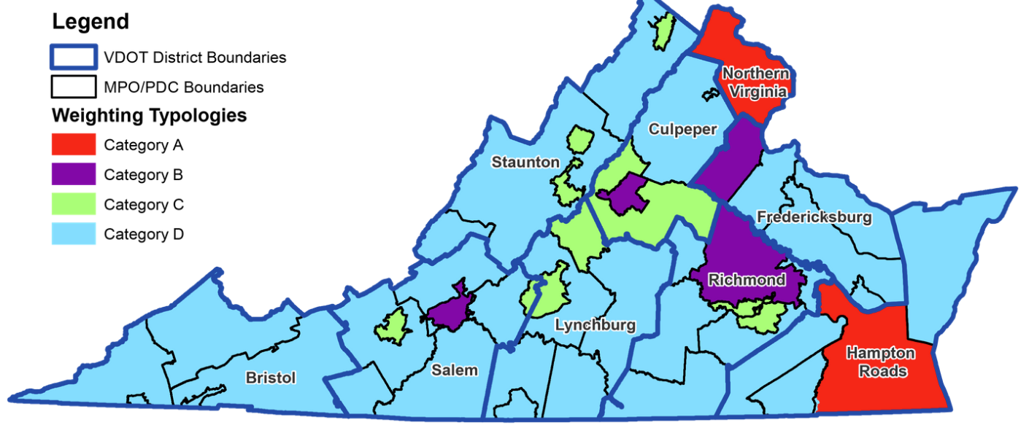
Example: Virginia SMART SCALE
Evaluate each project’s benefit on a scale relative to the needs of that region as compared across the commonwealth.
Factor | Safety | Congestion Mitigation | Accessibility | Land Use | Economic Development | Environmental Quality
Category A | 15% | 45% | 25% | * | 5% | 10%
Category B | 20% | 25% | 25% | * | 20% | 10%
Category C | 30% | 20% | 15% | * | 25% | 10%
Category D | 40% | 10% | 10% | * | 30% | 10%
Notes:
To give an example of what that regional variation can look like, this slide shows Virginia’s SMART SCALE project prioritization framework – CS worked with VDOT to develop SMART SCALE.
The Appalachian areas of Virginia – and other rural areas – are in Category D, where the highest weight is placed on safety and economic development.
By contrast, in Northern Virginia and Hampton Roads, more urban areas than what you’ll find here in West Virginia, the focus is more on congestion mitigation.

Slide 6
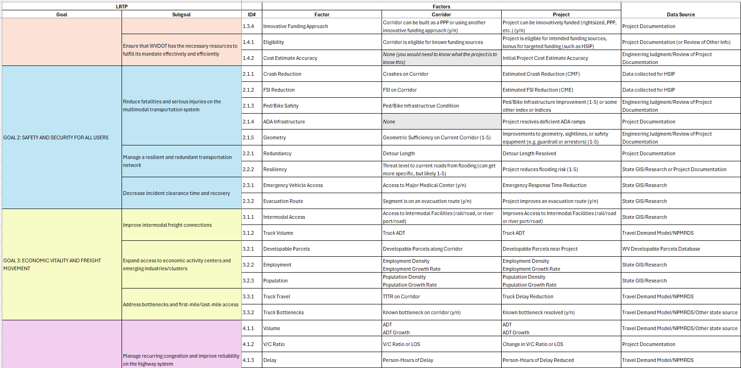
TIDS for Project Prioritization
60 factors currently under consideration
Notes:
Please don’t try to read this slide, but this gives you a glance at the factors under consideration at the moment, collected from some prior work at DOH and also from our work in Virginia, Ohio, Georgia, and Florida.
We’re currently looking into what data we’d need to collect – and DOH would need to keep current in the future – for each of these measures before whittling down the list.

Slide 7
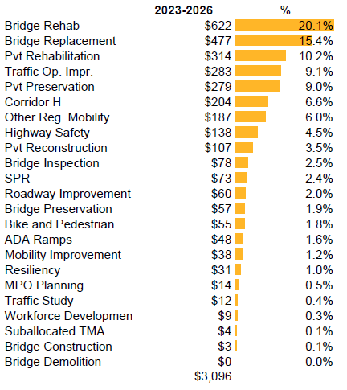
TIDS for Regional Mobility Corridors
Importance of regional corridors
  Economic development, opportunity
  Benefits over wide geographic area
  Freight movement, interstate travel
  Large investment for usable segments
Corridor H has been top priority
  Progress toward substantial completion
  Large proportion of overall STIP spend
  Opportunity to choose what comes next
Notes:
The Regional Mobility corridors would be prioritized using some of the same factors as in project prioritization, though specifics may need to change.
Prioritizing these corridors is important both because they have a significant economic and quality-of-life impact for many West Virginians, but also because they represent a significant proportion of STIP spending.
You can see here that Corridor H alone represented 6.6% of the last STIP and about that much again was spent on other Regional Mobility Corridors.
Corridor H is nearly complete, however. TIDS will help DOH transparently prioritize what might come next.

Slide 8
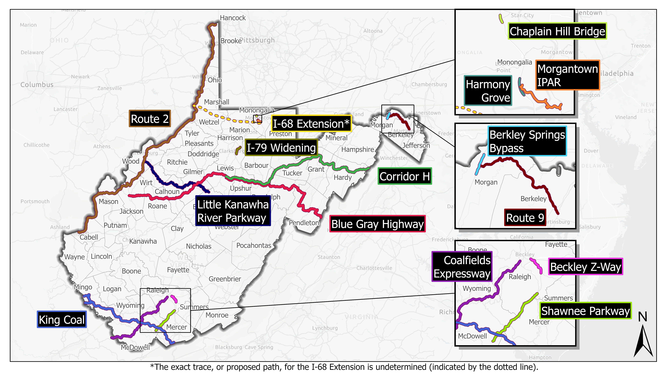
Notes:
Here’s a quick map of the Regional Mobility corridors DOH has identified with us so far. These would be the beginning of the set we’d prioritize, but it need not be limited to these. Additional corridors could be added.
Our intention is to prioritize unbuilt segments of these corridors that are buildable and usable in isolation, as well as large-scale upgrades to existing roadways within the corridors.

Slide 9
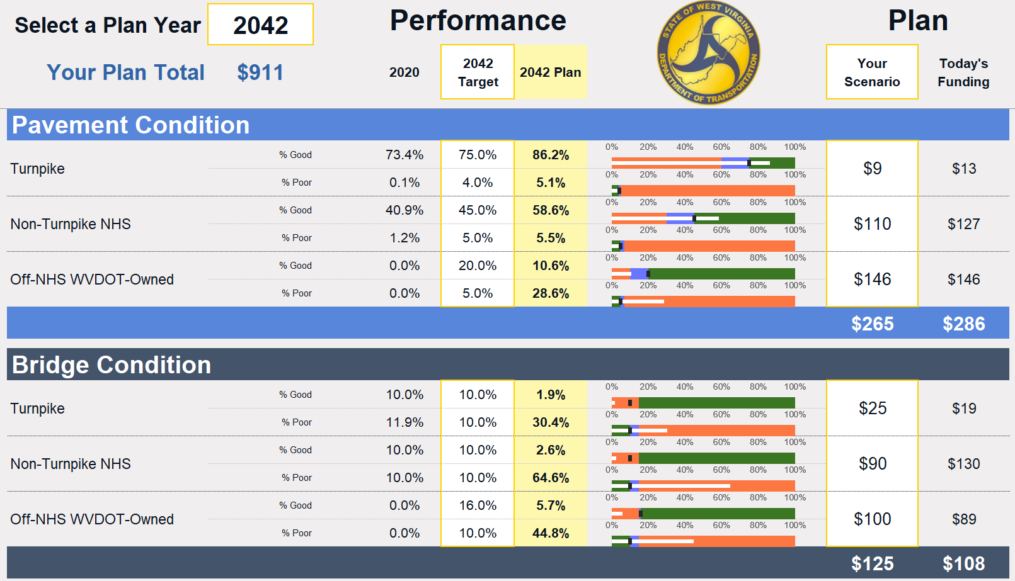
TIDS for Resource Allocation
Assignment of limited funds to STIP programs
Planning for Performance
  Developed in 2021 for LRTP
  Uses WVDOT’s existing models and new ones we develop
  Links performance to program spend and visualizes on a dashboard
Notes:
One more element of this project is data-driven tradeoffs between STIP programs.
In 2021, CS developed the Planning for Performance tool for DOH, which integrates performance models for bridges, pavement, and the other STIP programs at a statewide level.
We’re currently working to update and expand the PFP tool with new model runs.

Slide 10
When Will This be Implemented
Will be in development throughout 2026
TIDS will not be used for the STIP presented in September
TIDS will be implemented as soon as possible afterward
  STIP amendments
  Future STIPs
Comments, concerns, or input:
  Gehan Elsayed: gehan.m.elsayed@wv.gov
  Joe Zissman: jzissman@camsys.com
Notes:
So to return to those foundational questions: How do projects get added to the STIP, and how do you advance them or them forward?
TIDS is intended to provide a transparent and objective method that can facilitate straightforward conversations about adding and advancing projects.
The vision is that project proponents would be provided the evaluation criteria and would have the opportunity to submit information that serves those criteria when proposing a project.
The intention at the moment is to implement some elements of TIDS for the first STIP amendment after September, with more coming in 2027.
I’m happy to take questions, and you can also reach out to myself or to Gehan if something occurs to you later.
Thank you so much for your time this afternoon! I look forward to spending the next few days with you.

Slide 11
Corridors

Slide 12
Preliminary Corridor List – Create New Road
Corridor Name | Road Treatment | Road Length | Progress
Corridor H | Create a new road | 134 total miles (103 completed miles) | Partially complete.
I-68 Extension | Create a new road | 50 total miles | Incomplete. Road path undetermined.
King Coal Highway | Create a new road | 99 total miles | Incomplete. Not yet started.
Morgantown IPAR | Create a new road | 3.2 total miles (1.84 completed miles) | Partially complete.
Coalfields Expressway | Create a new road | 63 total miles (17 completed miles) | In progress. Partially complete.
Shawnee Parkway | Create a new road | 22 total miles | Incomplete. Not yet started.

Slide 13
Preliminary Corridor List – Existing Road
Corridor Name | Road Treatment | Road Length | Progress
Blue Gray Highway (US-33) | Reconfigure and expand existing road | 206 total miles | Incomplete. Not yet started.
Berkeley Springs Bypass | Reconfigure and expand existing road | 4 total miles (2 completed miles) | Partially complete.
I-79 Bridge over Chaplin Hill | Reconstruct a bridge | N/A | Incomplete. Not yet started.
Harmony Grove | Reconfigure existing road | 0.9 total miles | Incomplete. Not yet started.
Route 2 | Reconfigure and expand existing road | 231 total miles | Incomplete. Partially in progress.
Route 9 | Reconfigure and expand existing road | 24 total miles | Incomplete. Not yet started.
I-79 Morgantown | Reconfigure and expand existing road | 6 total miles | Incomplete. Not yet started.
Little Kanawha River Pkwy (WV-5) | Reconfigure existing road | 77 total miles | Incomplete. Not yet started.

Slide 14
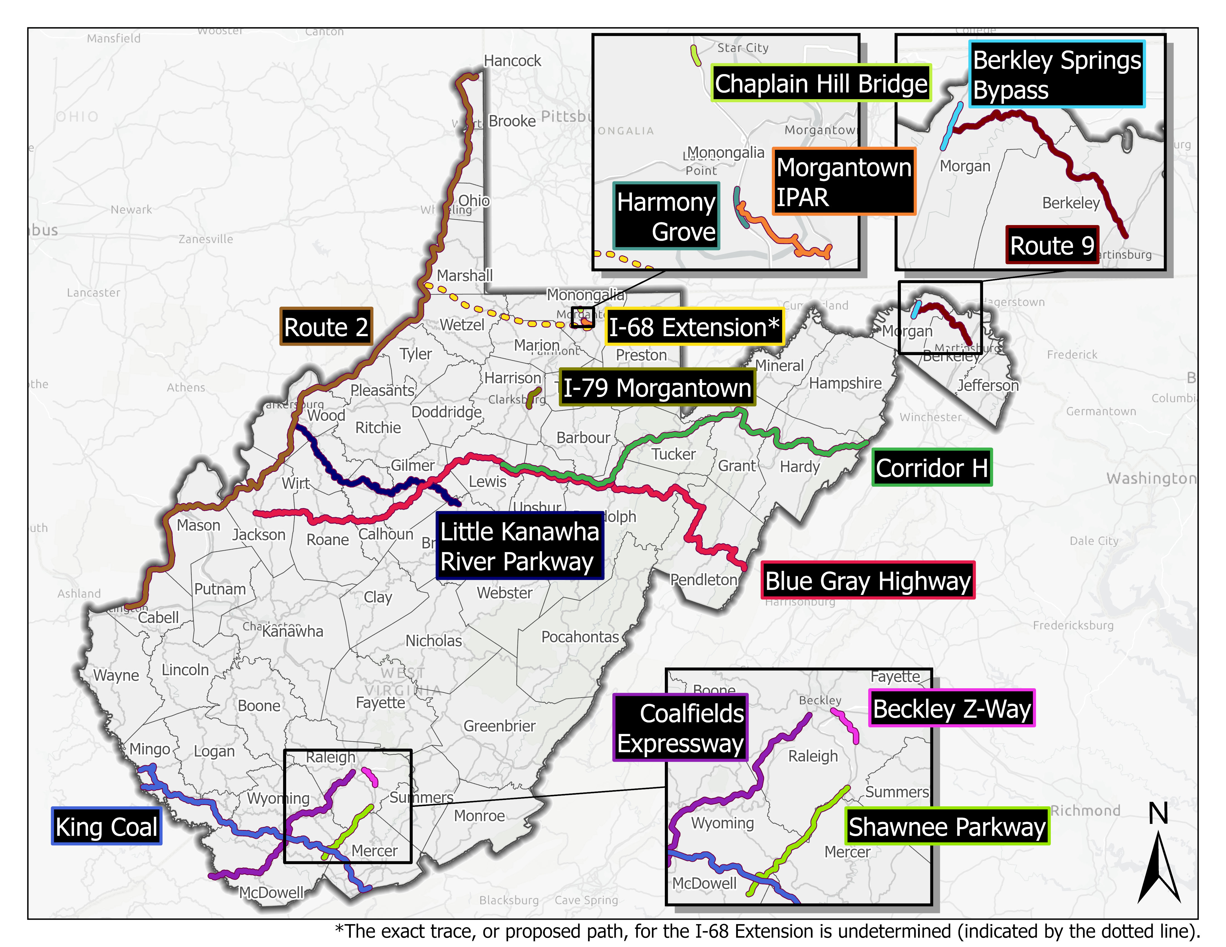

Slide 15
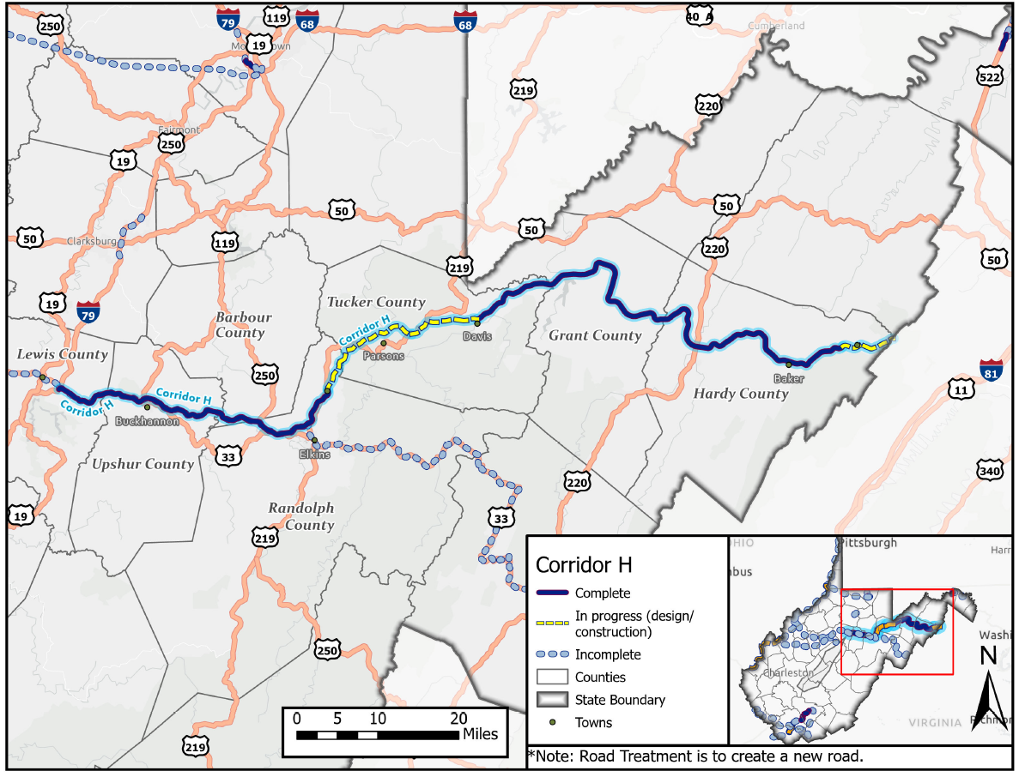

Slide 16
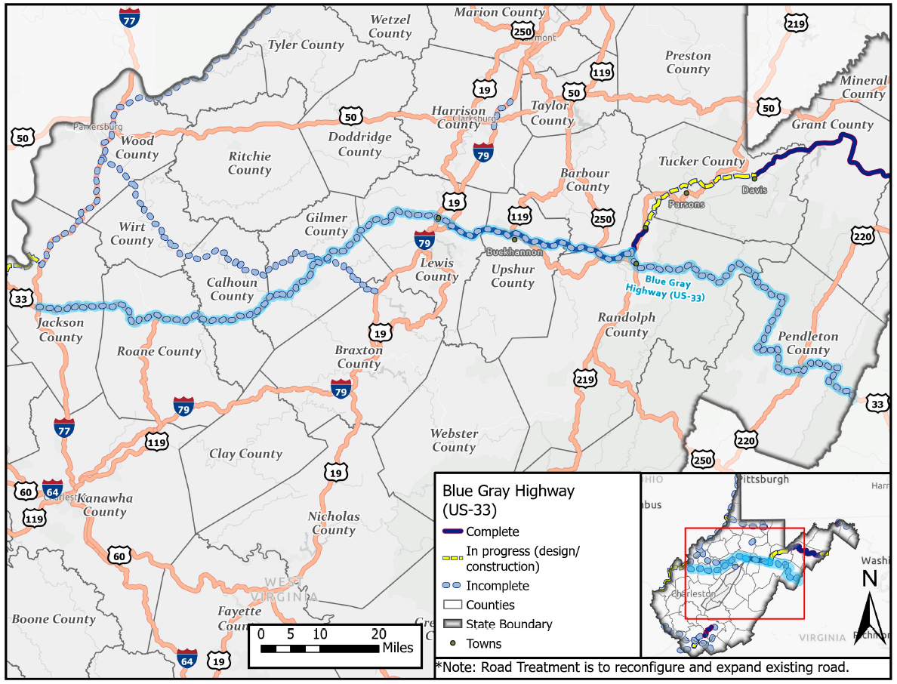

Slide 17
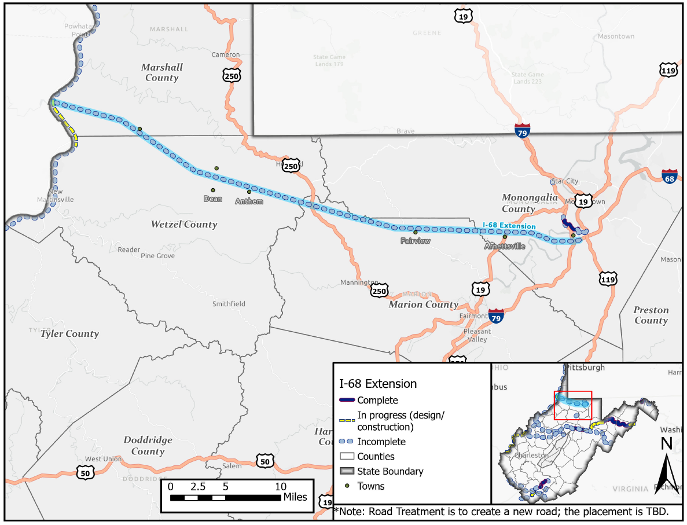

Slide 18
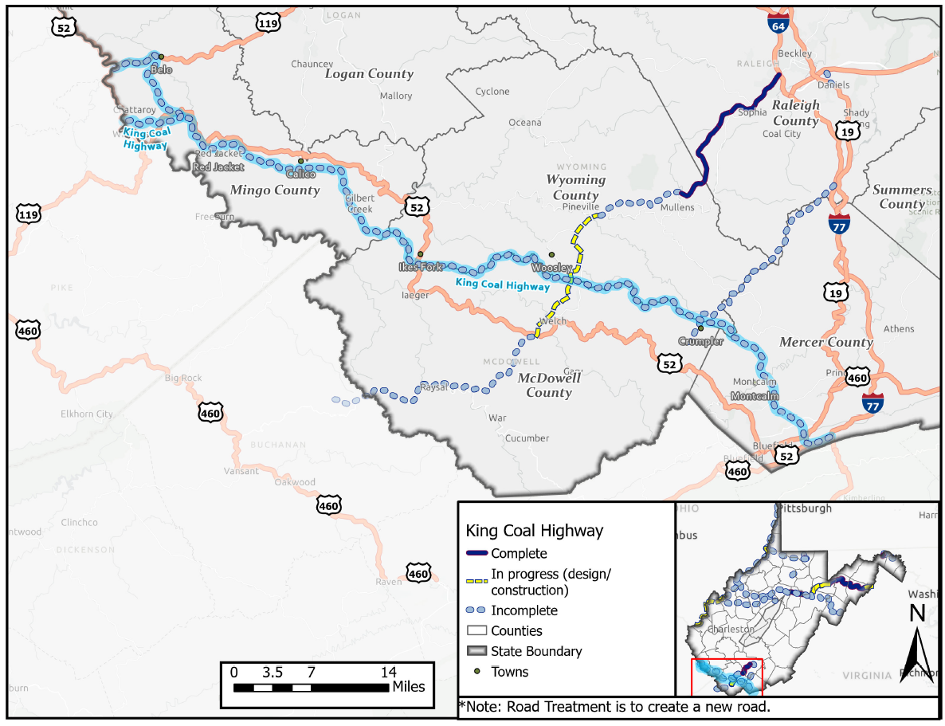

Slide 19
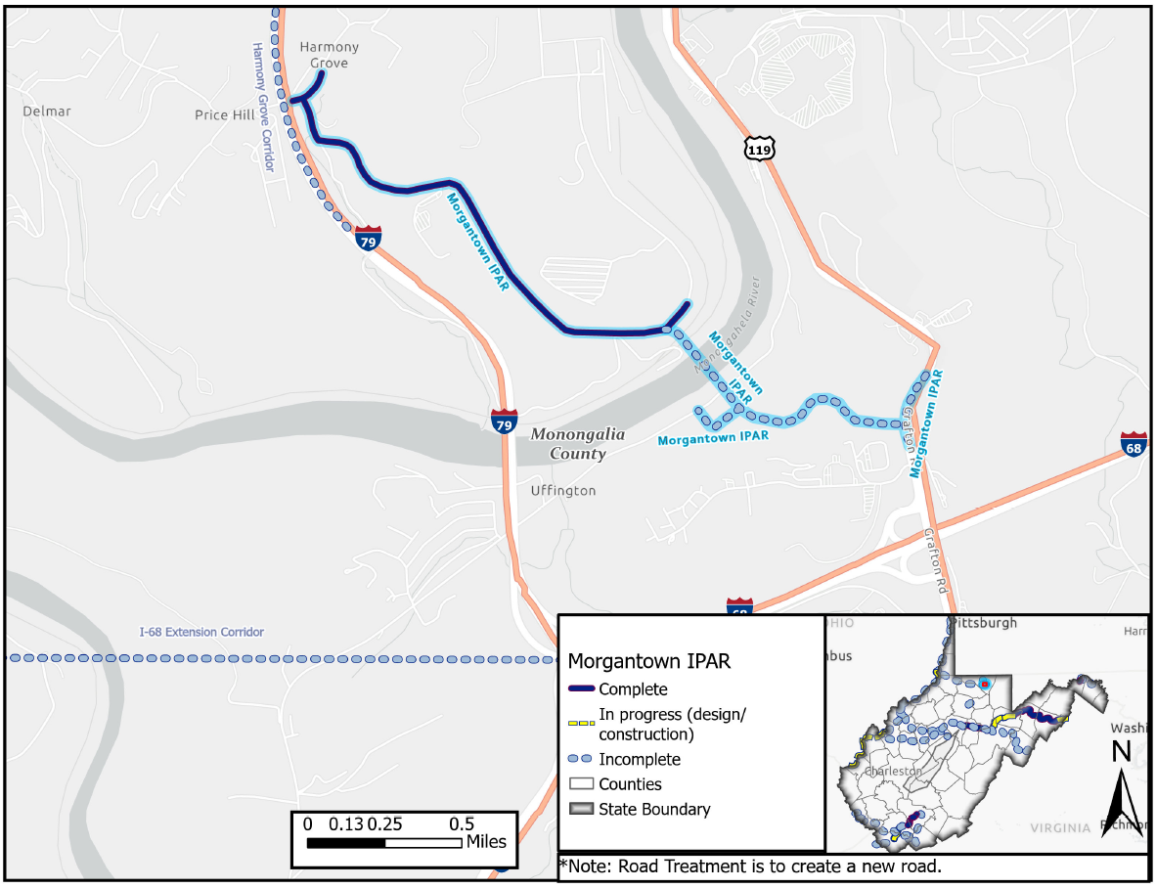

Slide 20
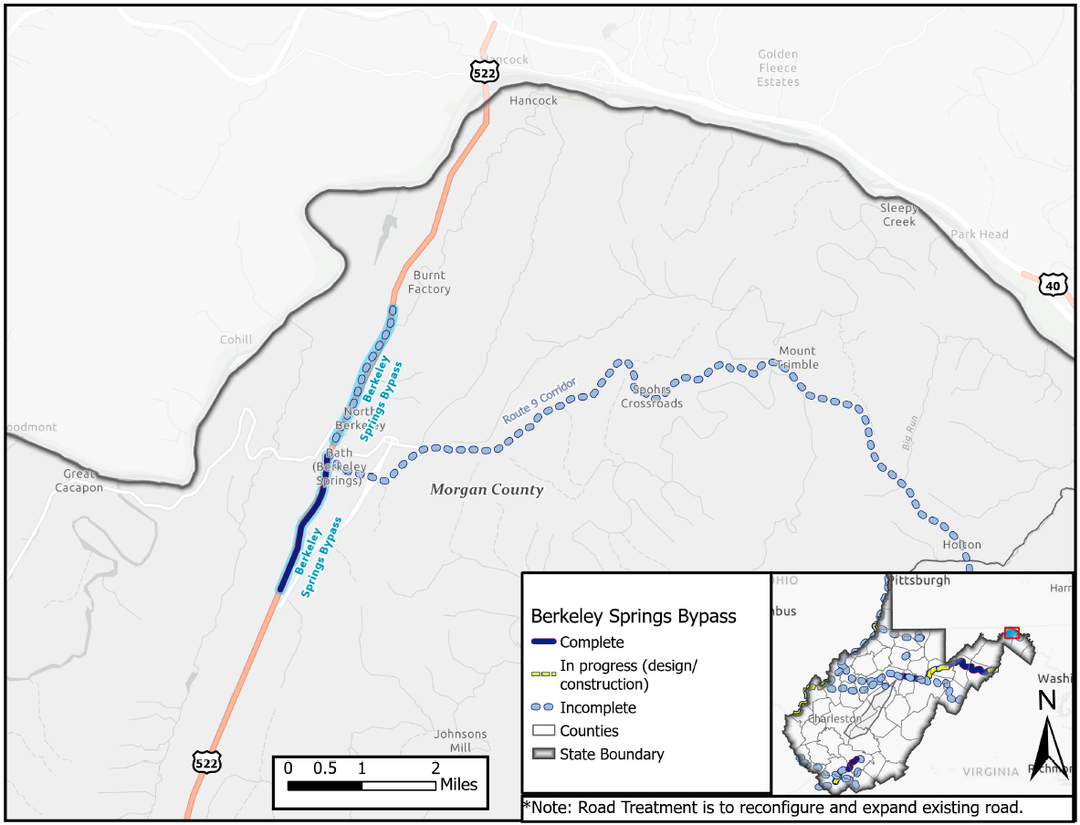

Slide 21
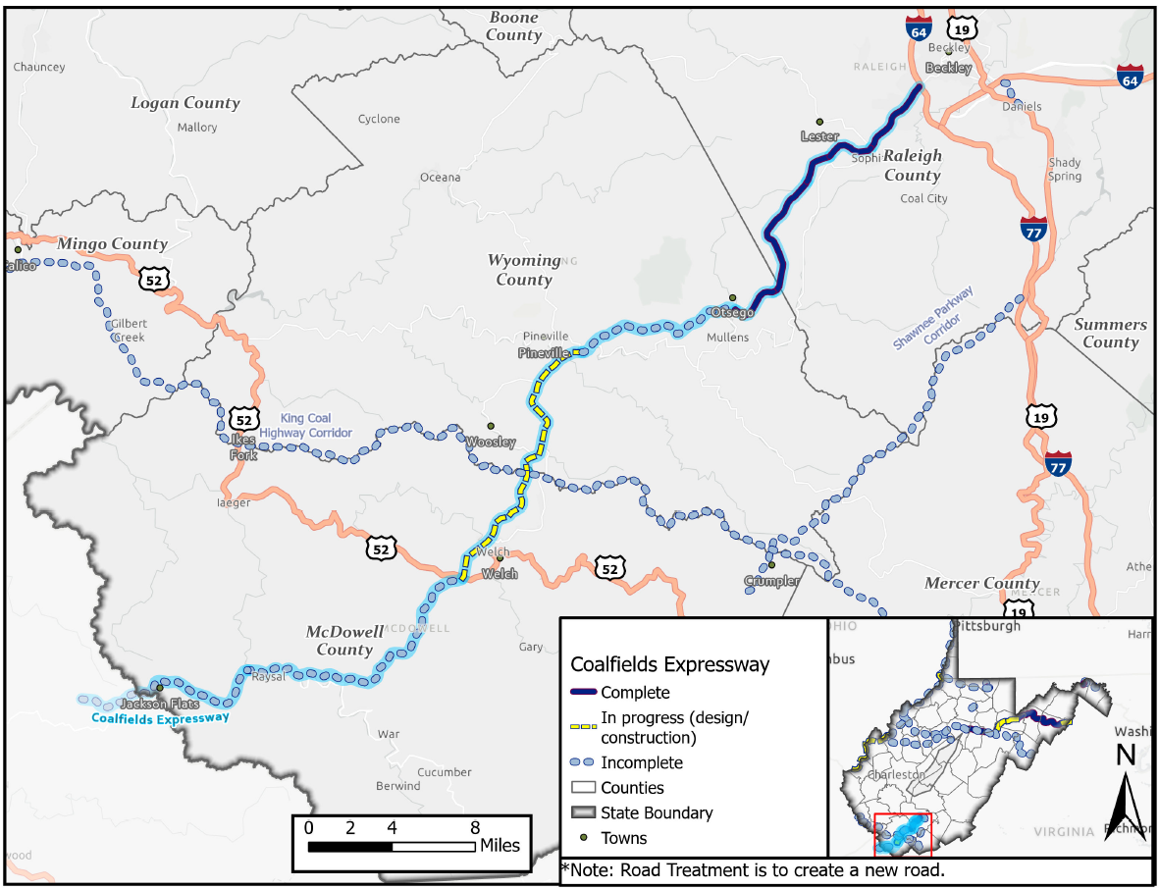

Slide 22
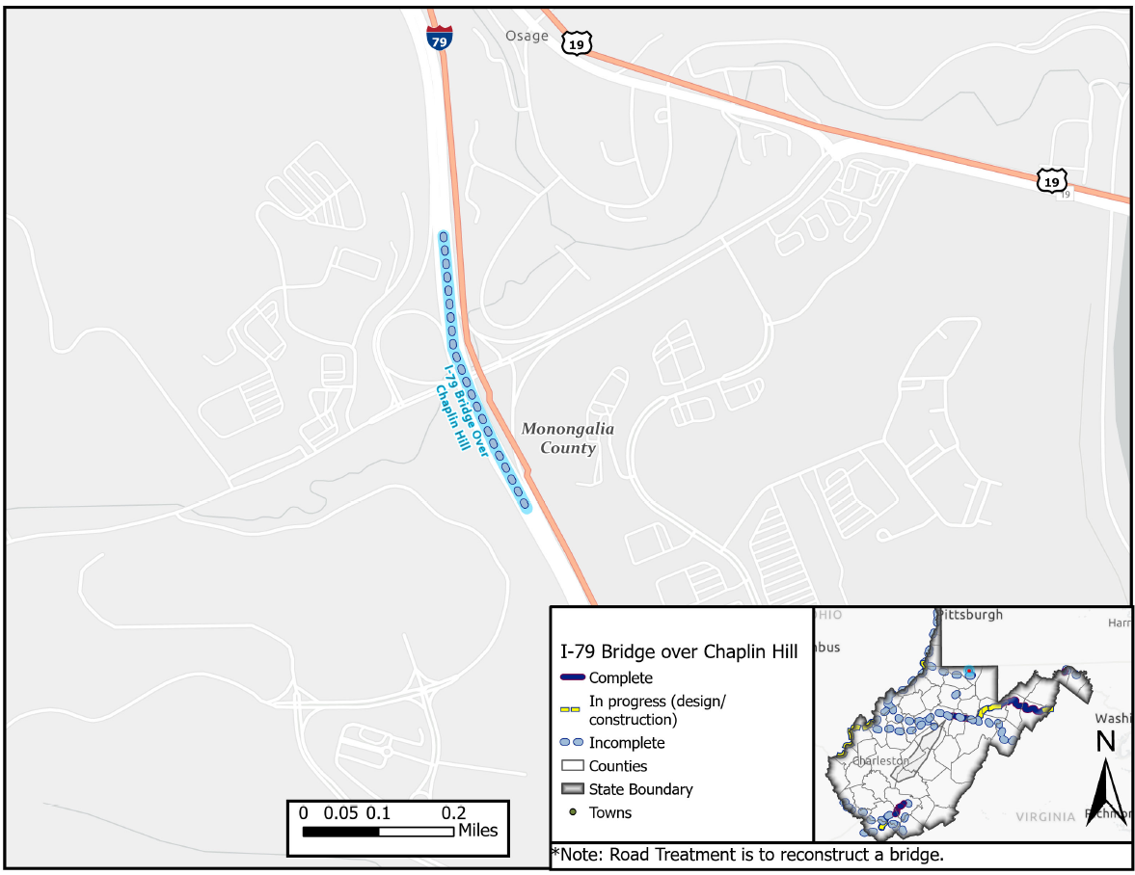

Slide 23
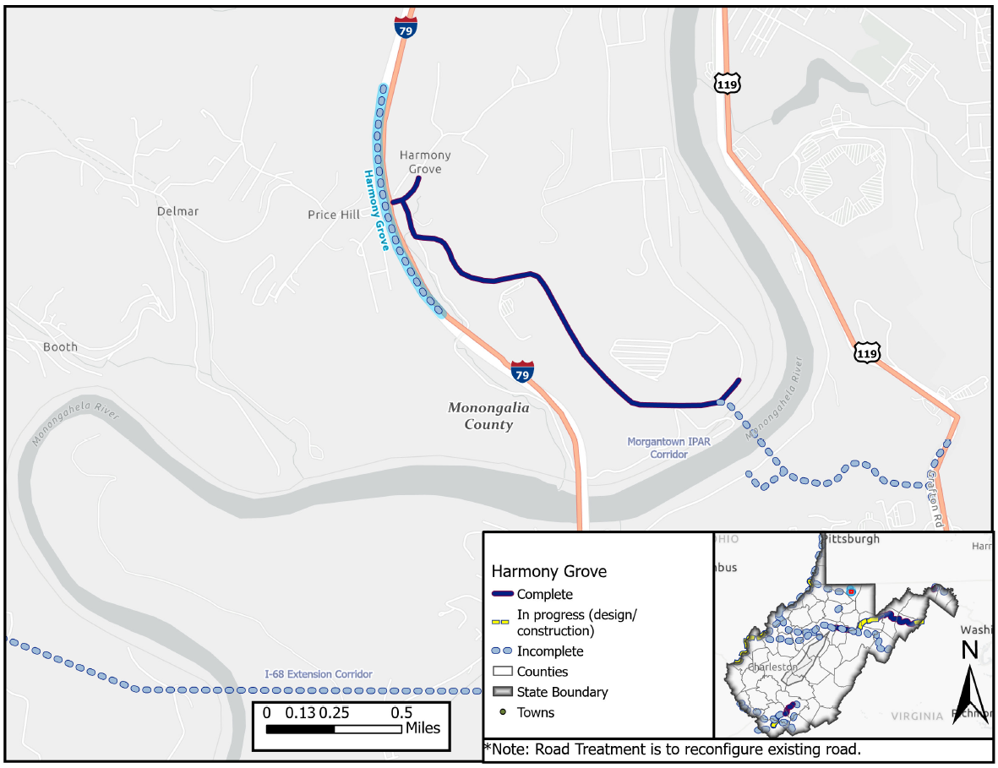

Slide 24
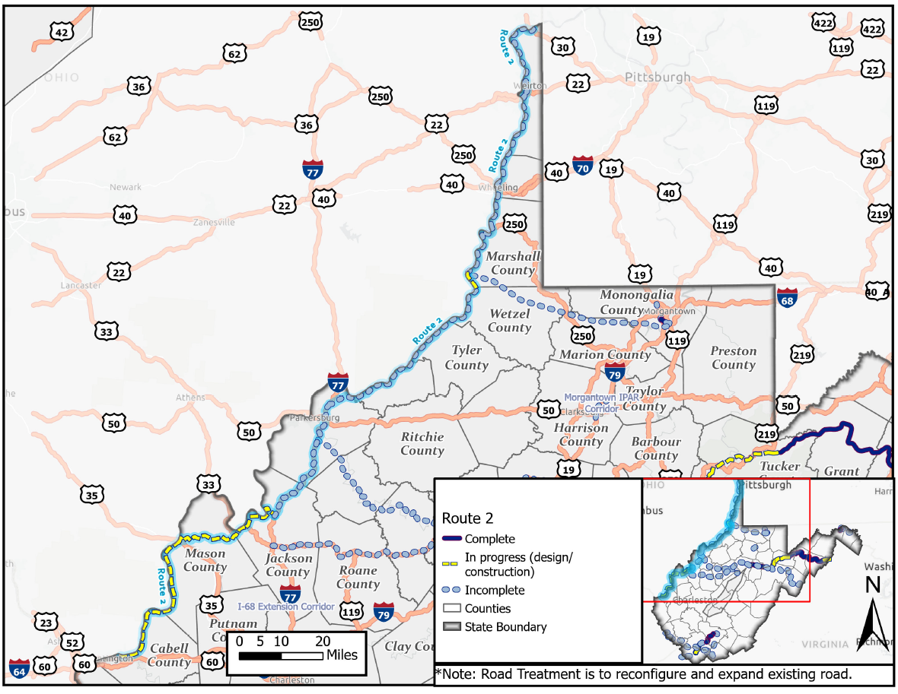

Slide 25
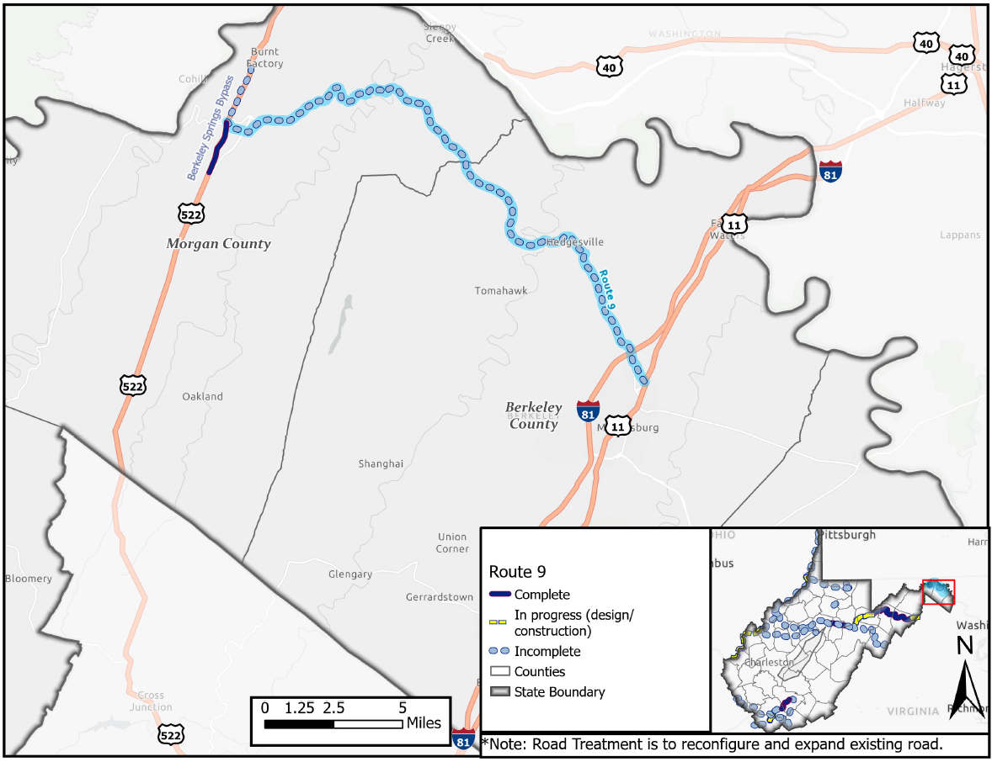

Slide 26
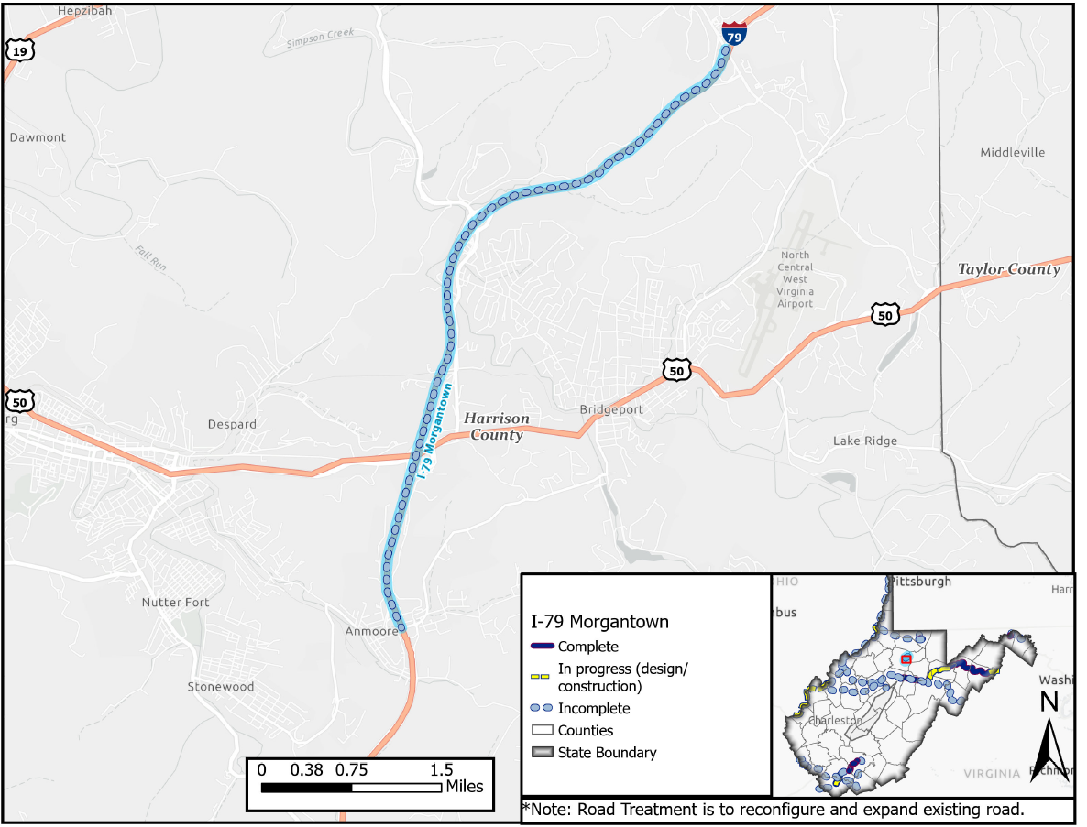

Slide 27
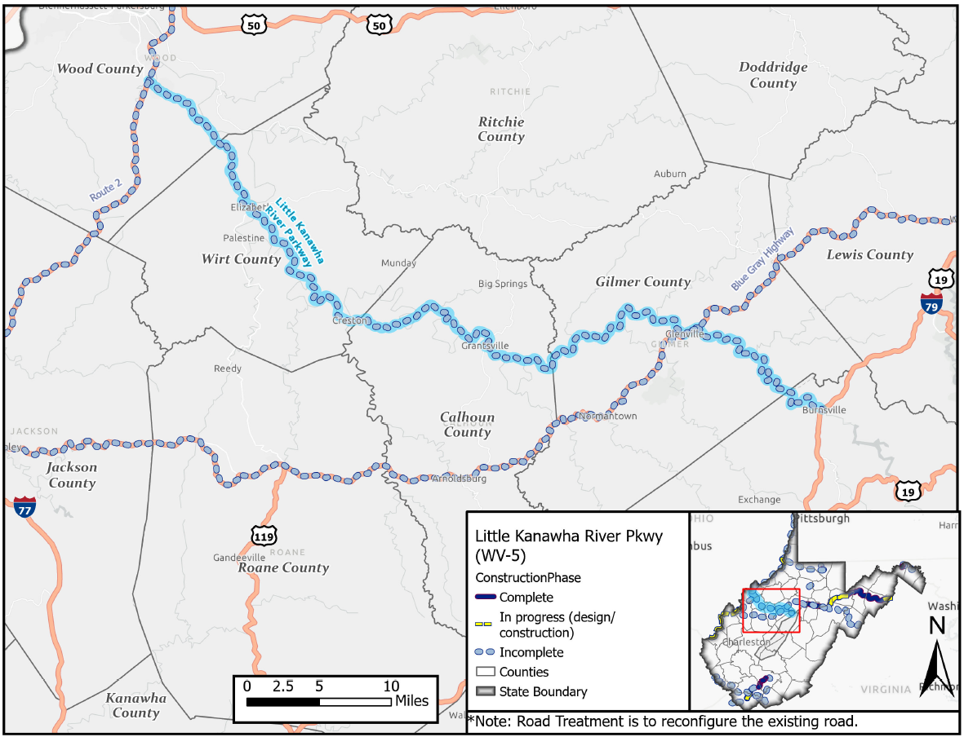

Slide 28
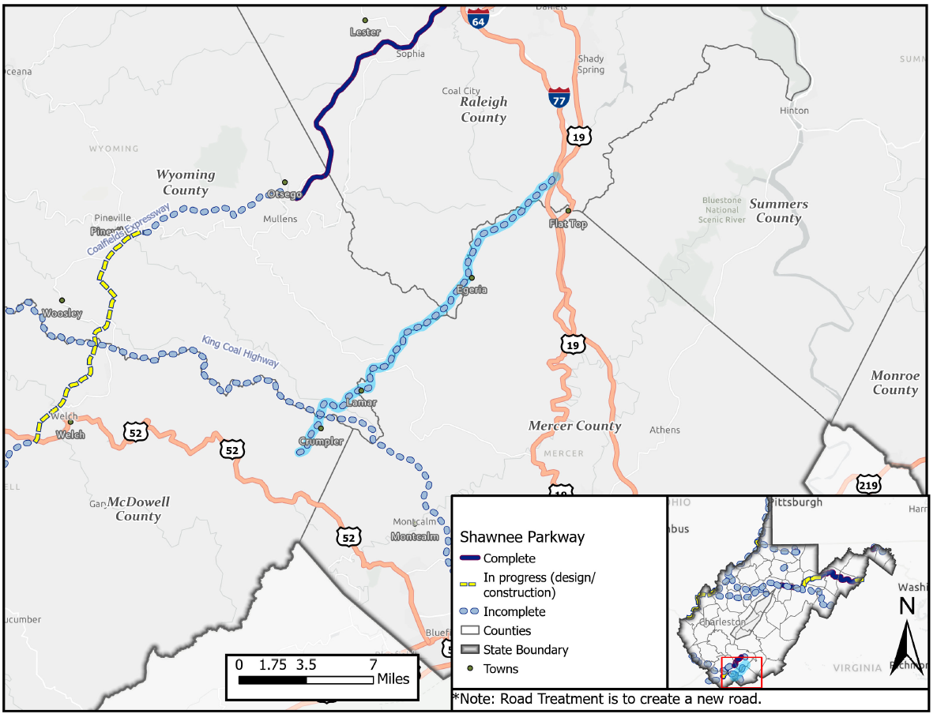

Slide 29
Examples

Slide 30
Example: Roanoke
What was the purpose?
  Prioritize needs for the LRTP based on plan goals
What was the approach?
  Six scoring categories
  Scored and weighted
What might apply here?
  Multi-criteria approach
  Criteria weighted differently in different places

Slide 31
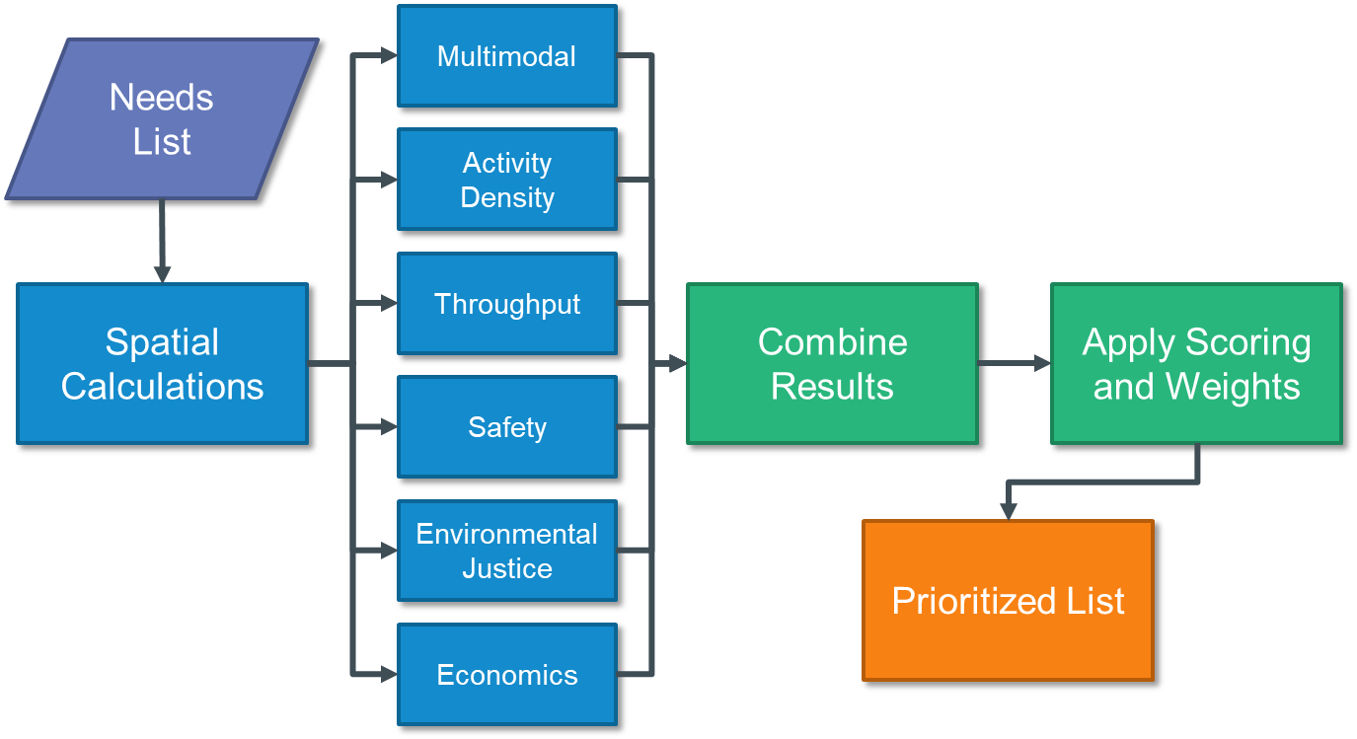
Example: Roanoke
Needs List Clean, organize, and place needs in correct geospatial location. Assign to categories: Automobile Safety, Pedestrian Safety, Bicycle Safety, Transit Safety, Congestion, System Management (Non-Transit), System Management (Transit).
Spatial Calculations Calculating whether the need applies to a series of six criteria: Multimodal, Activity Density, Throughput, Safety, Environmental Justice, Economics.
Combine Results All the criteria results are then combined in Excel.
Apply Scoring and Weights Weighting varies depending on the needs category
Prioritized List Displays the total points received for each individual need by its associated needs type. Scores can receive a maximum of 100 points.

Slide 32
Example: Roanoke
Roanoke Valley Transportation Plan Goals
Criteria
Measure
1. Provide a safe and secure transportation system
Multimodal
Multimodal Districts and Centers
2. Enable reliable mobility
Activity Density
Household and Job Estimate & Forecasts
3. Ensure convenient and affordable access to destinations
Throughput
Priority Corridors (Traffic Congestion Management Process)
VMT Growth
4. Foster environmental sustainability
Safety
VDOT Safety Needs
Top crash clusters and priority corridors
5. Maintain and operate an efficient and resilient transportation system
Environmental Justice
Equity Emphasis Areas
6. Support economic vitality
Economics
Development Priority Locations
Urban Development Areas
7. Promote equitable transportation investments

Slide 33
Example: Roanoke
Alignment with Plan Goals | 3, 6 |  | 3, 6 |  | 2, 3, 5, 6 |  | 1, 5, 7 |  | 4, 7 | 3, 6, 7
 | Multimodal |  | Activity Density |  | Throughput |  | Safety |  | Environmental Justice | Economics
Need Type | Centers | District | 2019 | 2045 | Priority Corridor | VMT Change | VTrans Needs (PSI) | PSAP | Equity Emphasis Areas | Development Priority Locations | Urban Development Areas
Automobile Safety |  |  | 5 | 5 |  | 20 | 50 |  | 10 | 5 | 5
Pedestrian Safety | 5 | 5 |  | 10 |  |  |  | 50 | 20 | 5 | 5
Bicycle Safety | 5 | 5 |  | 10 |  |  |  | 50 | 20 | 5 | 5
Transit Safety | 5 | 5 |  | 10 |  |  |  | 50 | 20 | 5 | 5
Congestion |  |  | 15 | 15 |  | 15 |  |  | 25 | 15 | 15
System Management (Non-Transit) |  |  | 12.5 | 12.5 | 12.5 | 12.5 |  |  | 25 | 12.5 | 12.5
System Management (Transit) | 10 | 10 |  | 20 |  | 20 |  |  | 20 | 10 | 10

Slide 34
Example: Virginia
What was the purpose?
  Make project selection transparent
What was the approach?
  Four weighting typologies for different regions
  Six criteria to weight
What might apply here?
  Goal of improving transparency
  Multi-criteria approach
  Criteria weighted differently in different places

Slide 35
Example: Virginia
Evaluate each project’s benefit on a scale relative to the needs of that region as compared across the commonwealth.
Factor | Safety | Congestion Mitigation | Accessibility | Land Use | Economic Development | Environmental Quality
Category A | 15% | 45% | 25% | * | 5% | 10%
Category B | 20% | 25% | 25% | * | 20% | 10%
Category C | 30% | 20$ | 15% | * | 25% | 10%
Category D | 40% | 10% | 10% | * | 30% | 10%

Slide 36
Example: Virginia
Six factor areas with corresponding measures
FACTOR AREAS | MEASURE ID | MEASURE NAME | MEASURE WEIGHT
Safety | S.1 | Equivalent property damage only (EPDO) of Fatal and Injury Crashes* | 70 percent
 | S.2 | EPDO Rate of Fatal and Injury Crashes | 30 percent
Congestion mitigation | C.1 | Person Throughput | 50 percent
 | C.2 | Person Hours of Delay | 50 percent
Accessibility | A.1 | Access to jobs | 60 percent
 | A.2 | Access to jobs for disadvantaged persons | 20 percent
 | A.3 | Access to multimodal choices | 20 percent
Environmental quality | E.1 | Air quality and environmental effect | 100 percent
 | E.2 | Impact to natural and cultural resources | 0 percent - Subtract up to 5 points
Economic development | ED.1 | Project support for economic development | 60 percent
 | ED.2 | Intermodal access and efficiency | 20 percent
 | ED.3 | Travel time reliability | 20 percent
Land use | L.1 | Transportation-efficient land use | 50 percent
 | L.2 | Increase in transportation-efficient land use | 50 percent

Slide 37
Example: Ohio
What was the purpose?
  Assess how major highways support economic growth
What was the approach?
  Four distinct ranking lists with varied weights
    Freight-focused
    Auto-focused
    Corridor economic-focused
    Balanced
What might apply here?
  Discussion of connections for/to key industries

Slide 38
Example: Ohio
Goal: To analyze where future growth and development could influence transportation system demand and performance, with particular focus on areas of potential stress and congestion.
Transportation
Existing & future demand
Congestion risks & trade corridors
Workforce
Labor force participation by industry
Commuting patterns & accessibility
Demographics
Population trends & forecasts
Household Characters
Development
Land use & development trends
Site Development pressures
Economics
Industry sector trends & employment
Freight-dependent industries
Investigated factors impacting demand for passenger and freight transportation within Ohio
Analyzed existing and future demand and performance implications

Slide 39
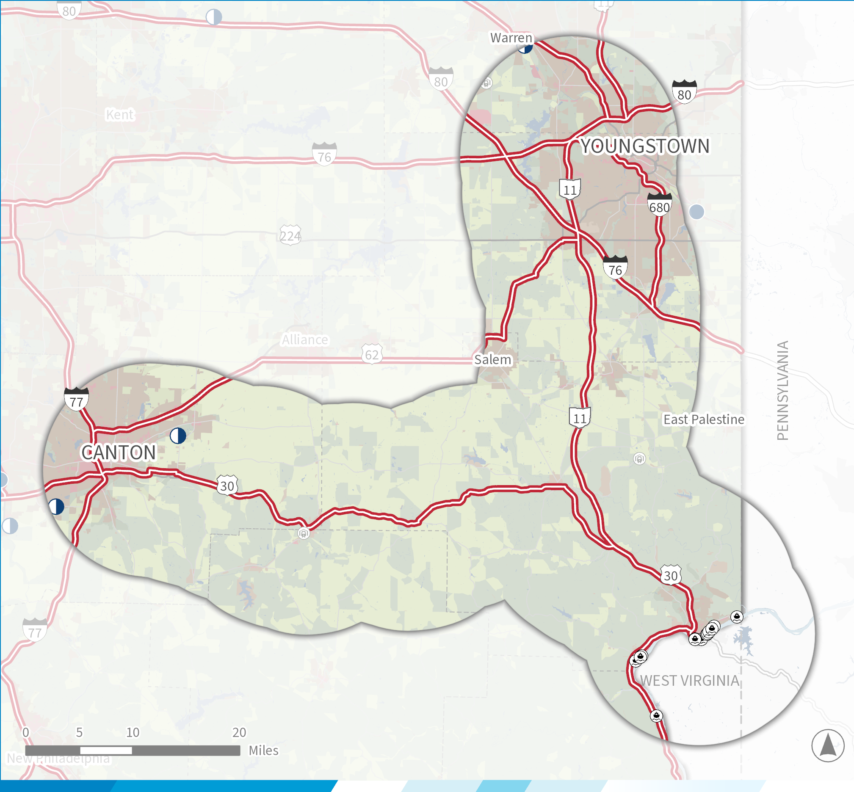
Example: Ohio
Focus Corridor Assessments
Canton/Youngstown-West Virginia/Pennsylvania
Lack of access control and safety concern between Trump Avenue and SR44 through the Village of East Canton. Elevated RSI within Village of East Canton and highest ranking HSIP location along the corridor at Trump Avenue intersection (#72 on suburban intersection list)
Existing and future conditions and performance along each corridor
  Historical trend, current, and projected future corridor travel demand, land use, and development patterns
Identify corridor needs
    Current corridor operating conditions, including roadway characteristics and operations, the interaction among multiple transportation modes, and locations of congestion, safety, and access concerns
Overlaps and gaps between the areas of concern and existing ODOT projects to identify actionable recommendations for transportation system projects to support statewide economic growth
Lack of access control and safety concerns within the Village of Minerva from Bonnieview Road to the Columbiana County line
Lack of access control and safety concern within the unincorporated area of Robertsville
Geometric concerns due to multiple locations where horizontal or vertical sight distance concerns have been identified via field visits and verified by ODOT districts

