Slide 1
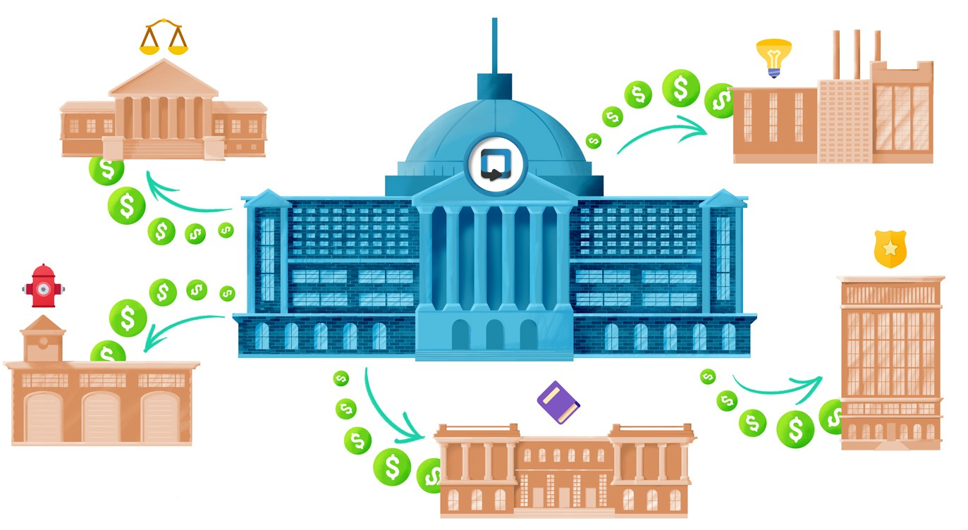
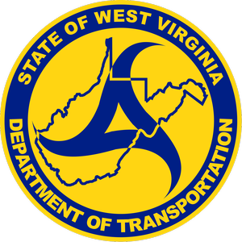
Grants Administrative Unit
Update On Federal Grants
Madisyn Mullins
Division Manager

Slide 2

Patrick Morrisey
Governor
Stephen T. Rumbaugh, P.E.
Secretary of Transportation/Commissioner of Highways
Michael DeMers
Deputy Secretary of Transportation/Deputy Commissioner of Highways
Gehan Elsayed, P.E., Ph.D.
Chief Engineer on Planning and Program Implementation
Timothy Sedosky
Planning Division Director
Brian Carr
Highway Engineer
Madisyn Mullins
Grants Administrative Unit Leader
James Morris
Business Operations Assistant

Slide 3

What We Do
Research
Research federal grant opportunities, consider eligible projects, review the Notice of Funding Opportunities, and apply.
Track
Track all grant awards and previously not awarded applications to consider for future funding.
Collaborate
Establish relationships with other state departments, metropolitan planning organizations, as well as universities and other local entities.
Manage
Submit federal quarterly reports as well as financial reports to the grant program manager.
Execute
Work with the federal grants management and program officers to complete grant agreements and amendments.

Slide 4
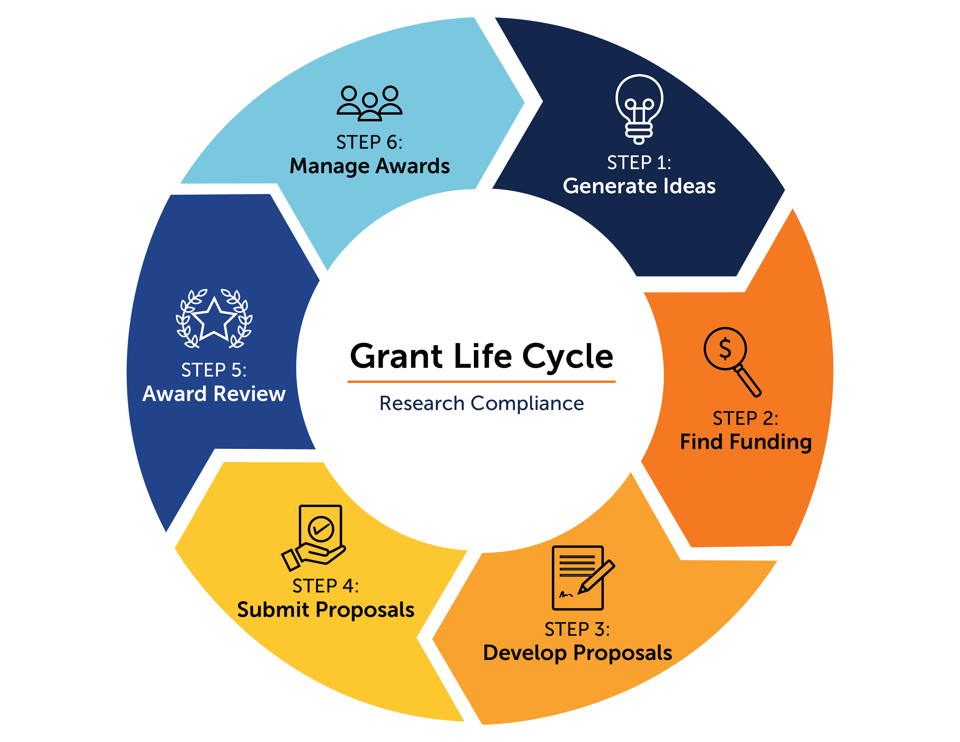
The Grant Process

Slide 5
What is a NOFO?
Every grant cycle begins when the Notice of Funding Opportunity is published.
This document will outline all requirements, important dates, eligibility, and guidance related to the grant opportunity.
It is very important to closely follow the NOFO when preparing a grant application. Key documents or information left out of your application can negatively affect your score during review or disqualify the project entirely.
Typically, the application period will be from 60-90 days.

Slide 6
There’s A Program... AND Acronym For Everything!
Promoting Resilient Operations for Transformative, Efficient, and Cost-Saving Transportation Program (PROTECT)
  Provides funding to ensure surface transportation resilience to natural hazards, including flooding, extreme weather events, and other natural disasters.
Accelerated Innovation Deployment (AID)
  Provides funding to accelerate the implementation and adoption of innovation in highway transportation.
Strengthening Mobility and Revolutionizing Transportation (SMART)
  Projects are focused on advanced smart community technologies and systems to improve transportation efficiency and safety.
Bridge Investment Program (BIP)
  Focuses on existing bridges to reduce the overall number of bridges in poor condition, or in fair condition at risk of falling into poor condition.
Port Infrastructure Development Program (PIDP)
  Projects that improve the safety, efficiency, or reliability of the movement of goods into, out of, around, or within a port.
Roadside Pollinator Program
  Established to provide grants to eligible entities to carry out activities to benefit pollinators on roadsides and highway rights-of-way.

Slide 7
Continued
Consolidated Rail Infrastructure and Safety Improvements (CRISI)
  Provides funding for projects that improve the safety, efficiency, and reliability of intercity passenger and freight rail.
Railroad Crossing Elimination Program (RCE)
  Provides funding for highway-rail or pathway-rail grade crossing improvement projects that focus on improving the safety and mobility of people and goods.
Better Utilizing Investments to Leverage Development (BUILD)
  Provides grants for surface transportation infrastructure projects with significant local or regional impact.
Multimodal Project Discretionary Grant (MPDG)
  Includes multiple programs such as Rural, Infrastructure for Rebuilding America (INFRA), and MEGA.
Competitive Highway Bridge Program (CHBP)
  Provides grants to States that have a population density of less than 115 individuals per square mile and less than 26 percent of total bridges classified as in good condition.
Wildlife Crossings Pilot Program (WCPP)
  Focuses on reducing Wildlife Vehicle Collisions (WVCs) while improving habitat connectivity for terrestrial and aquatic species.

Slide 8
Pre-Award Phase
Notice of Funding Opportunity (NOFO) is announced.
Register to apply
Review all required documents, eligibility, and narrative criteria.
Complete your application.
Application review process begins.
Award announcement made after review.

Slide 9
Award Phase
Notice of award.
A grant agreement template is sent. This begins the process of executing the grant agreement.
This process can take up to 18 months on average.
Kick off call with federal program manager is scheduled.

Slide 10
Post Award Phase
Reporting
Most grant programs will require quarterly progress and financial reports to be completed.
Auditing
This ensures compliance with funding agreements and proper usage of funds.
Close-Out
This process will take place once all work is completed and the grant funds have been expended.

Slide 11


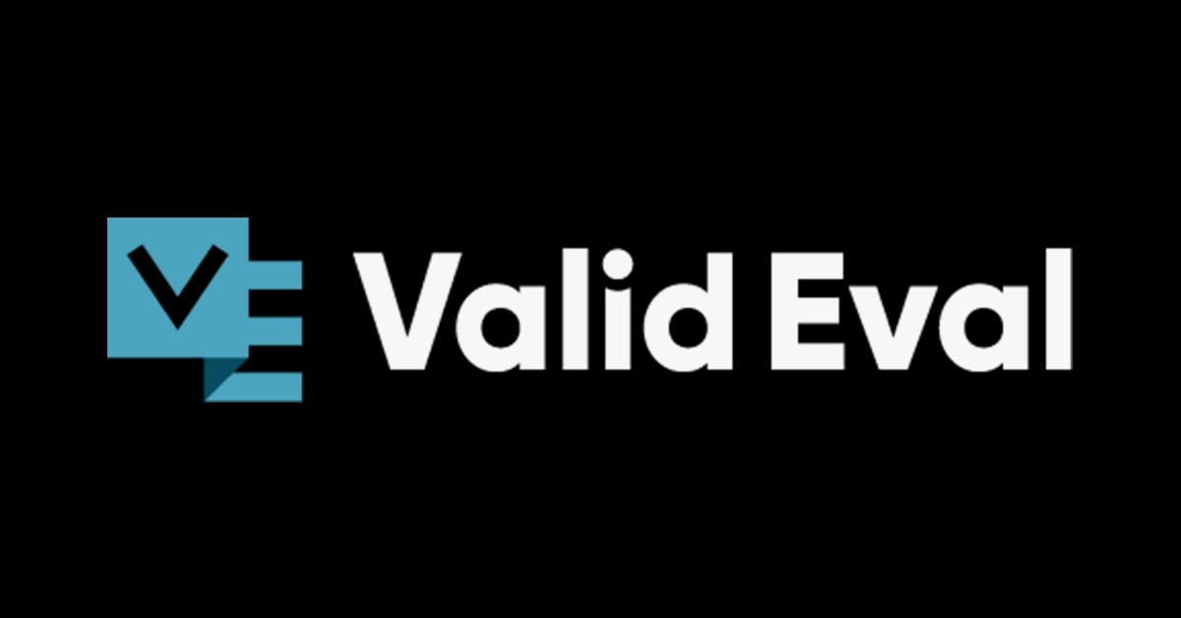
Grant Resources
Grant opportunities are released by many different federal entities on various federal sites. It is important to refer to the NOFO for each program to determine where to apply and who the grant will be managed through
  Federal Railroad Administration, Federal Highway Administration, etc.
Grants.gov is not only a great website to research grant opportunities, but also to find helpful resources.
While Grants.gov is the site most are applied through, FEMA GO, and Valid Eval are a few others that are used as well.

Slide 12
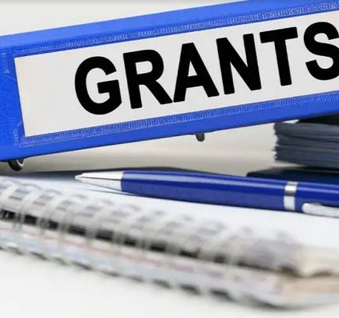
Grants.gov Walkthrough
Please note that to apply through Grants.gov, you must have a SAM.gov number.
How to search for grants.
How to create a workspace.
How to apply for a grant.

Slide 13
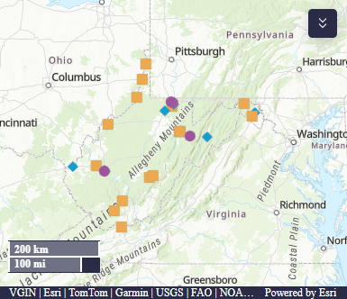
Overall Wins (Since 2019)
Congressionally Directed Spending
$38,913,000
West Virginia Department of Transportation Grants
Various programs such as INFRA, RURAL, RAISE, SMART, PROTECT, RCE, CRISI, BIP, AID
$649,817,283
Non-Department of Transportation Grants
Other State and Local entities.
FLAP, RAISE, Safe Streets For All, etc.
Estimated total is $88,985,159

Slide 14
Recent Wins
Competitive Highway Bridge Program
$65M
Dunbar Toll Bridge replacement and Kanawha Turnpike I-64 Overpass rehabilitation
Port Infrastructure Development Program
$23M
Nucor Steel West Virginia Material Handling Terminal
Better Utilizing Investments to Leverage Development Program
$24.8M
Statewide Truck Parking Strategy Project
Bridge Investment Program
$87M
Replacement of Market Street Bridge

Slide 15
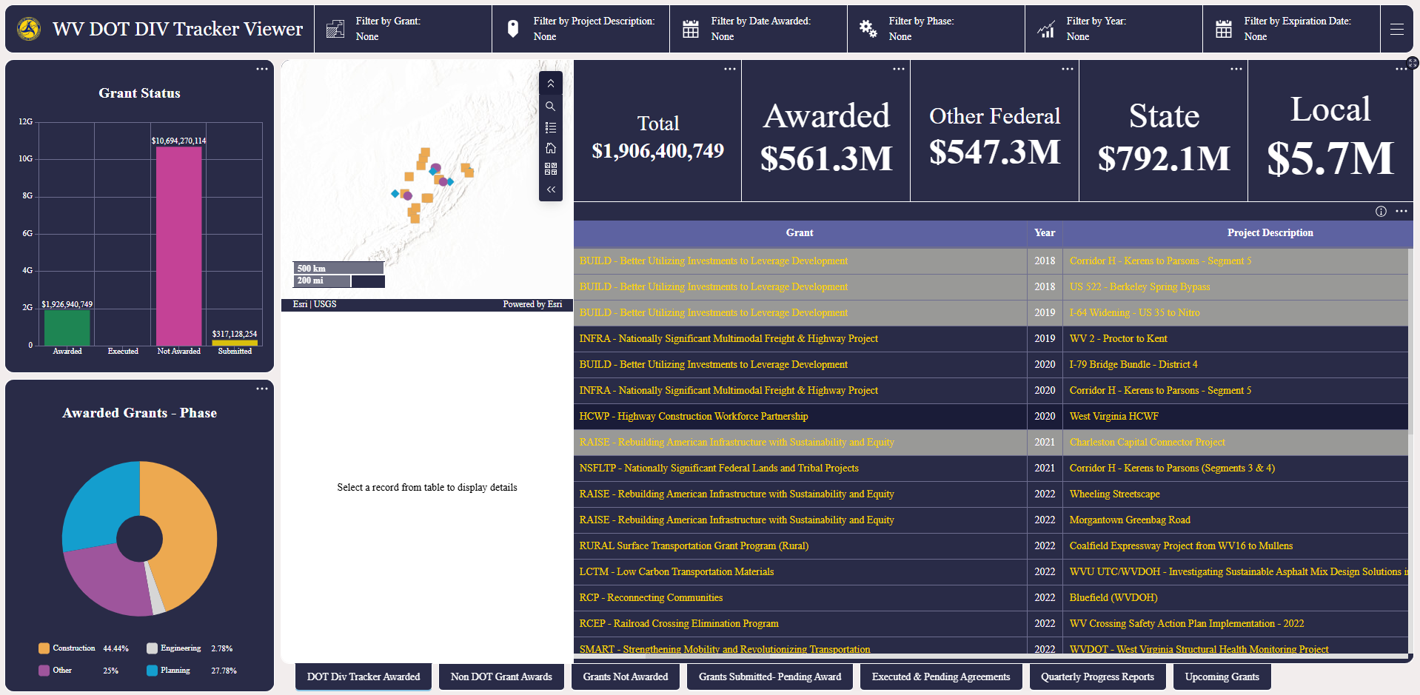
Grants Dashboard Example
This screenshot is from the “grants not awarded” tab.
Totals may take up to 24 hours to appear in the dashboard.

Slide 16
Questions?
If you have a project and need help finding a funding opportunity that fits, please reach out to our team!

Slide 17
Contacts
Madisyn Mullins
Grant Administrative Unit Leader
304-414-6915 Madisyn.t.mullins@wv.gov
James Morris
Business Operations Assistant
304-205-6202 james.w.morris@wv.gov
Gehan Elsayed
Chief Engineer on Planning and Program Implementation
304-414-6912 gehan.m.elsayed@wv.gov

