Slide 1


Walk & Ride:
Mountains
to Mainstreets
Building a Statewide Active Transportation Roadmap

Slide 2
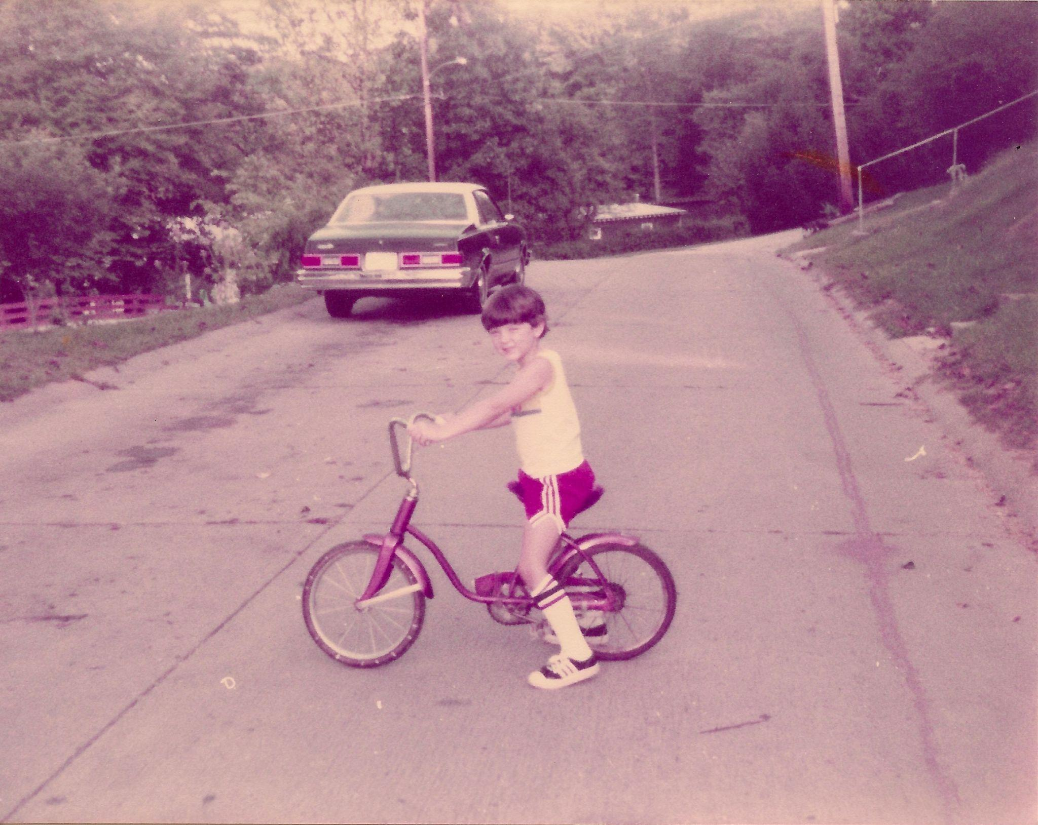
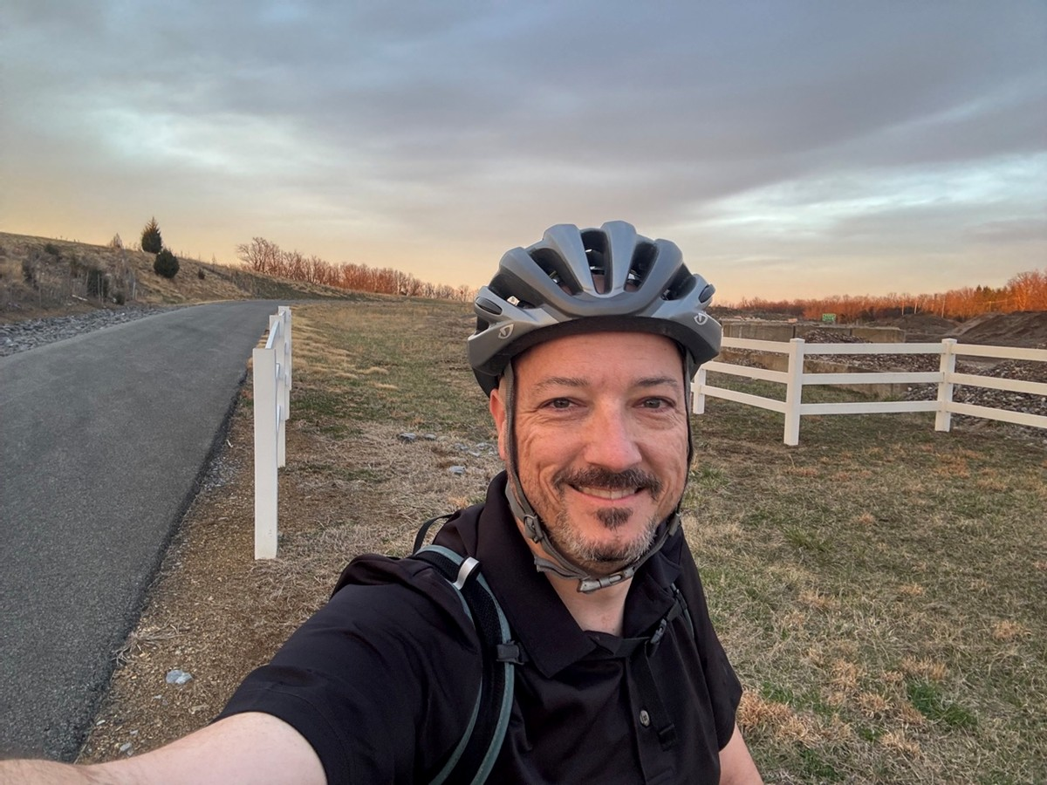
Introductions: Mike Dodd
26 Years
of Transportation Experience
16 Years
Of WVDOH Experience
2.5 years
Bicycle and Pedestrian Coordinator Experience

Slide 3
Transportation History

Slide 4
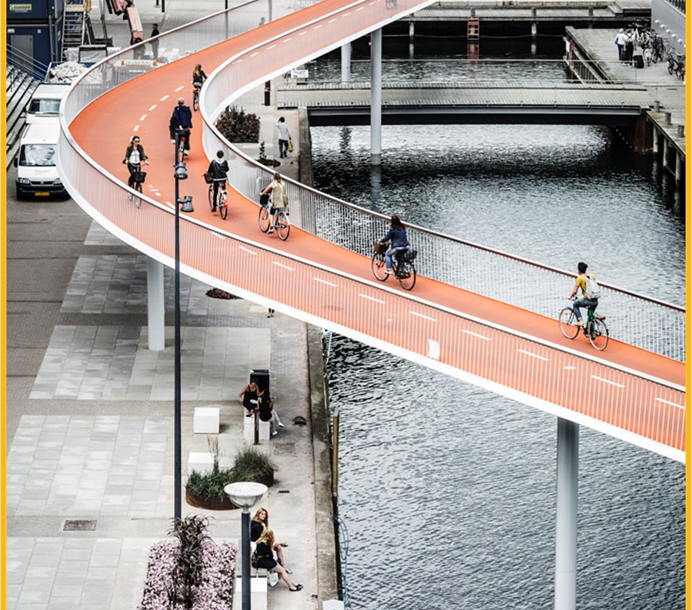

Ideal Bicycle and Pedestrian Infrastructure?
Kanawha Boulevard Trail, Charleston

Slide 5
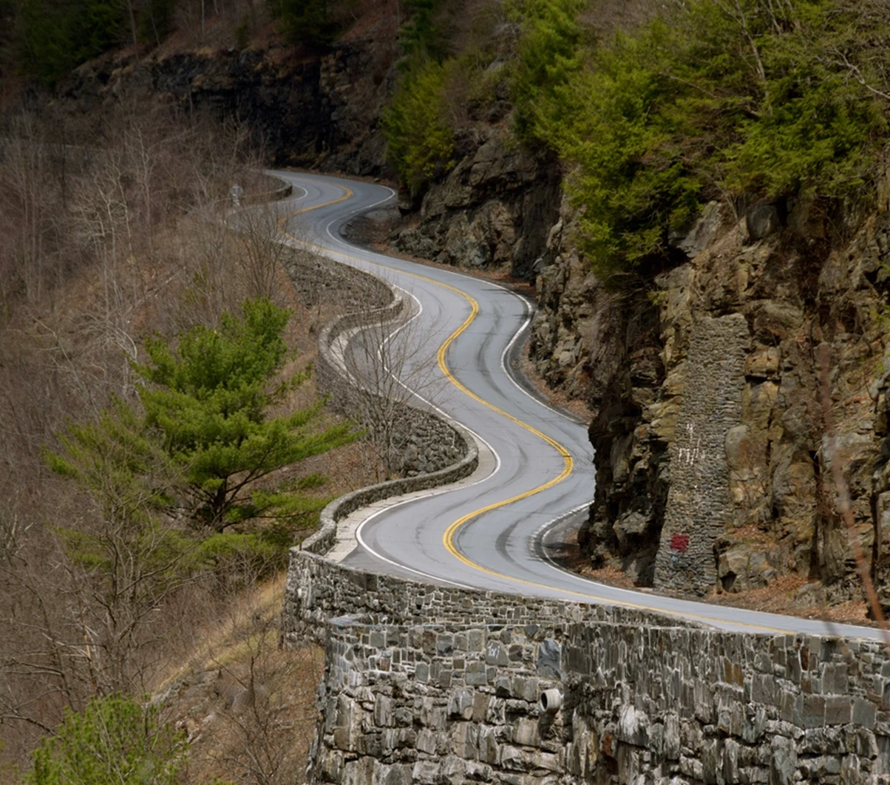
This is
West Virginia
Kanawha Boulevard Trail, Charleston

Slide 6
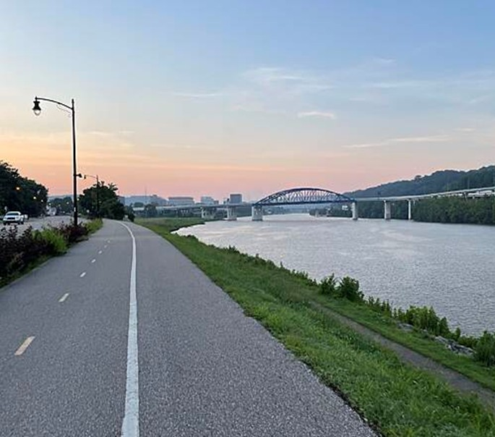
This is also
West Virginia
Kanawha Boulevard Trail

Slide 7
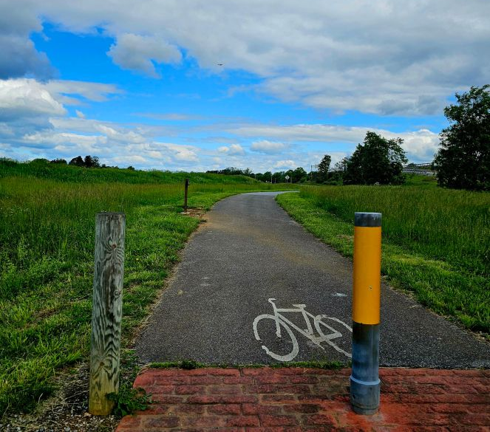
This is also
West Virginia
Kanawha Boulevard Trail, Charleston
Route 9 Bike Path

Slide 8
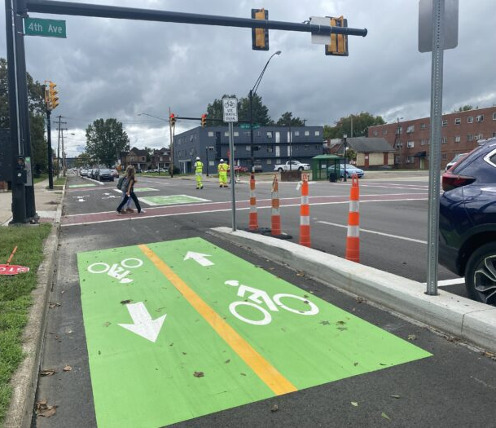
This is also
West Virginia
Hal Greer Boulevard, Huntington
Source: Randy Yohe/West Virginia Public Broadcasting

Slide 9
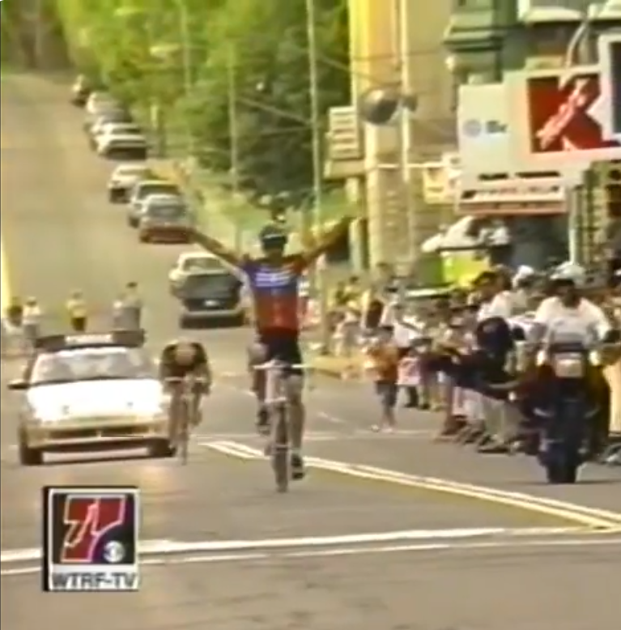
West Virginia
is a Cycling Destination
Kmart Classic Stage Race: 1990s

Slide 10
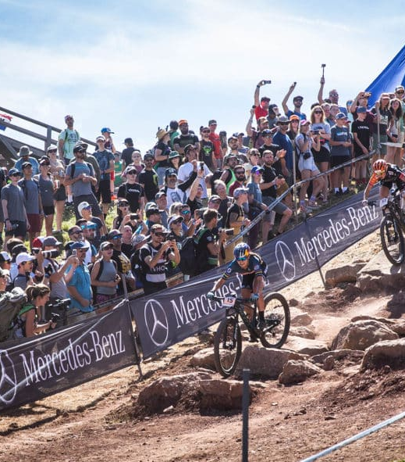
West Virginia
is a Cycling Destination
Mountain Bike World Championships Snowshoe: Today
Notes:
Snowshoe hosted the Mountain Biking World Cup in 2022. West Virginia University reported that spending by event attendees totaled more than $2.2 million and expenditures contribute more than $3.2 million in business volume.

Slide 11
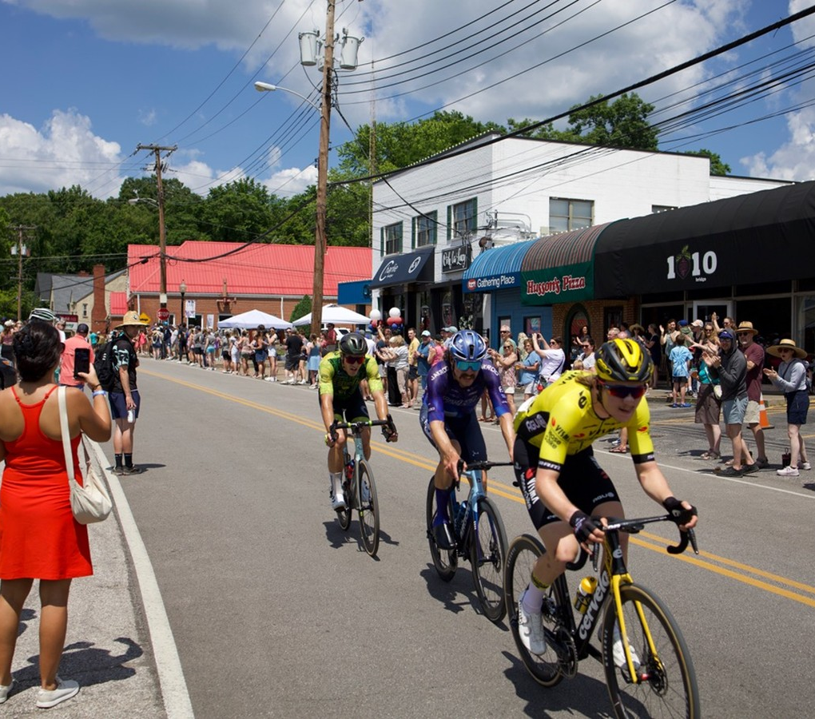
Source: Randy Yohe/West Virginia Public Broadcasting
West Virginia
is a Cycling Destination
USA Cycling Pro Road National Championships
Notes:
The City of Charleston reported that the event increased 50% from 2024 to have a $6.9 million economic impact during the 2025 event.

Slide 12
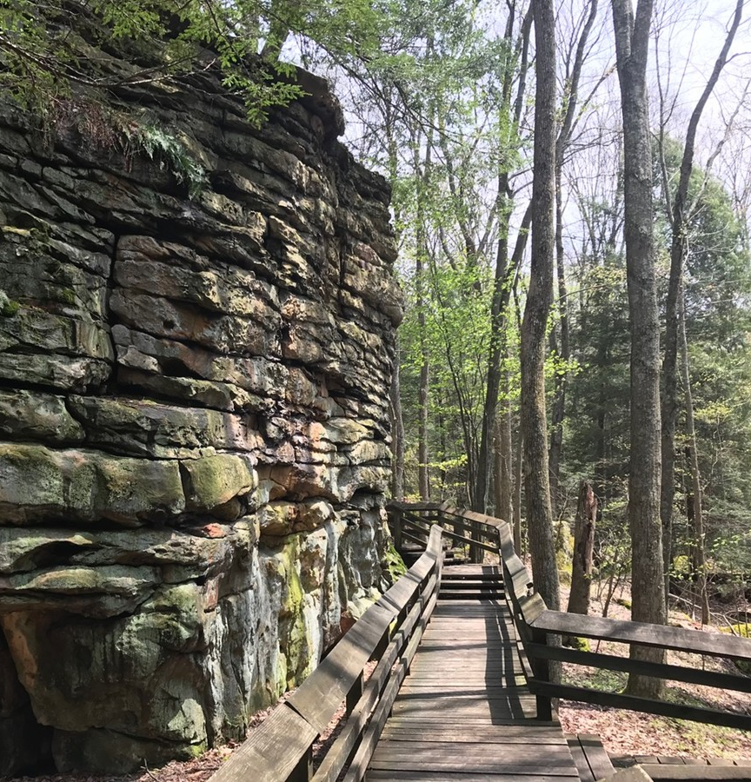
West Virginia
is a Destination
for Trails
Bear Town State Park

Slide 13
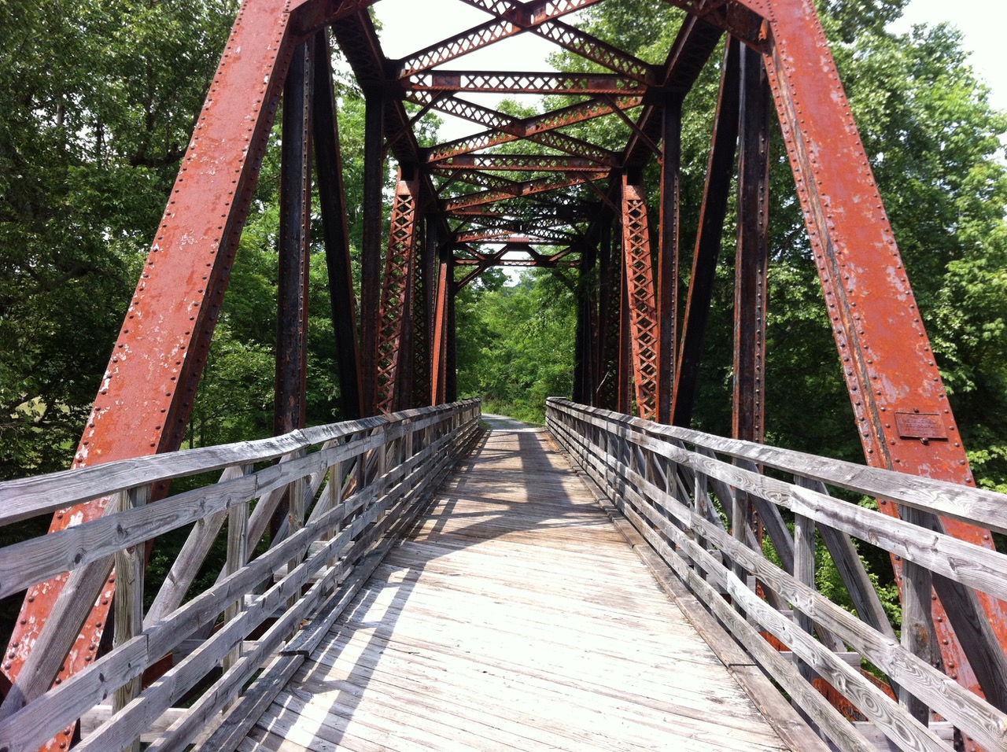
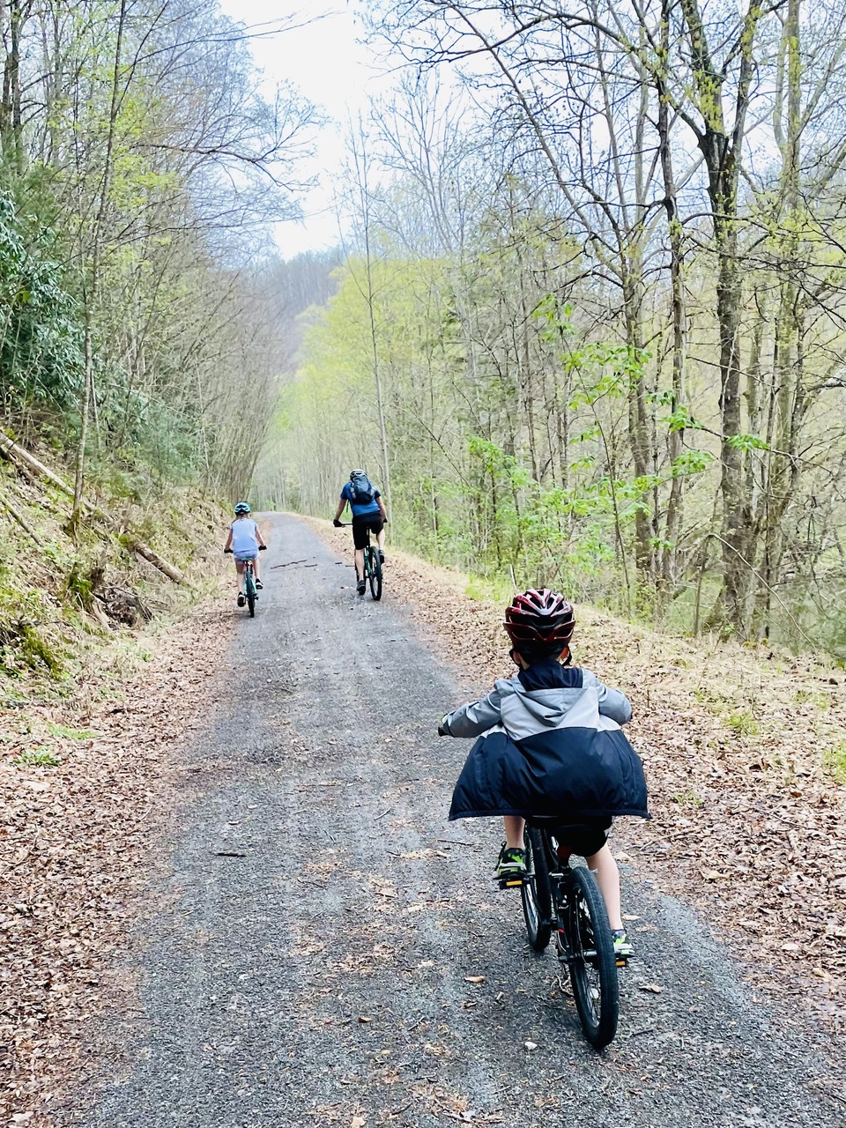
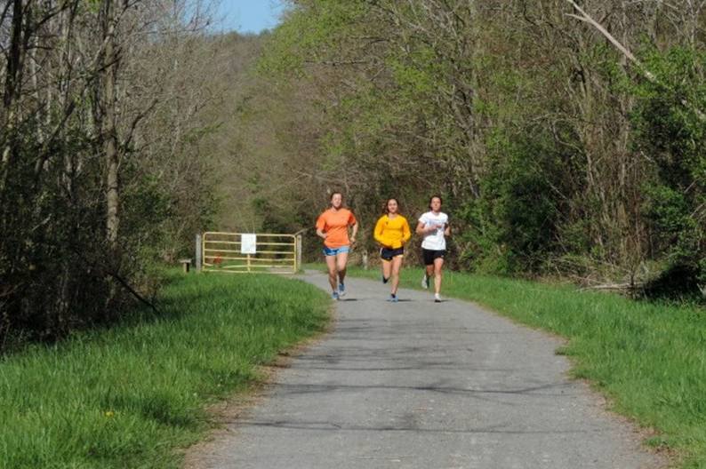
West Virginia Rails to Trails
Source: wvtrails.org
Greenbrier River Trail
Elk River Trail
Mon River Rail-Trail

Slide 14
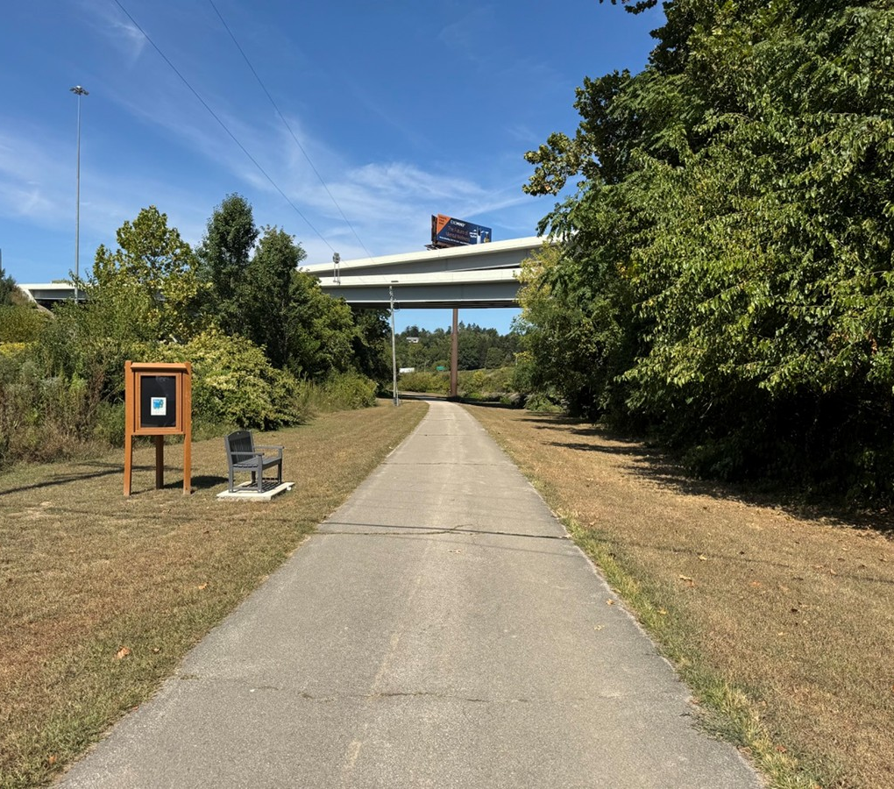
West Virginia
has Community Connections
Wheeling Heritage Trail
Notes:
4 miles

Slide 15
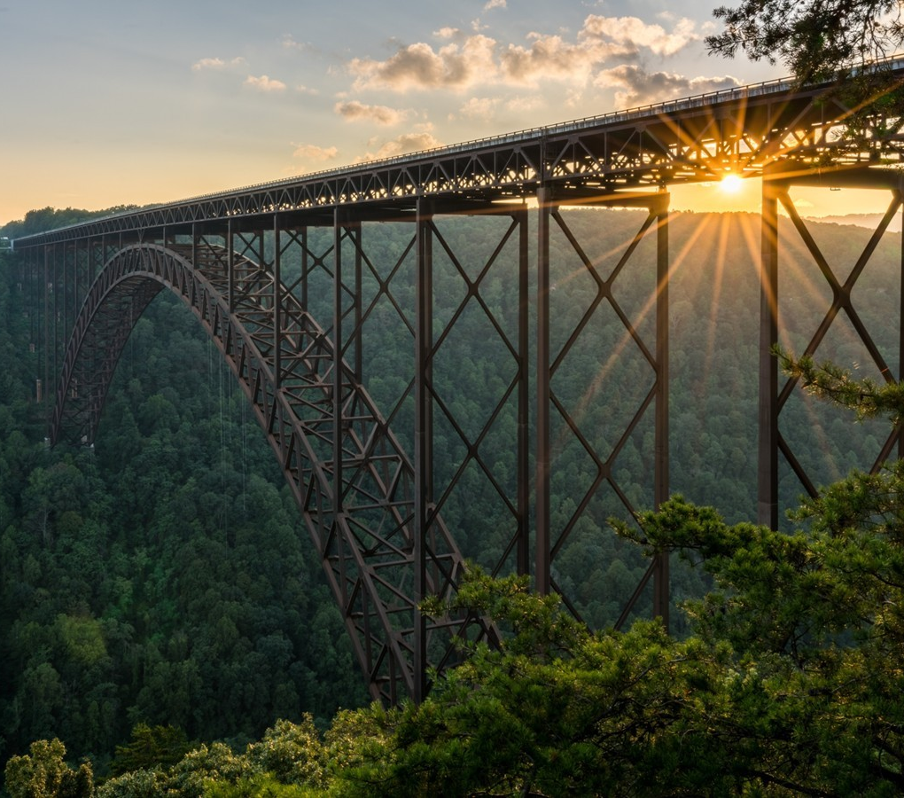
West Virginia
is an Outdoor Recreation Destination

Slide 16
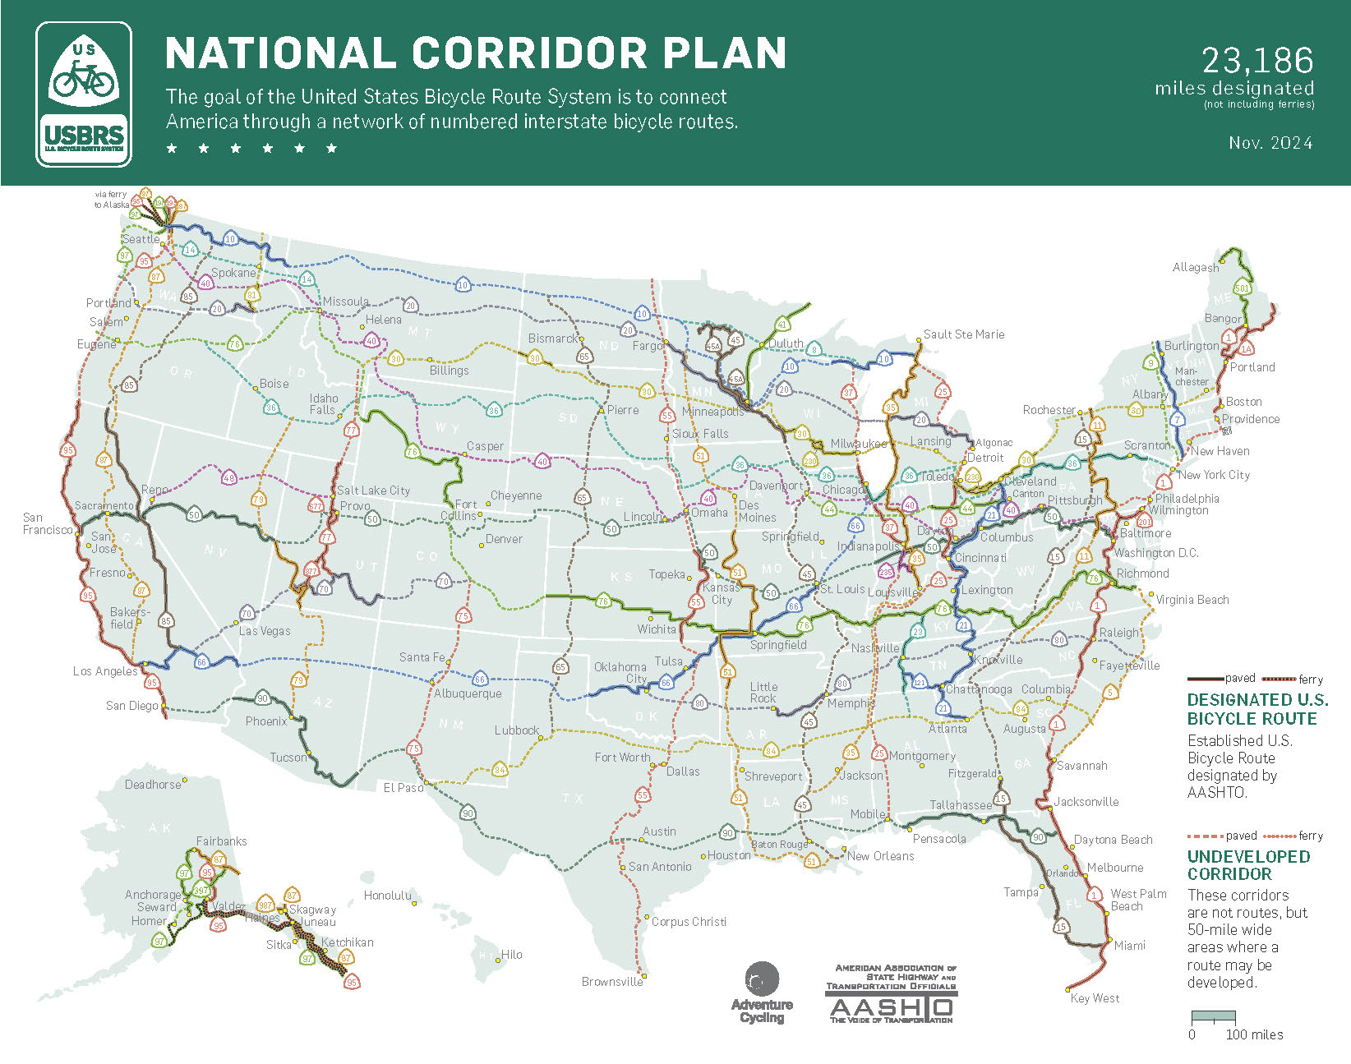
West Virginia
US Bike Routes

Slide 17
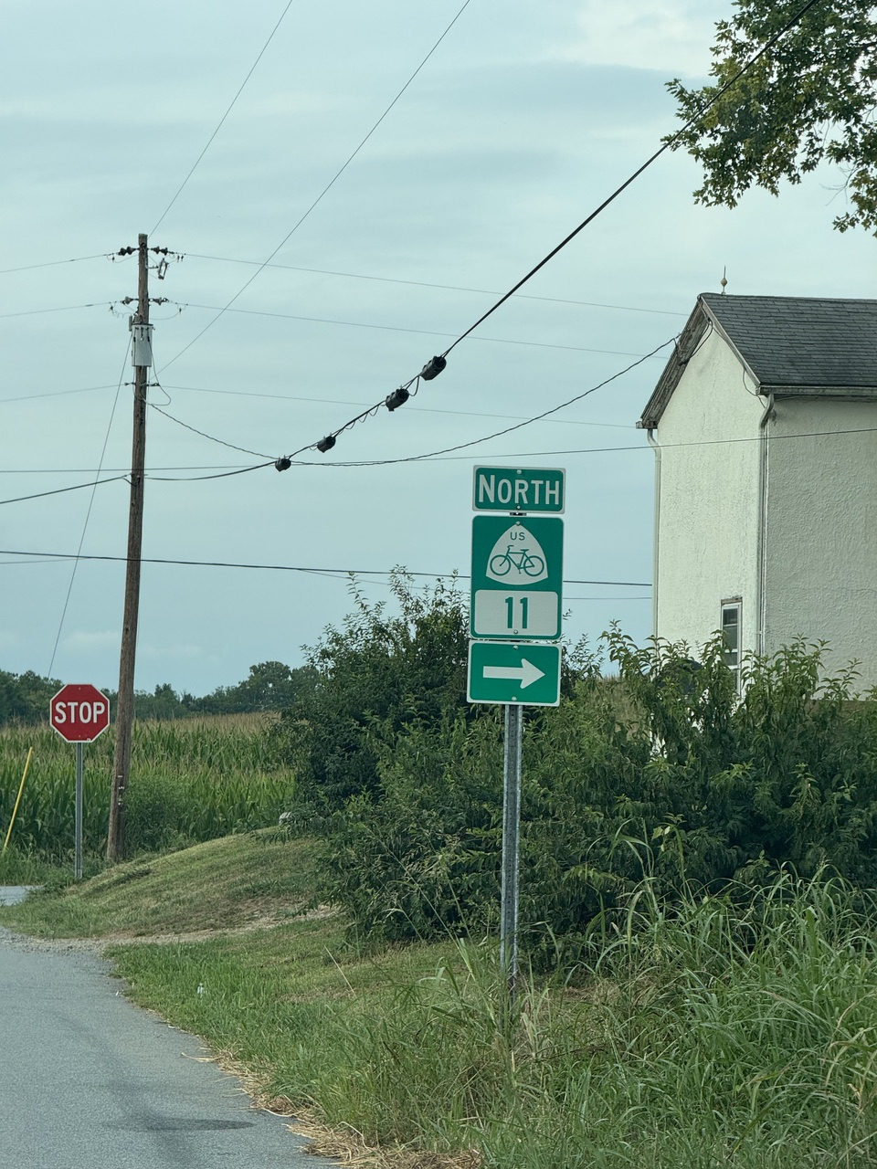
USBR 11
Virgina and Maryland

Slide 18
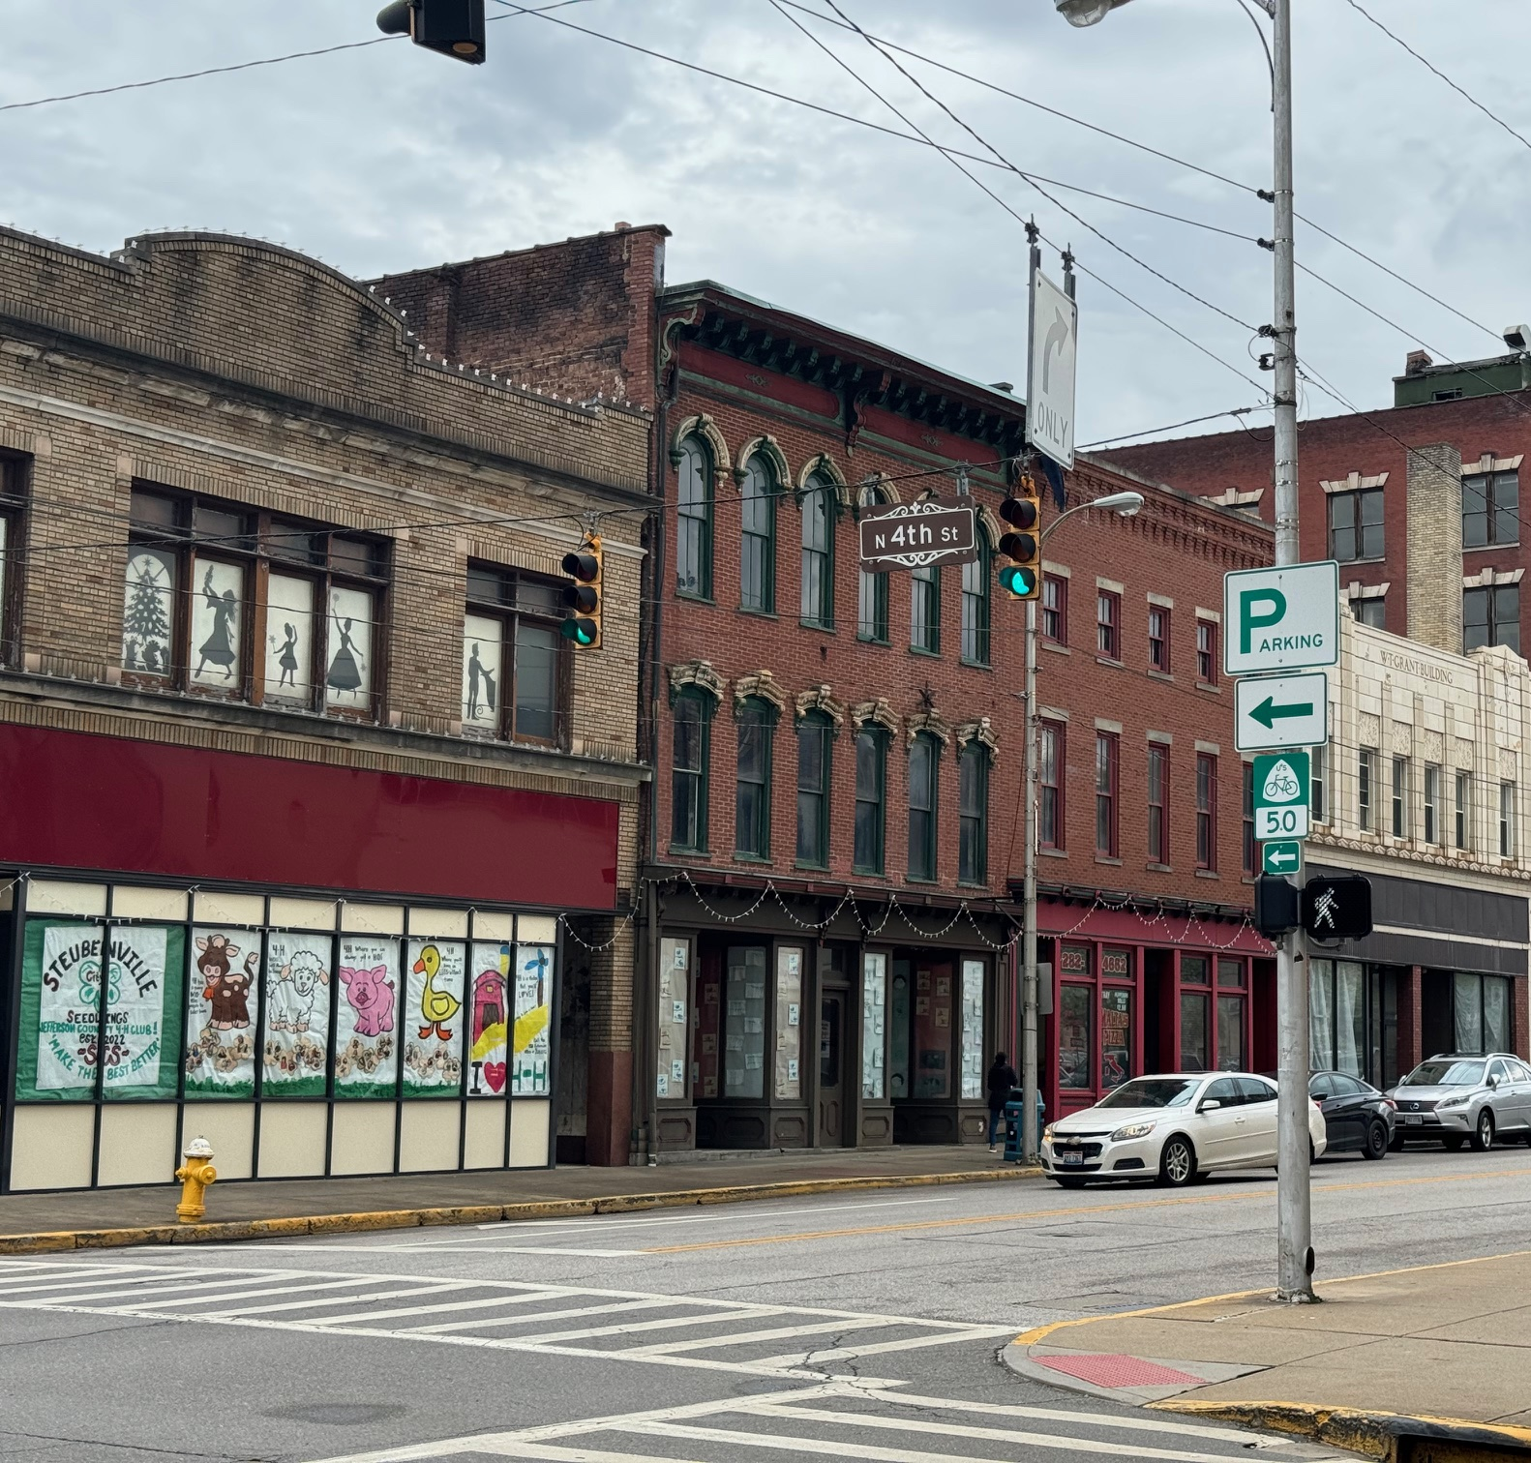
USBR 50
Ohio and Pennsylvania

Slide 19



Updating the Statewide Plan
2017
1997
Notes:
1991 under the Intermodal Surface Transpiration Efficiency Act (ISTEA) it was mandated each state appoint a coordinator dedicated to bicycle and pedestrian programs

Slide 20
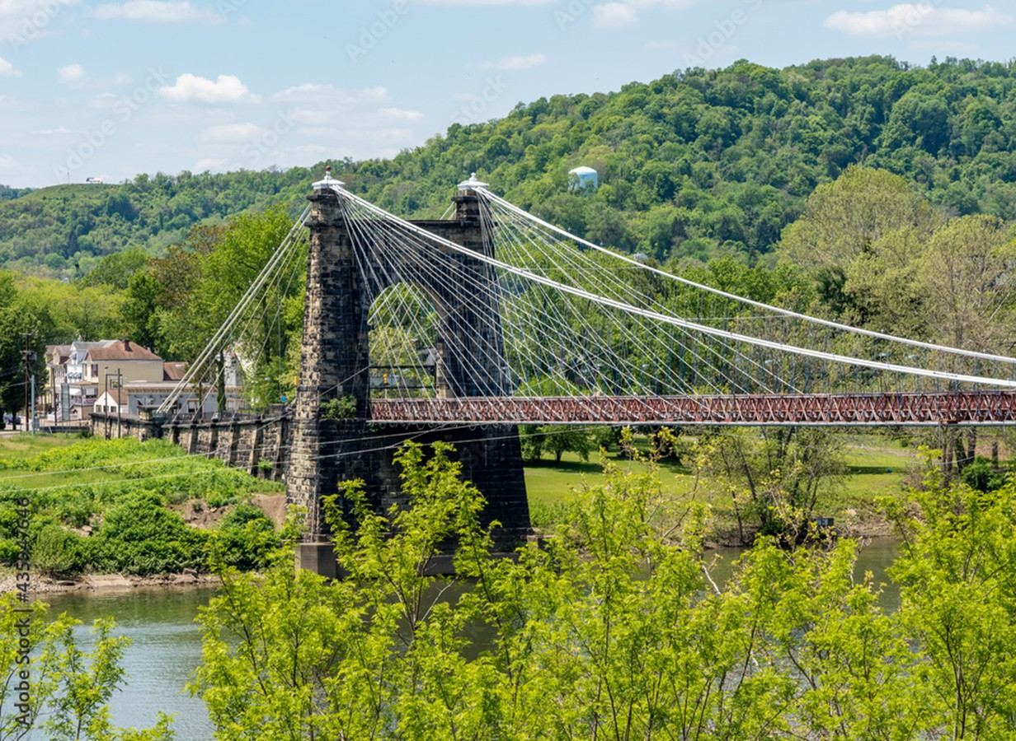
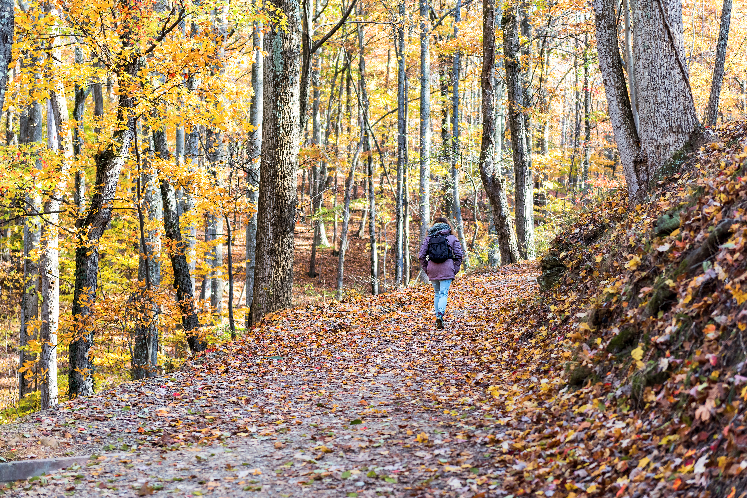
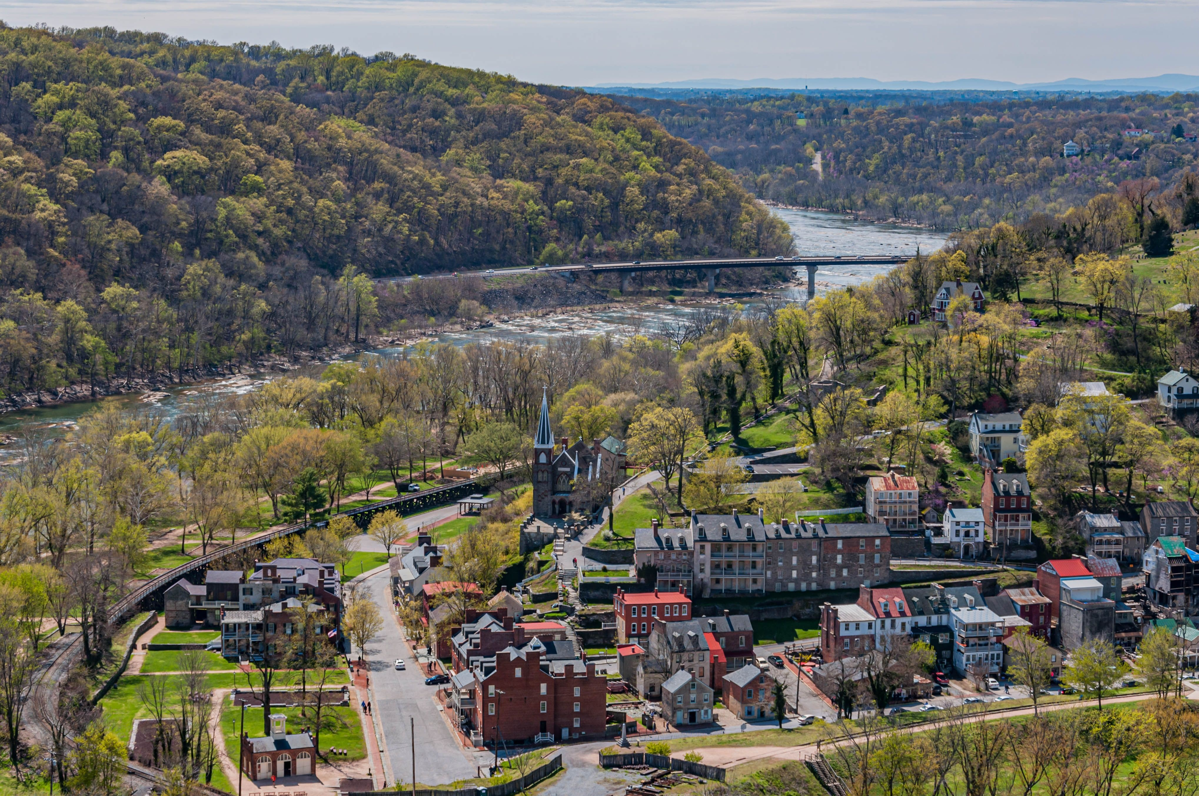
Statewide Bicycle and Pedestrian
Plan Goals
Connect people to safe, accessible, and comfortable active transportation infrastructure
Support healthy communities through infrastructure that is friendly to people of all ages and abilities
Enhance economic vibrancy by connecting people with our main streets, downtowns, and natural treasures

Slide 21
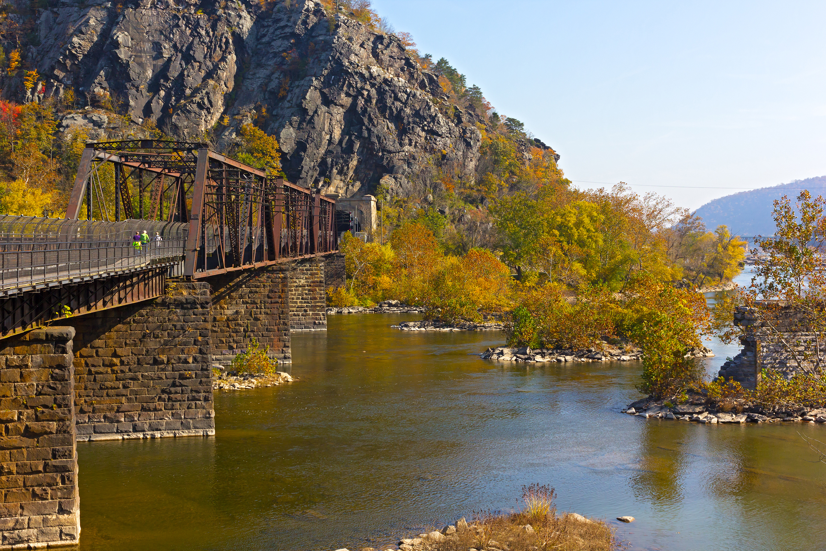
Plan Objectives and Strategies
Investments
Policies
Procedures
Designs
Programs
Partnerships

Slide 22
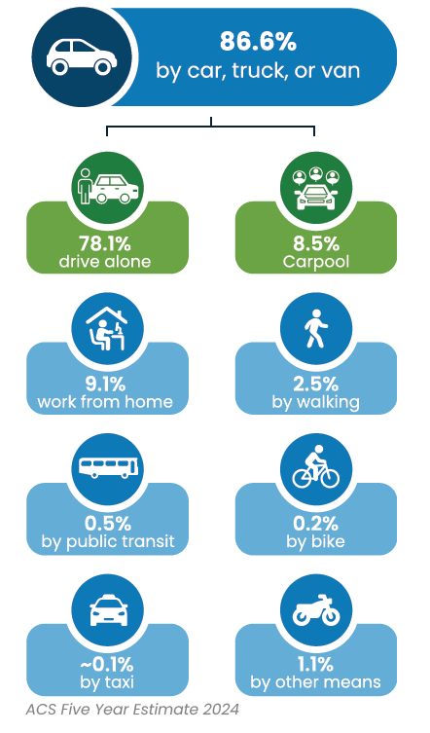
The Case for Active Transportation
Changing population
Health outcomes
Economic and workforce trends
Tourism and outdoor recreation

Slide 23
Active Transportation Assets
Mobility
Approximately 5,000 miles of trails
18 Public Transit Agencies
Outdoor Assets
36 State Parks
9 State Forests
National Assets
National Park and Preserve
National Scenic River
National Recreation Area
National Historic Trail
National Scenic Trail

Slide 24
Active Transportation Context
Downtowns
Adventure Cycling and Hiking
Rails to Trails
Campuses
Mainstreets

Slide 25
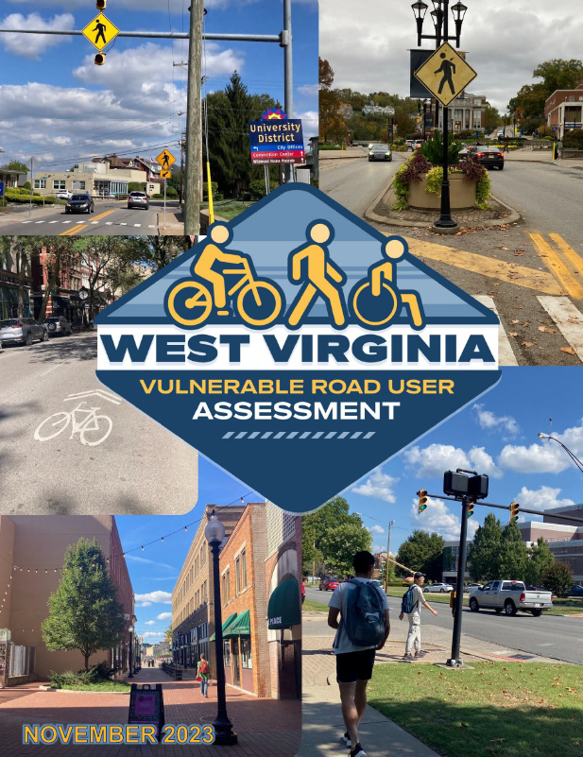




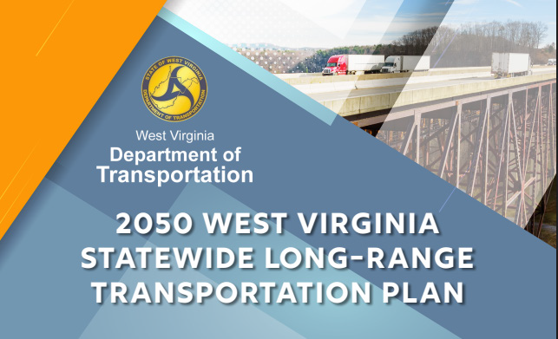
Connecting Statewide Work with
MPO Priorities

Slide 26

Mentimeter Time

Slide 27
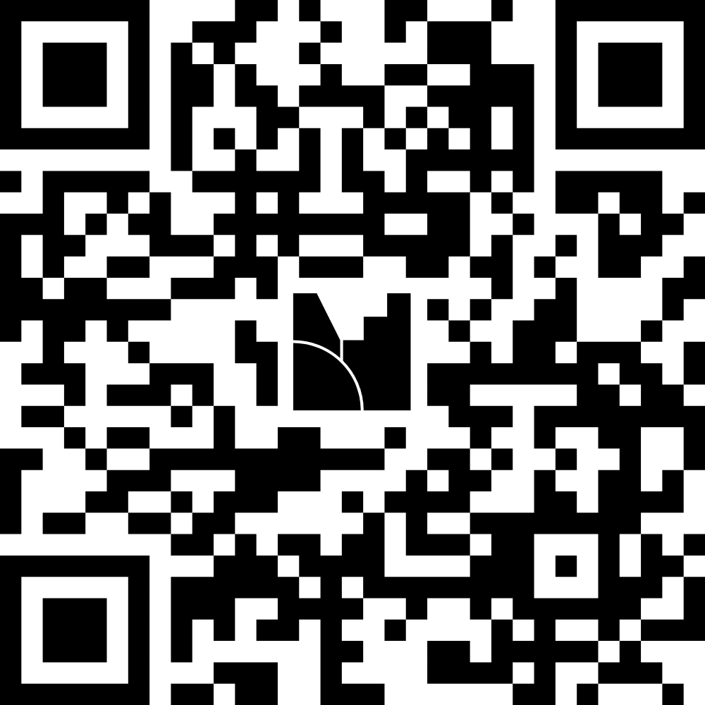
Mentimeter
Questions:
Before today, were you familiar with US Bicycle Routes?
What active transportation opportunity should the statewide plan make sure we do not miss?
What should be the top priority for improving walking and biking in West Virginia be?
What is the biggest barrier to active transportation in your area?

Slide 28
Deliverables
Data Analysis & Gap
Identification
Safety Analysis
Demand and Activity Generator Analysis
Statewide Active Transportation Analysis
Strategy and Actions Identification
Strategies and Actions
Safety Countermeasures Toolbox
Summary Action Plan
Policy and Program Diagnostic
Documentation and Storymap

Slide 29
Next Steps
June | July | Aug | Sept | Oct | Nov
Data Analysis & Gap Identification
Policy and Program Diagnostic
Documentation and Storymap
Strategy and Action Identification
Project Management and Engagement

Slide 30

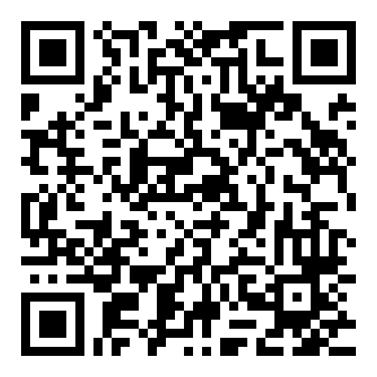
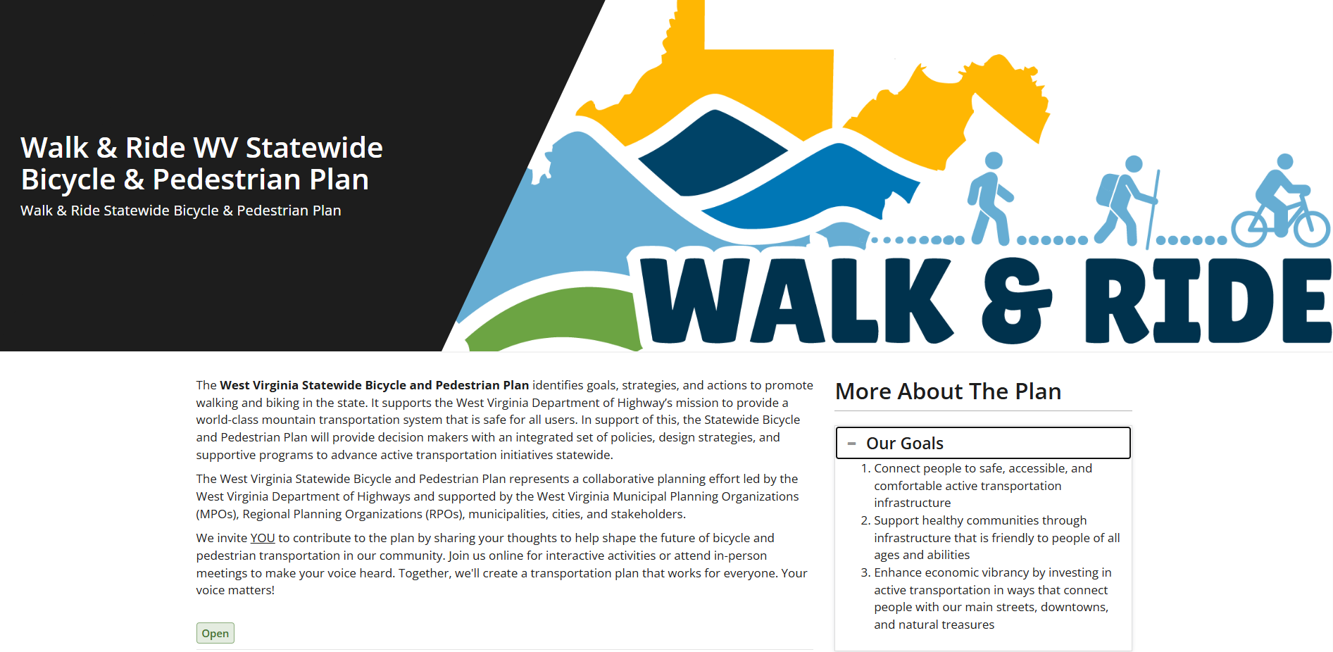
Summer Survey
Pssst! | Come by our table for more information

Slide 31

Engagement Events
Morgantown
  The Met Theatre
Weirton
  Thursday, June 4th
  4-6pm
Shepherdstown
  June 24th

Slide 32
Thank you!
Mike Dodd
Kate Cavazza
WVDOH
michael.a.dodd@wv.gov
Kimley-Horn
kate.cavazza@kimley-horn.com

