Slide 1
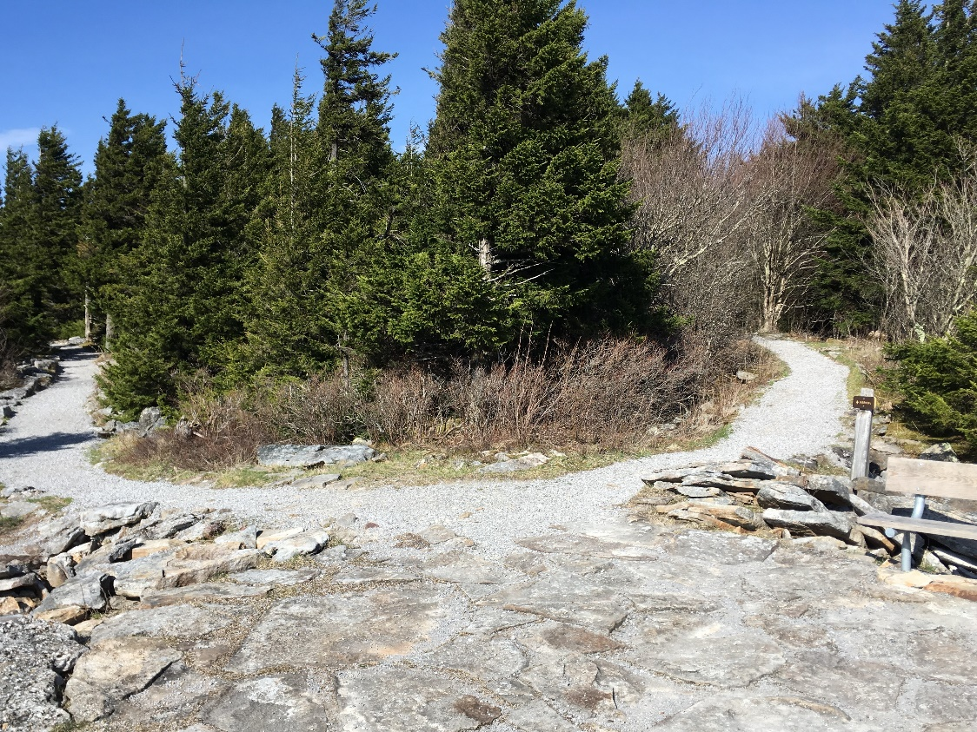
Transportation Alternatives/Recreational Trails Program
2026 WEST VIRGINIA PLANNING CONFERENCE
JUNE 2-4, 2026 MORGANTOWN
Notes:
Peer Exchange - Presentation is a precursor to the Peer Exchange with Wyoming, Ohio, PennDOT, Maryland, Virginia
Background and context and hope not to be duplicative with what the audience knows about our processes.
Stewards of Money / Differing Federal Requirements - We are the stewards of the taxpayers money and as such, have a moral and ethical responsibility, but also a statutory responsibility. It has become apparent through working with other federal agencies that the intent in managing the funds are essentially the same, but the requirements, i.e., checks and balances, can differ significantly. This can create some consternation when a sponsor receives funds from one federal agency with limited boxes to check in a process to the ones the WVDOH are tasked with through FHWA. Sponsors are not necessarily the most appreciative of the difference.
Local Public Agency purpose is to provide instruction and information needed for managing or administering local Federal-aid and State-aid transportation projects under the supervision and assistance of the WVDOT.

Slide 2
Transportation Alternatives (TA)/
Recreational Trails Program (RTP)
Transportation Alternatives (TA) Eligible Projects :
  A reimbursable program for non-traditional transportation projects.
  Includes funding for design and construction.
  On road and off-road trail facilities connecting two points for pedestrians, bicyclists and users of other nonmotorized.
  Sidewalks, bicycle infrastructure, pedestrian & bicycle signals, traffic calming techniques, lighting and other safety related infrastructure.
  Conversion of abandoned railroad corridors for trails.
  Turnouts, overlooks and viewing areas, inventory, control or removal of outdoor advertising, historic preservation and rehabilitation of historic transportation facilities and environmental mitigation activities.

Slide 3
Transportation Alternatives (TA)/
Recreational Trails Program (RTP)
Recreational Trails Program (RTP) Eligible Projects:
  Maintenance and/or restoration of existing trails.
  Development and/or rehabilitation of trailside and trailhead facilities and trail linkages.
  Purchase and/or lease of trail construction and maintenance equipment.
  Acquisition of easements or property for trails (willing seller only: Condemnation is prohibited).
  Operation of education programs to promote safety and environmental protection related to trails.
  Assessment of trail conditions for accessibility.
  Construction of new trails (with restrictions for new trails on Federal lands).

Slide 4
FFY 2025 Program Overview
60 TA applications requesting approximately ~$25M Federal. ($10.2M apportionment)
43 RTP applications requesting approximately $~6M Federal. ($1.2M apportionment)
On-line competitive grant application process.
Timelines - Grant cycle dates for opening and closing.
Eligibility – check your eligibility (TA nonprofit entity - New: restrictions removed).
Matching requirements – 80% Federal / 20% Sponsor Match.
  Cash Match. Force Account. Local Volunteers , ex. Trail Groups - “In-Kind”.
  WVDOH Contract Administration – Cash Match in advance and WVDOH will Bid/Let/Oversee the project.
  FHWA-encourages the use of contracts and co-operative agreements with qualified Youth Service and Conservation Corps.
  Sponsor advertised project (still must meet federal requirements).

Slide 5
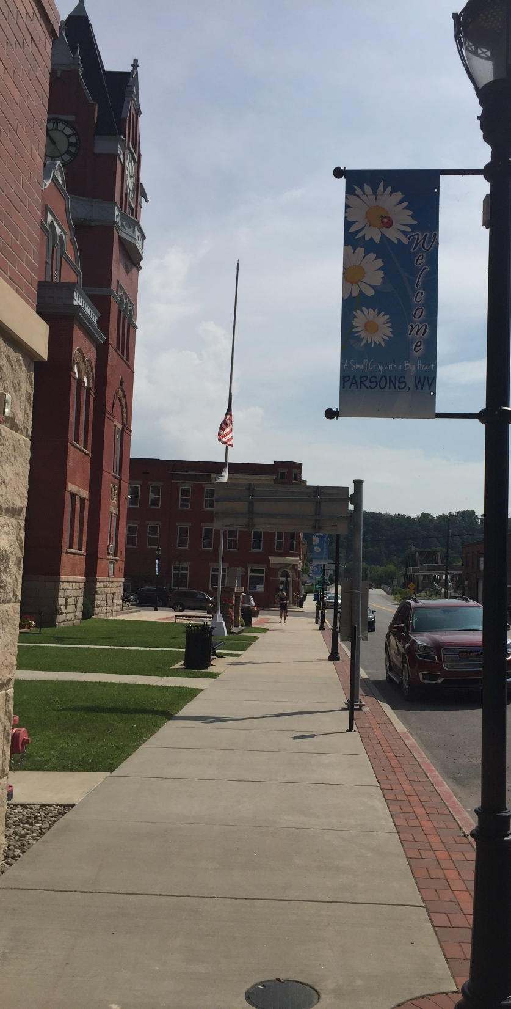
Transportation Alternatives (TA)/ Recreational Trails Program (RTP)
FFY 2026 Grant Cycle Opening Soon- June 2026
Applicants Must Register
    Email with Press Release / Timeline Dates will be sent to those registered
Intent to Apply Opening
    Open: Summer 2026
    Close: Two – Three-week period
Application Deadline
    Close: ~ 1.5 months

Slide 6
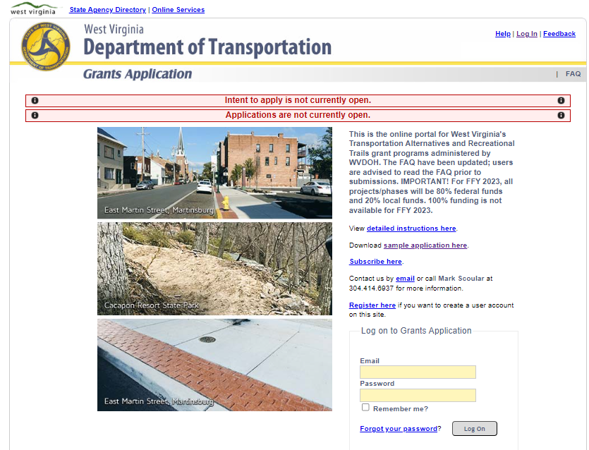
dohgrants.wv.gov
Notes:
Currently controls TA and RT applications
Scheduled for upgrades
Organizational help

Slide 7
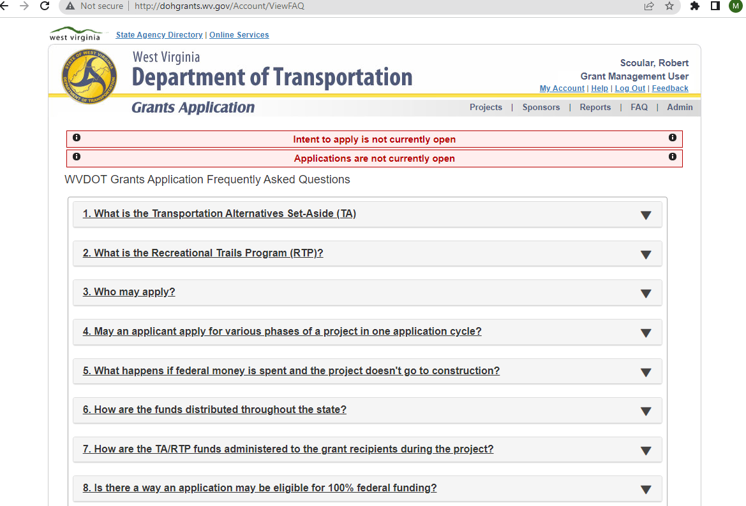
dohgrants.wv.gov

Slide 8
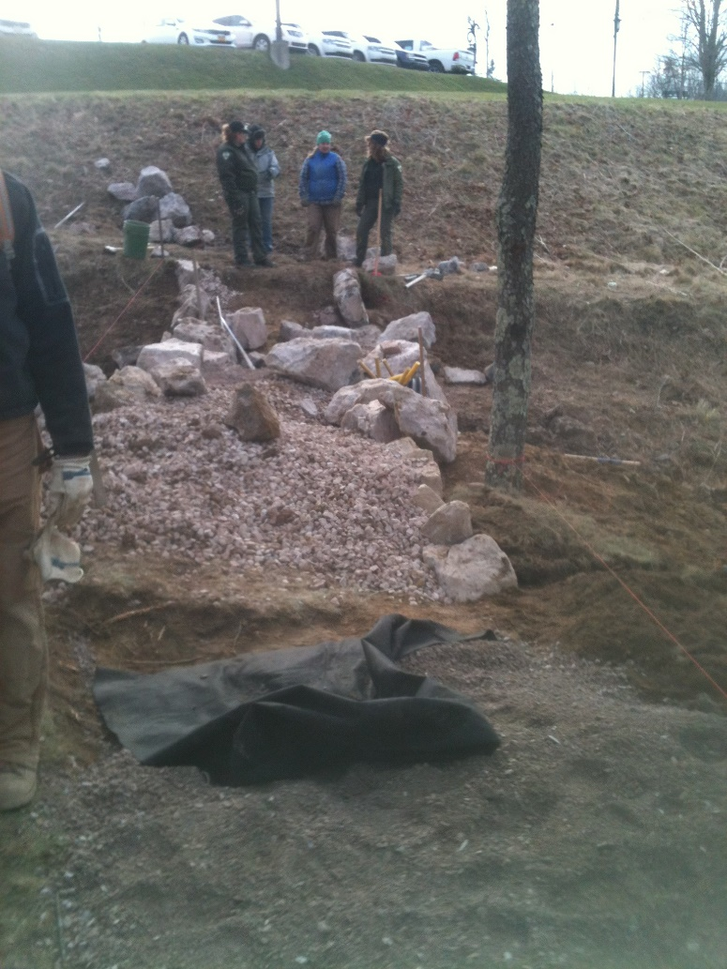
Application Tips
Clearly defined scope of work, project description and termini;
Environmental considerations, ex. permitting, archeology study
Previous studies, reports;
Map outlining work limits;
Quality updated photographs;
Previous studies, reports, etc.
Detailed cost estimate;
Right-of-way secured or, at minimum, considered;
Letters of recommendation.

Slide 9
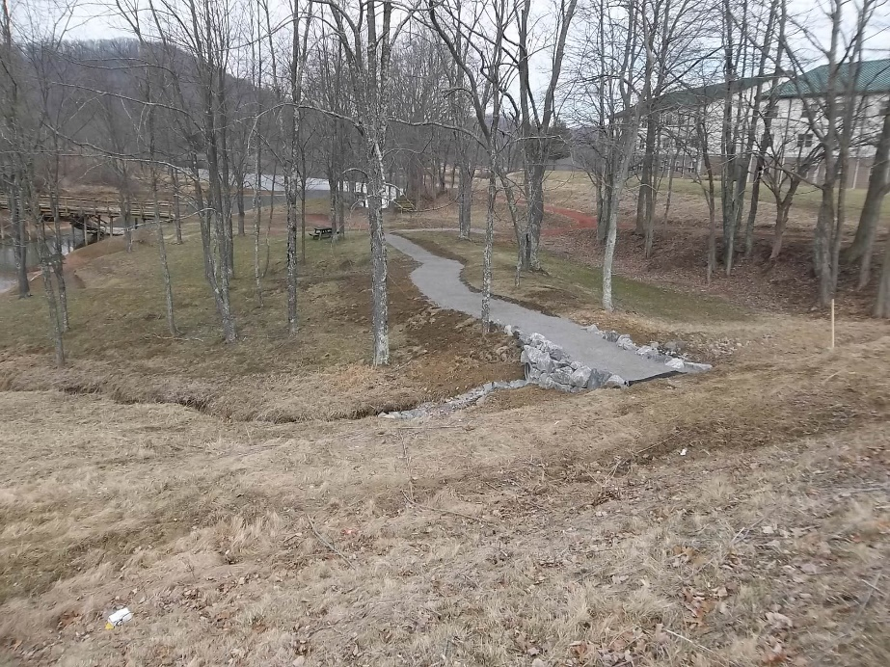
Less Competitive Applications
“Sidewalks throughout Town”;
Environmental considerations not accounted for;
Utility relocation is major work item;
Beautification only projects;
Inadequate documentation;
Insufficient funds being requested.

Slide 10
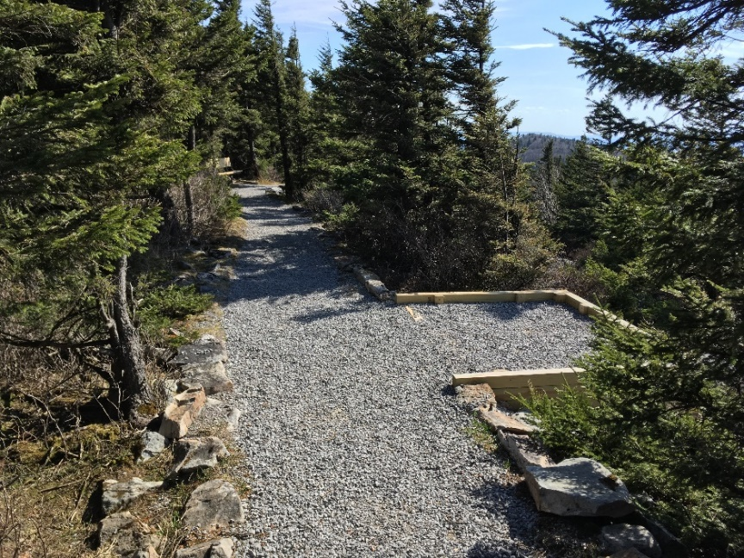
RTP Application Scoring
Recreational Trails Advisory Board Representatives
  Division of Natural
  Resources
  Department of Commerce
  Bicycle, outdoor enthusiasts
  Non-motorized and motorized
  representatives
  West Virginia DOT
Whispering Spruce Trail, Spruce Knob
dohgrants.wv.gov

Slide 11
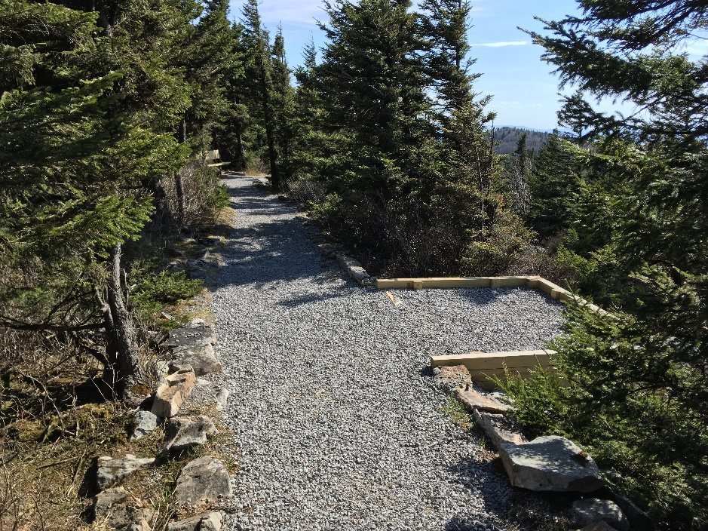
TA Application Scoring
Diverse Scoring Committee
Base Scoring (100 points)
  Accessibility and Mobility
  Quality of Life/Health
  Safety and Security
  Economic Vitality
  Partnership
  /Regional Significance
Whispering Spruce Trail, Spruce Knob
dohgrants.wv.gov

Slide 12
Matching Funds
  Cash Match
  Pay up front.
  Pay as you Go.
  Force Account – City / County full time employees.
  In-Kind
  Volunteer Labor.
  Donated materials.
  Some in-kind may be donated prior to project approval.
  New: Updated matching provisions – Federal funds etc.
  Youth Service and Conservation Corps.

Slide 13
National Environmental Policy Act
Section 106 of the NHPA
Rare, Threatened, & Endangered Species
Section 7 of the ESA
Section 6(f) of the LWCF
Floodplain Consultation
Section 4(f) of the USDOTA
Not ESA (Environmental Site Assessment)

Slide 14
TA and RTP Projects
Through Contract Administration 2025-2026
Greenbrier River Rail Trail (bridge redecking)
Hinton Sidewalks
Morgantown Airport Sidewalks
Caperton Trail Lighting
Romney Sidewalks
Shepherdstown Path
Wheeling Roebrecht Trailhead & Sidewalks
Augustine Avenue Trail Phases I and II
Parkersburg St. Marys/Dudley Avenue Sidewalks
Athens Sidewalks
Hawks Nest Rail Trail Trestle (bridge redecking)
Salem Sidewalks
Deckers Creek Trail- Cenforce Project

Slide 15
Eastern Federal Lands Access Program
https://highways.dot.gov/federal-lands/flap/wv
Programming Decisions Committee
Administered through WVDOH
PS&E, UTL, R/W and NEPA
Project Agreement with Sponsor
Last cycle was 100% Federal funding
Next call for projects FFYxxxx (TBD)

Slide 16
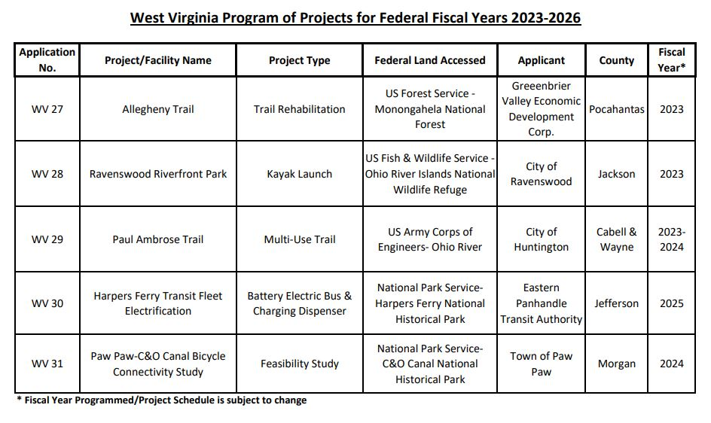
Eastern Federal Lands Access Program

Slide 17
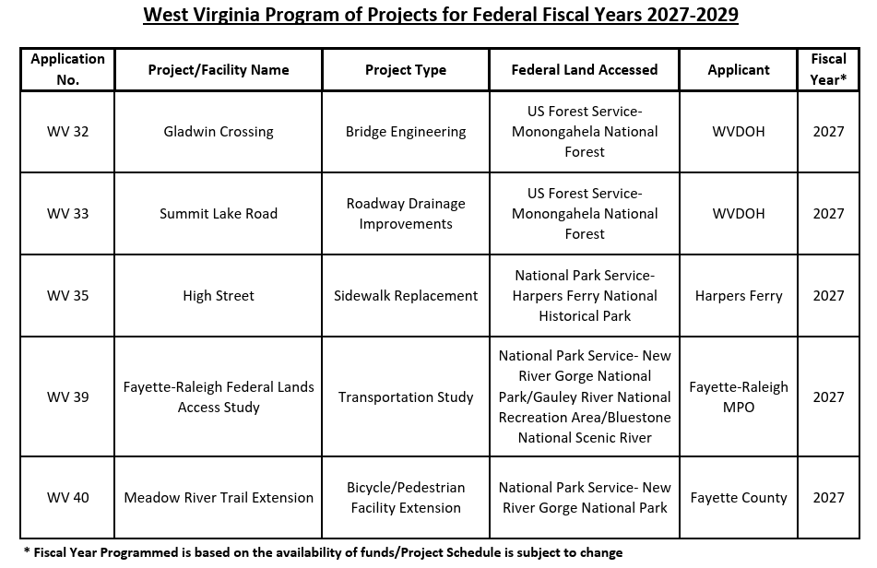
Eastern Federal Lands Access Program

Slide 18
Eastern Federal Lands Access Program
Flowing Springs Trail
Armory Canal at Harpers Ferry
Paw Paw Connectivity Study
Town of Bath Bicycle Connectivity Study (administered by FHWA-EFL)
D8 Signage & Trail Project (Allegheny Trail)
Brian Chapman 304/414-6907

Slide 19
Congressionally Directed Spending
Projects through Transportation/Federal Highway Administration are to be administered by WVDOH.
  Sponsor/Project Agreements.
  PS&E, UTL, R/W and NEPA.
  Predominantly through WVDOH Contract Administration.

Slide 20
Sponsors Reaching out to District
  If a District is contacted during the application cycle, or to discuss a sidewalk/non-traditional project:
  -Not looking for District to endorse project.
  -Any conflicts with traditional highway project?
  -Remind of DOH Standards/Specs.
  -DOH Contract Administration.
  -Right-of-Way/Drainage/ADA/NEPA.

Slide 21
Challenges Items that need considered through DOH Contract Administration.
Projects designed with DOH standards/specs/bid items - are to be administered by WVDOH.
13% E&C for Sidewalk, 19% for pedestrian bridges (or take the 30% amount).
Local Sponsors may want a little more involvement during construction.
  Falls on Planning Division to communicate with Sponsor.
But satisfying DOH-FHWA Stewardship Agreement & Federal-Aid construction requirements.

Slide 22
Moving Forward
Pre-Construction Meeting- Planning Division Staff & Project Sponsor.
Identify funding amount, including E&C.
Change Orders. How much left of 4%?
  Cut scope of project.
  Coordinate with Project Sponsor re: additional funding.
Matching Requirements………………… Federal funds @ 100%.
Post-design services agreement with design consultant. Especially true with vaults under sidewalks. Other- pedestrian bridge and/or lighting.

Slide 23
Moving Forward
Projects Administered by Sponsor.
  On R/W.
  Off R/W.
City PE, full-time employee.
Post-design services agreement with design consultant, on a project not being administered by DOH.
Certification by Sponsor/Consultant. Meeting FHWA 1273 and DOH Stewardship Agreement.

Slide 24
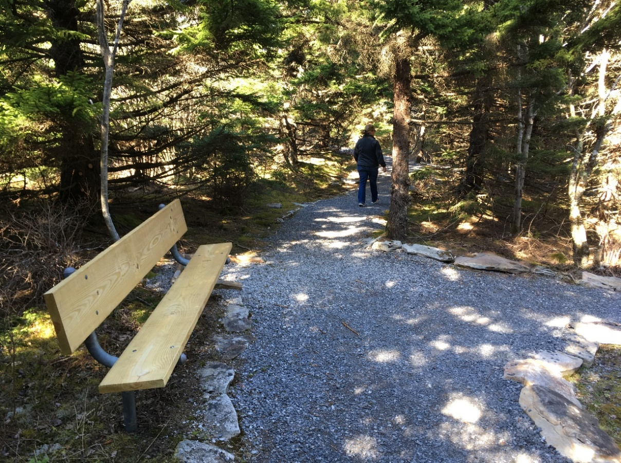
Thank You!
Timothy Sedosky
Travis Hayes
304/414-6916
Travis.W.Hayes@wv.gov
Kyle Oliver 304/205-6207
Kylena Nunnally 304/414-
Sharonnia Osabaya 304/414-6902
Rhonda Brisendine 304/414-6904
Cameron Hunt 304/414- 6943
Jennifer Ballard 304/414- 6832

