Slide 1


2026 WVAMPO/WVDOT Planning Division/WVLTAP Conference
The Tale of Two Zones
06/03/2026

Slide 2

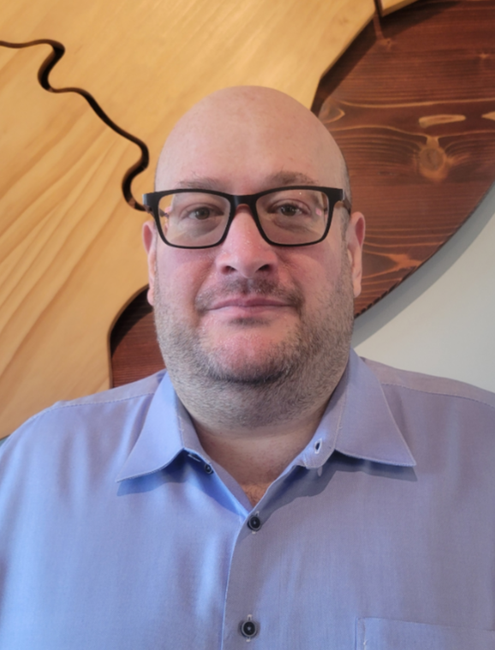

Introduction
KYOVA Interstate Planning Commission
Regional Intergovernmental Council
Mead & Hunt
Jeffery Mace,
CNU-A, CFE
Donna Hardy,
PE, RSP1
Chris Chiles

Slide 3
Southside Elementary and Huntington Middle Schools

Slide 4

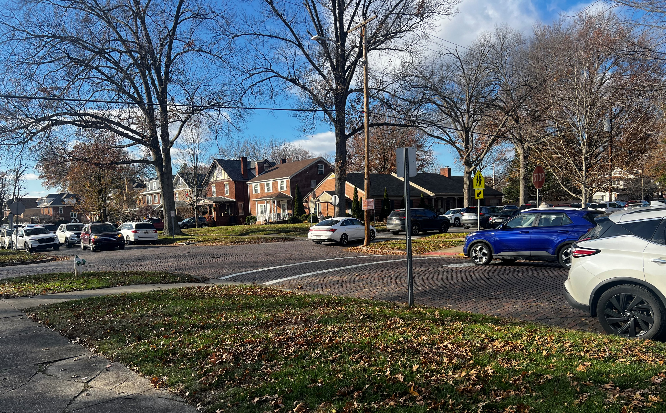
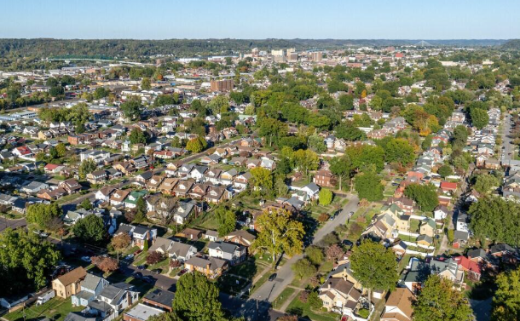
Huntington
2nd largest city in WV – approximately 45,000 residents
Home to Marshall University
Logical, grid based layout with narrow roads, many still comprised of brick
Much flatter and easier to navigate than most of West Virginia
Southside is one of Huntington’s oldest neighborhoods and more historically urban
Schools, churches, older homes, family and long-term community connections
Southside Elementary and Huntington Middle School Campuses

Slide 5

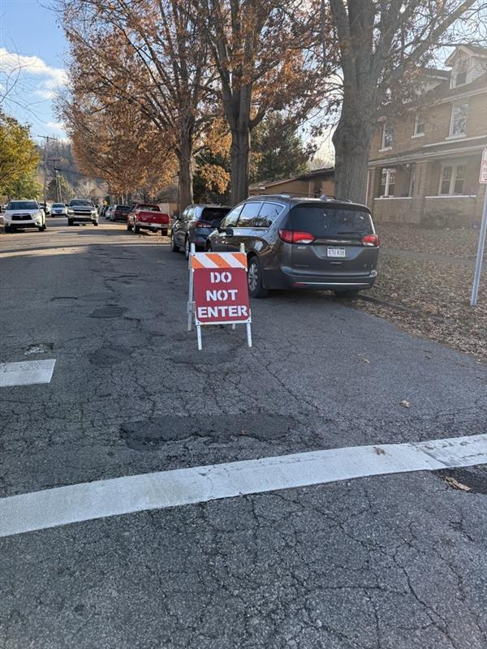
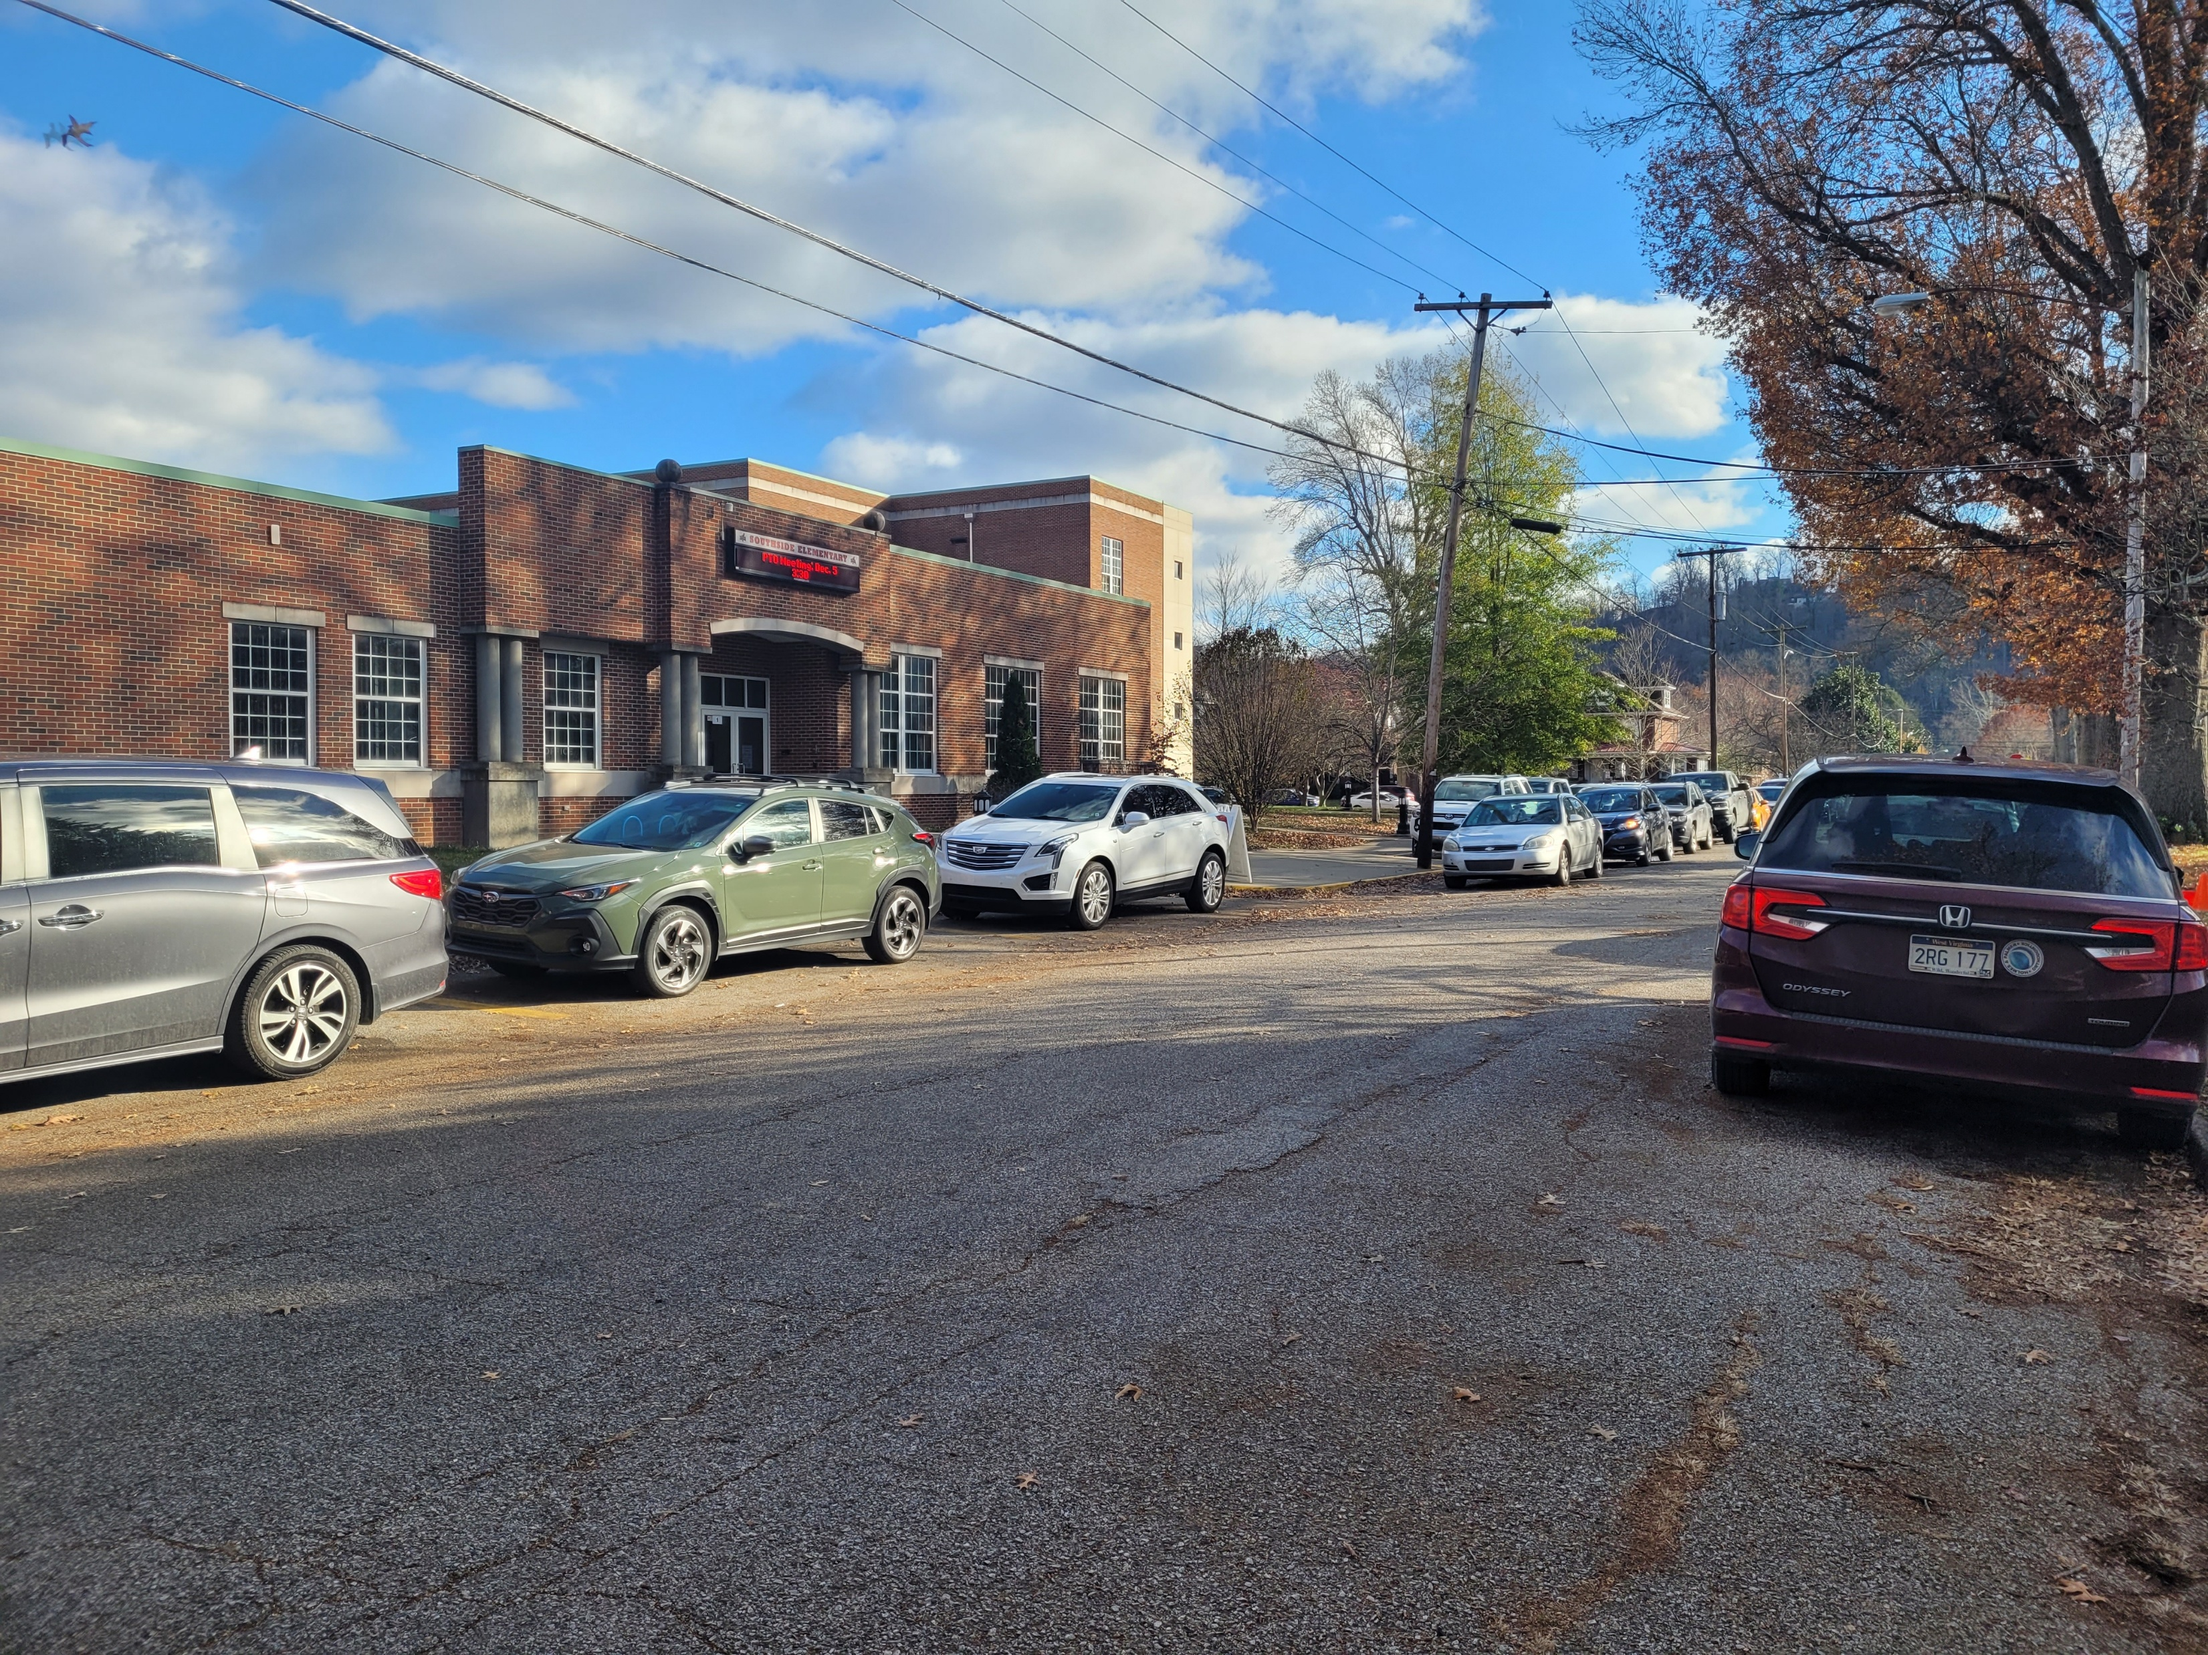
Southside Elementary
Enrollment is approximately 380 students
Grades Pre-K – 5th Grade
43 staff members
Highly dependent on walking
Very active during arrival/dismissal
Constrained by limited space and narrow streets
Doors open at 7:30 AM
Dismissal begins around 2:40 PM
Parent drop-off concentrated mostly on 2nd Street
Teachers assisting with drop-off and pick up
School staff blocks portions of 2nd Street to one way traffic only
Buses using 10th Avenue and some surrounding streets
School (2 Buses)

Slide 6

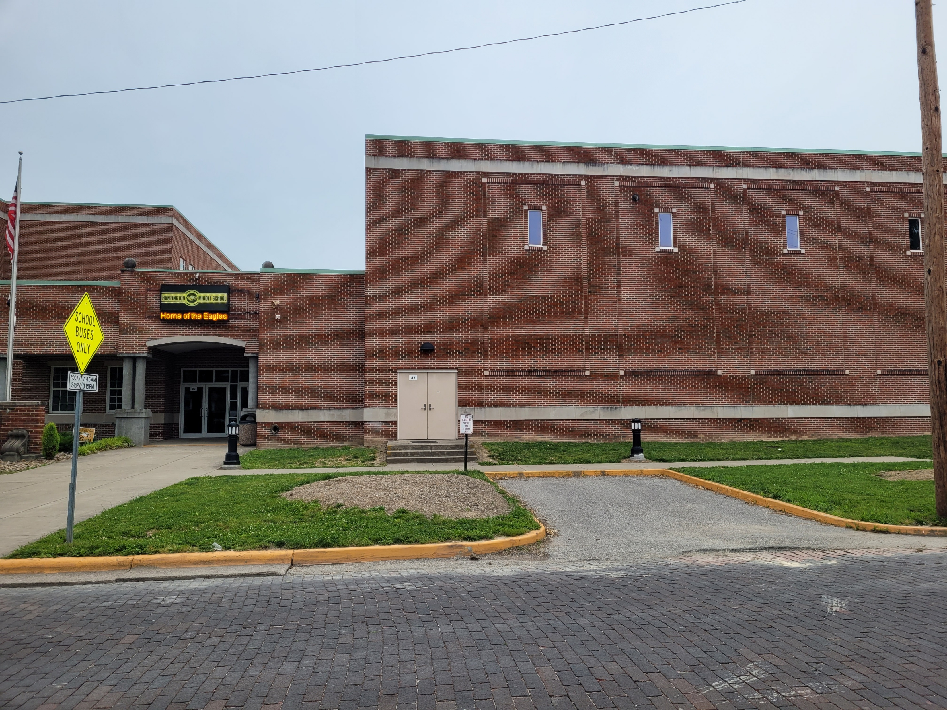
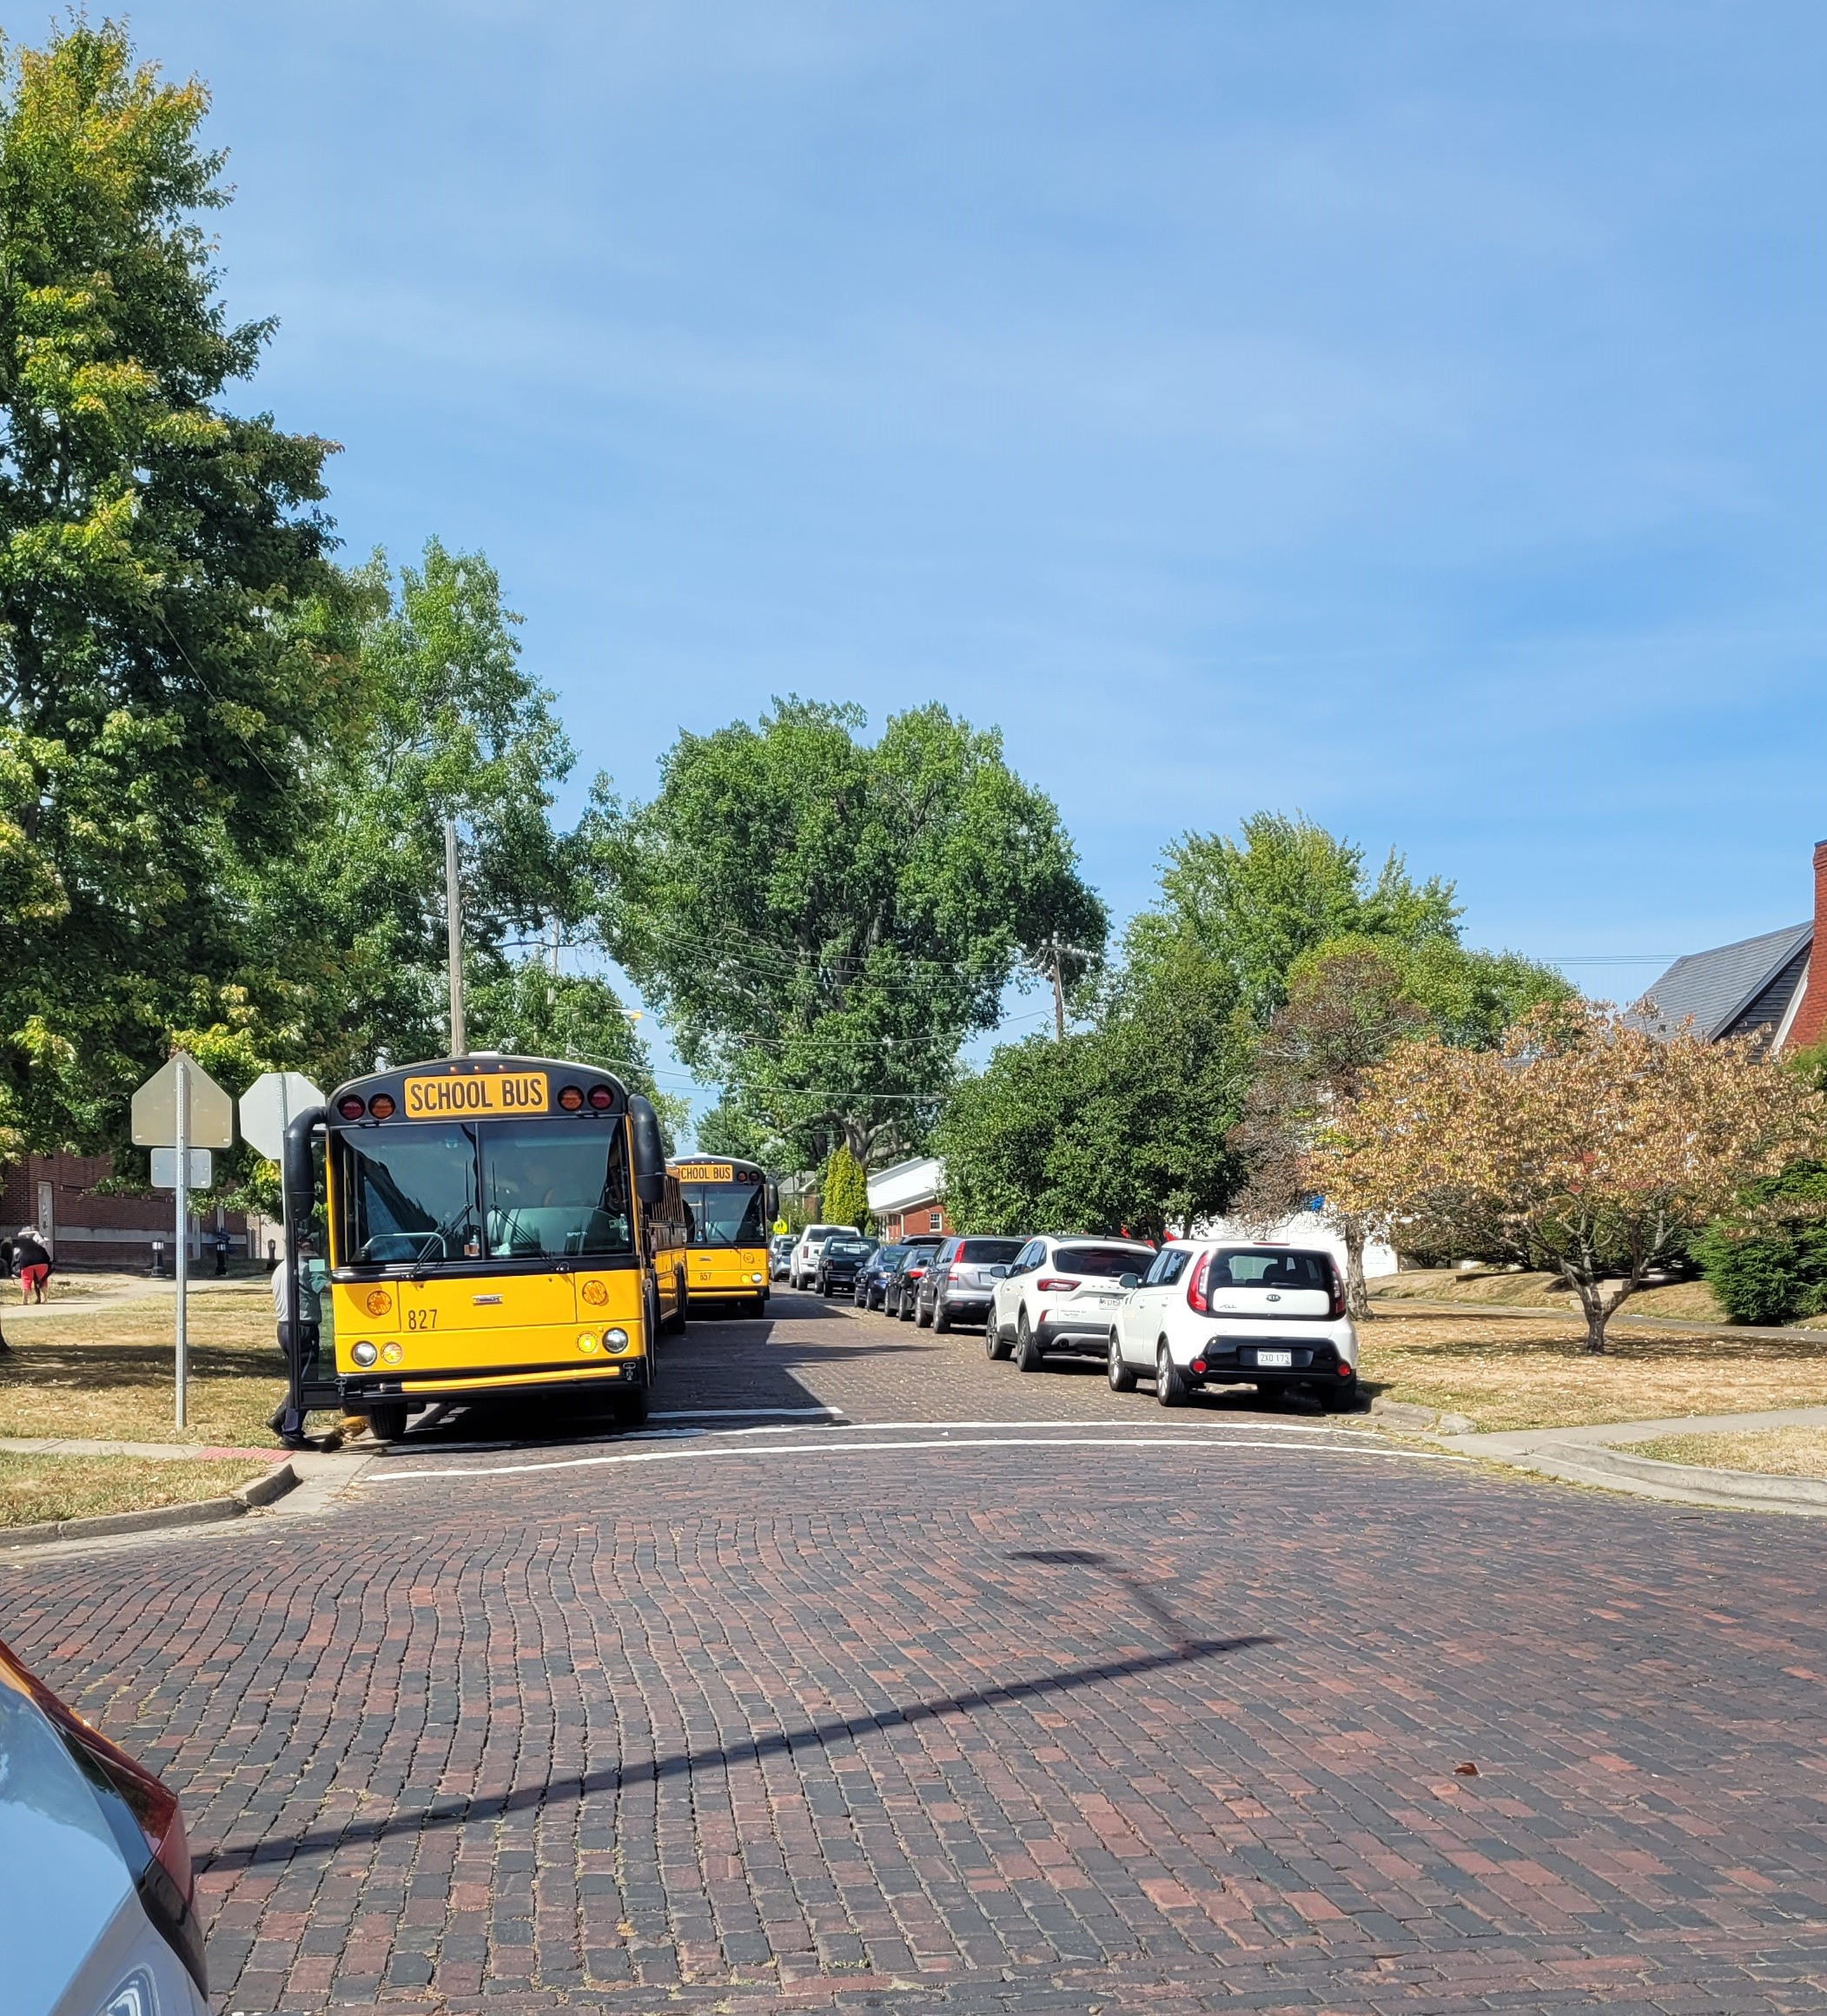
Huntington Middle School
Enrollment is approximately 630 students
Grades 6th – 8th Grade
90 staff members
Doors open at 7:00 AM
Dismissal begins at 2:55 PM
Main entrance on 3rd Street
No staff available to monitor
Parent pickup mostly on 3rd Street
Buses loading on both 3rd Street and 10th Avenue (10 buses)
Huntington MS feels more independent and less controlled than the elementary school.
  less supervised
  more likely to jaywalk

Slide 7
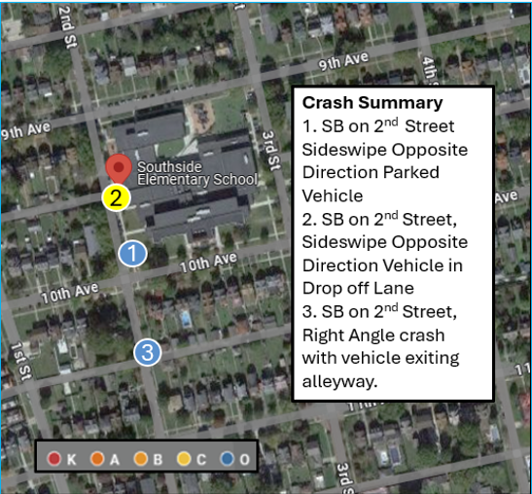
Crash Data
Provided by KYOVA Interstate Planning Commission
January 1, 2021 – December 31, 2023
Crashes occurring during drop off and pick up times
Total of three (3) crashes
A few notable crash characteristics:
All crashes involved Southside Elementary School
All crashes involved vehicles going southbound on 2nd Street
2 crashes were during drop off & 1 during pick up.
2 crashes were in clear conditions & 1 crash was in rain.
2 crashes involved moving vehicles trying to pass by parked vehicles
No crashes involved pedestrians or bicyclists.

Slide 8
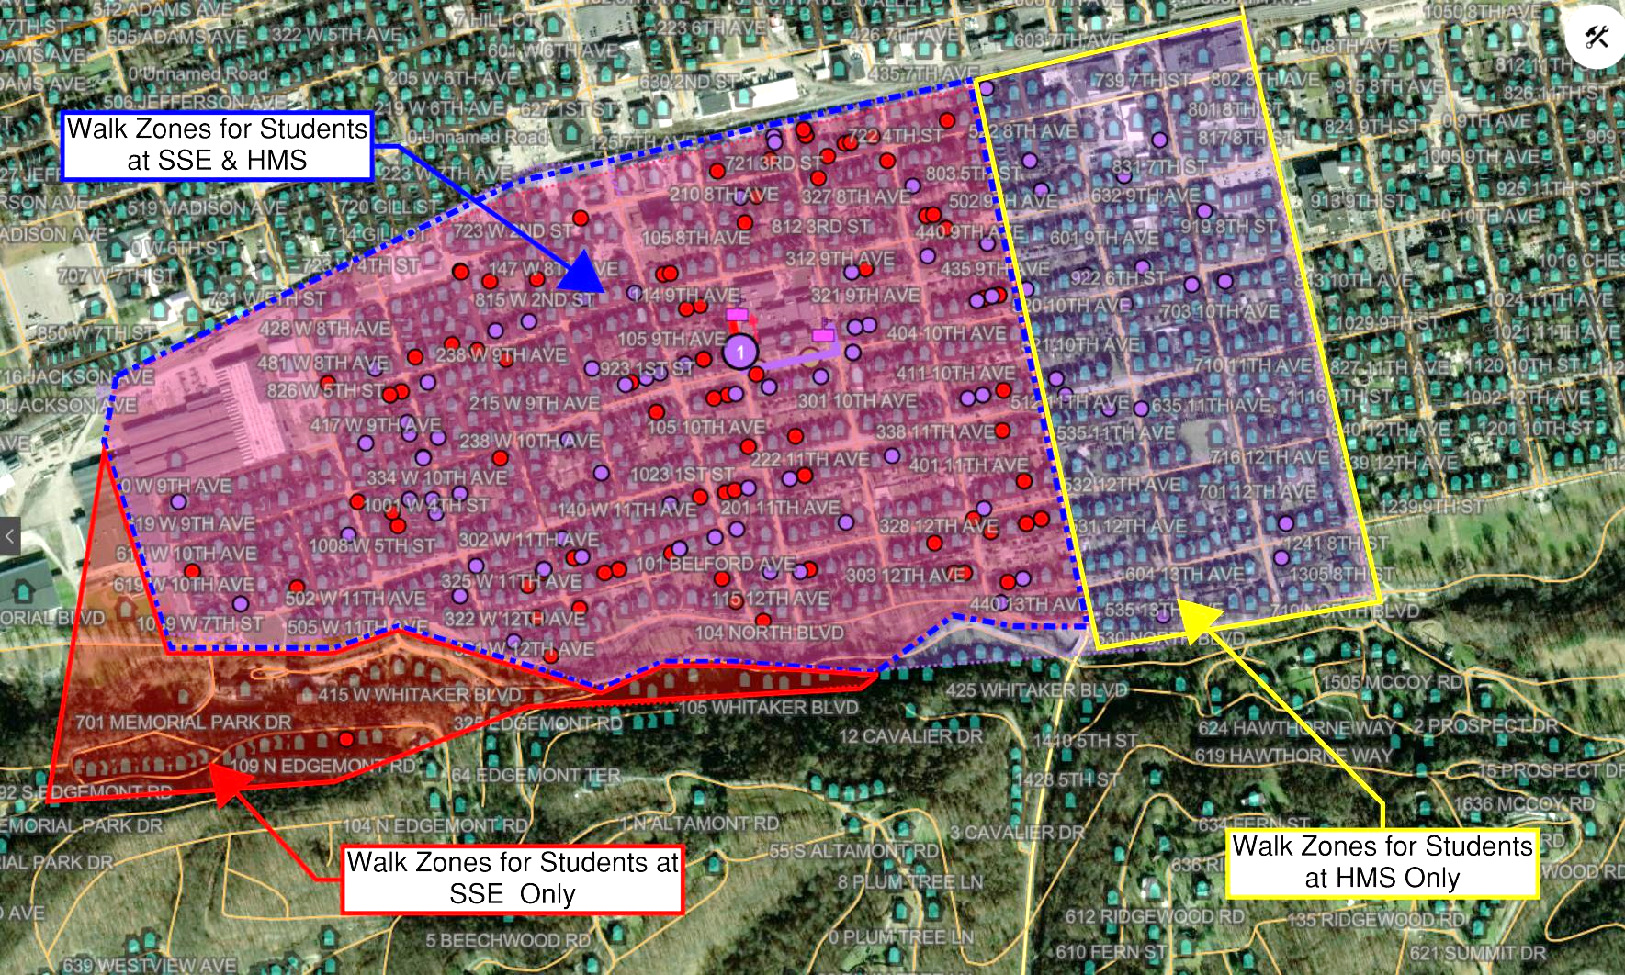
Walk Zones
WV Code §18-5-13 (f)(1)(A), commonly referred to as the two-mile rule, states: “adequate transportation will be provided at public expense for all children of school age who live more than a two-mile distance from the school by the nearest available road”
The walk zone for SSE only is more challenging than the walk zone for HMS only.
The walk zones account for a significant number of parent drop-off

Slide 9
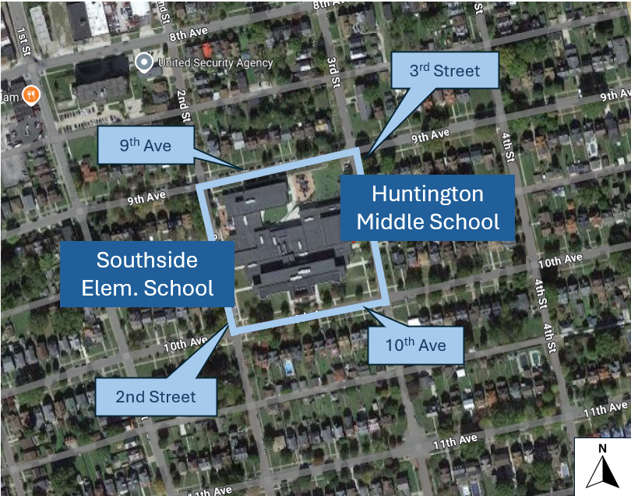
Challenges
Congestion
Conflicts between pedestrians, buses, parent drop off traffic and neighborhood traffic
Visibility at crossings
Historical neighborhood with brick streets and old growth trees
Parking

Slide 10
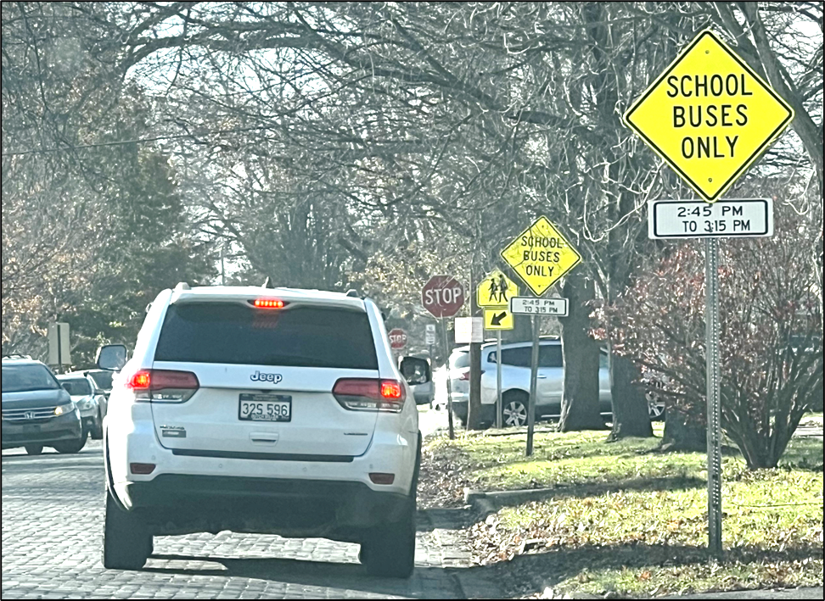
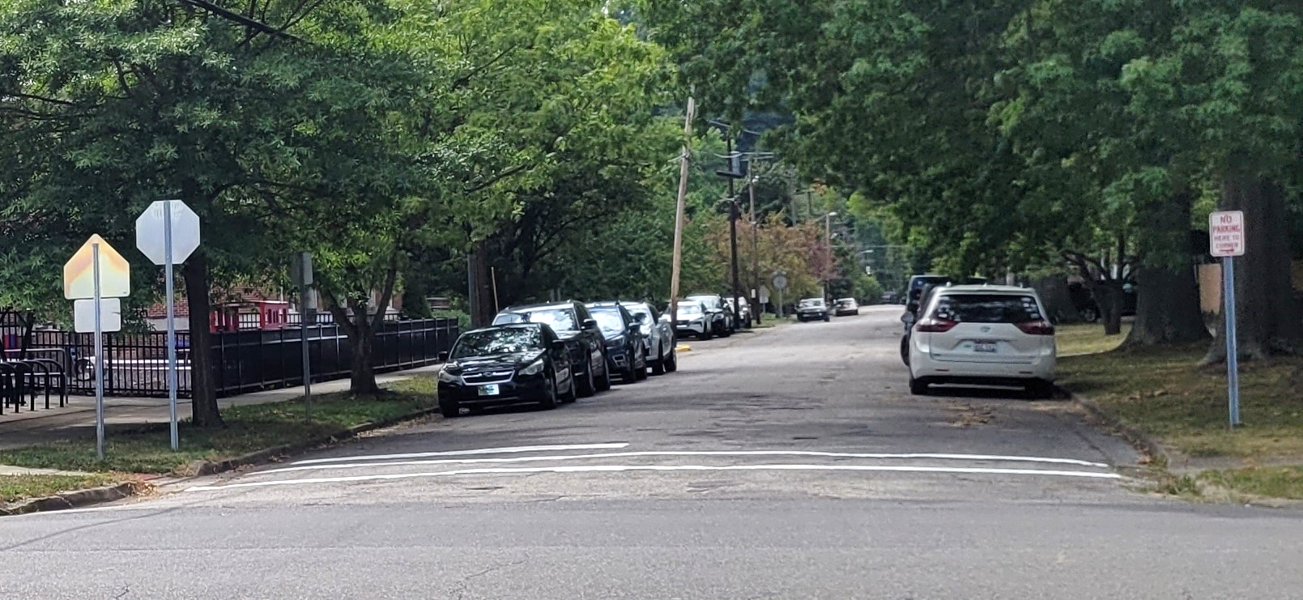
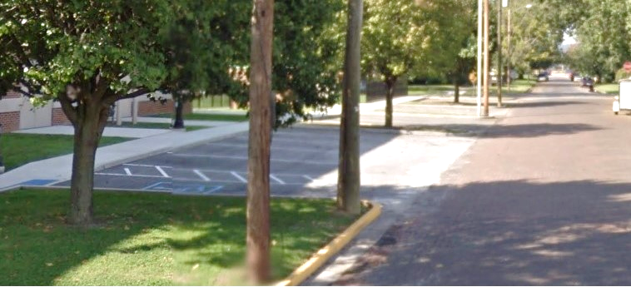
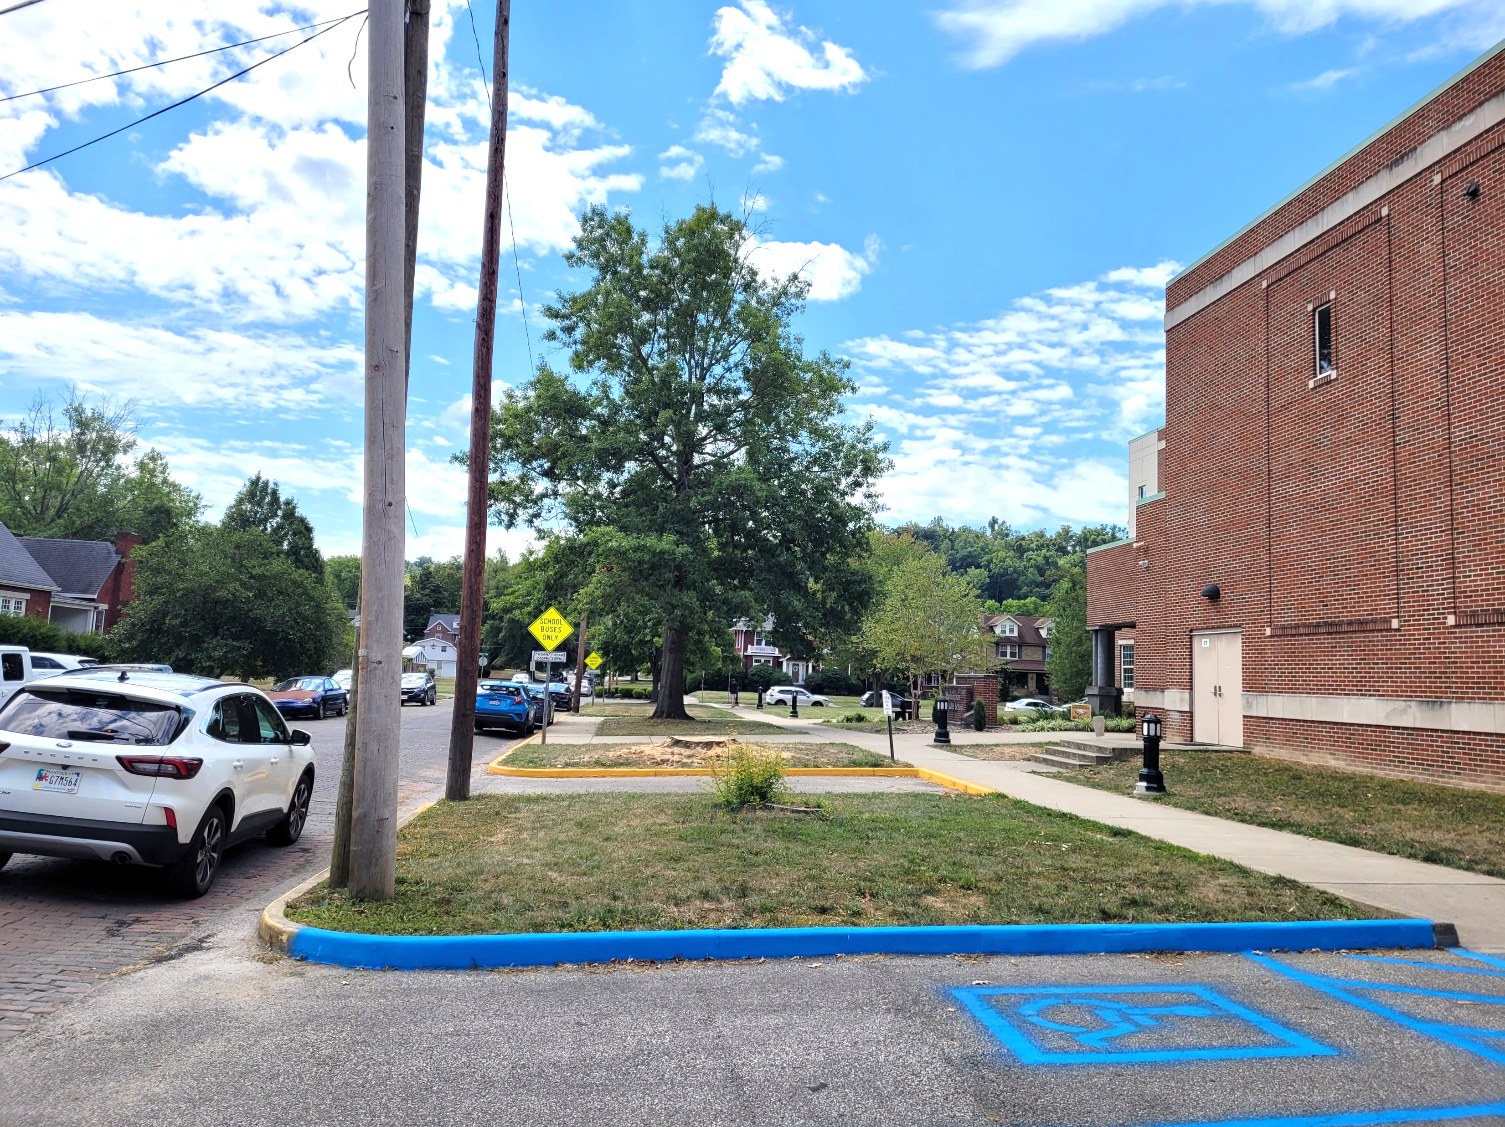
Challenges - Parking
Parking throughout the study area is limited, with little available off-street parking.
Parking restrictions and bus-only zones reduce available curb space near the schools
On-street parking supply is quickly filled by staff, parents, residents, and non-school vehicles.
Parking demand creates circulation and operational challenges during school arrival and dismissal periods
Notes:
Parking for the study area is very limited. Few of the adjacent properties have off street parking.
9th Avenue has parking restrictions on the southside of the road closest to school property.
10th Avenue has posted school bus only parking during drop-off/pick-up along northside of the road closest to school property.
2nd Street has 10 designated parallel parking adjacent to school (east side of street) including 1 handicap accessible spot and open parallel parking on west side of street.
3rd Street has 13 designated perpendicular parking spots adjacent to school (west side of street) including 1 handicap accessible spot.
Staff begin arriving at 6:30 a.m. and all designated spots are typically taken by 7:00 a.m. It was observed that parking spots are used by non-school related vehicles. Staff, visiting parents, and residents all vie for the remaining nearby on street parking.

Slide 11
Poca Elementary and Middle School

Slide 12


Poca
Small rural community – 875 residents
Blends small neighborhoods with hillsides and open land
In the Kanawha Valley industrial corridor with heavy truck traffic
Home of The DOTS – voted #1 HS Mascot in the nation
Highly walkable area even without ideal infrastructure
The schools, library, and Poca Plaza all sit tightly clustered along WV 62, creating a small-town “main street” feel — but also forces children to interact with highway traffic daily.
Busing available for all children

Slide 13
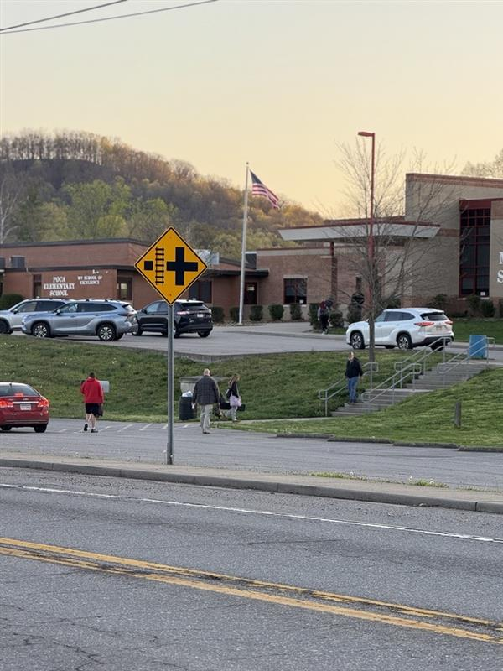
Poca Elementary
Enrollment is approximately 290 students
Grades Pre-K through 5th Grade
43 staff members
Students are supervised at arrival and dismissal
Teachers escort children across WV 62
Upgrades to sidewalk around school are used by students/parents
Doors open at 7:15 AM
Dismissal begins at 2:55 PM
Buses loading in designated loop in front of school (9 buses)

Slide 14
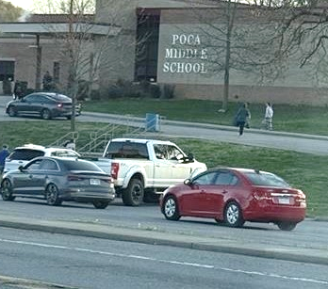
Poca Middle School
Enrollment is approximately 295 students
Grades 6th–8th Grade
46 Staff Members
One staff member assigned to monitor pickup/drop-off
MS students traveling freely between the school and Poca Plaza
Doors open at 7:15 AM
Dismissal begins at 3:05 PM
Buses loading in designated loop (12 buses)
Poca MS feels more independent and less controlled than the elementary school.
  less supervised
  more likely to jaywalk
  more likely to cross WV 62 independently

Slide 15
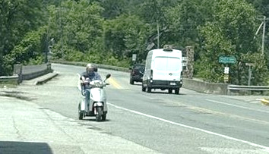
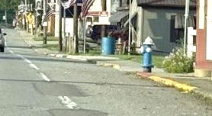
Accessibility Issues
There are sidewalks in various width from 4-5 feet located on both sides of the roadway.
Also, large gaps within the sidewalk network requiring pedestrians and those using mobility assistance devices to enter highway.
The sidewalk on the western side (WV 62) has fire hydrants within the sidewalk narrowing the sidewalk width to less than the required 36 inches for ADA compliance.
Wheelchairs to move into the street to continue along WV 62

Slide 16
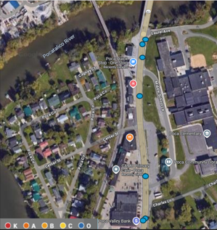
Crash Data Overview (7 Crashes)
Crash data from 2018-2023
1 crash within the school zone
6 crashes in dry & 1 in wet conditions
6 crashes in clear weather & 1 in rain.
Environmental Circumstances:
  1 crash - animal in the roadway
  1 crash impacted by weather conditions
  5 crashes - no contributing environmental circumstances
6 crashes were in daylight, & 1 was under dark – lighted conditions.
First Harmful Event:
  1 crash struck a parked vehicle
  1 crash involved a utility pole
  5 crashes involved another moving vehicle

Slide 17
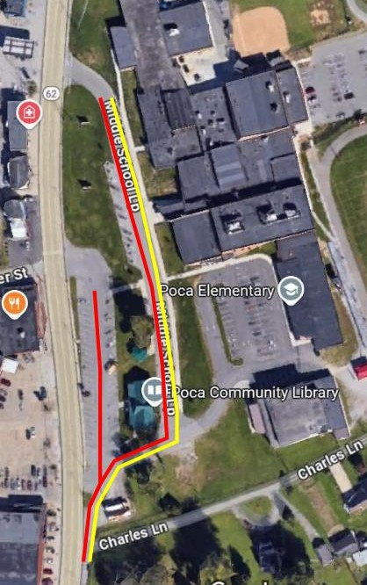
Challenges
Poca
Middle School
Access management
Missing pedestrian Infrastructure
Crossing major highway
Potential for speeding
Poca
Elementary School

Slide 18
Observations

Slide 19
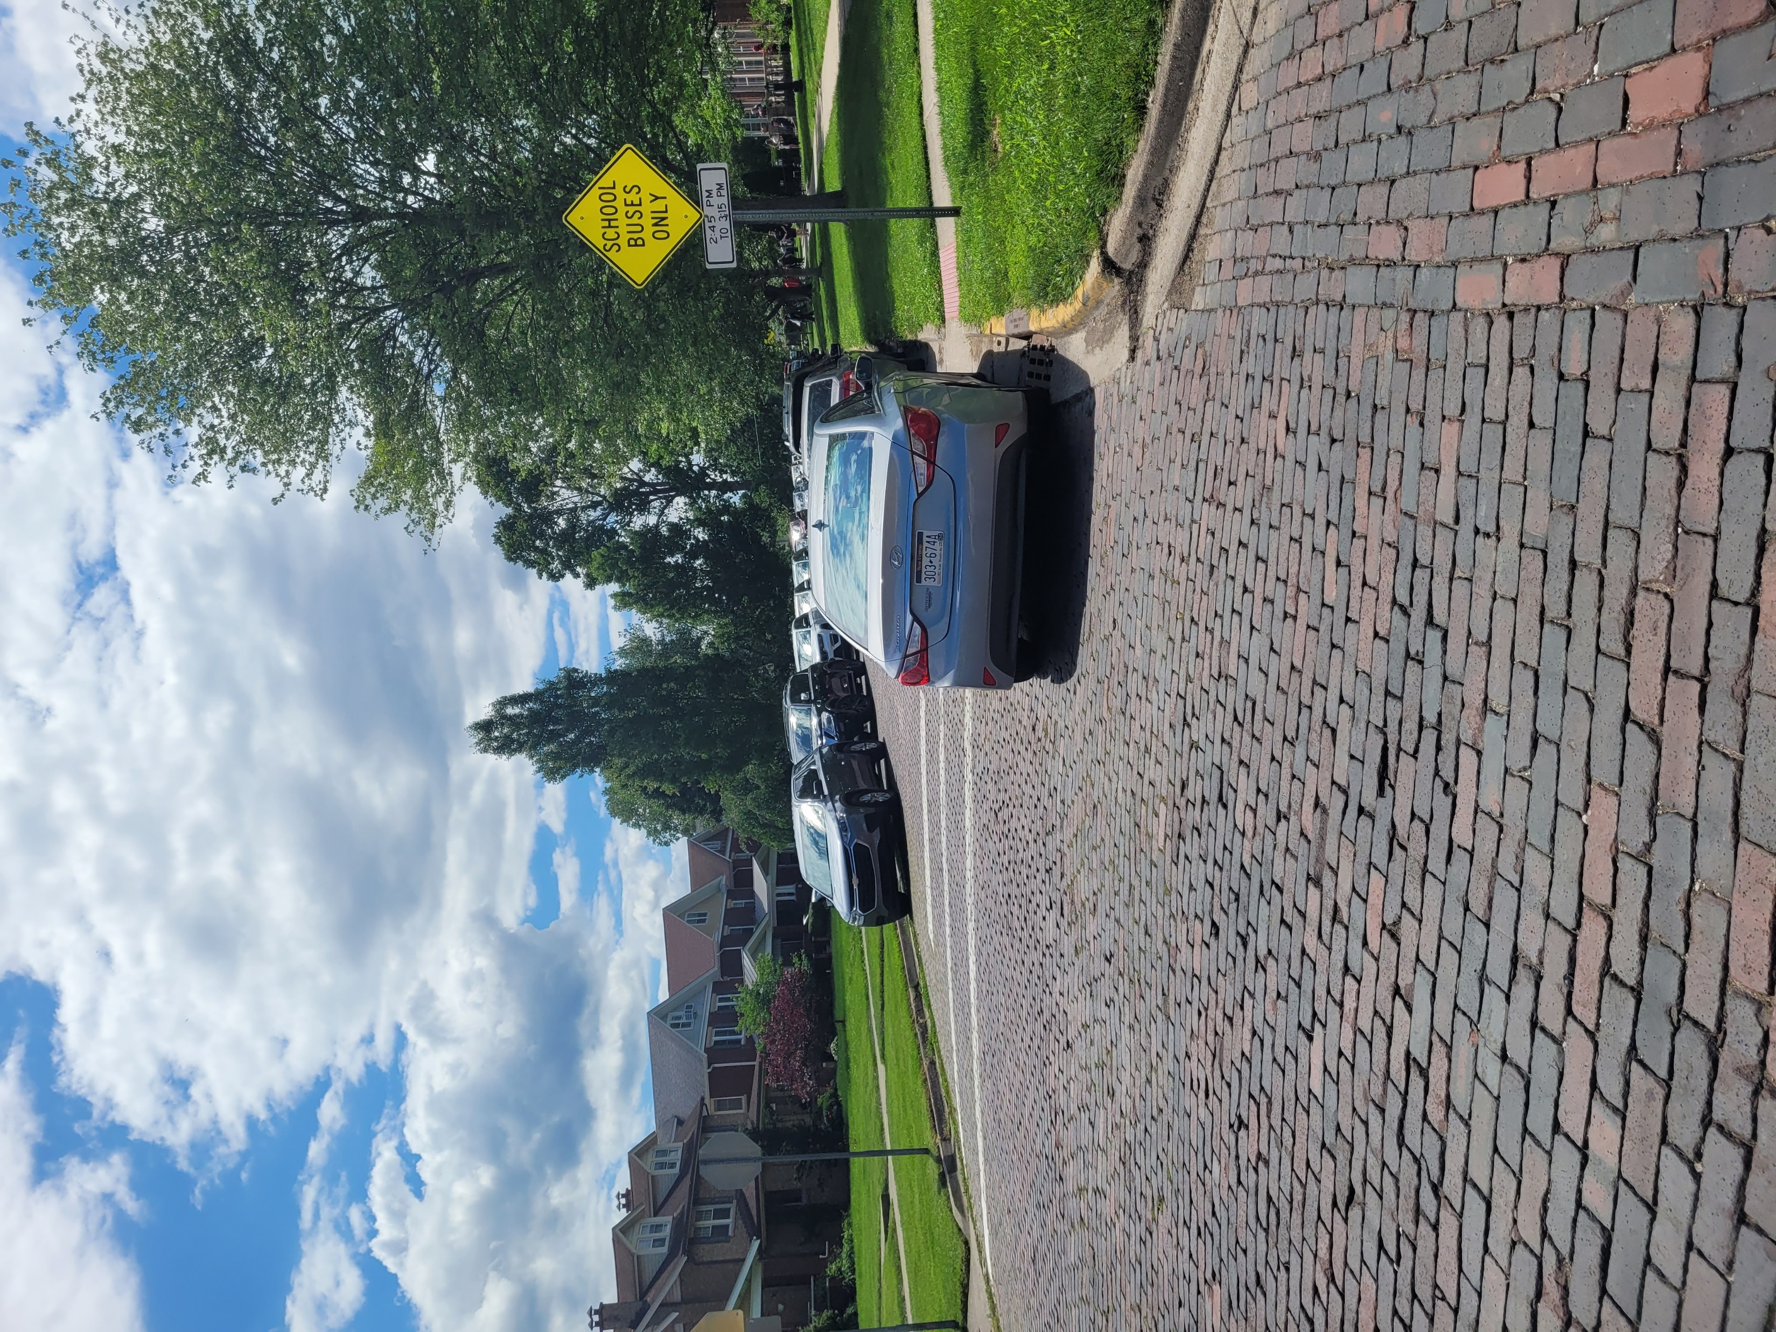
Observations - Huntington
Traffic Operations
Queueing and congestion observed on 10th Ave and surrounding streets
Driver confusion and inconsistent movements at intersections
Vehicles rolling through stop-controlled intersections
Longest vehicle queues observed on 10th Avenue
Parking & Circulation
Parking demand exceeded available curb space
Vehicles parked in designated bus/loading areas
Non-school traffic using school parking areas
Vehicles blocking crosswalks and circulation paths
Pedestrian Safety
Jaywalking observed despite available crosswalks
Limited crossing supervision at intersections
Conflicts between pedestrians and vehicle operations
School Operations
School staff actively managing loading and student pickup
Temporary traffic control implemented by school personnel
Early parent arrivals contributed to queue buildup
Heavy pickup activity concentrated around elementary dismissal periods
Notes:
Multiple vehicles rolling through stop-controlled intersections
Parking on both sides of 10th Avenue
Limited parking on south side of 9th Avenue
Non-school staff in school parking on 3rd Street
Bi-directional traffic on 2nd Street
Most used crosswalks but Jaywalking was observed
2nd Street was closed to southbound traffic by school personnel
Parking for elementary school pick-up on 10th Avenue although marked Bus Parking only.
Several elementary staff members on site helping children into vehicle
Vehicles blocking crosswalks
No crossing guards or school staff observed at intersections
Parents and buses attempting to go southbound on 3rd street causing traffic to be stopped
Significant vehicles pick up and limited pedestrians leaving elementary school.
Time to clear the queue was longer than previous observation
Vehicle completed a 3 point turn on 10th avenue and 2nd street intersection to back into street parking on 2nd street
Longest queue was observed on 10th avenue
Vehicles waiting for elementary school appeared unsure on how to proceed at intersection of 2nd Street and 10th Avenue

Slide 20
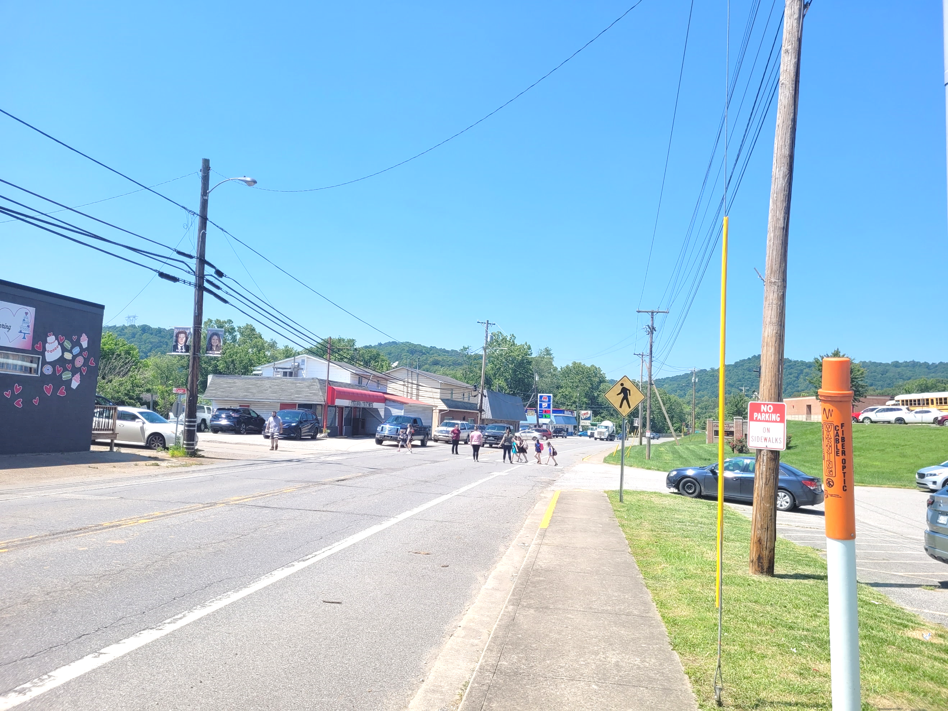
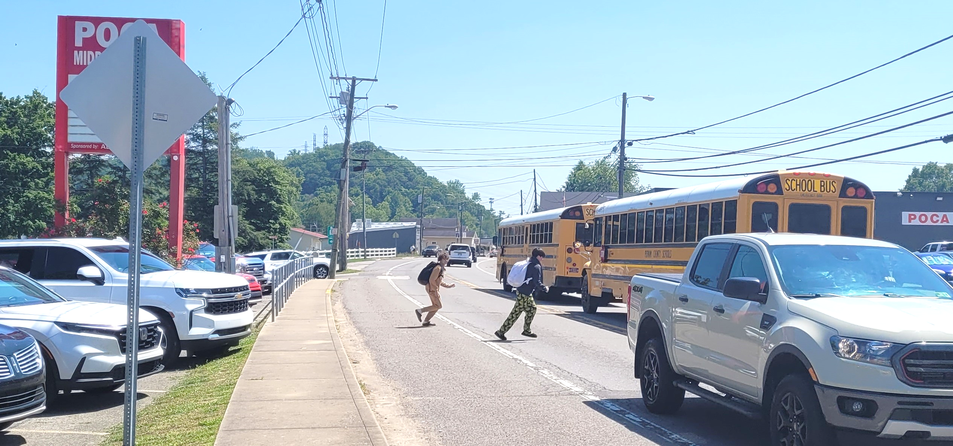
Observations - Poca
Pedestrian Safety & Behavior
The middle school area was the center of pedestrian conflict activity
Students frequently crossed midblock to access nearby plaza
Vehicles stopped unexpectedly to allow students to cross
Traffic Operations
Queueing and congestion occurred near the school loop and library lot
Access-management conflicts observed near Poca Plaza
Traffic operations did not align with natural pedestrian movement patterns
Infrastructure & Safety Deficiencies
Missing sidewalks limited safe pedestrian connectivity
Poor lighting reduced visibility and safety
Unsafe crossing conditions were observed
Lack of crossing guards increased pedestrian risk

Slide 21
Similarities
Elementary & Middle School overlap creates operational conflicts
Walking is a transportation mode
Shared concern is conflict and risk
Driver behavior is a major issue
Both campuses lack infrastructure designed for modern pickup volumes
Both campuses are important to the community
Notes:
Both are true “neighborhood schools”
Neither campus operates like a modern suburban school with:
giant parking lots
separated bus loops
large setbacks
controlled access roads
Instead, both are woven directly into existing neighborhoods and local streets.
In both locations:
children walk from nearby homes
parents use surrounding public streets for pickup
residents live immediately adjacent to the schools
the schools function as community anchors
The reports repeatedly emphasize walkability and community identity in both places.
2. Elementary + Middle School overlap creates operational conflicts
Both campuses have:
elementary and middle schools sharing space
overlapping dismissal periods
shared traffic circulation
buses and parents competing for the same areas
This creates many of the same issues:
queues
blocked crossings
unpredictable driver behavior
student/vehicle conflicts
In both studies, the consultants discuss:
separating buses from parents
improving circulation
reducing conflict points
staggering operations
3. Walking is a major transportation mode
This is one of the biggest similarities.
In both places:
large numbers of students walk
many families live within walking distance
students use surrounding neighborhoods daily
walking behavior strongly influences traffic operations
The studies both describe:
children crossing streets outside controlled locations
students using desire paths
students traveling between schools and nearby destinations
parents meeting children outside official pickup areas
Both studies treat walking as something to support — not eliminate.
That’s actually uncommon in modern traffic studies.
4. The real problem is not crashes — it’s conflict and risk
Interestingly, neither campus had severe crash histories involving children.
Both reports found:
relatively few crashes
limited serious injuries
no strong crash trend involving pedestrians
Yet both studies still identify major safety concerns because of:
near misses
blocked sight lines
jaywalking
congestion
confusion
driver unpredictability
Both reports are very proactive rather than reactive.
5. Driver behavior is a major issue in both studies
The reports repeatedly describe:
parents ignoring rules
unsafe drop-offs
illegal stopping
blocking crosswalks
confusing circulation
unsafe turns
Both campuses struggle with:
people prioritizing convenience over safety
informal pickup behavior developing over time
roadway systems being overwhelmed during short peak periods
The consultants in both studies recommend:
education campaigns
stronger enforcement
clearer signage
operational changes
rather than relying only on engineering.
6. Both campuses lack infrastructure designed for modern pickup volumes
This is probably the central theme connecting both studies.
Neither campus was originally built for:
today’s level of parent drop-off traffic
long vehicle queues
modern school security expectations
heavy curbside loading activity
Both campuses evolved in eras when:
more students walked
fewer parents drove
traffic volumes were lower
The studies basically say:
“The schools still function like neighborhood schools, but travel behavior has changed.”
7. Both studies emphasize vulnerable road users
Both reports focus heavily on:
children
pedestrians
bicyclists
ADA accessibility
visibility
crossing safety
Recommended improvements in both include:
high-visibility crosswalks
flashing beacons
better signage
crossing guards
sidewalks
pedestrian lighting
8. Both campuses are emotionally important to the community
This comes through clearly in both documents.
Neither study portrays the schools as “problem areas.”
Instead, they’re portrayed as:
beloved community institutions
central gathering places
important neighborhood anchors
places residents want to preserve
The tone in both reports is:
“Protect what makes these schools special while improving safety.”

Slide 22
Differences
Huntington
Urban
Dense
Grid-based
Parking-constrained
Congestion-dominated
Poca
Rural small-town
Highway-oriented
Lower traffic volume
Pedestrian-infrastructure deficient
Visibility/access-management dominated

Slide 23
Recommendations
The goal is to preserve what makes these schools valuable while improving safety and accessibility

Slide 24


Recommendations – Short Term (Huntington)
Install high-visibility crosswalks (6’ wide) and signage from 8th Avenue to 11th Avenue and 1st Street and 4th Street
Install flashing lights on all school zone speed limit signs
Add traffic control to Alleyways to run one way from school during school hours
Convert 2nd Street and 3rd Street to one-way pairs from 10th to 9th during bell time
Add signage to 3rd Street for Buses Only
Add No Parking Parent Pick Up only signage to 10th Avenue
Add No Parking During School Hours to westside of 2nd Street between 10th and 11th Avenue
Work with Huntington City police to increase police presence and parking enforcement during school hours
Send flyers reminding parents drop off/pick rules and discourage dropping off kids outside of school zone
Perform a safety campaign that discourages risky behavior including speeding, jaywalking, and blocking crosswalks
Examples of Signs
Notes:
Install high-visibility crosswalks (6’ wide) and signage from 8th Avenue to 11th Avenue and 1st Street and 4th Street
Install flashing lights on all school zone speed limit signs – Consider WVDOH Reimbursable School Zone Program or SS4A
Add traffic control to Alleyways to run one way from school during school hours (map).
Convert 2nd Street and 3rd Street to one-way pairs from 10th to 9th during bell time
Add signage to 3rd Street for Buses Only
Add No Parking Parent Pick Up only signage to 10th Avenue (map)
Add No Parking During School Hours to westside of 2nd Street between 10th and 11th Avenue
Work with Huntington City police to increase police presence and parking enforcement during school hours
Send flyers reminding parents drop off/pick rules and discourage dropping off kids outside of school zone
Perform a safety campaign that discourages risky behavior including speeding, jaywalking, and blocking crosswalks

Slide 25
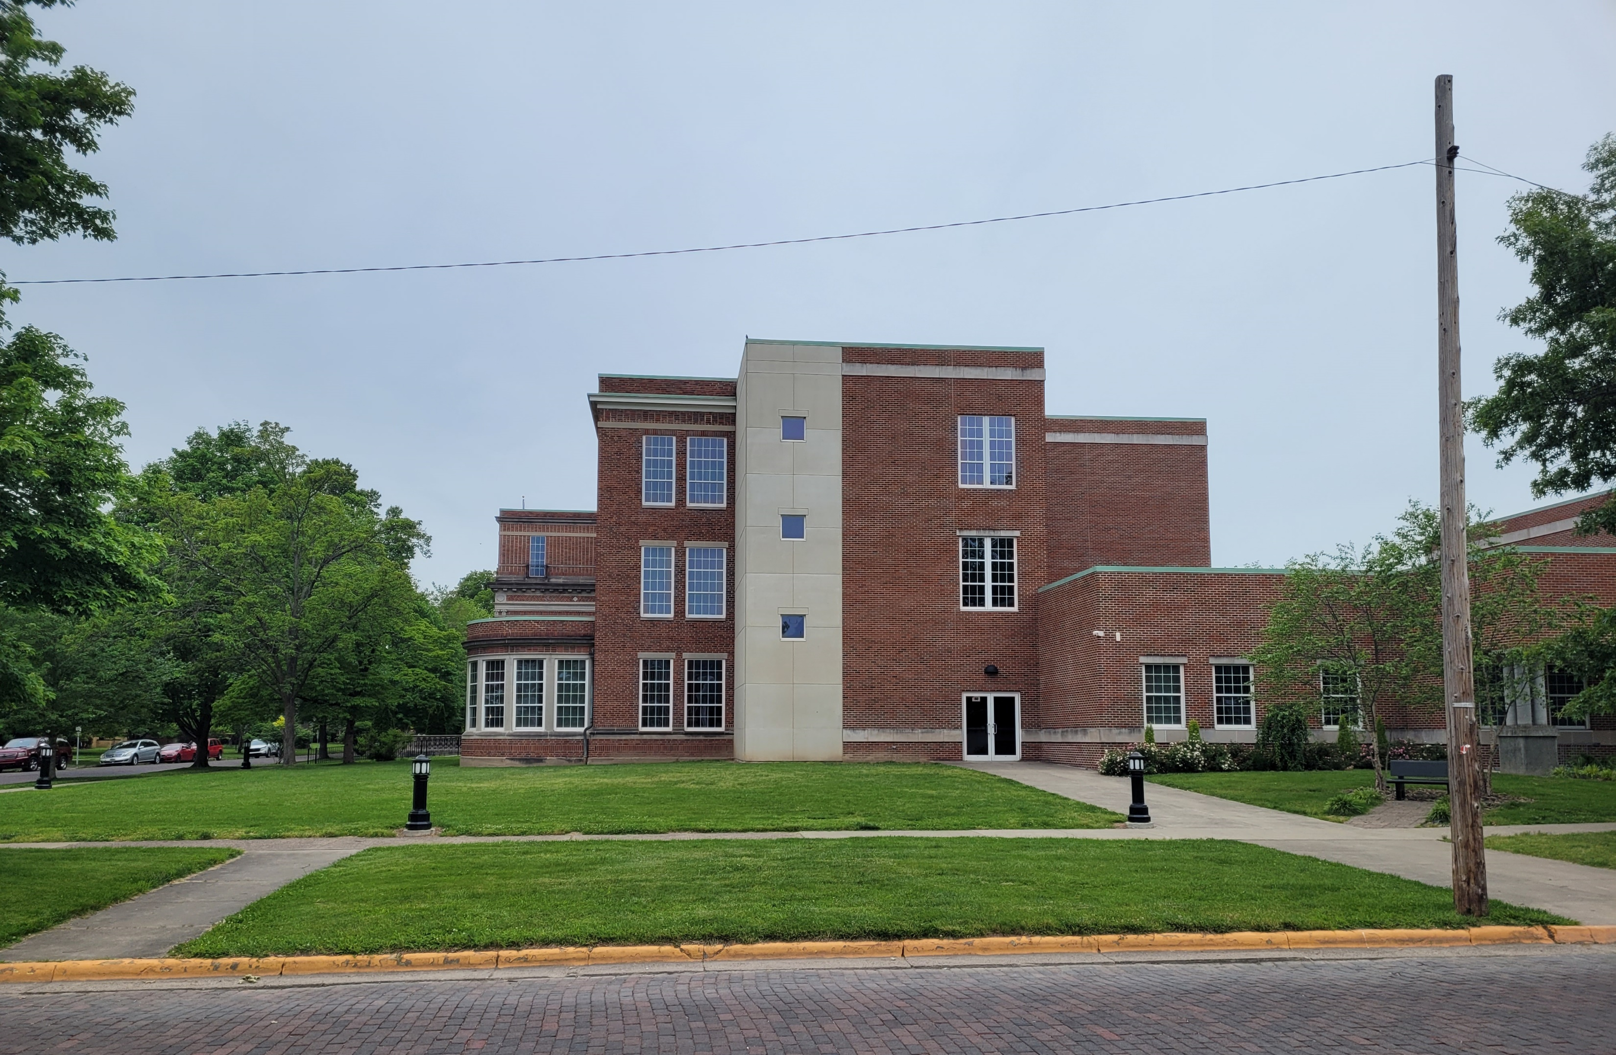
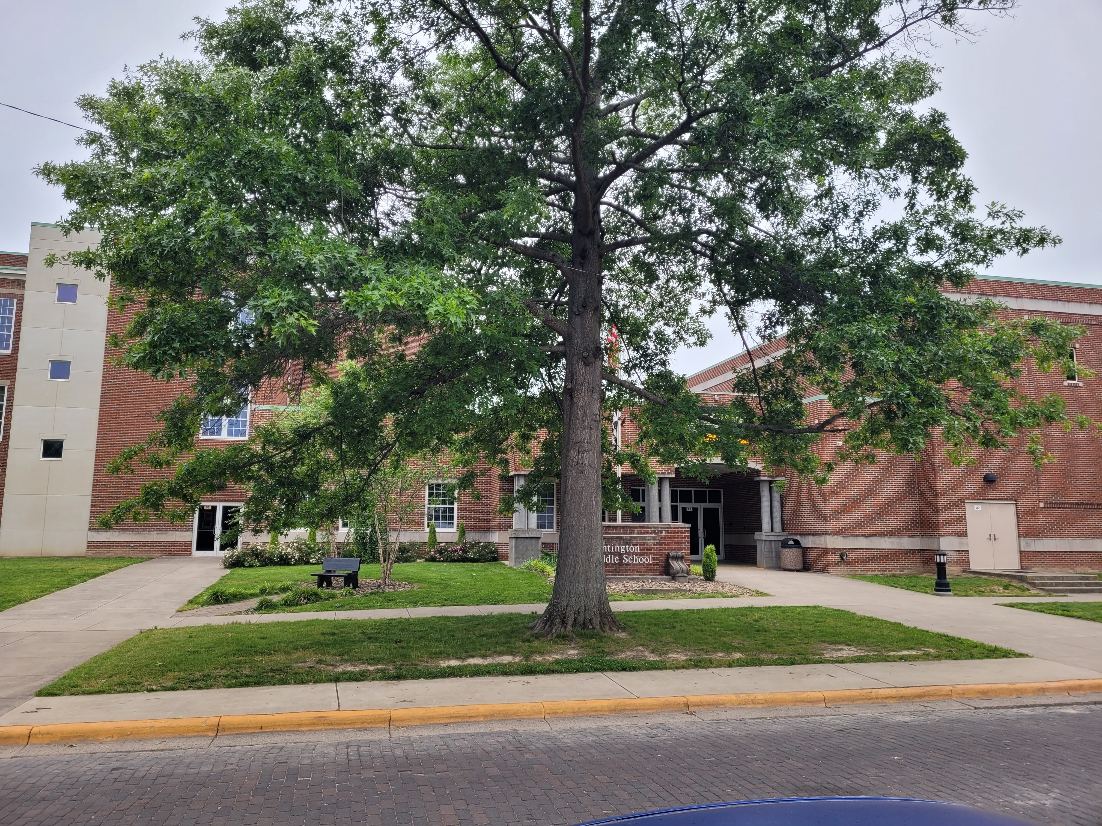
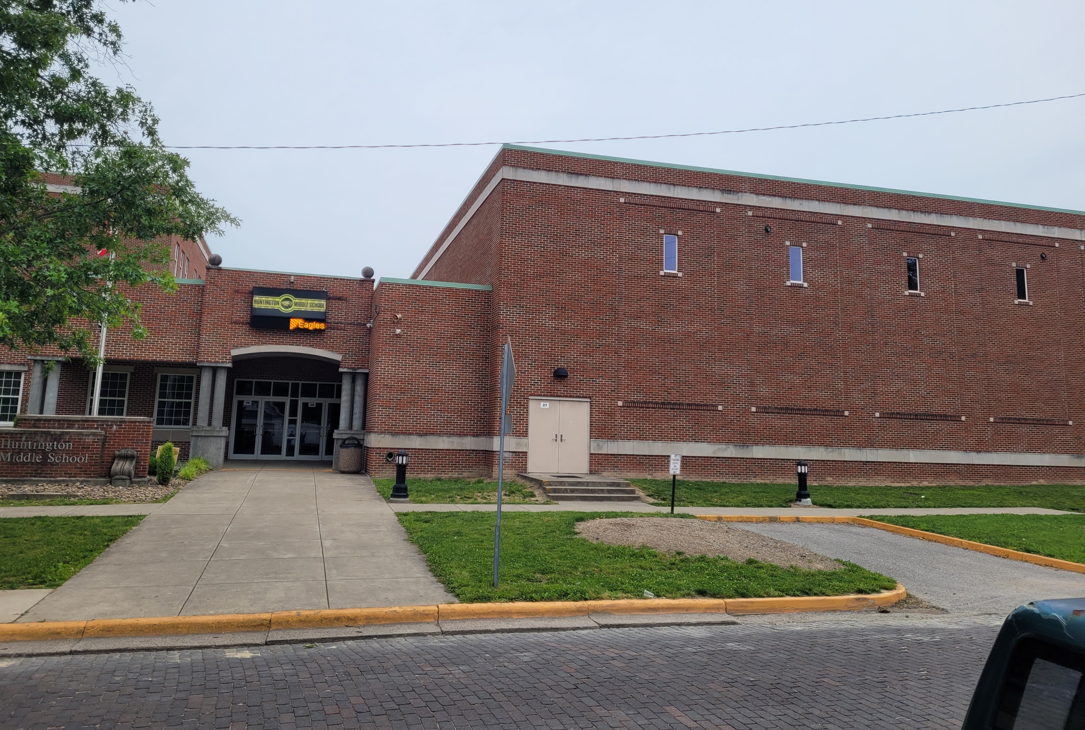
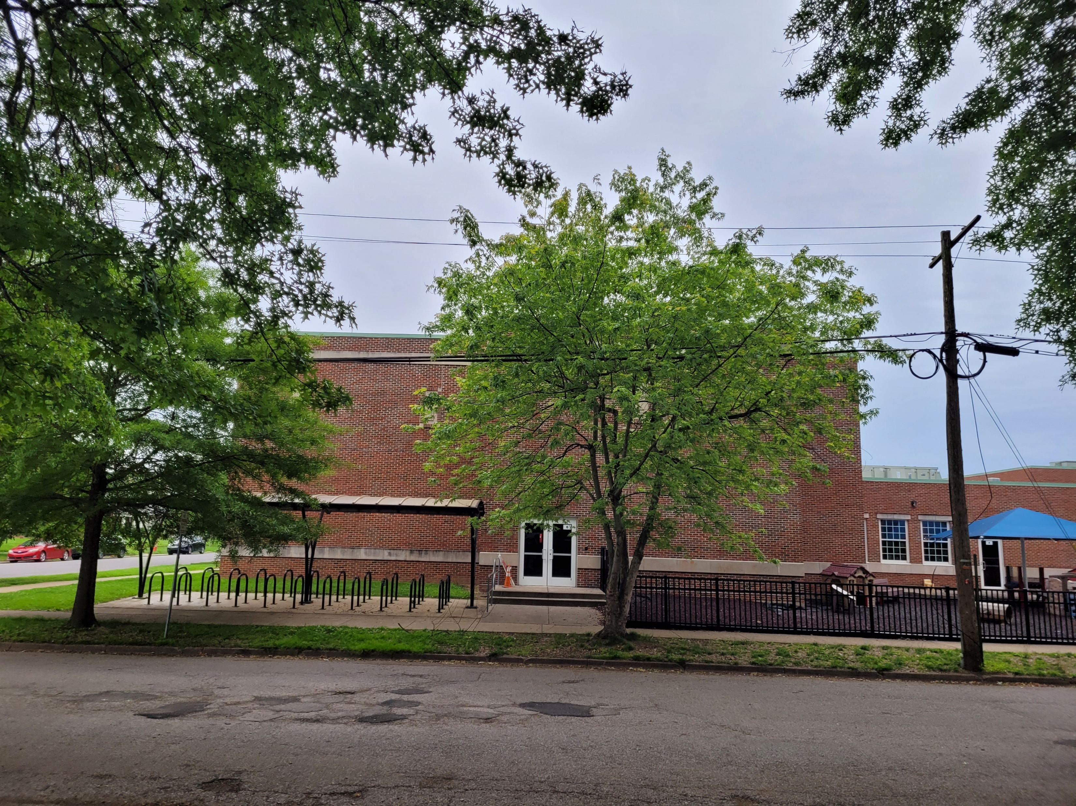
Recommendations – The Trade Off
Parking restrictions within 20 feet of all crosswalks
Curb extensions using pavement markings to identify area as no parking
Add Pull In Parking to 3rd Street – Remove 1 tree
Additional Parallel Parking on 2nd Street –Signing Exclusive Parking for school personnel.
Add Raised Pedestrian Crossings to crosswalks
Crossing Guards to reduce pedestrian risk
On street parking bans during school hours on 2nd and 3rd Street
4 Standard Pull In Spaces
No Tree Removal Necessary
5 Standard Pull-in Spaces
1 Tree Removed and Entrance blocked by Parking
3 additional Standard Pull In Spaces or 1 additional Standard/1 Handicap
No Tree Removal Necessary
Up to 4 Parallel Parking Spaces
3 Trees Removed
Notes:
Parking restrictions within 20 feet of all crosswalks to improve turning traffic and improve safety by providing additional visibility to motorists for pedestrians. Curb extensions using pavement markings to identify area as no parking – less available parking
Add Pull In Parking to 3rd Street – Remove 1 tree
Additional Parallel Parking on 2nd Street – Remove 3 trees and places additional vehicles by Pre-K Playground Area
Signing Exclusive Parking for school personnel - difficult to enforce and precludes visiting parents from using available spaces.
Add Raised Pedestrian Crossings to crosswalks - traffic calming but can lead to issues with drainage, snowplowing, difficult for buses, increase noise and discomfort to driver.
Crossing Guards to reduce pedestrian risk – would require buy in from City and development of a training program for volunteers.
On street parking bans during school hours on 2nd and 3rd Street – may adversely affect parking for residents

Slide 26
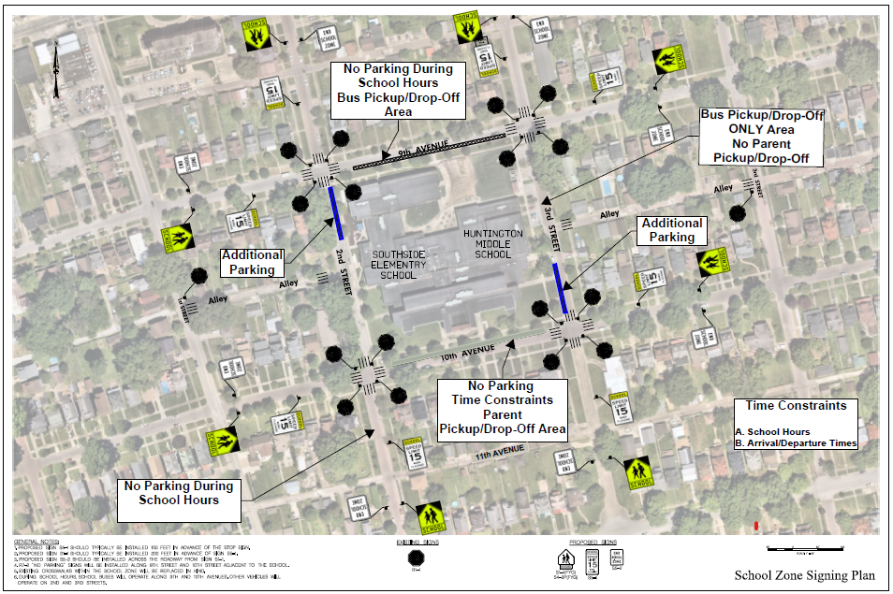

Recommendations

Slide 27
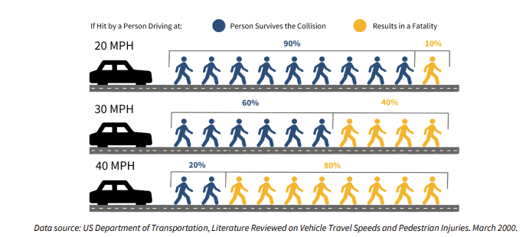

Recommendations
Location | Direction | Posted Speed | Avg. Speed | 85th Percentile | % Traveling 5 mph (or more) Over Posted Speed Limit
Southbound Along WV 62 Adjacent to the Poca Middle School | SB | 35 | 34 | 37 | 3.7%
Short Term:
Enhance signing and marking on Laurel Avenue and Center Street
Use tubular markers to create access management at the shopping center.
Work with City to do a safety campaign that discourages risky behavior including speeding, jaywalking, and blocking crosswalks
Consider reducing speed limit to 25 mph

Slide 28
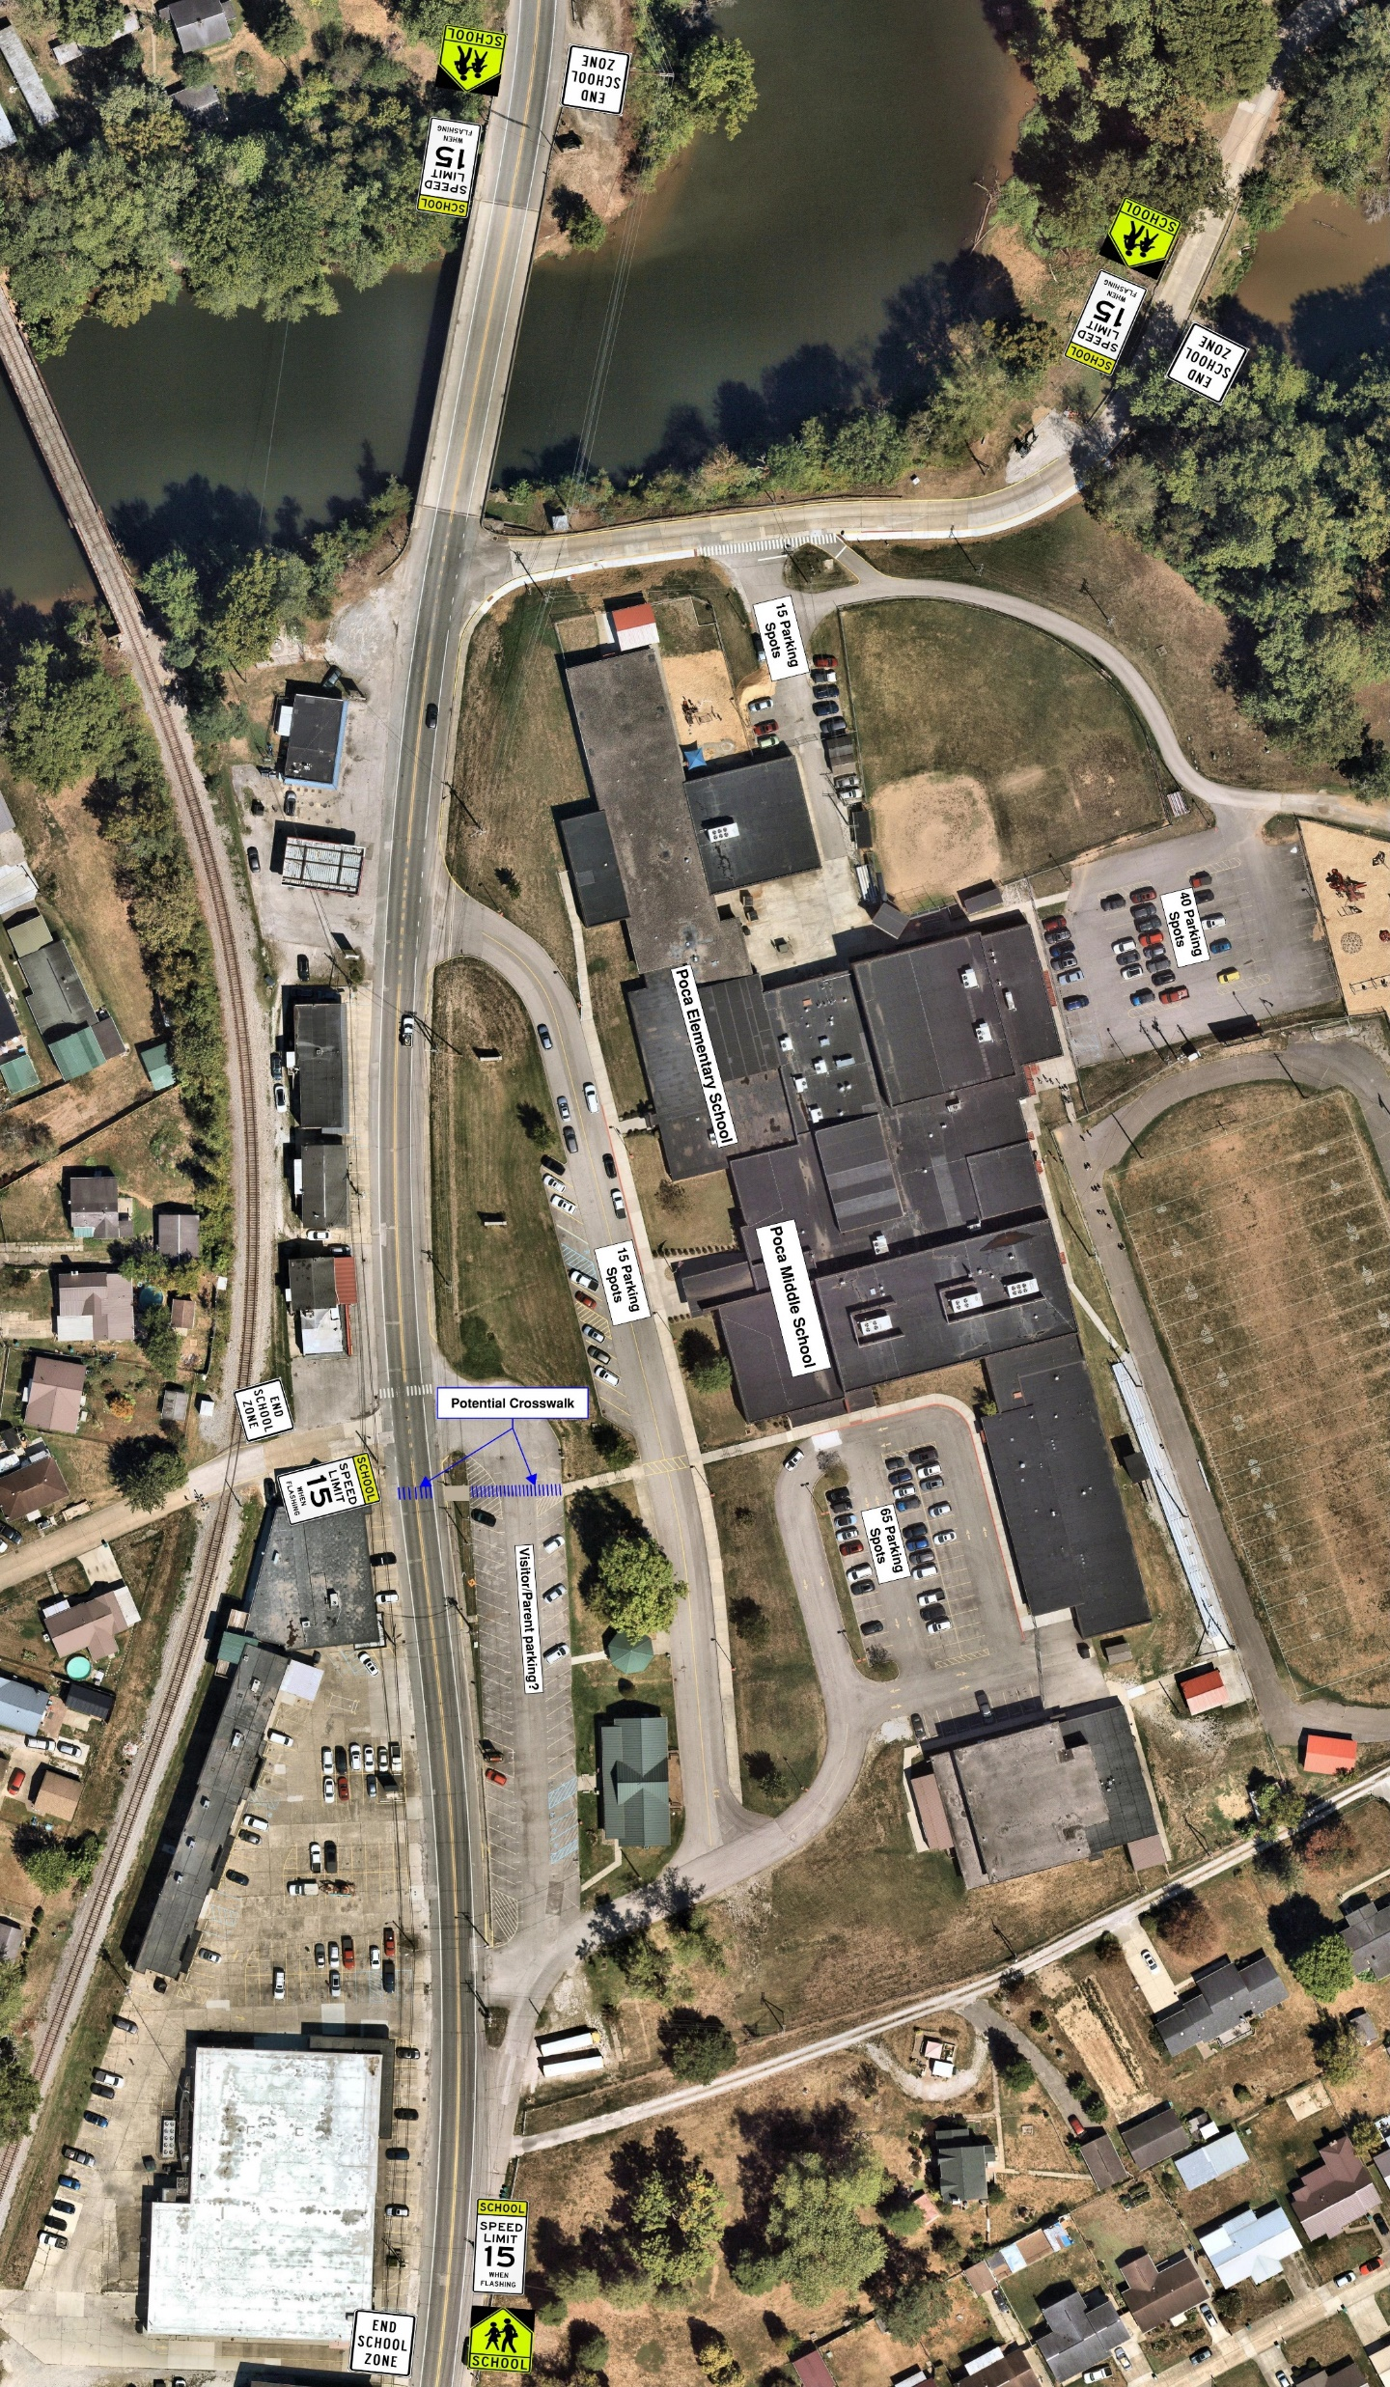
Short Term Recommendations – School Zone
Install high-visibility signage from the end of the bridge to Charles Lane
Add school zone signage to Laurel Avenue and move existing sign with flashing beacon on southbound WV 62 to be more visible to traveling public
Work with schools to find volunteers to work as crossing guards.
Send flyers reminding parents drop off/pick rules and discourage dropping off kids outside of school zone

Slide 29
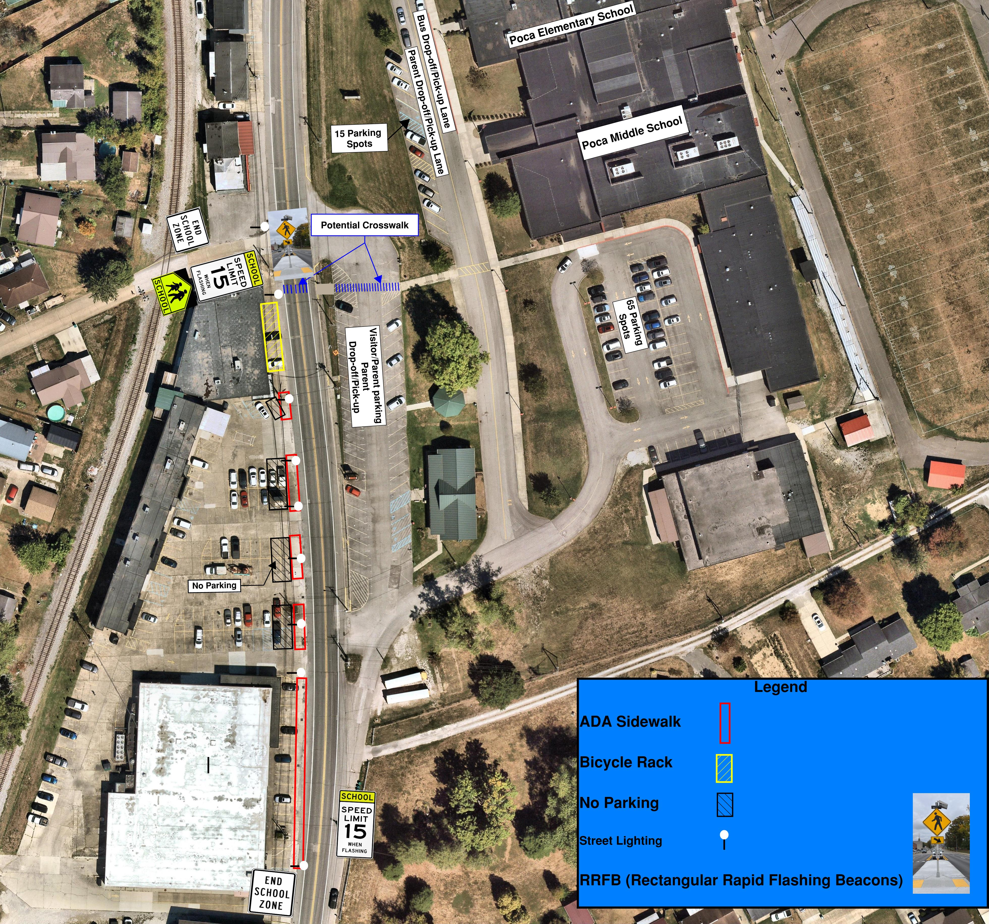
Long Term Recommendations
Install LED Street Lighting and sidewalk to area in front of shopping center
Install permanent access management at Poca Plaza including removal of parking places adjacent to roadway with cross hatching, planters, benches and/or bike racks

Slide 30
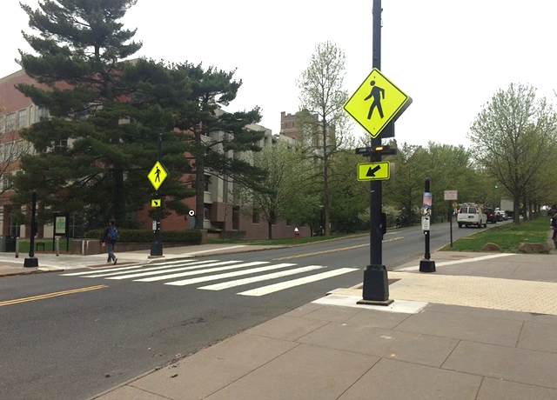
Recommendations – Pedestrian Crossing
Relocate longitudinal bars crosswalks on WV 62 to line up with Center Street intersection and existing pedestrian facilities on school campus. Fully eradicate existing crosswalk.
Install Rectangular Rapid Flashing Beacon (RRFB) to assist children crossing WV 62.
Install sidewalks on both sides of WV 62 including ADA ramps to complete the gaps in the sidewalk network

Slide 31
Conclusion
Rural and urban school zones face different traffic patterns, roadway conditions, and safety risks.
Urban school zones focus on pedestrian and multimodal safety, while rural zones prioritize speed management and visibility.
School safety improvements must be tailored to the unique context of each community.
Observations are as important as data
Develop a solution for the community with the community
Notes:
Rural and urban school zones require different solutions because traffic patterns, roadway design, travel behavior, land use, and safety risks vary significantly between dense urban neighborhoods and rural corridor environments.
School zone improvements must be tailored to local context, as urban areas typically prioritize pedestrian connectivity and multimodal access, while rural areas often focus on speed management, visibility, and separation from high-speed or heavy vehicle traffic.
Effective school safety strategies depend on the surrounding environment, meaning treatments successful in walkable urban neighborhoods may not address the unique operational and safety challenges present in rural communities.

Slide 32

Questions?
Chris Chiles
KYOVA Interstate Planning Commission
Jeffery Mace, CNU-A, CFE
Regional Intergovernmental Council
Donna Hardy, PE, RSP1
Mead & Hunt

