Slide 1
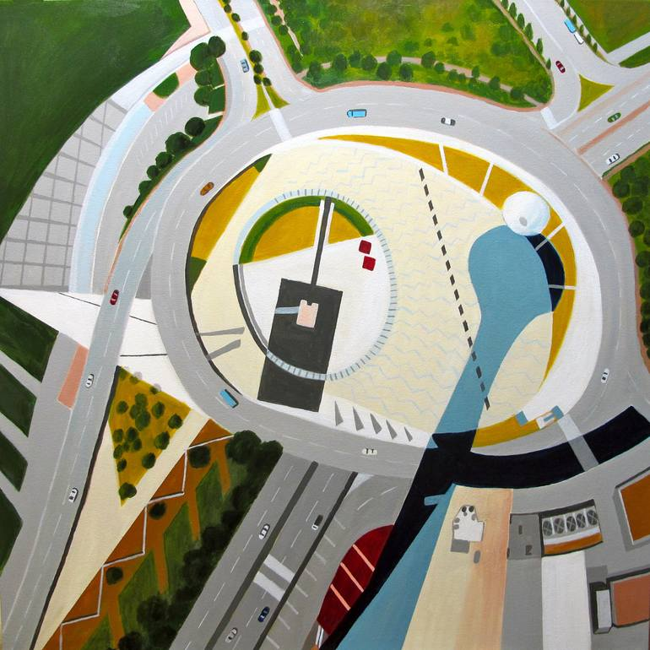
The Logics of Legitimacy of Metropolitan Planning Organizations
Presented by:
Samuel L. Richardson, MPA, AICP
Ethan W. Combs, MPA
Untitled, N Akkash, 2023

Slide 2


Agenda
01 | Introductions
02 | Why do MPOs have authority and why do people accept it?
03 | The Logics Framework
04 | The Tensions of the Logics that MPOs live within
05 | Conclusion

Slide 3
Presenter Introductions
Samuel L. Richardson, MPA, AICP
Ethan W. Combs,
MPA
Sam is the Transportation Planning Director for the Bel‑O‑Mar Regional Council, Vice Chair of the West Virginia Association of Metropolitan Planning Organizations and serves on the WV LTAP Advisory Board.
He brings more than seven years of experience in regional governance and infrastructure planning, with a strong record of advancing safety, accessibility, and local capacity through competitive federal grants.
Transportation Planning Director
Bel-O-Mar Regional Council
Transportation Planner
Bel-O-Mar Regional Council
Ethan Combs is a Transportation Planner with the Bel‑O‑Mar Regional Council, where he works on regional transportation planning and public transit coordination across local governments.
His work focuses on MPO policy and compliance, human services transportation, and the collaborative foundations that support effective regional planning.

Slide 4
Believe it or not, there is a “Science of Public Administration”
Notes:
Tie these two together

Slide 5
Public administration can be traced to early administrative systems such as the Roman Empire, which developed formal hierarchies for taxation, law, and military governance
Public administration emerged as a formal field of study in 1887 with Woodrow Wilson’s The Study of Administration
By the mid‑20th century, the field expanded to include organizational behavior, decision‑making, and policy processes
Today, public administration is an interdisciplinary field drawing from political science, economics, and management
The field examines how authority operates through formal organizations and administrative systems; It focuses on how public decisions are carried out through management structures

Slide 6
Why do MPOs have authority and why do people accept It?

Slide 7
Why do MPOs Have Authority? (The Easy Question)
Why do People
Accept it? (The Harder Question)
Where MPO Authority Comes From
Federal Law (Title 23)
State Recognition
Required Regional Role
Formal Planning Products
BUT…
Authority alone does not explain acceptance
Many institutions still lack public trust
Why do People Accept it?
MPOs do not control land use
MPOs do not levy taxes
MPOs does not enforce the law
BUT…
MPOs work. Why is that?

Slide 8
MPOs Operate in Legitimacy (The Real Answer)
Legitimacy is Not Power
Legitimacy means:
  Decisions feel reasonable
  Processes feel fair
  Outcomes feel justified
  The institution is trusted, even in bouts of disagreement
MPOs operate on legitimacy more than control

Slide 9
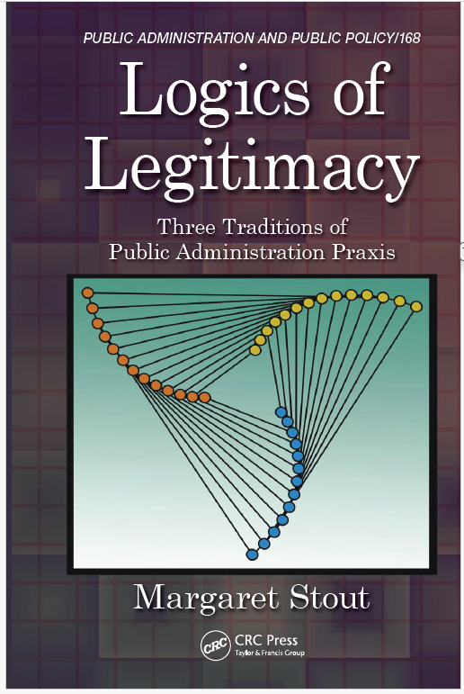
Logics of Legitimacy by Margaret Stout
Logics of Legitimacy
Dr. Margaret Stout examines how legitimacy is understood in public administration
She argues that legitimacy is not singular, but shaped by competing traditions within the field
These traditions differ in how they define authority, administrative roles, and public engagement
She organizes these into three logics: constitutional, discretionary, and collaborative

Slide 10
The Three Logics of Legitimacy

Slide 11

Constitutional
The Three Logics of Legitimacy
Discretionary
Collaborative
Constitutional = Law, rules, representation
We are legitimate because we are authorized
Discretionary = Expertise, analysis, performance
We are legitimate because we know
Collaborative = Participation, trust, shared decisions
We are legitimate because we decide together

Slide 12
Most Organizations Often Rest on One or Two Logics
  Some rely mainly on Law
  Some rely mainly on Expertise
  Some rely mainly on Participation
Problems arise when one logic dominates
Law without trust
Expertise without consent
Participation without influence

Slide 13
Constitutional
Where We (MPOs) Sit
MPOs
Discretionary
Collaborative
Title 23 Requirements
Formal Adoption and oversights
Data, modeling, technical analyses
Performance Measures
MPO Boards
Interagency Coordination
Public Involvement

Slide 14
Constitutional
The Three Logics of Legitimacy
The U.S. Constitution grants Congress authority to write laws and allocate funding
Congress uses this authority to pass surface transportation authorization bills
  Establish funding programs
  Set requirements for how funds are used
Federal law (Title 23, NEPA, Title VI) ties transportation funding to public interest and accountability
These requirements introduced key questions into the planning process
  Do we want this project?
  What will it cost?
  Who is impacted?
MPOs emerged within this framework to support regional decision-making and coordination
State DOTs have traditionally focused on system efficiency, not community-building
Constitutional = Law, rules, representation
We are legitimate because we are authorized
Notes:
Original slide notes: The US Constitution
-Authorizes congress to write laws and spend money
-Congress historically passes what’s surface transportation funding authorization bills
-Establish funding
-Write the compliance rules with the funding
-History of surface transportation reauthorization
-Where in the timeline were MPOs established
-Recognition of some of the failures of construction the interstate system
-Roads are racist (toned down!)
-People who designed them originally had a blind spot or apathetic
State DOT – they’re aren’t a community builder
- Get people to where they need to go quickly
Congress Title 23 NEPA, MPOs, Title VI Environmental – Compliance with the public interest
-Do we even want this road? How much will it cost? Where will it be built? What ROW will need?
Board structure – mimics the constitution

Slide 15
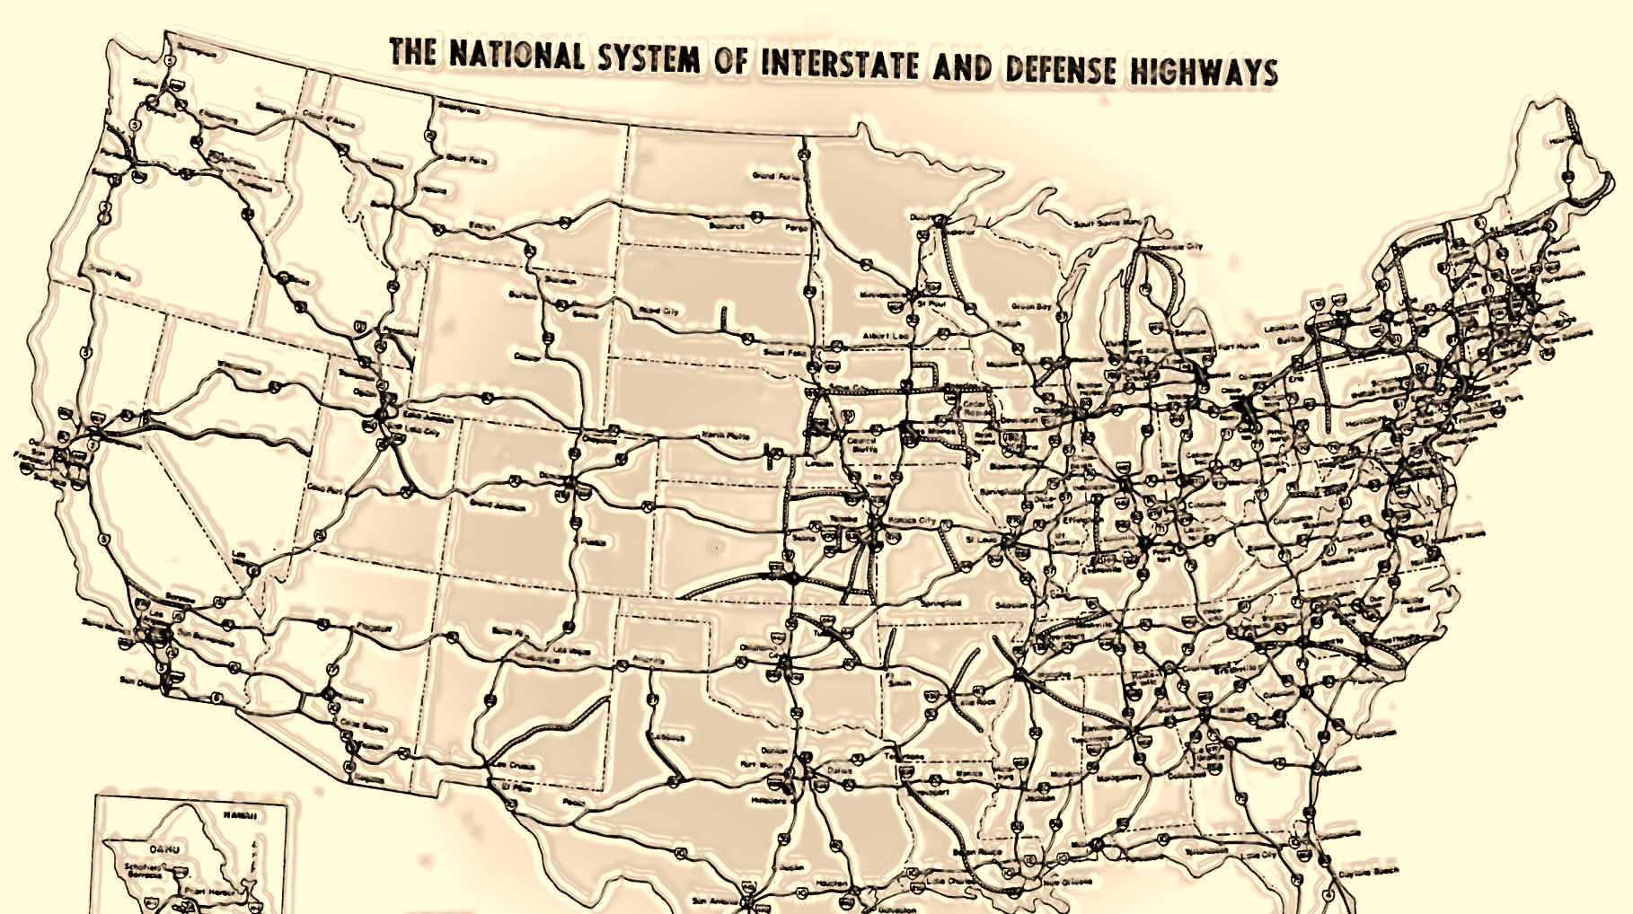
Constitutional
History of the Federal Highway System and MPOs
1991 - The Intermodal Surface Transportation Efficiency Act (ISTEA) is signed
1998 - The FAHA of 1958 is signed increasing funding for Interstate System
1964 - The Urban Mass Transportation Act is signed, providing funds for mass transit
1973 - FAHA of 1973 funds Highway Safety Program and permits states to withdraw segments of interstate system to fund mass transit
2005 - Safe, Accountable, Flexible, Efficient Transportation Equity Act: A Legacy for Users (SAFETEA-LU) is signed
2021 – Infrastructure Investment and Jobs Act (IIJA) signed providing historic levels of funding
1956 - Dwight D. Eisenhower signs the Federal-Aid Highway Act (FAHA) of 1956
1962 - The FAHA of 1962 is signed and requires a 3-C planning
1968 - FAHA of 1968 is signed, establishing fair housing standards for those displaced
1983 - Surface Transportation Assistance Act is signed
1998 -Transportation Equity Act for the 21st Century (TEA-21) is signed
2015 - Fixing America’s Surface Transportation (FAST) Act is signed
1952 1960 1968 1976 1984 1992 2000 2008 2016 2024
1962 - MPOs introduced in the Federal Aid Highway Act of 1962
1992 - Original System of the 1956 FAHA mostly completed
1964 - Urban Mass Transportation Act establishes Urban Mass Transportation Administration (Now the FTA)

Slide 16
The Three Logics of Legitimacy
Collaborative
MPOs are required to support public participation, but often go beyond minimum requirements
Engagement is continuous, not limited to MTP or TIP update cycles
  Feedback gathered through meetings, activities, and ongoing outreach
Public input directly informs project development and regional priorities
Planning is guided by the 3‑C process (continuing, cooperative, comprehensive)
MPOs function as collaborative teams rather than one-time presenters
The goal is meaningful public involvement, not just formal compliance
Collaborative = Participation, trust, shared decisions
We are legitimate because we decide together

Slide 17
The Three Logics of Legitimacy
Discretionary
Meaningful public involvement depends on technical and professional knowledge
Research and training occur continuously in the background
Applied research embedded in the work program
Professional expertise is developed through credentials and continuing education
  AICP, GISP, PE, MPA, CNU‑A, WV LTAP Road Scholars
Administrative legitimacy is reinforced through demonstrated competence and expertise
Discretionary = Expertise, analysis, performance
We are legitimate because we know

Slide 18
Example of how Two Logics can Coincide
Discretionary
Collaborative
Discretionary and collaborative logics often operate together in practice
Partnerships with programs like LTAP strengthen technical expertise and credibility
  MPOs work with training providers to identify needs and deliver relevant support
Special Topic Meetings
  Mode-based committees
    Freight, pedestrians, cyclists, public transportation
  Specific road or street development groups
Collaboration expands capacity while reinforcing professional competence
  See WV LTAP/MPO Panel: Success Through Collaboration
Discretionary = Expertise, analysis, performance
We are legitimate because we know
Collaborative = Participation, trust, shared decisions
We are legitimate because we decide together

Slide 19
Constitutional
MPO Organizational Structures Are
Discretionary
Collaborative
Model authority as a regional representative democracy
Some MPO structures favor more proportional representation than others
Directly infuse the experts into authority
State DOTs
Public Transit
Inform authorities through a strong public feedback mechanism
Public Advisory Committees
Strong public participation and community feedback mechanisms
Technical Advisory Committees
MPO Organizational Authority

Slide 20
Constitutional
MPO Public and Stakeholder Participation Is
23 CFR 450.316
Interested parties, participation, and consultation.
Legitimate
Stakeholders and techniques are defined by federal authority
Requires a discretionary and collaborative approach
Decision-Making
Discretionary
Collaborative
Techniques are governed to provide guarantees of accessibility to the process
Authority
Freight shippers, transportation authorities, port authorities and more

Slide 21
The Tensions of the Logics that MPOs Live Within

Slide 22
Common Areas of Tension for MPOs
Common MPO Tensions
  Technical rigor vs. public understanding
  Compliance vs. meaningful participation
  Regional priorities vs. local autonomy
  Speed vs. deliberation
These tensions are structural, not failures

Slide 23
Why Integration of all Three Legitimacies is Hard
You cannot perfectly satisfy all logics at once
Someone must decide
Most institutions default to hierarchy or expertise
But MPOs do something different
They manage tension through process
They rely on credibility, not coercion

Slide 24
Today’s Governance Reality
Contemporary Governance is:
Networked
Multi‑jurisdictional
Inter‑sectoral
Trust‑dependent
Legitimacy matters more than command

Slide 25
The Whole Point
MPOs emerge as some of the most legitimate public organizations
NOT because they are:
    The most powerful
    The most technical
    The most participatory
  But because they:
    Balance law, expertise, and collaboration
    Govern through consent, not force
    Fit the world we actually work in

Slide 26
In Conclusion…
In today’s networked governance environment, MPOs are among the most legitimate public organizations operating today because they rely on trust, shared decision-making, and coordinated action rather than control.

Slide 27
Thank you!
If you want to talk about this topic more, here are our emails
Samuel Richardson Ethan Combs
srichardson@belomar.org ecombs@belomar.org

