Slide 1
2027-2031
June 4, 2026
WEST VIRGINIA
STRATEGIC HIGHWAY SAFETY PLAN

Slide 2
Today’s Agenda
What is an SHSP?
Why Update? – Purpose and Process
SHSP History in West Virginia
Current SHSP
Safe System Approach
State of the State – West Virginia Serious Injuries and Fatalities
SHSP Goal and Objective
Emphasis Area Selection
Next Steps

Slide 3
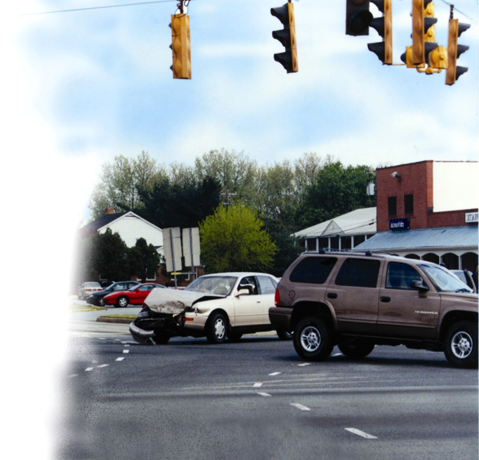
What is a Strategic Highway Safety Plan (SHSP)?
Comprehensive transportation safety plan with a goal of reducing highway fatalities and serious injuries on all public roads
Establishes consistent statewide goals, objectives, emphasis areas, priorities, and countermeasures with stakeholders and across other transportation plans
Makes effective use of highway safety related data to determine data-driven priorities
Addresses engineering, management, operation, education, enforcement, and emergency medical services through common goals and strategies

Slide 4
SHSP Requirements
Multidisciplinary approach and coordination
  Enforcement, Education, Engineering, and Emergency Medical Services
Analyze and make effective use of safety data
Consider the safety needs of all public roads
Adopt performance-based goals
Implementation and Evaluation
FHWA Special Rules
  High Risk Rural Roads
  Older Drivers and Pedestrians
  Vulnerable Road Users
Plan must describe the update process
Be completed no later than 5 years from the date of the previous approved version
Be approved and signed by the Governor of the state or designee
Provide strategic direction for other state/local safety plans

Slide 5
SHSP Stakeholders
State GHSP representative
MPOs and regional transportation planning organizations
Representatives of major modes of transportation
State and local traffic enforcement officials
Highway-rail grade crossing safety representative of the Governor
Motor Carrier Safety program representative
Motor vehicle administration
Non-motorized user representatives
Other safety stakeholders

Slide 6
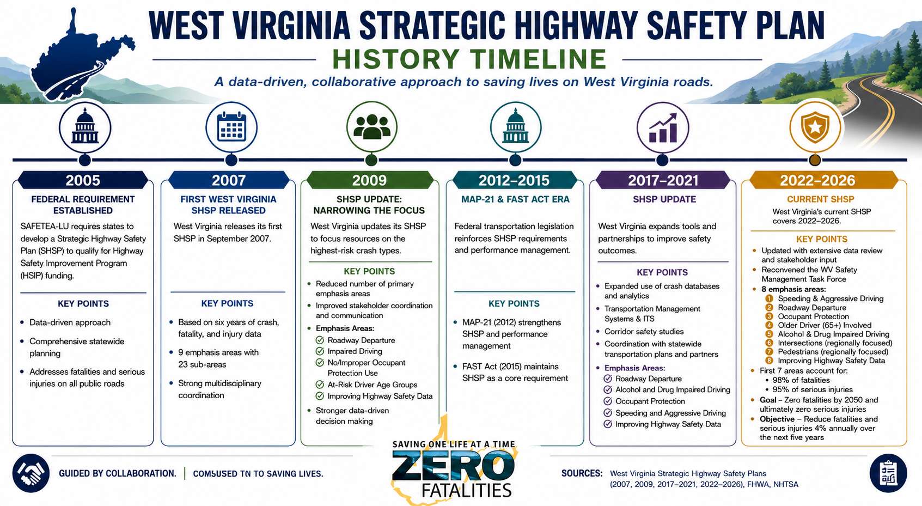
WV SHSP History
Graphic created using ChatGPT

Slide 7
SHSP Update – Purpose
Why update?
  FHWA says we have to!
    23 CFR 924.9(a)(3)(i) – SHSP shall be updated no later than 5 years from the previous approved version
    2022 – 2026 SHSP signed by Secretary Justice in June 2022
  Refresh data analysis and emphasis areas
    Identify changes in data trends – crashes, population, etc.
    Include new emphasis areas where data is trending in the wrong direction (more fatalities or serious injuries compared to previous five years)
    Consider removing emphasis areas that may be trending in the correct direction
  Address changes in Federal rulemaking or guidance
    Vulnerable Road User Safety Assessment
    NPRM issued in 2024, but withdrew in 2025 – no changes to 23 CFR Part 924
  Address changes in state laws, policy, guidance

Slide 8
SHSP Update - Process
SHSP Update Kick-off meeting
Analysis of fatalities and serious injuries
SHSP goal and objective review
Emphasis area selection
Evaluate past performance
Identify emphasis area performance-based objectives
SHSP coordination with other safety and transportation plans
Identify strategies
Obtain SMTF approval
Obtain Governor’s approval (or designee)
May 2026
We are here
Dec. 2026
Plan approval

Slide 9
SHSP Update – Process Approval Checklist
FHWA approves the update process, not the actual SHSP document
A state’s SHSP update process will be approved if:
  The SHSP is consistent with section 148 of 23 U.S.C.
  The process used by the state to update the SHSP is consistent with section 148 of 23 U.S.C.
Update process is approved by the FHWA Division Administrator
FHWA provides and approval checklist
  Used as a guide to develop the SHSP in consultation with the SMTF

Slide 10
West Virginia Fatalities and Serious Injuries

Slide 11
Fatalities and Serious Injuries

Slide 12
West Virginia and the Nation
West Virginia
National Average
Source: Fatality Analysis Reporting System, 2023 data, latest available
Notes:
WV is ranked 5th in highest fatality rate in the nation, based on 2023 data which is the latest available for all states. In the previous plan, WV was ranked 13th highest, based on 2019 data. So while the fatality rate has increased, our fatality numbers have gone down.

Slide 13
Goals and Objectives

Slide 14
Goal and Objective
2022 – 2026 WV Strategic Highway Safety Plan goal:
  Work cooperatively to improve roadway safety, eliminating fatalities and serious injuries through the coordinated efforts of enforcement, education, emergency medical services, and engineering.
2022 – 2026 WV Strategic Highway Safety Plan objective:
  Achieve zero fatalities by 2050 and ultimately zero serious injuries on our roadways, by reducing fatalities and serious injuries 4% annually over the next five years.

Slide 15
Introduction to the Safe System Approach

Slide 16
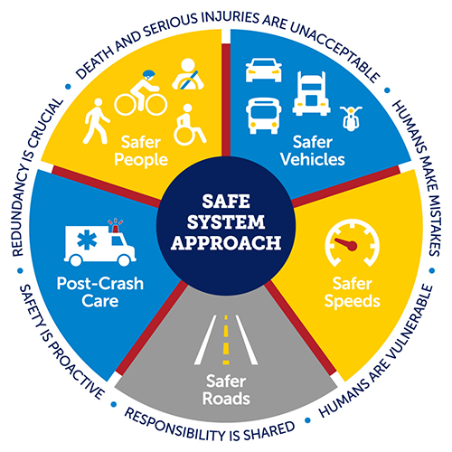
Safe System Approach
Safe System Approach has been adopted by the U.S. DOT as the guiding paradigm to address roadway safety
  Supports implementation of the National Roadway Safety Strategy
Shift from our conventional reactive safety approach
  Focuses on both human mistakes AND human vulnerability
  Designs a system with many redundancies in place
Multiple layers of protection to both prevent crashes from happening in the first place and minimizing the harm caused to those involved when crashes do occur

Slide 17
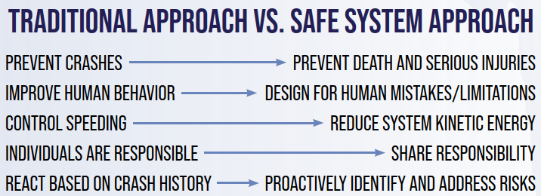
Safe System Approach
Comparison of traditional approach to safety and the Safe System Approach

Slide 18
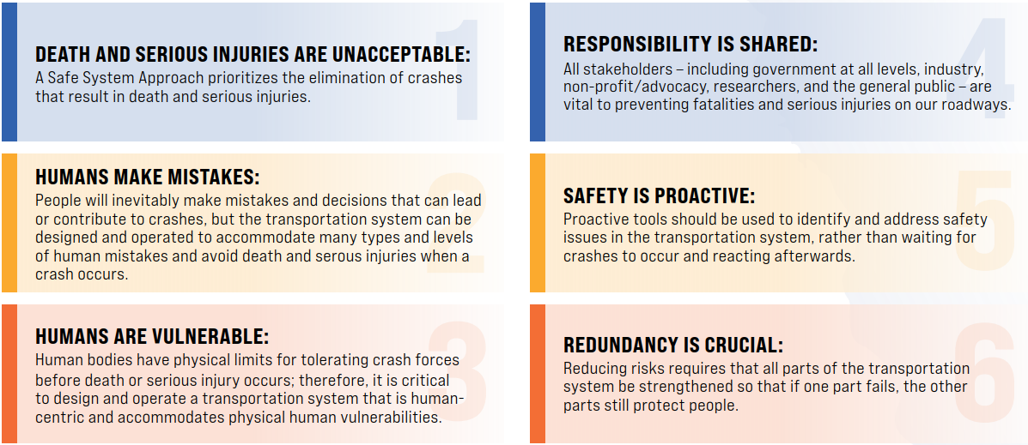
Safe System Approach - Principles

Slide 19
Safe System Approach - Objectives
Safer People
  Encourage safe, responsible driving and behavior by all
  road users
  Create conditions that prioritize their ability to reach their
  destination unharmed
Safer Vehicles
  Expand the availability of vehicle systems and features
  that help to prevent crashes and minimize the impact of
  crashes on both occupants and non-occupants
Safer Speeds
  Promote safer speeds in all roadway environments through a
  combination of thoughtful, equitable, context-appropriate
  roadway design, appropriate speed limit setting, targeted education,
  outreach campaigns, and enforcement

Slide 20
Safe System Approach - Objectives
Safer Roads
  Design roadway environments to:
    Mitigate human mistakes and account for injury tolerance
    Encourage safer behaviors
    Facilitate safe travel by the most vulnerable users
Post-Crash Care
  Enhance the survivability of crashes through expedient
  access to emergency medical care, while creating a safe
  working environment for vital first responders and
  preventing secondary crashes through robust traffic incident
  management practices

Slide 21
Safe System Approach
The “Swiss Cheese Model” of redundancy creates layers of protection
Death and serious injuries only happen when all layers fail
Safer road users
Safer road users
Safer vehicles
Safer vehicles
Safer speeds
Safer speeds
Safer roads
Safer roads
Post-crash care
Post-crash care

Slide 22
Safe System Approach
Incorporating the Safe System Approach into the WV SHSP
  Organize the SHSP around the Safe System Approach
  principles and elements
  The 4 E’s (enforcement, education, engineering, and
  emergency services) should address the six principles
  of the Safe System Approach
    Build strategies around the six principles and the 4 E’s in each
    emphasis area
  Identify where emphasis areas may overlap the five
  elements of the Safe System Approach
    Implement cross-cutting countermeasures to address multiple
    elements

Slide 23
Emphasis Areas

Slide 24
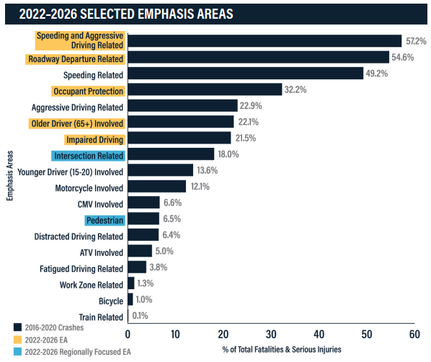
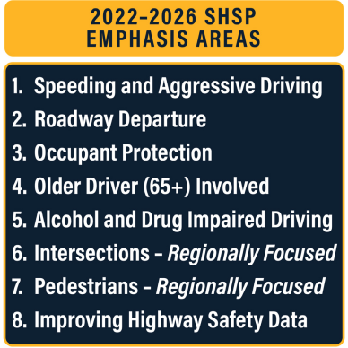
SHSP Emphasis Areas
2022 – 2026 SHSP Emphasis Areas

Slide 25
Emphasis Area Selection

Slide 26
Potential SHSP Emphasis Areas
Combined Fatalities & Serious Injuries
2022-2026 SHSP EA (NOTE: Speeding & Aggressive Driving is a combined EA)

Slide 27
2027-2031 Potential SHSP Emphasis Areas
Speeding & Aggressive Driving
Roadway Departure
Occupant Protection
Older Driver (Age 65+)
Intersections
Younger Drivers
Alcohol & Drug Impaired Driving
Motorcycles & ATVs
Vulnerable Road Users – Pedestrians & Bicyclists
Work Zones
Improving Highway Safety Data
Traffic Incident Management & Response

Slide 28
Speeding & Aggressive Driving

Slide 29
Speeding and Aggressive Driving
Annual Fatalities and Serious Injuries
Speeding and Aggressive Driving Related | 2022-2026 SHSP ’15-’19 Crashes | 2027-2031 SHSP ’19-’24 Crashes | Trend
% of total fatalities | 57.4% | 65.4% | ↑
% of total serious injuries | 57.2% | 70.6% | ↑

Slide 30
Speeding and Aggressive Driving
Causal Factors
% of Total Speeding & Aggressive Driving Fatalities
% of Total Speeding & Aggressive Driving Serious Injuries

Slide 31
Roadway Departure

Slide 32
Roadway Departure
Annual Fatalities and Serious Injuries
Roadway Departure Related | 2022-2026 SHSP ’15-’19 Crashes | 2027-2031 SHSP ’19-’24 Crashes | Trend
% of total fatalities | 62.2% | 57.5% | ↓
% of total serious injuries | 52.6% | 50.6% | ↓

Slide 33
Roadway Departure
Causal Factors
% of Total Roadway Departure Fatalities
% of Total Roadway Departure Serious Injuries

Slide 34
Occupant Protection

Slide 35
Occupant Protection
Annual Fatalities and Serious Injuries
Occupant Protection | 2022-2026 SHSP ’16-’20 Crashes | 2027-2031 SHSP ’19-’24 Crashes | Trend
% of total fatalities | 44.9% | 43.7% | ↓
% of total serious injuries | 28.7% | 28.4% | ↓

Slide 36
Occupant Protection
Causal Factors
% of Total Occupant Protection Fatalities
% of Total Occupant Protection Serious Injuries

Slide 37
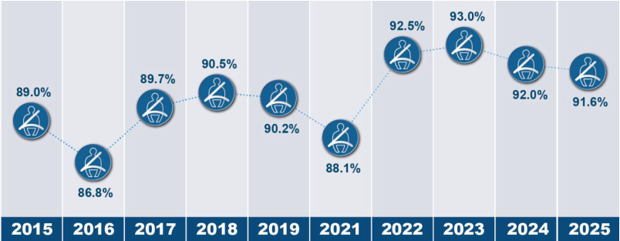
Occupant Protection
West Virginia Observed Seat Belt Use Rate
Source: 2025 WV Observational Seat Belt Survey Report
Seat Belt use rate at time of 2022-2026 SHSP Publication

Slide 38
Older Drivers (65+) Involved

Slide 39
Older Driver (65+) Involved
Annual Fatalities and Serious Injuries
Older Driver (65+) Involved | 2022-2026 SHSP ’15-’19 Crashes | 2027-2031 SHSP ’19-’24 Crashes | Trend
% of total fatalities | 27.4% | 27.0% | ↓
% of total serious injuries | 20.6% | 21.9% | ↑

Slide 40
Older Drivers (65+) Involved
Causal Factors
% of Total Older Driver (65+) Involved Fatalities
% of Total Older Driver (65+) Involved Serious Injuries

Slide 41
Intersections

Slide 42
Intersections
Annual Fatalities and Serious Injuries
Intersection Related | 2022-2026 SHSP ’15-’19 Crashes | 2027-2031 SHSP ’19-’24 Crashes | Trend
% of total fatalities | 13.8% | 15.3% | ↑
% of total serious injuries | 19.2% | 20.9% | ↑

Slide 43
Intersections
Causal Factors
% of Total Intersection Related Fatalities
% of Total Intersection Related Serious Injuries

Slide 44
Younger Drivers

Slide 45
Potential Emphasis Area Trends
Younger Driver (Age 15-20) Involved | 2022-2026 SHSP ’15-’19 Crashes | 2027-2031 SHSP ’19-’24 Crashes | Trend
% of total fatalities | 11.0% | 12.6% | ↑
% of total serious injuries | 14.3% | 18.5% | ↑

Slide 46
Impaired Driving

Slide 47
Impaired Driving
Annual Fatalities and Serious Injuries
Alcohol or Drug Related (Impaired Driving) | 2022-2026 SHSP ’15-’19 Crashes | 2027-2031 SHSP ’19-’24 Crashes | Trend
% of total fatalities | 24.2% | 16.9% | ↓
% of total serious injuries | 20.8% | 14.1% | ↓

Slide 48
Impaired Driving
Causal Factors
% of Total Alcohol or Drug Related Fatalities
% of Total Alcohol or Drug Related Serious Injuries

Slide 49
Motorcycles & ATVs

Slide 50
Potential Emphasis Area Trends
Motorcycle Involved | 2022-2026 SHSP ’15-’19 Crashes | 2027-2031 SHSP ’19-’24 Crashes | Trend
% of total fatalities | 11.6% | 13.4% | ↑
% of total serious injuries | 12.2% | 15.1% | ↑

Slide 51
Potential Emphasis Area Trends
ATV Involved | 2022-2026 SHSP ’15-’19 Crashes | 2027-2031 SHSP ’19-’24 Crashes | Trend
% of total fatalities | 6.4% | 6.9% | ↑
% of total serious injuries | 4.7% | 5.0% | ↑

Slide 52
Vulnerable Road Users

Slide 53
Potential Emphasis Area Trends
Pedestrians | 2022-2026 SHSP ’15-’19 Crashes | 2027-2031 SHSP ’19-’24 Crashes | Trend
% of total fatalities | 9.1% | 9.2% | ↑
% of total serious injuries | 5.7% | 5.3% | ↓

Slide 54
Potential Emphasis Area Trends
Bicycle | 2022-2026 SHSP ’15-’19 Crashes | 2027-2031 SHSP ’19-’24 Crashes | Trend
% of total fatalities | 0.9% | 1.0% | ↑
% of total serious injuries | 1.1% | 1.1% | -

Slide 55
Work Zones

Slide 56
Potential Emphasis Area Trends
Work Zone Related | 2022-2026 SHSP ’15-’19 Crashes | 2027-2031 SHSP ’19-’24 Crashes | Trend
% of total fatalities | 1.6% | 2.3% | ↑
% of total serious injuries | 1.1% | 2.0% | ↑

Slide 57
Applying the Safe System Approach

Slide 58
Viewing Proposed Emphasis Areas
Based on the Safe System Approach
Safer People
  Occupant Protection – 32.2% combined fatalities and serious injuries
  Older Drivers (65+) Involved – 23.2% combined fatalities and serious injuries
  Young Drivers (15-20 years old) Involved – 17.0% combined fatalities and serious injuries
  Alcohol and Drug Related (Impaired Driving) – 14.8% combined fatalities and serious injuries
  Pedestrians – 6.3% combined fatalities and serious injuries
    See Vulnerable Road User Safety Assessment

Slide 59
Proposed Emphasis Areas
Based on the Safe System Approach
Safer Vehicles
  Motorcycles – 14.6% combined fatalities and serious injuries
Safer Roads
  Roadway Departure – 52.3% combined fatalities and serious injuries
  Intersections – 19.5% combined fatalities and serious injuries
  Work Zone Related – 2.0% combined fatalities and serious injuries

Slide 60
Proposed Emphasis Areas
Based on the Safe System Approach
Safer Speeds
  Speeding and Aggressive Driving – 69.3% combine fatalities and serious injuries
Post Crash Care
  Improving Highway Safety Data
  Traffic Incident Management
  Improving Emergency Response Times

Slide 61
Next Steps

Slide 62
Next Steps
Current progress
  SHSP Update Kick-off meeting
  Analysis of fatalities and serious injuries
  SHSP goal and objective review
  Emphasis area selection
Next steps
  Evaluate past performance
  Identify emphasis area performance-based objectives
  SHSP coordination with other safety and transportation plans
  Identify strategies
  Prepare draft plan and submit to SMTF for review
  Address comments and finalized plan
  Obtain SMTF approval
  Obtain Governor’s approval (or designee) & FHWA approval of process
May 2026
We are here
Dec. 2026
Plan approval

Slide 63
Thank you!
Marsha K. Mays, P.E., WVDOH,
Strategic Safety Planning & Analysis Engineer
Marsha.K.Mays@wv.gov

