Slide 1

What Not to Say. What Not to Do.
Guidance for
Liability Neutral Language
Ron W. Eck, P.E.
WV LTAP
Ronald.Eck@mail.wvu.edu

Slide 2
Agenda
Introduction and Background
Recommendations on What Not to Say
Recommendations on What Not to Do
Wrap-Up
Q & A

Slide 3
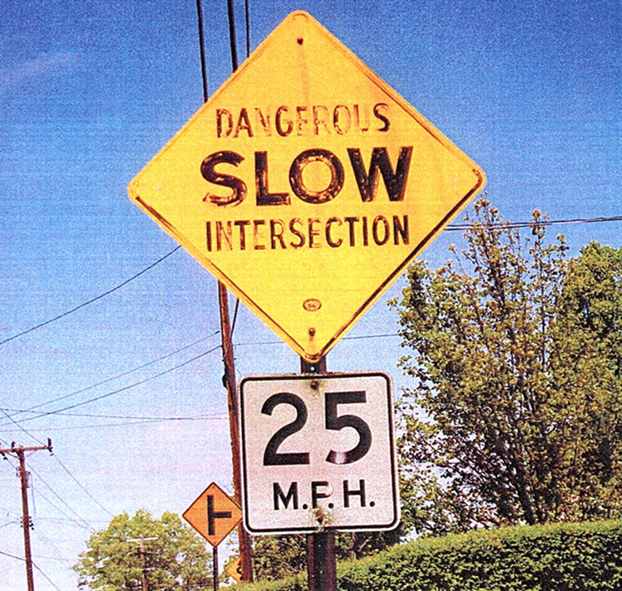
What’s Wrong in This Picture?

Slide 4
Words Have Power!
Don’t Let Them Be Used Against You or Your Organization

Slide 5
The Situation
Employees of state and local road agencies make public presentations. They are interviewed by the media.
State and local road agencies generate a variety of documents—
-- manuals -- memos
-- policies -- emails
-- studies -- reports
Consultants and contractors generate similar documents

Slide 6
The Situation (cont’d)
Almost all written communications prepared within a public agency are accessible through public records requests and during the litigation process.
For private sector firms, information can be accessed during the litigation process.
Such documents can be used by litigants and the courts as evidence regarding the standard of care or duties for road agencies and private sector firms who are sued for alleged negligence.

Slide 7
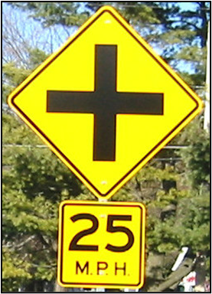
Liability Neutral Language
Clear, direct and objective wording that is descriptive and factual rather than taking a position on who might be responsible.
Using words/language that reflect how things are actually done

Slide 8
Recommendations on What Not to Say
Choose Each Word Carefully—certain words should be avoided
Avoid Using Vague Phrases
Watch for Surplus Language

Slide 9
Choose Each Word Carefully
Words such as unsafe, hazardous or dangerous tend to create the potential for liability due to what is implied.
When used to describe a condition of the road, they imply that if the specified feature is improperly maintained or in need of repair, the road, rather than driver error is at least partially at fault.
Words can imply that an agency is careless or negligent if it has not remedied the condition before a crash occurs.

Slide 10
Partial List of Words That Can Create Unintended Liability
Concern Inadequate/Insufficient
Dangerous Poor
Deficient Problem
Edge Drop-Off Require
Ensure the Safety . . . Risk/Risky
Excessive Safe
Hazard/Hazardous Trap
Hot Spot Unsafe

Slide 11
Example--Guide Published by a Government Agency for Local Municipalities
In describing ways to improve safety on local roads, the guide states:
“Reduce crash severity by designing appropriate slopes/ditches and removing hazardous roadside features.”

Slide 12
Assessment
Note use of word “hazardous.”
When a respected organization acknowledges roadside features create a dangerous condition, it creates a liability risk for state and local agencies.
Make it liability neutral by removing the word.

Slide 13
Example—Training Materials
Presented by A Trade Association
One of the slides states:

Slide 14
Example—A Vendor of
Temporary Traffic Control Devices
The company website states--
Ensure public safety.
Counties and municipalities have the responsibility to ensure the safety of the public during festivals, parades, or other events that take place in local communities. We specialize in event traffic control and would love to help manage the traffic for your upcoming event.

Slide 15
Assessment
Note use of the word “ensure” with respect to safety.
The legal duty of a road agency is to provide “reasonably safe” roads. There is not a duty to ensure the safety of road users. However, agencies (and others) can create a higher duty through the language they use.
Make liability neutral by deleting the term or by stating the facts, that is, the duty is to provide reasonably safe roads.

Slide 16
Avoid Using Vague Phrases
Phrases such as “consideration should be given to” and “wherever possible” may appear to provide flexibility for an agency.
However, they in essence require action to be taken.
Factual information and descriptions that allow the practitioner to use engineering judgment to make a decision are more useful and allow the use of discretion in performance of the work.

Slide 17
Example—State A Maintenance Manual
“The Department, when fencing is damaged by an errant vehicle that has left the pavement of a State Highway and livestock is present, is authorized to give notice to the property owner; notify HP; complete a temporary repair while the owner is responding; and repair the fence if the situation seems too dangerous. The property owner or damaging party will be billed for the repairs. Repairs made to non-Department fence will meet the minimum Department standards.”

Slide 18
Assessment
Policy contains language that is not clear. Should identify the parameters of the agency’s responsibility.
The word “dangerous” is used
Maintenance staff is left to determine how dangerous is “too dangerous.”
How and when is that decision made?

Slide 19
Example—State B Maintenance Manual
Inspection and Repair of Fences and Gates
1. Purpose. The purpose of this activity is to protect the safety of the public by keeping livestock off the highway and ensuring that controlled access is maintained.
2. Timing of Maintenance. Fences should be inspected twice a year and needed repairs and maintenance scheduled. Fence and gate damage should be scheduled for repair as soon as practical.

Slide 20
Assessment
Policy is consistent with principles mentioned.
Sets a specific schedule for fence inspection (twice a year).
But provides flexibility within the policy to allow repairs to be done “as soon as practical.”

Slide 21
Watch for Surplus Language
Can be words that are redundant or duplicative or words that seek to explain a concept that does not require explanation.
Can impact the clarity of an idea or provide a plaintiff’s attorney with a theory of negligence that would not have been apparent from a concise, clearly written sentence or paragraph.

Slide 22
Example—City C’s Vision Zero Website
City C makes this statement on its website:
“The primary responsibility of the City government is to ensure the safety and well-being of all of the city’s residents. One death on our streets is one too many.”

Slide 23
Assessment
This language suggests that the government itself is “ensuring” the safety of all its residents. This is not an appropriate legal standard of care.
The sentence could be eliminated entirely or replaced with a sentence that simply sets out the facts, such as “In the last ten years, there have been 34 deaths and 442 serious injuries on our roads. Our goal is to reduce the number of deaths and serious injuries every year.”

Slide 24
Recommendations on What Not to Do
Don’t forget to Schedule Regular Policy Reviews
Don’t Fail to Match Field Conditions to Language in Guidance
Don’t Hit SEND Without Carefully Reviewing Your Email/Text
Don’t Forget Media Training

Slide 25
Don’t Forget to Schedule Regular Policy Reviews
Policy documents and instructional manuals should undergo regularly scheduled comprehensive reviews.
Look for information that is confusing or inaccurate and ensure that the processes that were in place at the time the guidance was initially written are still in place.
Technical documents should be reviewed by engineering/technical staff to verify compliance with generally accepted engineering practices.

Slide 26
Don’t Forget to Schedule Regular Policy Reviews (2)
Staff who implement the policy should be involved with its review so that the guidance can be implemented in the field.
Agency legal counsel should also be actively involved.
When revising a policy, make sure internal consistency is maintained.

Slide 27
Example—County D’s Website on How to Report Conditions That May Require Maintenance
Shoulder Maintenance
Accidents are likely to occur where drivers are called on to make decisions under circumstances where their vehicles are unable to respond properly. When a vehicle leaves the roadway, the driver no longer has the ability to fully control the vehicle. Maintaining useable shoulders along rural roads helps to provide a clear recovery and maneuver room (“space”) to escape potential accidents or reduce their severity. The two (2) basic maintenance problems we face are: shoulder “drop-offs” which should be scheduled for maintenance and immediate repair if the “drop” from the edge of pavement is greater than 2 inches; and shoulder “build-up” which is handled by cleaning the shoulders, especially after the winter season, and berm removal operations prior to paving.

Slide 28
County D Example (continued)
Sidewalks
The County Highways Division keeps a list of sidewalk problem locations that have been reported by residents. If the sidewalk is settled, but not broken, the sidewalk will be temporarily patched with asphalt if there is a tripping hazard.

Slide 29
Assessment
Explanations of road operations and characteristics provide many opportunities for a plaintiff’s attorney (surplus language).
Discussion about consequences which may occur when a vehicle leaves the roadway should not be found in a maintenance policy or on an agency’s website (surplus language).
Statements made diminish the role of driver error in the sequence of events.
The agency admits it has a list of “problem” sidewalks that it has not fixed.

Slide 30
Assessment (2)
Purpose of the website is to provide information to the public about how and when to contact the agency to report conditions, not to provide an explanation of the reasons that roadways have been constructed.
Passages should be rewritten instead of revised.
Passages could be reduced to simply provide contact information for the departments that perform repairs during and after business hours.
Give examples of conditions that merit reporting . . .

Slide 31
Example (continued)
Maintenance Requests
Please contact the agency via e-mail or phone during regular business hours if you observe any of the following conditions:
Trees or shrubs blocking the view of oncoming traffic;
A pothole or sinkhole;
A clogged drainage ditch;
Damaged pavement markings/striping/stop bars;
Shoulder conditions where there is a difference in elevation between the traveled way and the shoulder in excess of two inches;
A settled or broken sidewalk.

Slide 32
Example (continued)
Please call 911 for roadway conditions such as:
Objects in roadways such as debris, trees or large animal carcasses;
Downed electric or phone lines;
A collision;
Roadway(s) flooding; snow and ice conditions;
Traffic or pedestrian signal malfunction;
Flooding in roadside ditches or in/across roadways.

Slide 33
Don’t Fail to Match Field Conditions to
Language in Guidance
A conflict between written policy and application of the policy in the field will usually be resolved in favor of the plaintiff.
Language in the policy/guidance must match the practices in the field.
All instructions should be written so they are easy to understand.
Language should be reviewed periodically for liability issues and to make sure the written guidance is aligned with current practices.

Slide 34
Example—Roadway Repair Prioritization of State E
State E prioritizes repair of components that provide for the safety of the traveling public into 3 categories. These levels of service are:
Desirable. Maintain all safety appurtenances to original design standards; all hardware functional; no noticeable appearance defects.
Acceptable. Maintain all safety appurtenances to original design standards; all hardware functional; few noticeable appearance defects.
Tolerable. Maintain all safety appurtenances to original design standards; all hardware functional; readily noticeable appearance defects.

Slide 35
Assessment
The words desirable, acceptable, tolerable and defects are all expressions of the author’s opinion. They do not convey directions, examples or a clear message.
Instead of opinion words, a list of examples or photographs could be used to convey the intended message.
Another option is to use a priority system such as Priority A, Priority B, etc. and give examples of those situations.
Make sure that the conditions or features of the road identified in the priority system are in compliance with the written expectations of the agency.

Slide 36
Don’t Hit SEND Without Carefully Reviewing
Your Email/Text
May involve policy changes under consideration or may be related to design, construction or maintenance activities.
May be a good source of documentation of the thought process of staff as they review and revise policies.
Include only facts that are presented in an understandable, factual and neutral manner.
Remember . . .
-- an email is a legal document, not a conversation
-- emails are forever!

Slide 37
Example—Two City F Employees
Two technician employees of City F’s public works department are discussing, on their City email accounts, the recently released design plans for reconstruction of a major intersection in the city. Snippets follow.
Heather: “What da ya think of the left turn design from Maple to
Fifth?”
Ryan: “Looks dangerous to me! It’s creating a trap for southbound
pedestrians. Somebody could get killed there.”
Heather: “I agree!”

Slide 38
Assessment
Work-related emails/texts should include only facts, presented in a factual and neutral manner.
Heather and Ryan are conversing and expressing opinions, forgetting that email chains are legal documents that can and will be provided to the plaintiff in the event of a lawsuit.
Their use of these “loaded” words to describe a proposed design would be picked up by plaintiff’s attorney and used against the City.
They are entitled to their opinions but it would be best to share them via phone or in a face-to-face conversation.

Slide 39
Example—State G Internal Email
From a DOT unit manager to DOT construction engineering staff involved
on project to construct a new interchange (part of an email chain).
Subject: Drainage Items Not in Contract

Slide 40
Assessment
Manager is clearly frustrated by pace of work and all of the changes on the project.
When plaintiff’s counsel discovered this email, he thought there were problems on the project and that appropriate standards were not followed. Agency employees and consultants were questioned extensively about this in depositions.
Would have been introduced to cause doubt in the minds of jurors.
Better to express these in-person at project meeting rather than in an agency email.
Leave feelings/emotions out of agency emails.

Slide 41
Don’t Forget Media Training
Prepare in advance—what topics will be covered? Who will be conducting the interview? Is it for print or TV?
Identify major points of discussion and plan to present accurate and timely information in an understandable way
Plan the specific words you intend to use
Do not answer a question that is not clear—ask for clarification
If a reporter makes a statement that is false or misleading, address it
Take a breath, don’t rush to answer a question
Get formal training. Contact your LTAP center—help is available

Slide 42
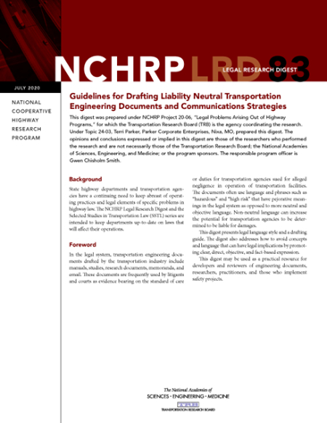
Excellent Resource
NCHRP Legal Digest 83—Guidelines for Drafting Liability Neutral Transportation Engineering Documents and Communications Strategies (July 2020)
Addresses how to avoid concepts and language that can have legal implications by promoting clear, direct, objective and fact-based expression.
Document available (free) at:
http://nap.nationalacademies.org/25894

Slide 43
Knowledge Check
Questions

Slide 44
Which of These Phrases Incorporate LNL Principles?
Where hazards are within the clear zone, guardrail or barrier wall shall be provided at least 6 feet off the traveled way.
Where objects are within the clear zone, guardrail or barrier wall should be considered.
Both of these.
Neither of these.

Slide 45
How Would You Describe This Condition?
8-inch elevation difference between pavement surface and shoulder

Slide 46
Any LNL Concerns with These Sentences?
How Would You Re-Write?
The sidewalk is 5 feet wide, smooth concrete with a cross slope of 2% and a grade of 4%, therefore, it is safe.
Using one inspector who specializes in concrete pavements will be adequate for this roadway construction project.
Paths should be clear of debris and adequately drained to prevent accumulation of trash/mud that can cause a trip or slip hazard.

Slide 47
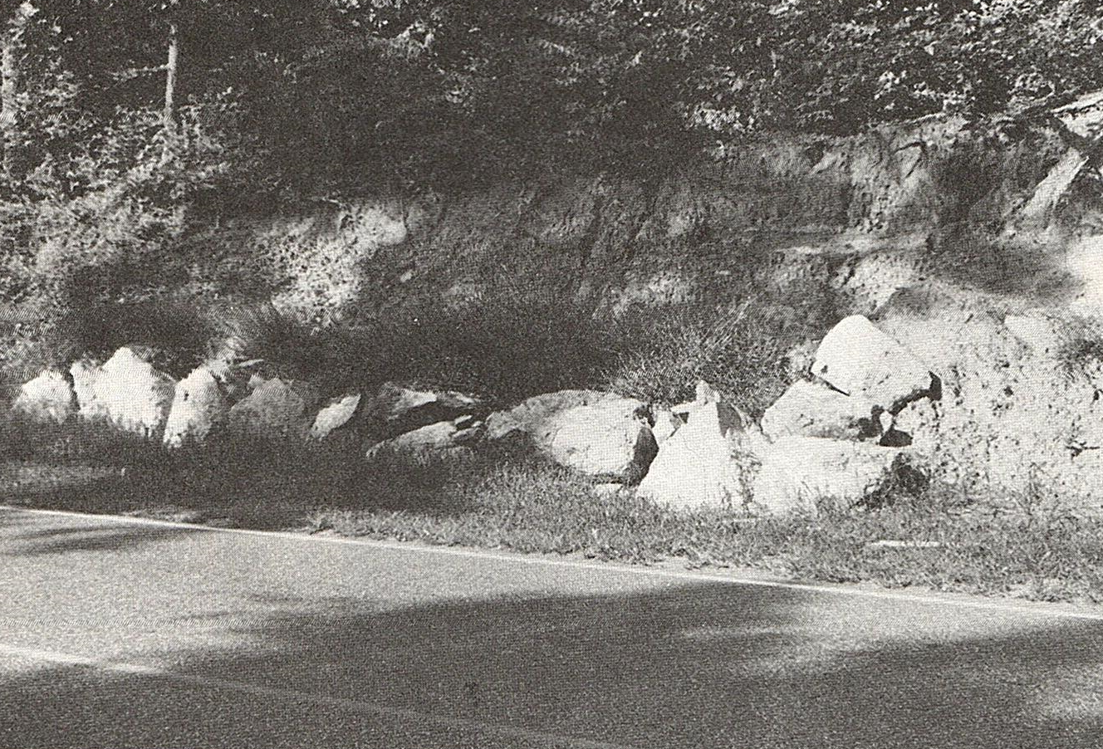
How Would You Re-Write the Caption?
Large Rocks Used to Stabilize the Sideslope Are A Hazard to Motorists.

Slide 48
Thank You!
Questions?
Ronald.Eck@mail.wvu.edu

