Slide 1

KYOVA CMP &
TDM Updates
West Virginia Transportation Planning Conference
June 3, 2026
Notes:
Introductions – Saleem and Allison

Slide 2
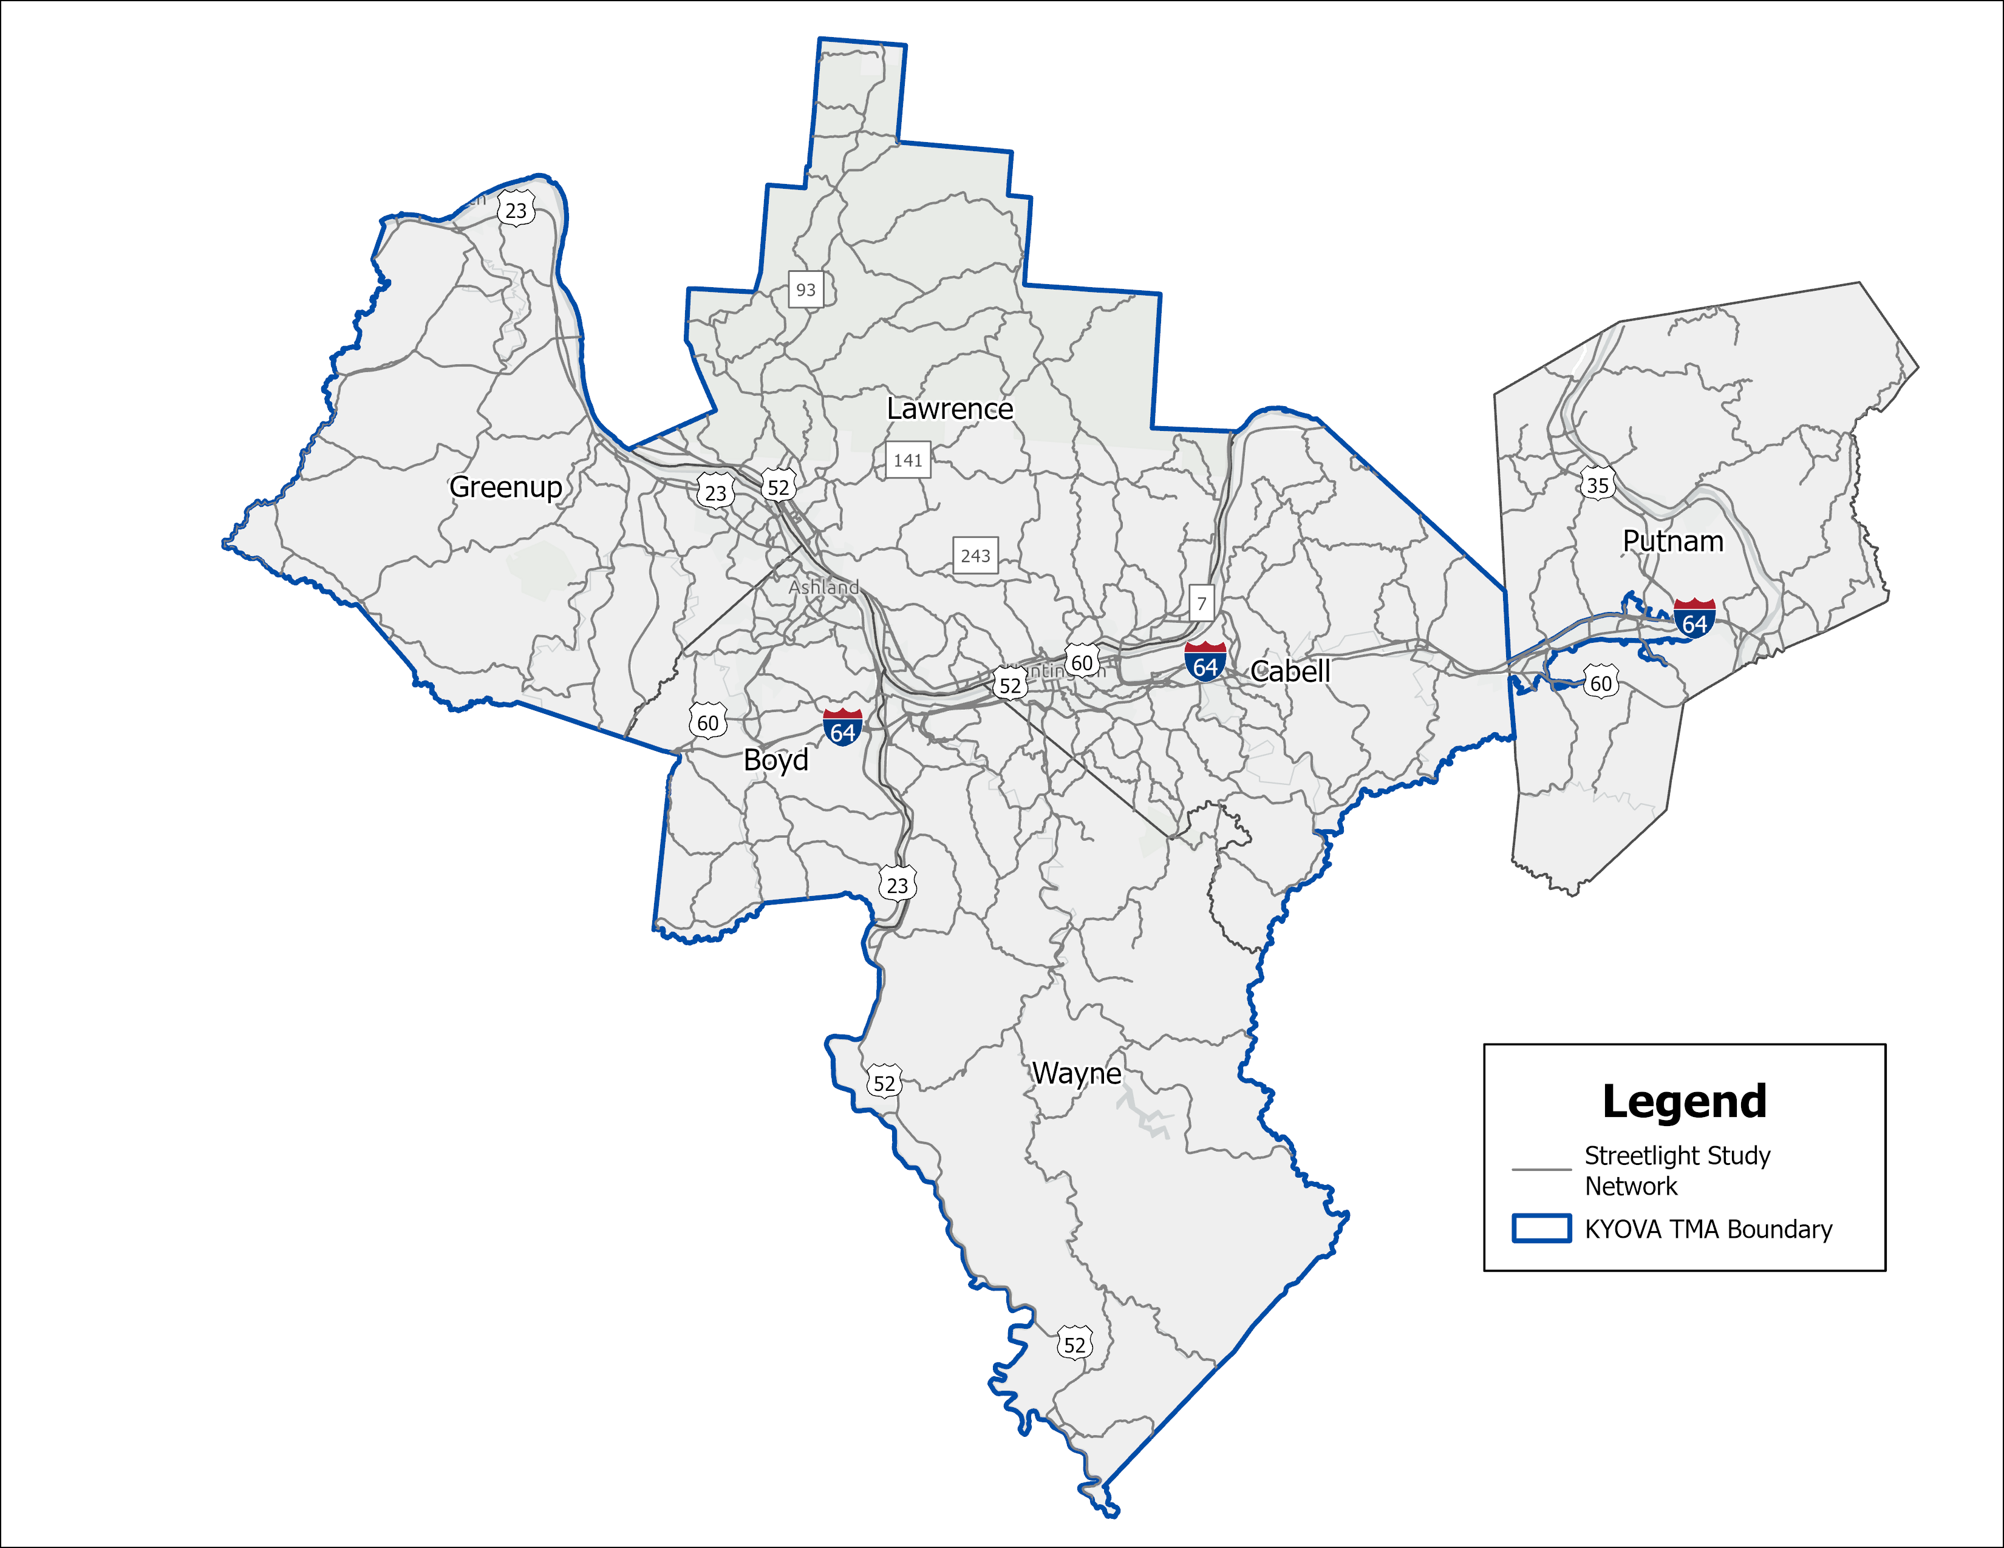
KYOVA and the Huntington TMA
Cabell County, WV
Wayne County, WV
Boyd County, KY
Greenup County, KY
Lawrence County, OH
Putnam County, WV (partial – TMA)
Notes:
SALEEM
The KYOVA MPO includes 5 counties – Cabell and Wayne Counties, WV, Boyd and Greenup Counties, KY, and Lawrence County, OH
The Huntington urban area was designated as a TMA as a result of the 2010 Census
A Transportation Management Area, known as a TMA, is an urban area with a population greater than 200,000
The TMA includes areas within the KYOVA MPO as well as a portion of the RIC MPO in Putnam County. KYOVA is the lead planning agency for the Huntington TMA.
The CMP study area includes the entire KYOVA MPO as well as the portion of Putnam County included in the Huntington TMA.

Slide 3
Study Elements
Congestion Management Process
Travel Demand Model
Notes:
SALEEM
This presentation will cover both the development of the KYOVA Congestion Management Process and the KYOVA Travel Demand Model update
While these are two separate efforts, each effort benefits the other

Slide 4
Project Overview
Congestion Management Process (CMP)
  Update the current 2014 plan with a new congested network
  Create a prioritized toolbox of congestion mitigation strategies
Travel Demand Model (TDM)
  Update model to a 2023 base year
  Prepare interim and future horizon years
Notes:
SALEEM
Here is a quick overview of the intent of each project.
CMP:
Update the current 2014 plan with a new congested network
Create a prioritized toolbox of congestion mitigation strategies
TDM:
Update model to a 2023 base year
Prepare interim and future 2050 horizon years

Slide 5
Congestion Management Process
Notes:
SALEEM
Let’s talk about each of these two projects individually. We’ll spend most of our time on the CMP.

Slide 6
Concurrent Studies
Congestion Management Process
Freight Plan
SS4A Tri-State Safety Action Plan
Notes:
SALEEM
KYOVA is conducting a number of plans and studies concurrently.
This was done intentionally so that the plans could build off of each other
The data developed by these sister studies and the strategies coming from each will lead to more informed decision-making, better use of funds, and more cohesive incorporation into the MTP and TIP.

Slide 7
Desired Outcomes
Develop a congestion management process that addresses the unique challenges in the KYOVA/Huntington TMA region
Emphasize freight and safety considerations by bringing in data and outcomes of concurrent planning efforts
Create a process to integrate the CMP with subsequent plans
Notes:
SALEEM
Before beginning the CMP, we identified a specific set of desired outcomes.
The idea is to move beyond what’s federal required to address the specific needs of the study area.
Those needs include a focus on freight and safety, which are being addressed in the sister studies.
We also want to create a durable process that helps the CMP integrate with subsequent plans such as the MTP and TIP.

Slide 8
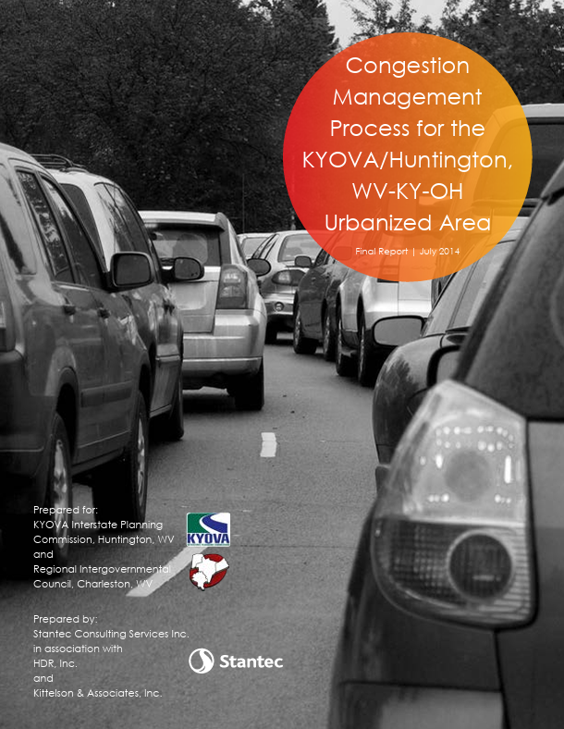
Comparing to the Previous CMP
Last CMP prepared in 2014
Changes since the last plan:
  Data availability
  Demographic shifts
  Economic growth
  National trends
Notes:
SALEEM
It also helps to understand the changes since the last plan:
Data availability – we now have Streetlight data accessible via ODOT. We also have the benefit of the updated travel demand model and other plans that will be discussed later
Demographic shifts – population and employment continues to shift to different places within the region
Economic growth – new industrial growth is happening in the region that influences travel trends
National trends – changes such as new freight movement patterns with increases in online shopping, work from home percentages, and focus on safety trends

Slide 9
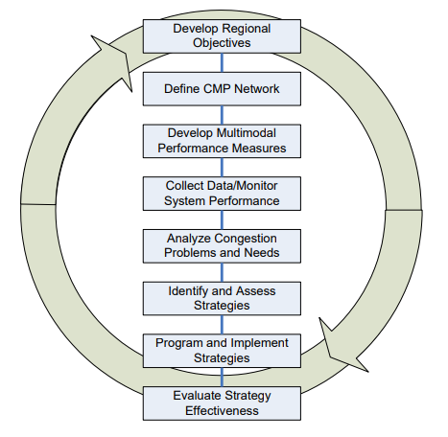
The Congestion Management Process
Notes:
ALLISON
This is the federal 8-step CMP process. This is required for every CMP.

Slide 10
The Congestion Management Process
We are here!
Notes:
ALLISON
We started our CMP development in 2025. The pace of the CMP has largely been dictated by the desire to make the best use of data that’s available.
The process will conclude in early 2027.
Right now, we’re analyzing system performance, identifying and analyzing congestion problems, and beginning the process of strategy identification.

Slide 11
Goals / Objectives – CMP Update
Preserve, maintain, and enhance the existing transportation system
Support the economic vitality of the region, especially by enabling global competitiveness, productivity, and efficiency
Improve the operational efficiency of the transportation network
Protect and enhance the environment and promote energy conservation
Enhance the safety and security of the transportation system for all users
Enhance the integration and connectivity of the transportation system across and between modes, for people and freight
Maintain financial responsibility in the development and preservation of the transportation system
Notes:
ALLISON
We started by looking at CMP goals and objectives.
Our CMP goals exactly match those developed by KYOVA for their last MTP.
For objectives, we developed a series of supporting statements that help tie the goals to the desired outcomes of the CTP.

Slide 12
Performance Indicators
Performance Indicator | Proposed Threshold / Measure
Travel Time Index (TTI) | >1.3*
Vehicle Hours of Delay | >20*
Safety Performance Indicator | TBD
Freight Performance Indicator | TBD
Fixed Route Transit Coverage | Yes or No
Bike/ped Facility Coverage | Yes or No
*On links with volumes above 1000
Notes:
ALLISON
Once we had our guiding statements, we could identify ways to measure them. We developed a series of performance indicators.
These performance indicators do several things:
Take advantage of data coming from available sources, such as Streetlight for traditional congestion measures and freight and safety study data.
Consider the impacts of recurring and non-recurring congestion.
Consider the roadways that will be of regional importance (volumes above 1000).

Slide 13
Corridor Identification – Step 1
Base study network from Streetlight data
Notes:
ALLISON
We then needed to figure out what we’re analyzing. We start with our Congestion Management Network.
This was identified as the network where we have Streetlight data available.

Slide 14
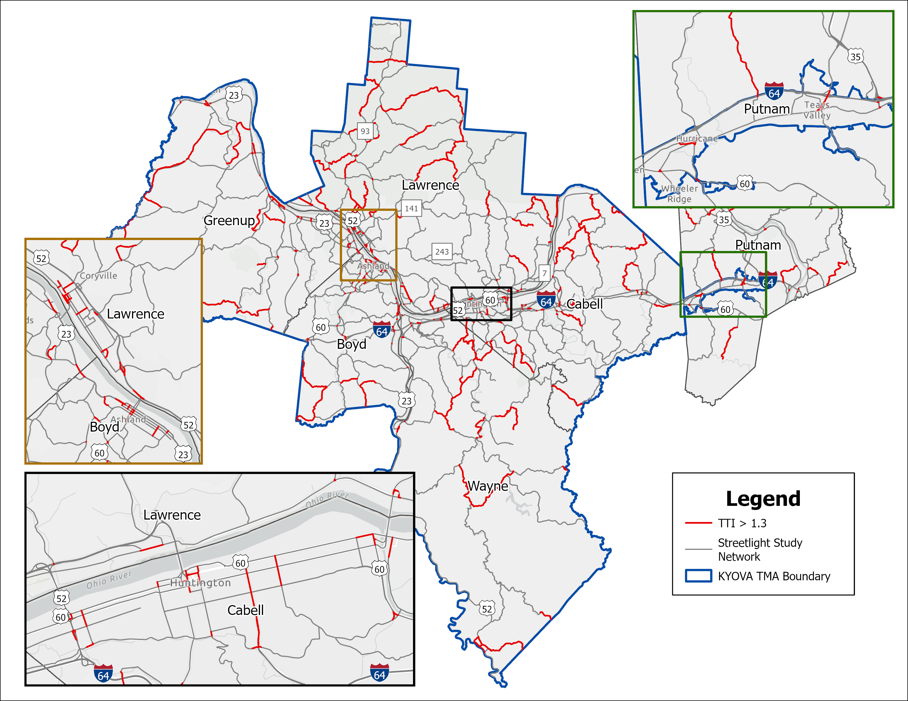
Corridor Identification – Step 2A
Performance Indicator: Travel Time Index (TTI)
Threshold > 1.3
Notes:
ALLISON
Next we need to begin the process of identifying congested corridors. We start by understanding what our performance indicators are telling us.
We looked at Travel Time Index (the ratio of how long it takes to travel somewhere compared to its free flow speed)

Slide 15
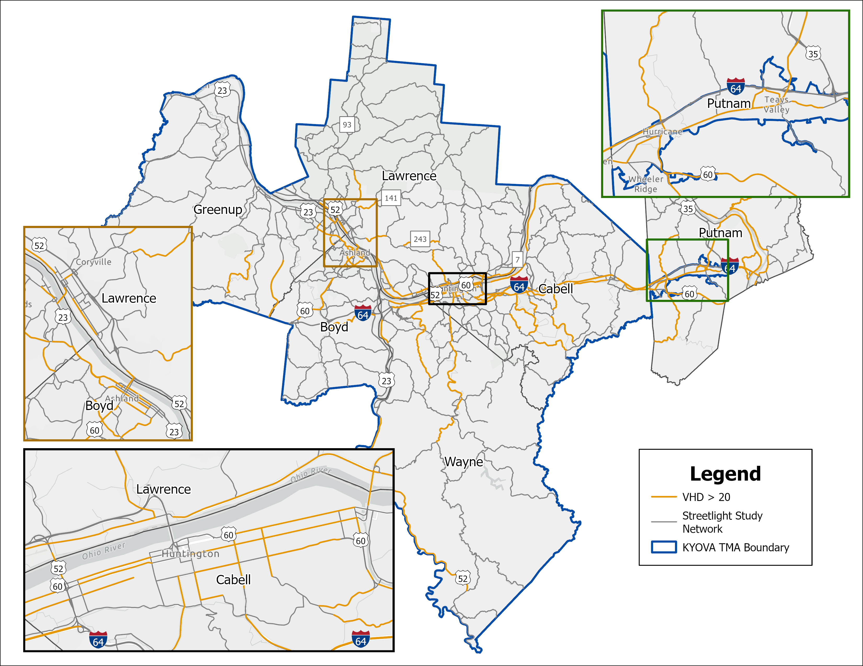
Corridor Identification – Step 2B
Performance Indicator: Vehicle Hours of Delay (VHD)
Threshold > 20
Notes:
ALLISON
Continuing with Step 2 the project team also looked at all links that exceeded 20 Vehicle Hours of Delay.

Slide 16
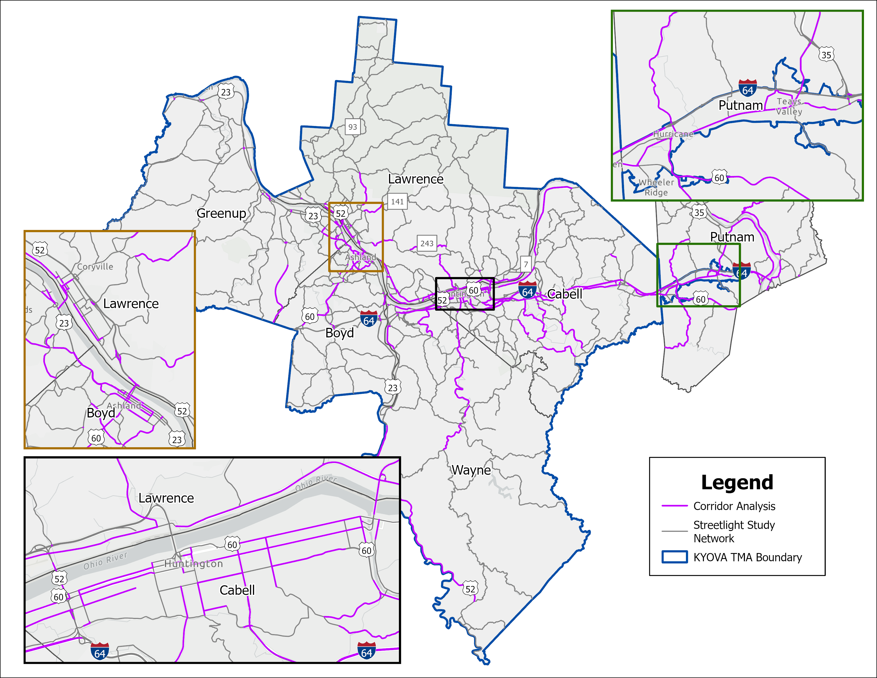
Corridor Identification – Step 3
VHD and TTI indicators only on links with volumes > 1000
Notes:
ALLISON
After querying out any facility with a volume less than 1,000 vpd, this resulted in a series of links that experience some sort of congested condition.

Slide 17
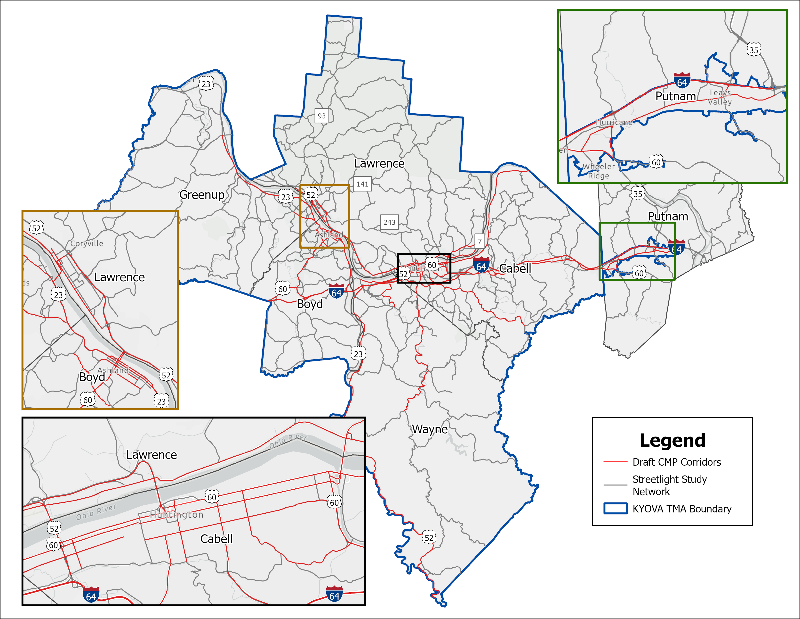
Draft CMP Corridors
Highlighted Corridors
  I-64
  US 52
  US 60
  Hal Greer Blvd
  3rd Ave
  5th Ave
  WV 2
  SR 7
  US 23
Notes:
ALLISON
From here, we are able to move from congested links to congested corridors.
This is not an exact science. We want to have corridor segments that are of a sufficient length to be able to identify reasonable strategies.
We want to look at congested links, eliminate those that are short disconnected segments, and connect those that may be close together but not continuous.
Congested corridor were identified in all portions of the study area. They include I-64, US highways, major state routes, bridge crossings, and significant routes within urban and suburban centers.

Slide 18
CMP Toolbox Categories
Active Transportation
Transit
Transportation Demand Management
Capacity Expansion
Freight
Technology and Operations
Safety
Notes:
ALLISON
We have come up with a strategy toolbox to help us link identified congested corridors with ways to mitigate that congestion.

Slide 19
CMP Goals to Toolbox Categories
 | Active Transportation | Transit | Transportation Demand Management | Capacity Expansion | Freight | Technology & Operations | Safety
1. Preserve and Maintain Network | ✓ | ✓ | ✓ |  | ✓ | ✓ | ✓
2. Economic Vitality |  |  |  | ✓ | ✓ |  | ✓
3. Operational Efficiency |  | ✓ | ✓ | ✓ |  | ✓
4. Safety and Security |  |  | ✓ |  |  | ✓ | ✓
5. Environment | ✓ | ✓ |  |  |  | ✓
6. Connectivity | ✓ | ✓ |  | ✓ | ✓
7. Financial Responsibility | ✓ | ✓ | ✓ | ✓ | ✓ | ✓ | ✓
Notes:
ALLISON
Our strategy toolbox categories align with the project goal areas. We’re looking for the places where these intentionally cross over.

Slide 20
Draft Strategies
Active Transportation
Transit
Transportation Demand Management
Bikeways, walkways, and trails
Connectivity and intersection treatments
Connection to main streets
Micromobility and E-Mobility Options
Programs like Safe Routes to School and Cycling Without Age
Diversity of services
  Microtransit, demand response, intercity transit services
Real time arrival signage
Park and ride lots
Reduce fares
Transit Signal Priority
Telework
Flexible work hours
Land use and growth management
    Transit Oriented Development, Transit Oriented Communities, mixed-use development
Notes:
ALLISON
We’ve developed a series of initial draft strategies. The purpose of these strategies is to provide a wide variety of policy, program, and project tools to allow us to implement congestion management concepts.

Slide 21
Draft Strategies
Capacity Expansion
Technology and Operations
Safety
Lane additions and new roadways
Grade separated crossings
ITS and Transportation System Management
  Arterial signal coordination
  Ramp and access control, including bridges
  Integrated corridor management
Traffic Incident Management
Traffic calming
Speed management
Special event management
Intersection efficiency and safe crossing opportunities
Construction and work zone management
Freight
  Dedicated truck lanes
  Truck stops
  Weigh-in motion technology
  Truck incentives and use restrictions
Notes:
ALLISON
Of note here are our draft freight and safety strategies. These are initial ideas but are likely to change to take the most advantage of the outcomes of the freight and safety studies.

Slide 22
CMP Implementation
Implementation of the CMP strategies will consider three factors:
  Prioritization and programming
    Framework to guide the evaluation of strategies
  Performance Measurement
    Inclusion of CMP solutions in MTP and TIP projects
    CMP performance measurement and connections to MPO performance measures
  CMP Integration
    Strategies to support and augment MTP development
Notes:
ALLISON
Moving forward, we’ll be looking for ways for the CMP to better integrate with the region’s performance measurement framework
We will also look for ways for the MTP to intentionally pair with the CMP

Slide 23
Travel Demand Model
Notes:
ALLISON
Now let’s move on to the Travel Demand Model

Slide 24
Travel Demand Modeling Efforts
2023 Base Year SE Data
2050 Future Year SE Data
2050 Future Year Projects
Model Documentation
Notes:
ALLISON
KYOVA’s travel demand model is routinely updated every few years. For this update, we went through the following process:
Update 2023 Base year socioeconomic data
Update 2050 future year socioeconomic data
Input 2050 future year projects
Prepare model documentation

Slide 25
Travel Demand Modeling Efforts
Cabell/Wayne County Transportation Land Use Study
  Incorporated known upcoming development
All other land use held constant at 2023 values
  Considered population trends and staff feedback
Notes:
ALLISON
The travel demand model also benefitted from a concurrent study. The Cabell/Wayne County Transportation Land Use Study was coordinated with to provide known upcoming development in the WV portion of the KYOVA area
Based on population trends and staff feedback, land uses in the other portions of the study area were held constant at 2023 values.

Slide 26
Thank You!

