Slide 1

From Crash Records to Machine Learning:
Data Quality Challenges and Decision-Support Opportunities
Yusuf W. Zakaria, Transportation Specialist | WWW Interstate Planning Commission
2026 WV Transportation Planning Conference | June 3, 2026
1

Slide 2
Presentation Outline
01
Study Background & Data Access
MPO context, GCAT data source, and the crash record overview
02
Descriptive Overview
Crash types, hotspot analysis, and executive summary
03
Beyond Descriptive Analytics
Why ML? Opportunity and data readiness challenges
04
Feature Analysis & Engineering
Speed, contour, control, weather, temporal, behavioral factors
05
Machine Learning Results
Neural network classification, SHAP feature importance by segment
2

Slide 3
PART 01
Study Background & Data Access
MPO context, GCAT, and the crash record
3

Slide 4
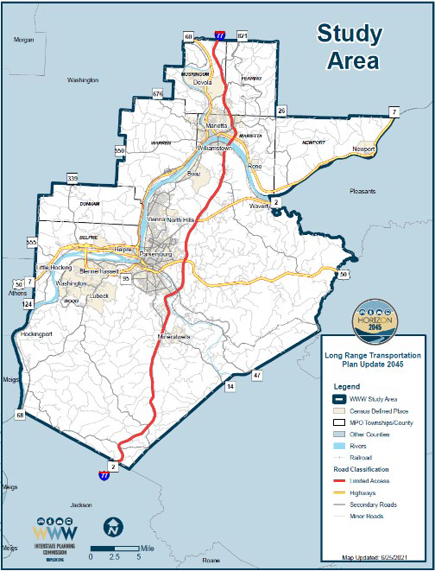
Study Area: WWW MPO: Ohio Side
Bi-state MPO spanning West Virginia & Ohio
~4,534
Crash incidents in the record (2020-2023)
GCAT
Primary data access tool (ODOT GIS Crash Analysis Tool)
Multi-year
Period of review: Ohio-side corridor focus
82
Engineered features used in ML model
100%
Neural network classification accuracy (overfitted)
4

Slide 5
PART 02
Descriptive Overview of Crash Data
Crash types, spatial hotspots, and executive summary
5

Slide 6
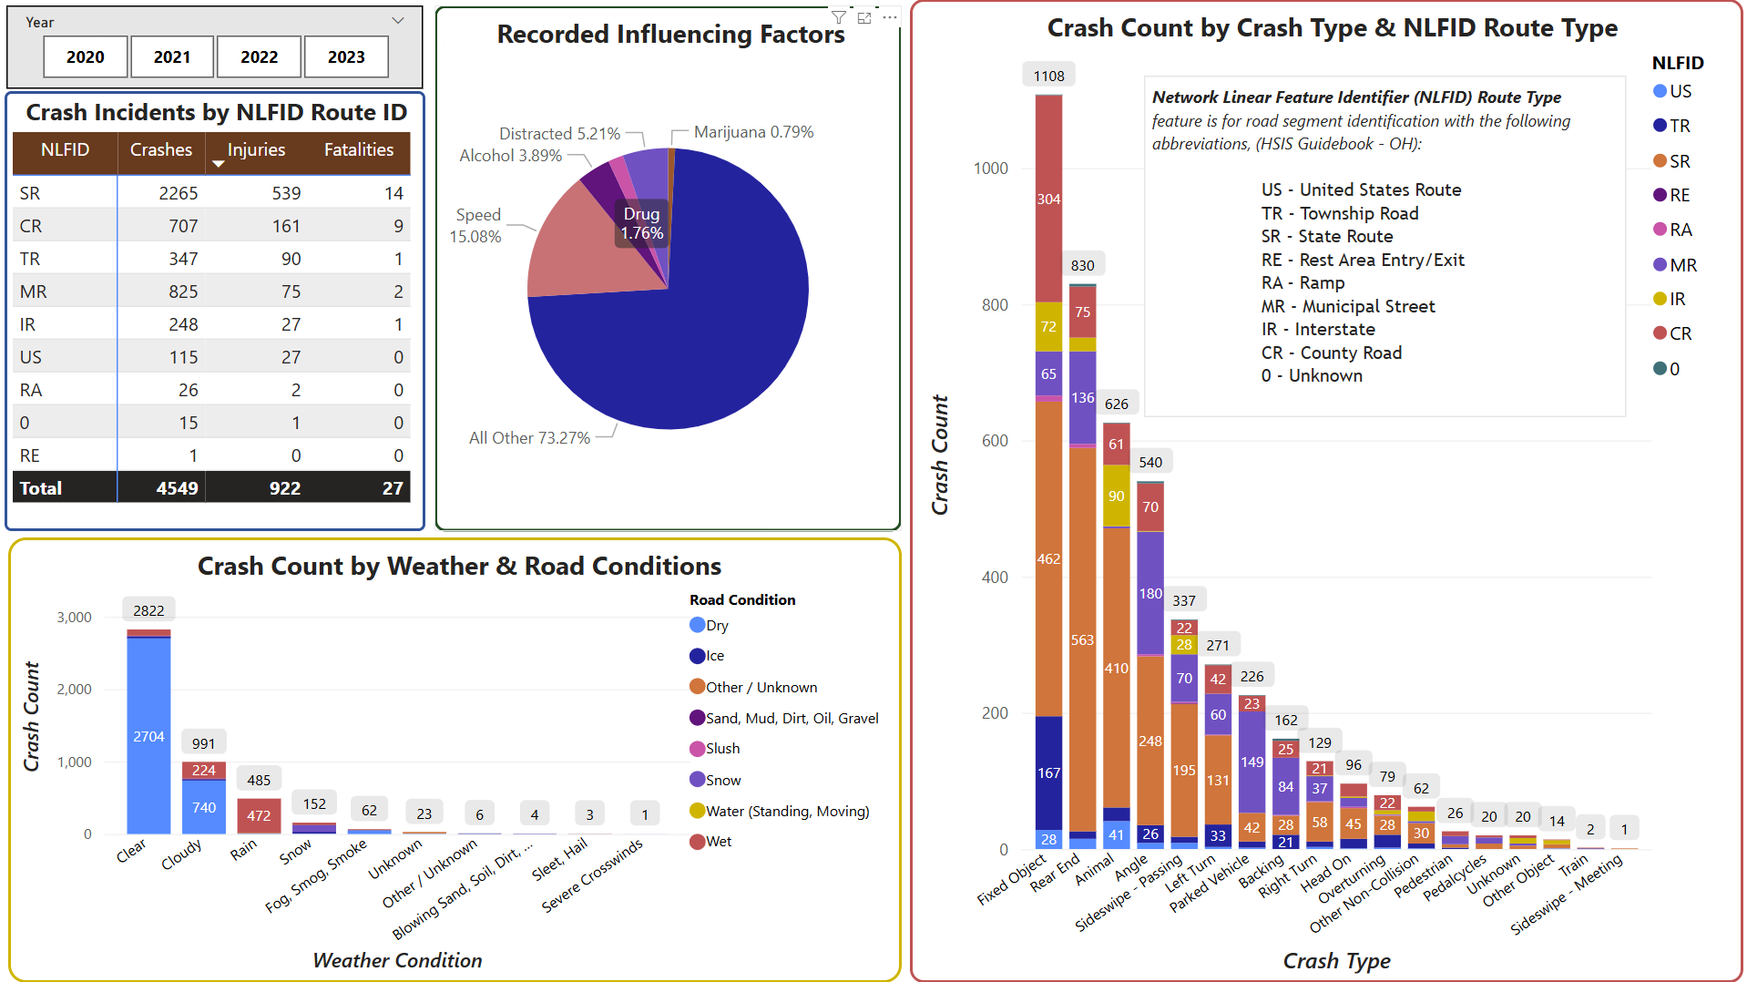
Summary of Crash Incidents
Executive summary: key metrics from the complete crash record
6

Slide 7
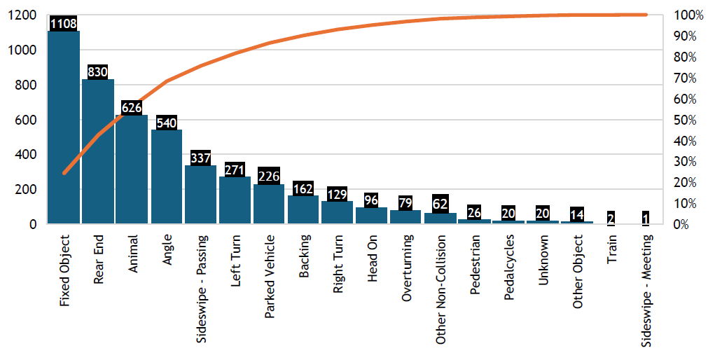
Overview of Crash Types — Raw Crash Data
Pareto analysis: the 80/20 rule holds strongly across this record
≈80%
of crashes fall under just 5 of 18 crash types
Rear-end, fixed object, animal & angle crashes dominate
Intersection types (left/right turn) rank lower than expected
Non-intersection crashes account for >75% of all incidents (pp. 23)
The Pareto pattern holds consistently across speed-limit subgroups
7

Slide 8
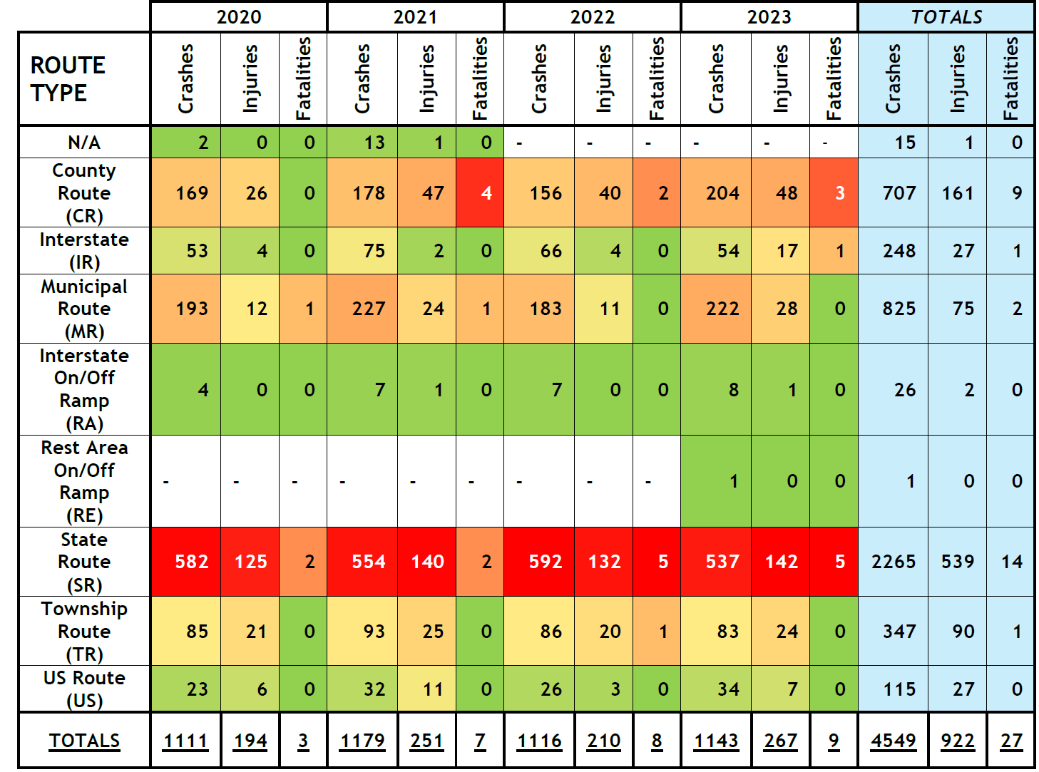
Crash Hotspot Map & Route Incidence Matrix
Crash hotspots for intersections on the long list
Incidence matrix with row-level heatmap
8

Slide 9
PART 03
Beyond Descriptive Analytics
Why machine learning? — opportunity and data readiness
9

Slide 10
From Visualization to Machine Learning
~4,500 data points: significant, but constrained
THE OPPORTUNITY
DATA CHALLENGES
ML reveals contribution of factors within each record beyond counts and maps
Identifies patterns invisible to cross-tabulation or summary statistics
Supports targeted safety campaigns and corridor-specific countermeasures
Transferable framework to similar roadway contexts in the MPO region
1
Erroneous or missing values
One or more attributes incomplete in a significant share of records
2
Roadway upgrades within study period
Network changes between crash years affect attribute validity
3
Attribute Homogeneity
Some categorical variables lack sufficient spread for ML
4
Nuanced variables
Granular attributes need careful encoding or consolidation
10

Slide 11
PART 04
Feature Analysis & Engineering
Preparing crash variables for machine learning
11

Slide 12
Feature: Posted Speed Limit Distribution
Unit 1 as principal reference: proximity assumption for other units
28.9%
of crashes at 55 mph (1,310 incidents)
22.2%
at 25 mph, urban corridor (1,007)
<2%
at speeds 0–20 mph combined
12

Slide 13
Road Contour & Traffic Control Type
Roadway geometry and control characteristics at crash location
78% straight roads • 62% straight & level • 78% uncontrolled traffic: crash profile skews heavily toward open-road, non-intersection events
13

Slide 14
Feature Engineering: Visibility from Weather Condition
Simplified 4-category encoding replaces 10+ original weather variables with perceived visibility
Category | Original Variable | % of Record
Good | Clear | 62.0%
 | Cloudy | 21.7%
 | Severe Crosswinds | 0.0%
Average | Rain | 10.7%
 | Sleet / Hail | 0.1%
 | Snow | 3.4%
Poor | Blowing Sand, Soil, Dirt, Snow | 0.1%
 | Fog, Smog, Smoke | 1.4%
Unknown | Other / Unknown | 0.1%
 | Unknown | 0.5%
83.8% of crashes occurred in GOOD visibility; weather is not the primary risk driver
14

Slide 15
Feature Engineering: Road Surface Condition
Simplified 5-category encoding replaces 8+ original road condition
Category | Original Variable | % of Record
Dry | Dry | 77.2%
Ice | Ice | 1.5%
 | Slush | 0.2%
 | Snow | 2.4%
Sediments | Sand, Mud, Dirt, Oil, Gravel | 0.1%
Unknown | Other / Unknown | 0.4%
Wet | Water (Standing, Moving) | 0.2%
 | Wet | 18.1%
77.2% dry road crashes
15

Slide 16
Temporal Distribution: Monthly & Hourly Patterns
When crashes happen — seasonal trends and daily peaks
Oct–Nov peak seasonally • Afternoon peak 3–4 PM • Low overnight hours; behavioral and exposure patterns drive timing
16

Slide 17
Driver Age & Behavioral Influencing Factors
Binary features: senior/young driver involvement and impairment indicators
Senior 21.7% • Young 31.4% • Impaired 5.1% • Distracted 5.2%; yet these 4 factors drive 81% of fatalities in the record
17

Slide 18
Feature Engineering: Speed Limit
Discrete numerical values of principal driver speed compared to their posted/legal speed limit +/-5MPH vs 0 was used for encoding.
Numerical representation for speed is likely not accurate.
50% of incidents: under-speed or stationary vehicles • Only 2% classified as over-speeding • Speed encoding derived from Unit 1 posted vs. recorded speed (±5 mph threshold)
18

Slide 19
Influencing Factors vs. Crash Severity
4 factors responsible for 81% of all fatalities in the record despite covering only 21% of crashes
Filter | Crashes | Injuries | Serious Injuries | Fatalities
Complete Record | 4,534 | 921 | 161 | 27
Alcohol Related | 177 | 71 | 15 | 6
Drug Related | 80 | 48 | 16 | 9
Marijuana Related | 36 | 23 | 9 | 3
Speed Related | 685 | 221 | 44 | 4
% of Complete Record | 21.57% | 39.41% | 52.17% | 81.48%
These factors are not mutually exclusive; together they account for 21 of 27 fatalities in the record
19

Slide 20
Classification Encoding: Crash Severity
5-level severity hierarchy re-encoded to 3 severity levels (for possible use as target for classification)
Resulting “subjective encoding” is inherently imbalanced and rational.
Original | % of original | New encoding | % of new encoding
Fatal Injuries | 0.57% | Fatal/Serious | 3.396%
Serious Injuries | 2.82%
Minor Injury | 13% | Minor Injury/Injury Possible | 23.18%
Injury Possible | 10.1%
No Injury/ PDO (Property Damage Only) | 73.4% | PDO/No Injury | 73.42%
77.2% dry road condition crashes • 73.4% property-damage-only • “Only” 0.57% fatal crashes
20

Slide 21
PART 05
Machine Learning (ML) Model Results & Potential Policy Direction
Neural network classification and SHAP feature importance by speed-limit segment
21

Slide 22
Final ML Model: Approach & SHAP Interpretation Guide
Neural network binary classifier
How to Read the SHAP Plots
Model:
Neural network binary classifier — Fatal/Serious vs. Minor+
Red points = attribute present/high value
Features:
82 engineered features from all crash record and feature engineering
Blue points = attribute absent/low value
Right of axis = FOR Fatal/Serious outcome
Accuracy:
100% correctly classified all speed-limit segment observations
Left of axis = AGAINST Fatal/Serious
Explainer:
SHAP (SHapley Additive exPlanations)
Higher score = greater feature importance
Segments:
NLFID 0 • 25 mph • 35 mph • 40 mph • 45 mph • 50 mph • 55 mph • 60 mph • 65–70 mph • Hotspot Intersections
Ambiguous = unclear directional impact
⚠️CAUTION:
The presence of some features should be interpreted carefully – especially features that induce certain driving habits.
Opposing features as well as “uncommon/unusual” states CAN show up.
22

Slide 23
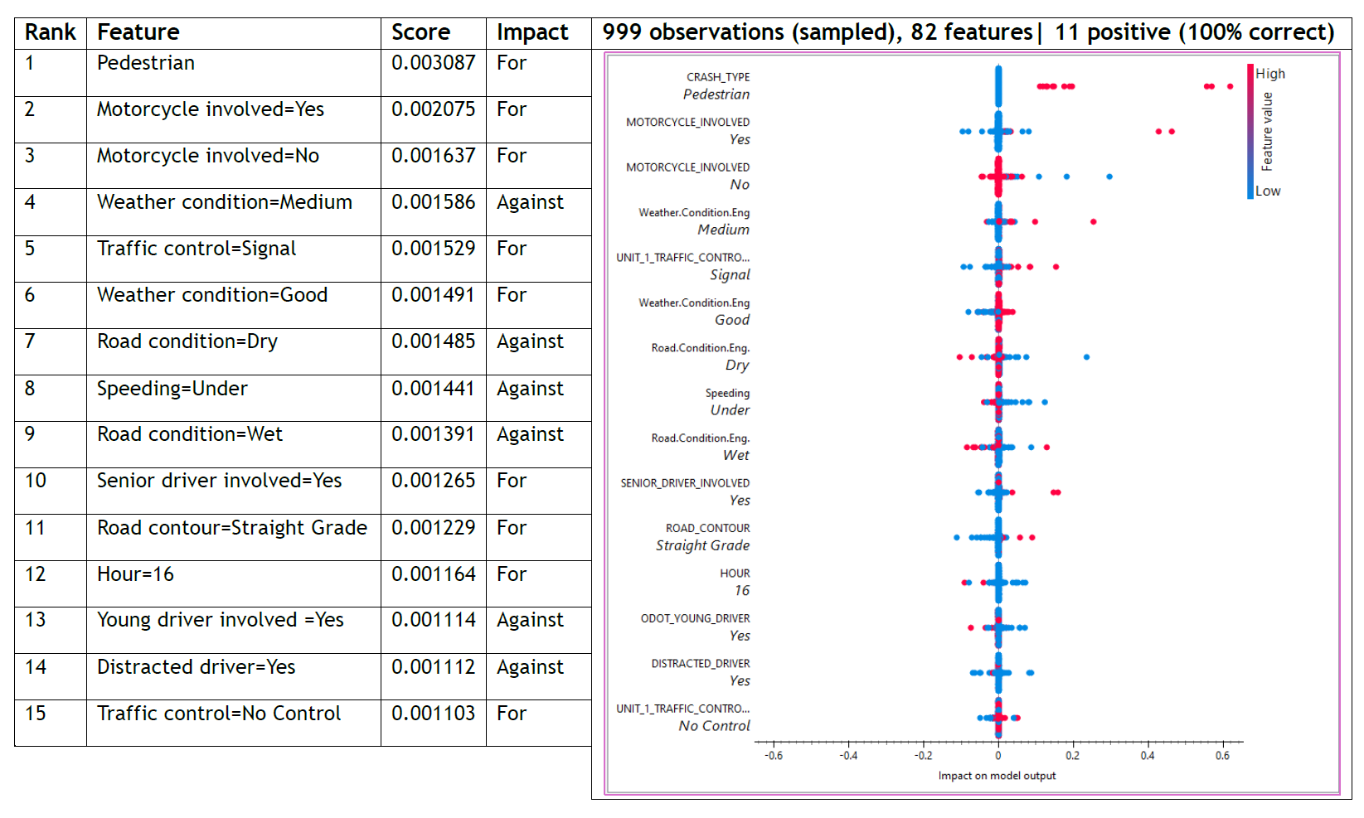
SHAP Feature Importance By Speed-Limit Segment
Top contributing features predicting Fatal/Serious crash outcome at 25 mph
% of fatalities in the record
23

Slide 24
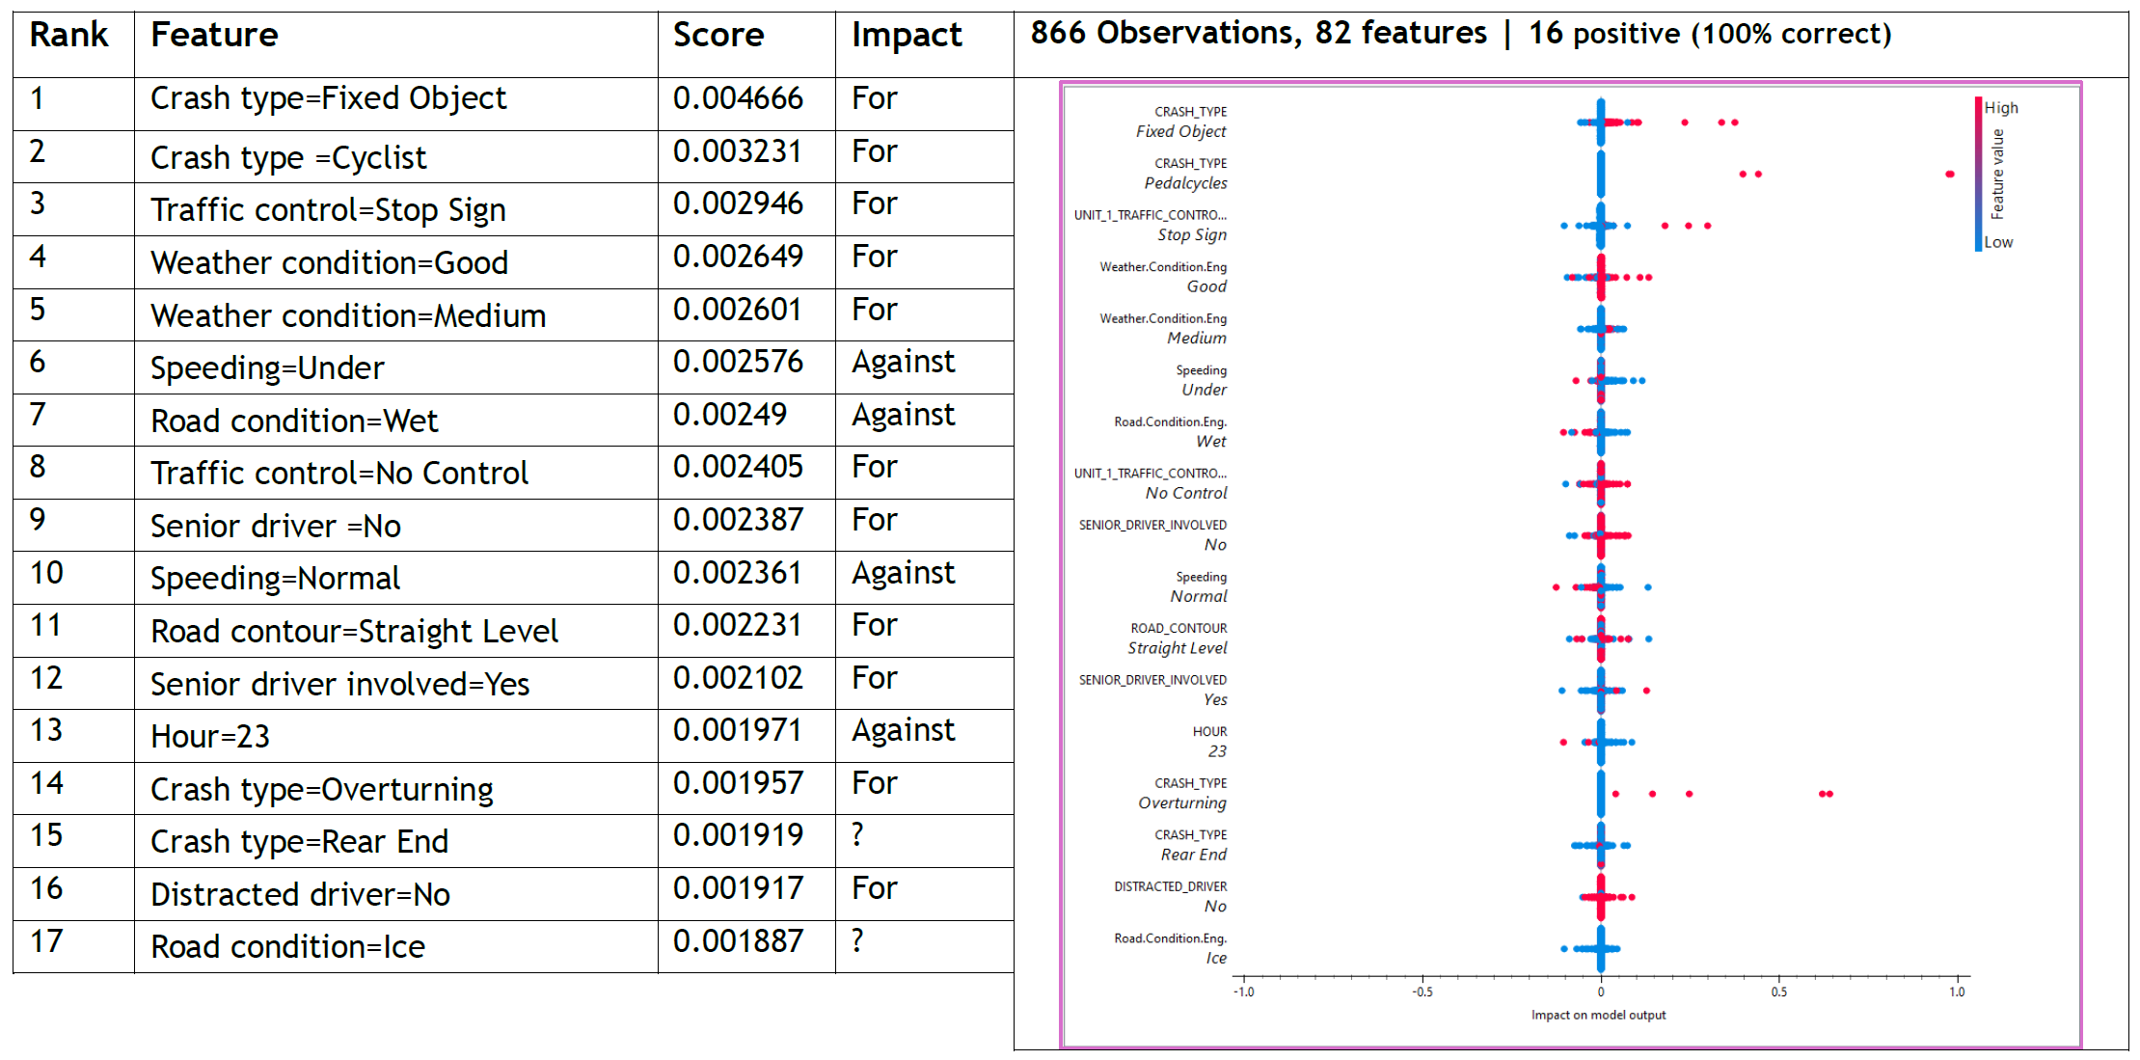
SHAP Feature Importance By Speed-Limit Segment
Top contributing features predicting Fatal/Serious crash outcome from 35 mph to 40 mph
24

Slide 25
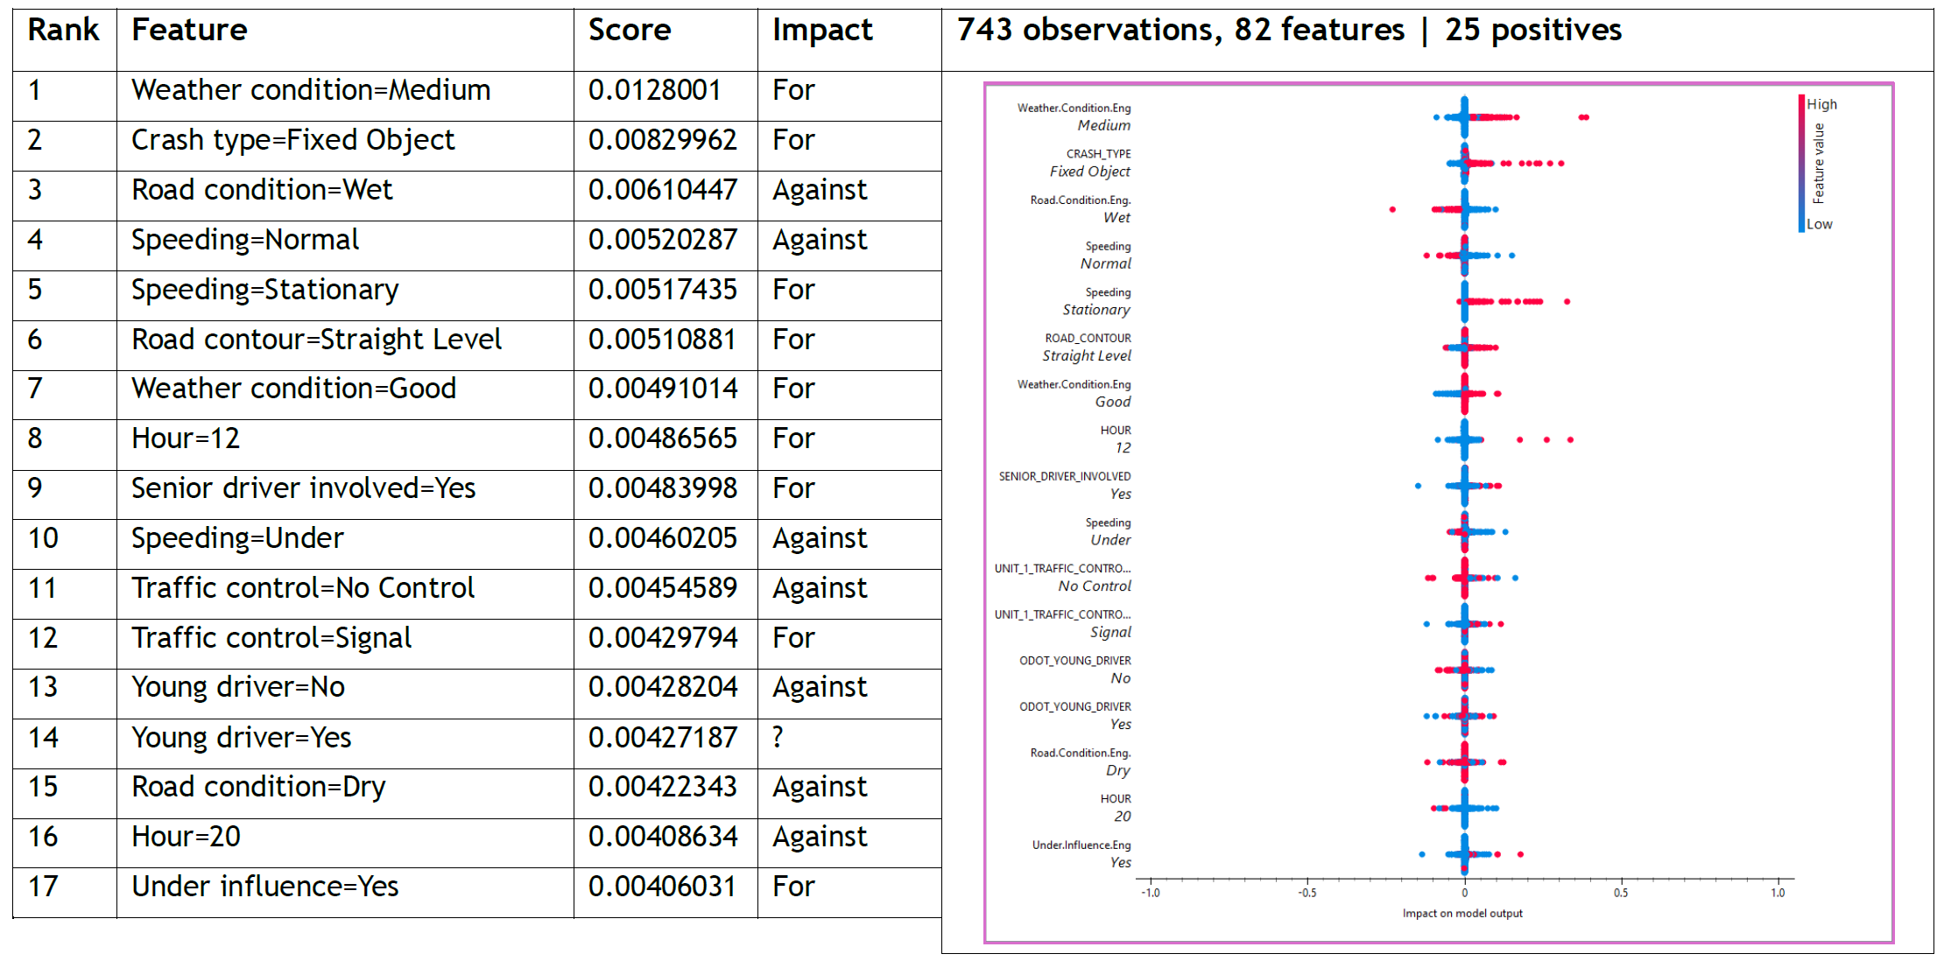
SHAP Feature Importance By Speed-Limit Segment
Top contributing features predicting Fatal/Serious crash outcome from 45 mph to 50 mph
25

Slide 26
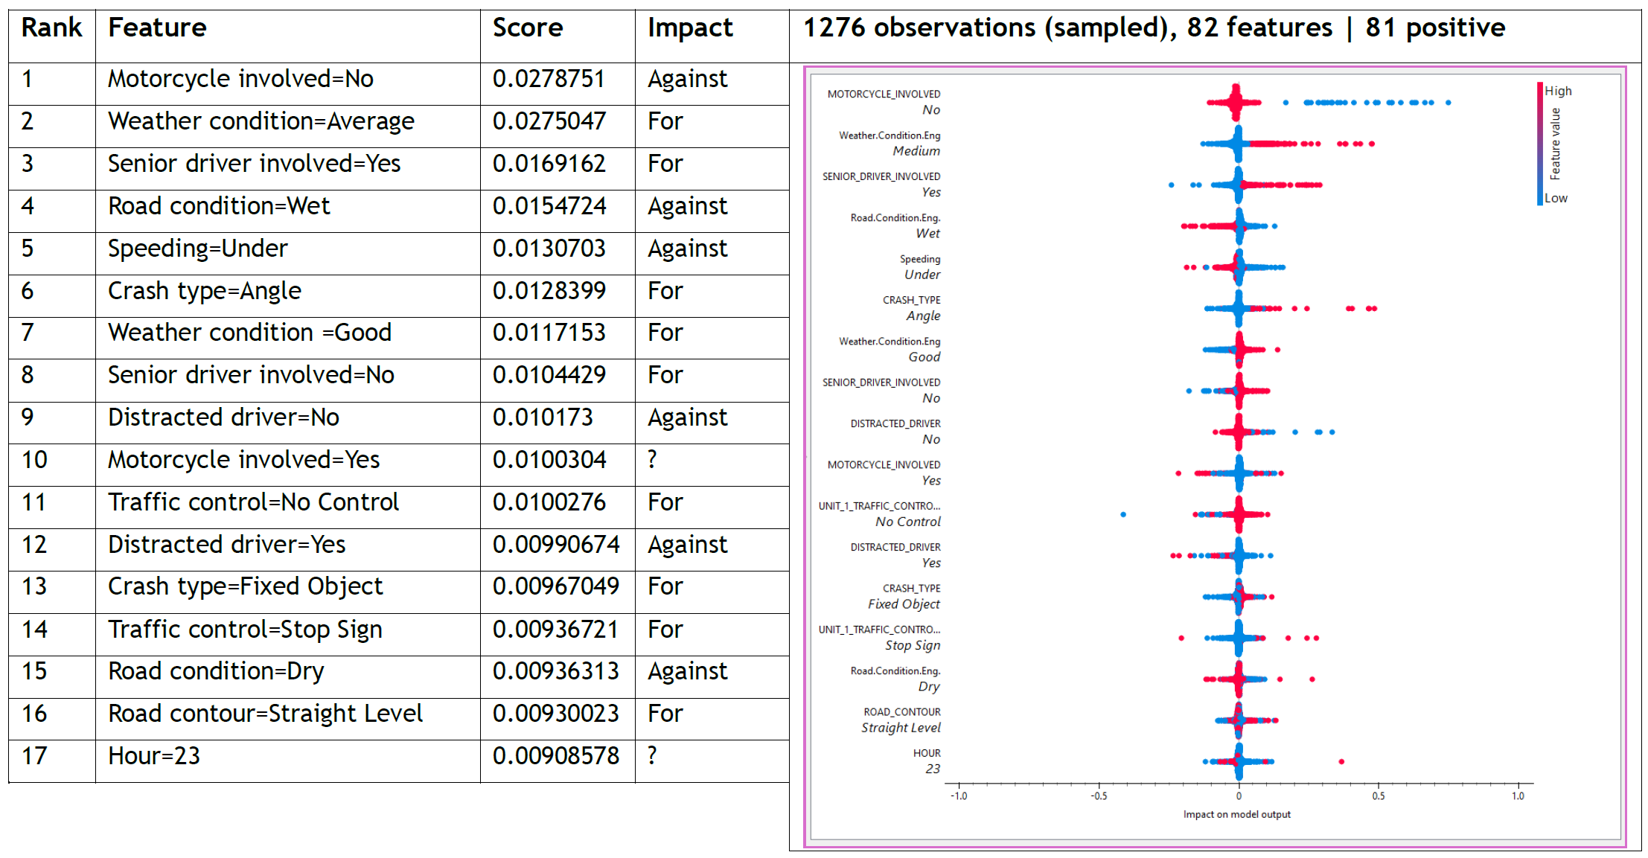
SHAP Feature Importance By Speed-Limit Segment
Top contributing features predicting Fatal/Serious crash outcome at 55 mph
26

Slide 27
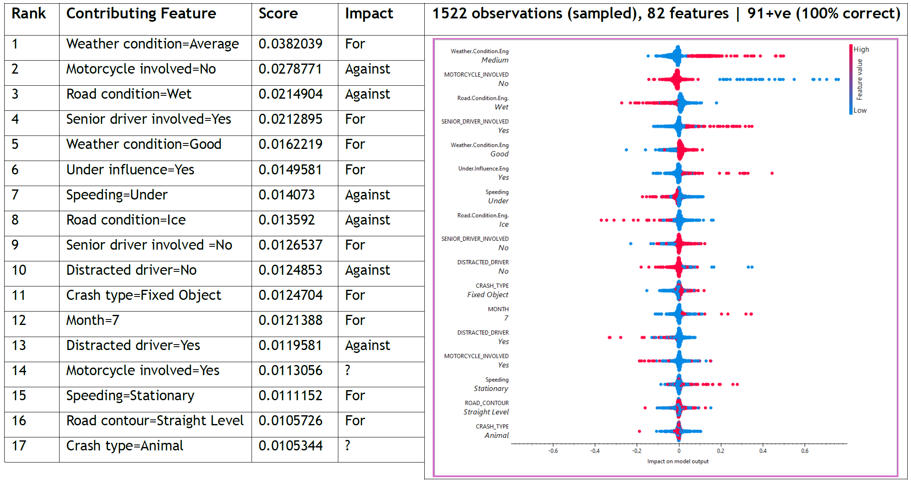
SHAP Feature Importance By Speed-Limit Segment
Top contributing features predicting Fatal/Serious crash outcome from 55 mph to 60 mph
27

Slide 28
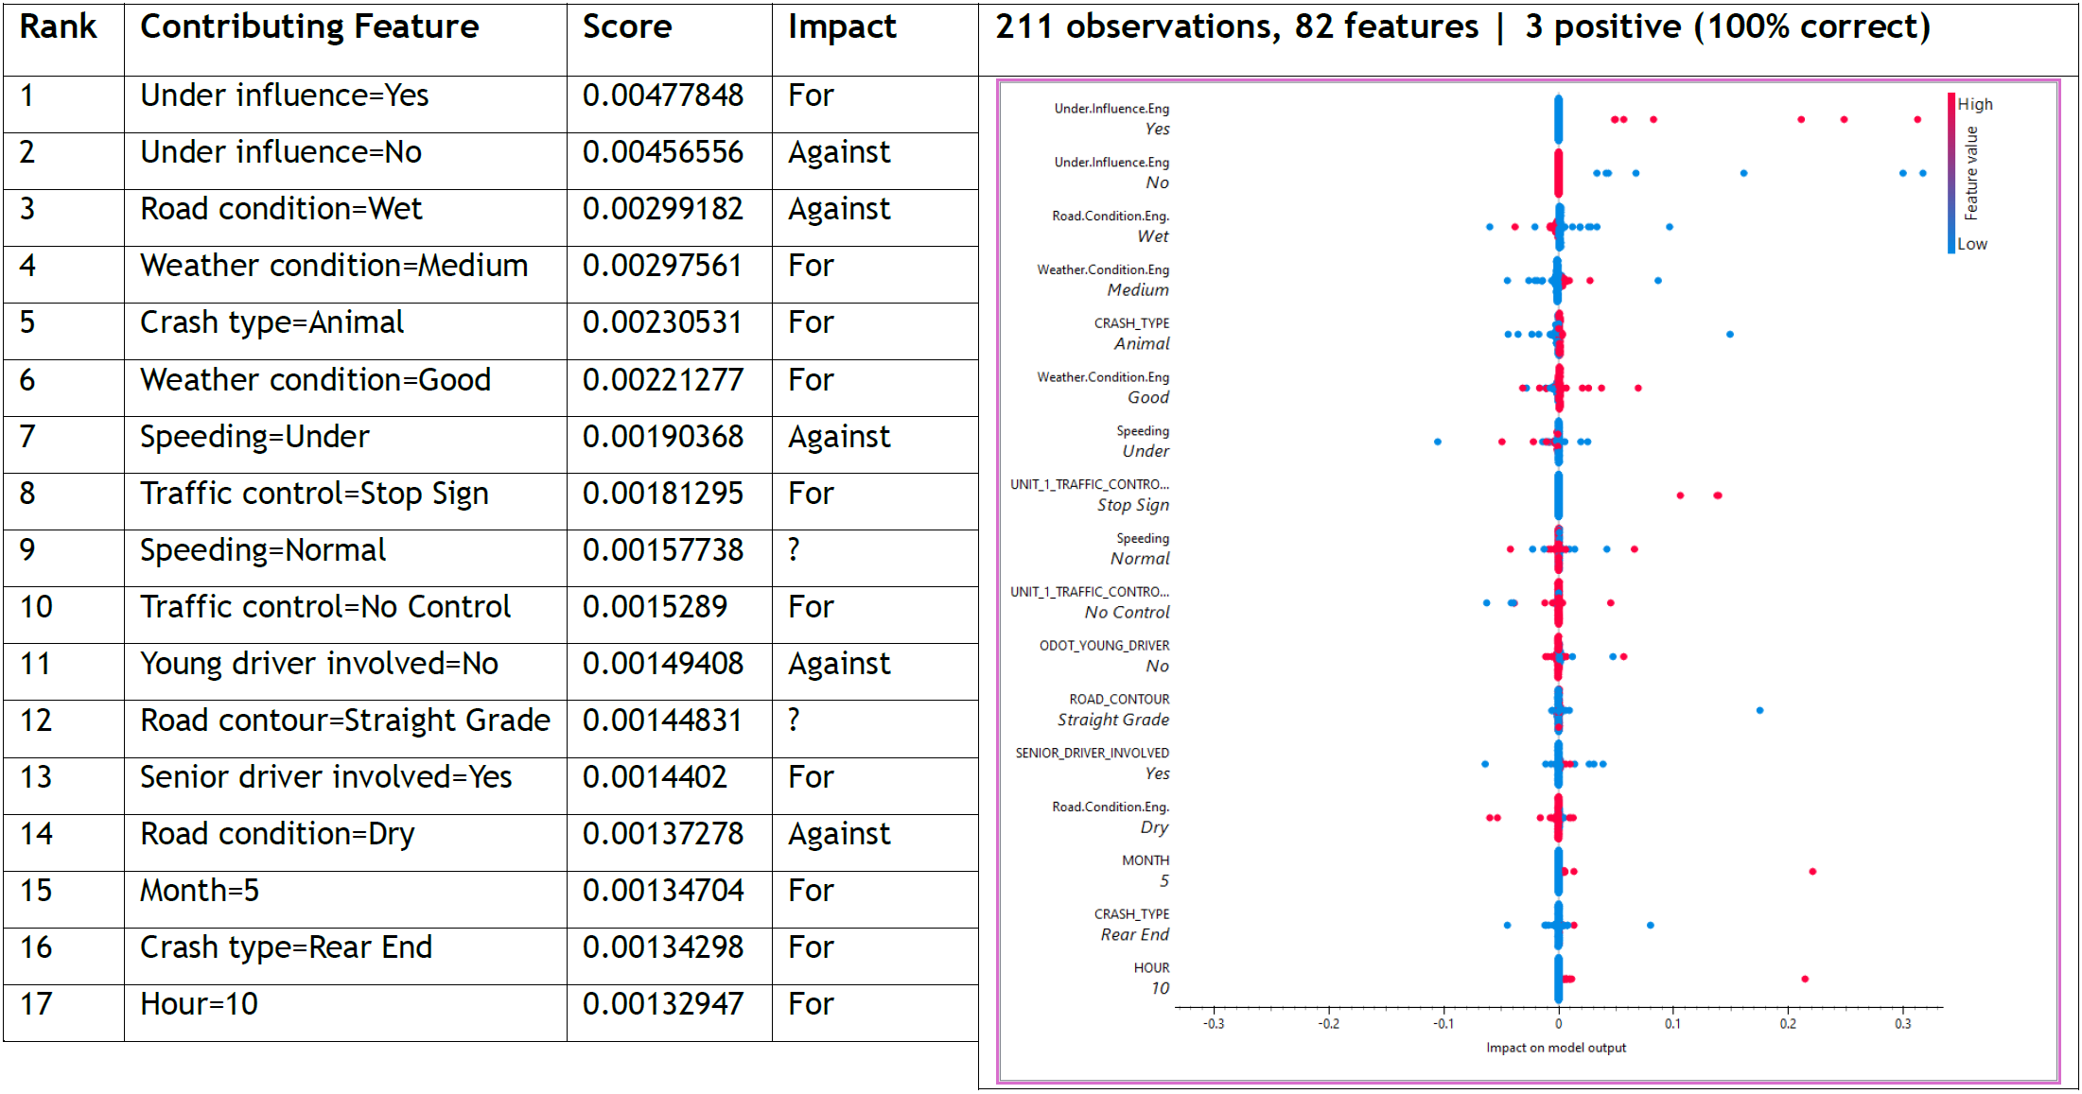
SHAP Feature Importance By Speed-Limit Segment
Top contributing features predicting Fatal/Serious crash outcome from 65 mph to 70 mph
28

Slide 29
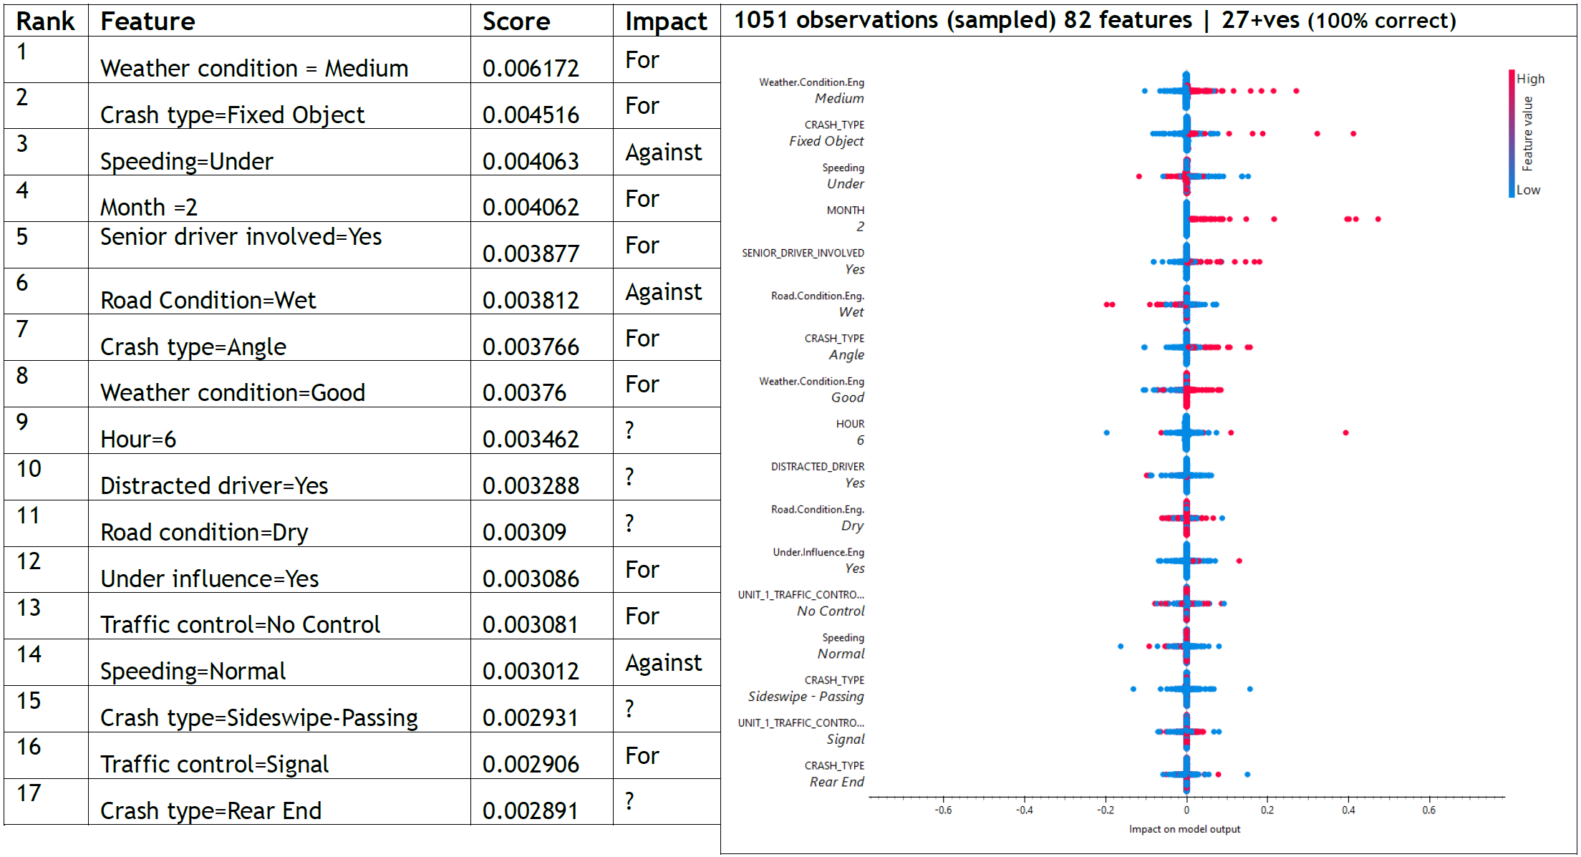
SHAP Feature Importance By Speed-Limit Segment
Top contributing features predicting Fatal/Serious crash outcome at “Hotspot” Intersections
29

Slide 30
PART 06
From Findings to Actions
The Road Forward: Data Strategy for ML-Ready Crash Records

Slide 31
From Reporting to Intelligence: A Forward-Looking Data Strategy
Rethinking the crash data pipeline: from the scene report to the machine learning model
Scene
Report
▶
Structured
Entry
▶
Validation
& QC
▶
GIS
Integration
▶
ML-Ready
Pipeline
Officer capture
Standardized fields
Flags & review
Spatial enrichment
Analysis & insight
Descriptive fields have value: inputs should be consolidated, not elimination entirely
Every form design decision has downstream consequences
Narrative and detailed descriptive fields remain important for reporting, public communication, and contextual understanding. The problem for use in ML pipelines is not richness but redundancy.
Fields with duplicative intent dilute signal for ML without adding informational value.
THE BALANCING ACT: Thoughtful field consolidation preserves meaning while improving model fitness.
A crash record that was not captured cannot be reconstructed.
Poorly structured fields cannot be reliably cleaned and introduced subjectivity in preparations for ML works.
Decisions made at the reporting form level either open or permanently foreclose analytical possibilities.
A forward-looking database must be designed with its end use, including machine learning, explicitly in mind from the outset.
30

Slide 32
Smarter Collection: Standardization, Automation & GIS Integration
Practical design principles that improve data quality without increasing officer burden
01
Standardize Core Fields
AUTOMATE & SIMPLIFY: Example Implementations
Adopt uniform drop-down selection across all jurisdictions for crash type, contributing factors, road condition, and injury severity. Free-text in high-signal fields compounds into thousands of inconsistencies. Standardization is the highest-leverage single intervention available.
📍 Location Auto-Population
🛣️ GIS Pre-Fill & Field Graying
GPS coordinates cross-referenced with road centerline GIS: address, route, and milepost, speed limit, signal types, etc. populate automatically. Officer verifies rather than types. Reduces location errors at source.
Speed limit, lane count, functional class, median type, and roadway conditions pre-load from existing GIS layers. Fields gray out unless officer actively disputes; only deviations require input.
02
Capture ML-Relevant Metrics
Future reporting forms should deliberately include variables with predictive value: precise conflict point, pre-crash maneuver, infrastructure condition rating at site, and richer temporal context.
🔀 Conditional Field Logic
⚑ Pre-Submission Cross-Validation
03
Pedestrian and cyclist fields appear only when crash type requires them. School zone fields activate only when location falls within a designated zone. Cognitive load drops significantly.
Form flags internally inconsistent entries before submission & especially for late submitted records and manual entry fields: for example, recorded travel speed inconsistent with road type, or injury level mismatched with crash severity code. Catches errors at source.
Enforce Standards Where It Matters Most
Not all fields carry equal weight. Injury severity, contributing factor, and precise location are critical. Tiered enforcement, including mandatory review for high-severity incidents, protects the fields that drive the most analytical value.
31

Slide 33
Data Quality as a Long-Term Public Safety Investment
A crash record cannot be retroactively corrected: quality at the point of collection is effectively permanent. This makes upstream data investment uniquely high-return.
◎
◈
◉
Targeted Enforcement
Factor-Specific Countermeasures
Collective National Intelligence
Consistently collected data enables deployment of resources to specific road segment types, conditions, and time windows where serious injury risk is demonstrably highest, shifting from reactive response to proactive positioning.
Isolating the contribution of individual variables (speed, impairment, geometry, time) on comparable roadway segments enables countermeasures designed for the actual cause. Similar segments become a significant study population, not just context.
Can be effective in studying combination of factors that result in specific outcomes using ML techniques
Uniform standards adopted across jurisdictions transform isolated MPO datasets into nodes of a shared analytical infrastructure. Patterns invisible at the local level emerge at scale. More quality data improves model accuracy non-linearly; the compounding returns can be substantial.
Better data → sharper risk mapping → more effective resource allocation
Comparable corridors → transferable lessons → evidence-based design
Consistent standards → pooled national data → population-level insight
A strict, sustained commitment to data quality is not an administrative burden; it is a long-term investment in the precision of every safety decision that follows.
32

Slide 34
Thank You
Questions & Discussion
Yusuf W. Zakaria, Transportation Specialist | WWW Interstate Planning Commission
2026 WV Transportation Planning Conference | June 3, 2026
33

