Slide 1







Crash Analysis for the KYOVA Region
Ohio River Valley Tri-State SS4A Initiative
Bethany Wild
Transportation Planner | KYOVA Interstate Planning Commission
Jonah Mackay
Client Success Manager | Citian

Slide 2



Meet the Presenters
Bethany Wild
Jonah Mackay
Transportation Planner
KYOVA Interstate Planning Commission
Client Success Manager
Citian
Bethany is a Transportation Planner with KYOVA Interstate Planning Commission, where she leads regional planning work across the tri-state Ohio River Valley. On the SS4A initiative, her focus is the crash analytics that drive the region's high-injury network and the prioritization logic behind it.
Jonah is a Client Success Manager at Citian. He works directly with Cities, Counties, States, and MPOs on the implementation, rollout and ongoing use of CRASH. He works closely with agency staff to optimize their use of safety data and the CRASH platform to translate fragmented data into the queries, rankings, and outputs that feed their safety plans.
/
Page 02

Slide 3
About KYOVA Interstate Planning Commission
Bethany Wild // KYOVA Interstate Planning Commission
Who We Are
KYOVA Interstate Planning Commission is the metropolitan planning organization serving the Huntington, WV, Ashland, KY, Ironton, OH tri-state urbanized area along the Ohio River Valley.
KYOVA coordinates regional transportation planning across three states, working with member jurisdictions to develop long-range transportation plans, short-range improvement programs, and special studies that address the region's unique multi-state mobility needs.
3
360,000
States
KY · OH · WV
Estimated
Population
38,404
181
Crashes
(2019-2024)
Fatal crashes
since 2019
/
Page 03

Slide 4
KYOVA's SS4A Award
Bethany Wild // KYOVA Interstate Planning Commission
Ohio River Valley Tri-State Comprehensive Safety Action Plan
Plan Completion: 2027 (scheduled)
Project Scope
Planning Goals
Key Milestones
Tri-state coverage across KY, OH, and WV
Focus on eliminating roadway fatalities and serious injuries
Emphasis on high-risk corridors and underserved communities
Clean up & ensure accurate crash data
Develop a data-driven Comprehensive Safety Action Plan that implements the SSA
Identify and prioritize high-injury network locations
Establish a regional safety performance framework
Project Start: Spring 2025
Crash Data Analysis: Ongoing
First Stakeholder Meeting: May 2026
Plan Adoption: 2027
/
Page 04

Slide 5
Building the Plan: The Data Problem
Bethany Wild // Jonah Mackay, Citian
The Cross-State Challenge
A regional safety action plan covering three states inherits three crash databases. Kentucky, Ohio, and West Virginia each maintain their own repository, with distinct schemas, coding conventions, access procedures, and degrees of preprocessing required before the records are analysis-ready.
Producing a defensible picture of crash patterns at the segment and intersection level across the KYOVA footprint depends on consolidating those three sources and querying them as one dataset.
Three separate state crash databases
Inconsistent data schemas across jurisdictions
No unified query environment for the region
Difficulty identifying cross-boundary corridors
/
Page 05

Slide 6

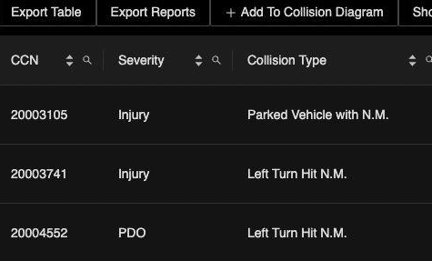
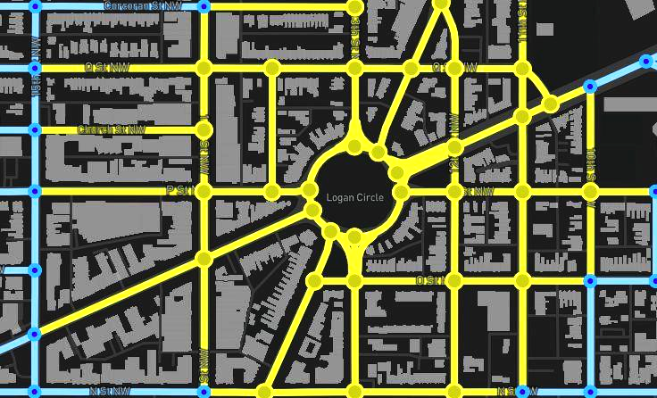
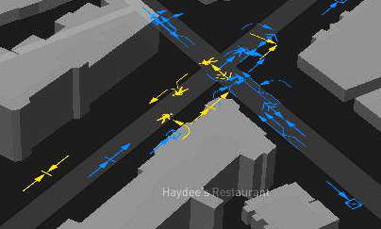
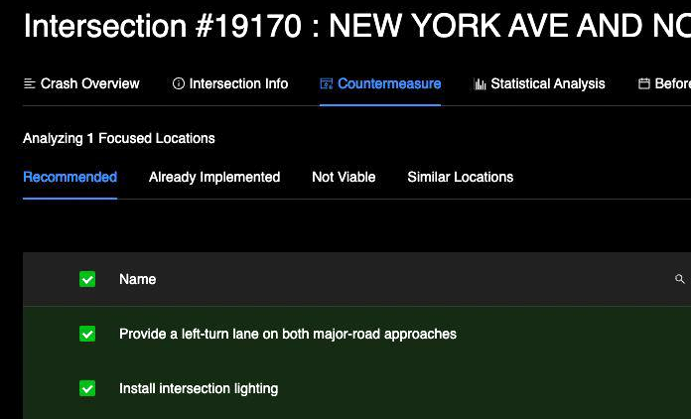
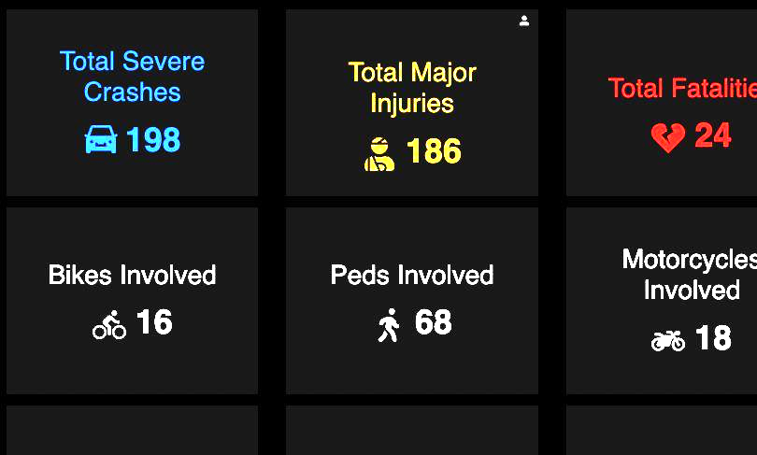
About Citian & CRASH
Jonah Mackay // Citian
Citian is a software company transforming how state & local agencies plan, prioritize, and deliver transportation investments.
CRASH is Citian's platform for transportation safety analysis. It consolidates crash data management, analysis, and visualization in a single environment. CRASH allows users to pinpoint risk hotspots, prioritize interventions, and quantify impact for fast confident decisions.
Refine Crash Data | Identify a High- Priority Intersection | Create Collision Diagram | Compliance, Costs & Cost-Benefit Analysis | Generate Reporting & Programming
/
Page 06

Slide 7
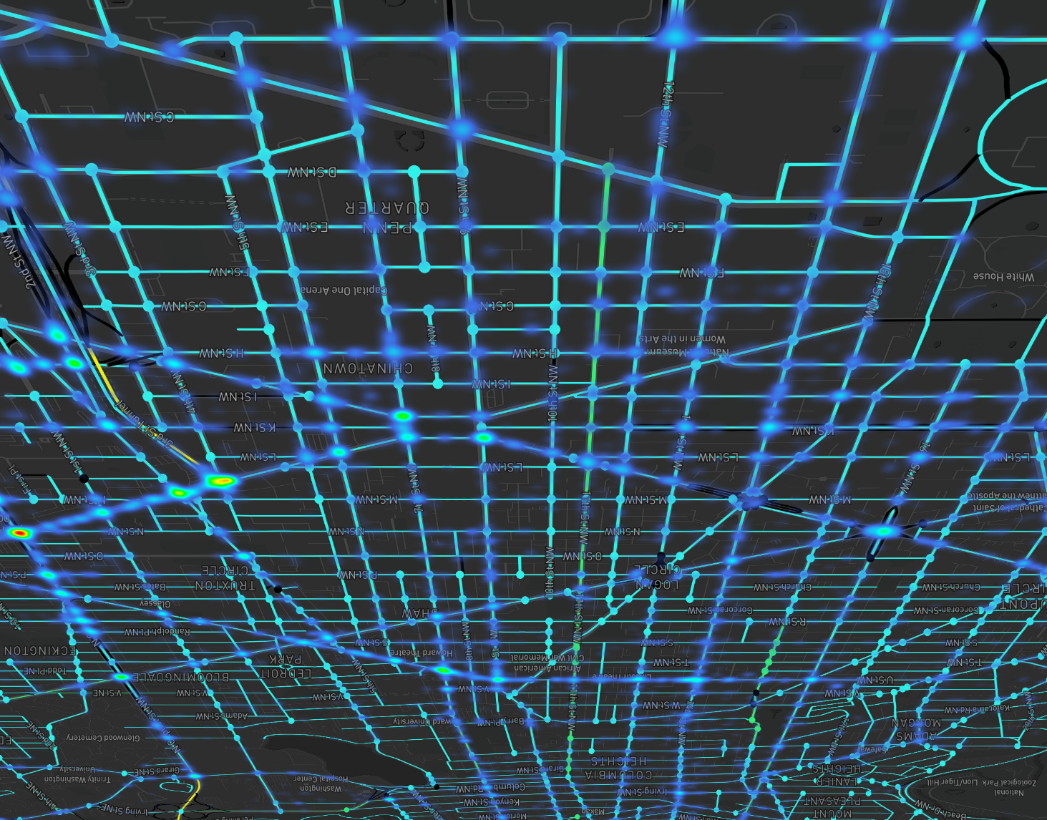


How KYOVA Uses CRASH
Jonah Mackay // Citian
KYOVA's SS4A crash analysis is especially augmented by two CRASH capabilities:
Compliance Reporting
Data
Fusion
01
Proximity-Based Crash Querying
Helps users understand safety patterns at specific locations. Users can define a buffer around any corridor, intersection, local dataset, or custom geometry and return every crash inside it.
Implementation and Evaluation
Data
Refinement
02
Segment & Intersection Ranking
Sets the order of investigation and Investment. Every segment and intersection in the region is ranked using crash frequency, severity weighting, and other parameters tuned to KYOVA's analytical framework, producing a ranked location list that drives SS4A implementation sequencing.
Countermeasure Selection
Network
Screening & Predictive Analysis
/
Page 07

Slide 8
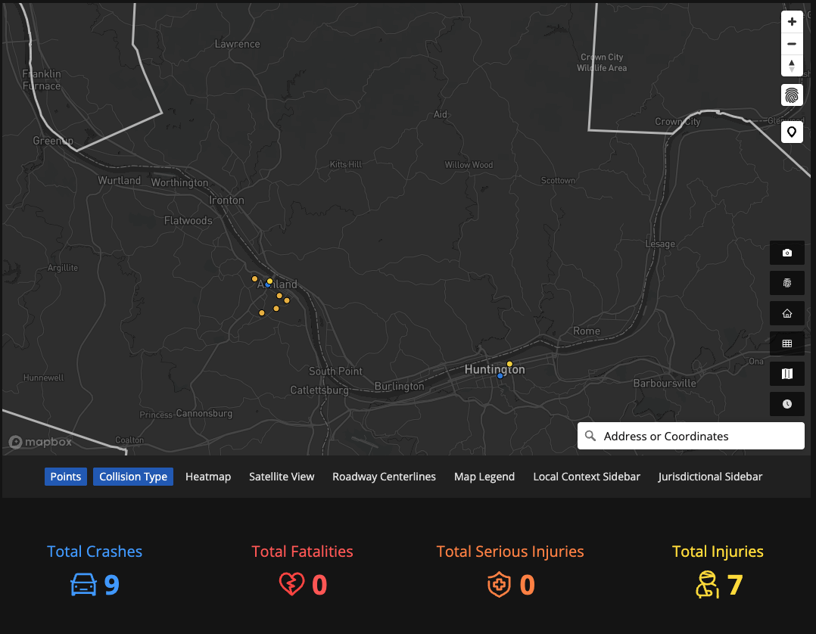
Proximity-Based Crash Querying
Jonah Mackay // Citian
What It Does
CRASH allows users to consider custom areas — a radius, a corridor, custom shape, or local context dataset — and the platform returns every crash inside it across the integrated dataset
How KYOVA Applies It
Analyze crashes within custom boundaries
Review crashes within a set distance of schools, transit stops, and other pedestrian generators
Monitor progress along priority corridors
A map of all crashes involving a bicyclist within 100 ft of the existing bicycle network in 2024.
/
Page 08

Slide 9
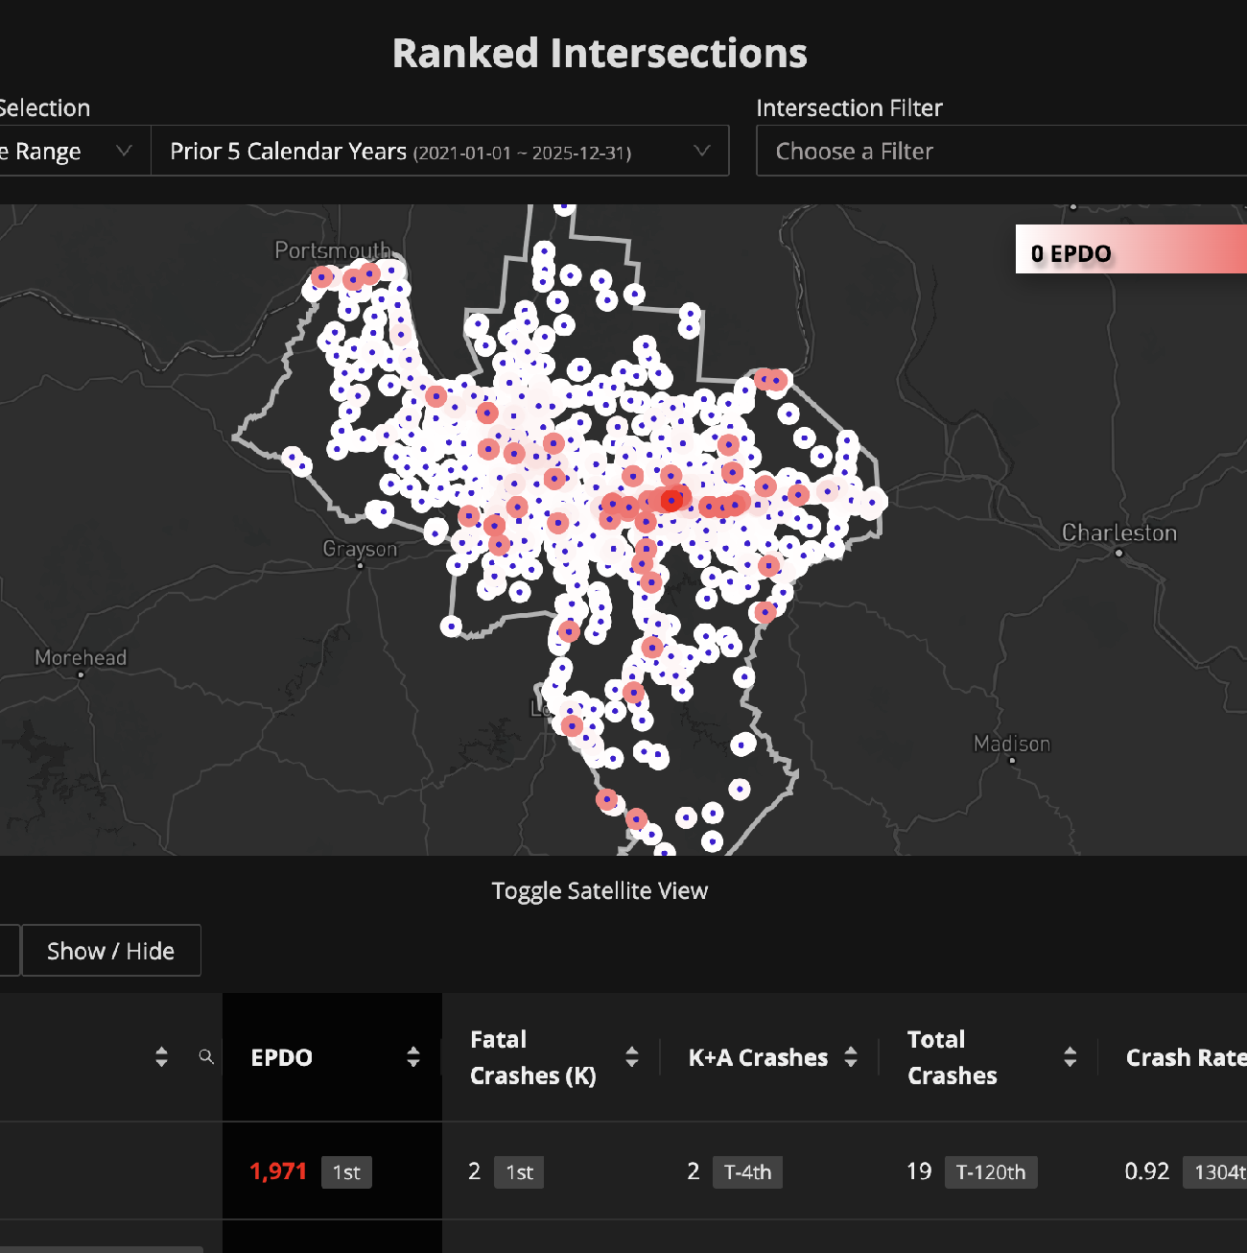
Segment & Intersection Ranking
Jonah Mackay // Citian
Ranking Methodology
CRASH scores each segment and intersection across the region using crash frequency, severity, crash-type composition, and more. Rankings are computed at the regional scale and can be filtered by geography, functional classification, or any combination of crash attributes.
How KYOVA Applies It
Produce a single ranked high-injury network spanning all three states
Use the ranking to sequence site-specific safety investigations and countermeasure development
Align the ranked output with SS4A implementation phases and federal funding cycles
/
Page 09

Slide 10
From Analysis to Action
Jonah Mackay // Citian
CRASH outputs feed the SS4A deliverables directly. The ranked locations and proximity-based pattern findings establish the analytical record behind KYOVA's countermeasure recommendations and implementation sequencing.
1
2
3
4
Crash Data Integration
Location Analysis
Priority Setting
Countermeasure Development
Tri-state crash records consolidated in CRASH across KY, OH, and WV with reconciled geometry
→
Proximity queries and rankings surface the highest-risk segments and intersections in the network
→
Ranked outputs define the SS4A high-injury network and the order of implementation
→
Location-specific crash patterns inform countermeasure selection at each prioritized site
/
Page 10

Slide 11
Live Demonstration
Jonah Mackay // Citian
We will now move into KYOVA's CRASH environment and walk through three typical workflows:
01
Proximity-Based Crash Queries
We will execute a proximity query on for pedestrian crashes near existing bus stops in Huntington, reviewing the returned crash records and areas of concern.
02
Segment & Intersection Rankings
We will quickly rank all segments and intersections across the KYOVA region, identify a location to address, and generate countermeasure recommendations specific to that location.
03
Geographic Queries
Requests for analysis are often based on geography, not crash data. We will review a typical way of querying and analyzing crashes within a custom area.
/
Page 11

Slide 12
In Summary
Jonah Mackay // Citian
KYOVA’s SS4A Goals
How CRASH Supports
01
Develop a data-driven Comprehensive Safety Action Plan
Unified environment, data-lake, and analysis tools for SS4A development
02
Identify and prioritize high-injury network locations
Automated, customizable rankings of segments, intersections, and corridors regionwide
03
Establish a regional safety performance framework
Allows users to evaluate the impact of potential countermeasures and perform Before-and-After Studies
/
Page 12

Slide 13
Thank You
Questions & Discussion
Bethany Wild
Transportation Planner
KYOVA Interstate Planning Commission
bwild@kyovaipc.org
www.kyovaipc.org
Jonah Mackay
Client Success Manager
Citian
jonah@citiansolutions.com
citian.com
/
Page 13

