Slide 1


Appalachian Application of Complete Streets
Translating Walk Audits into Implementable Safety Improvements

Slide 2
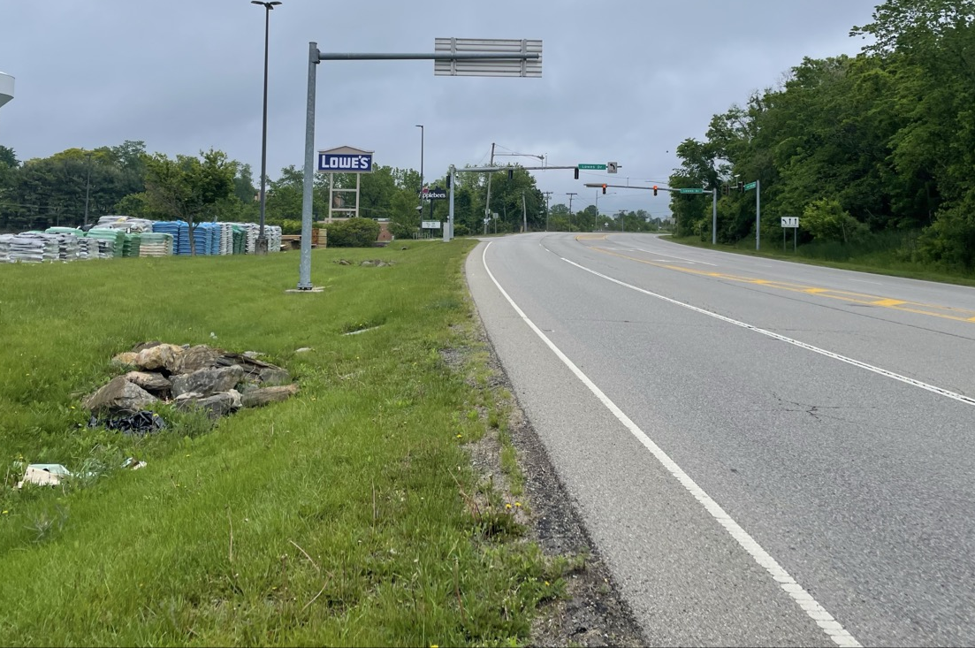
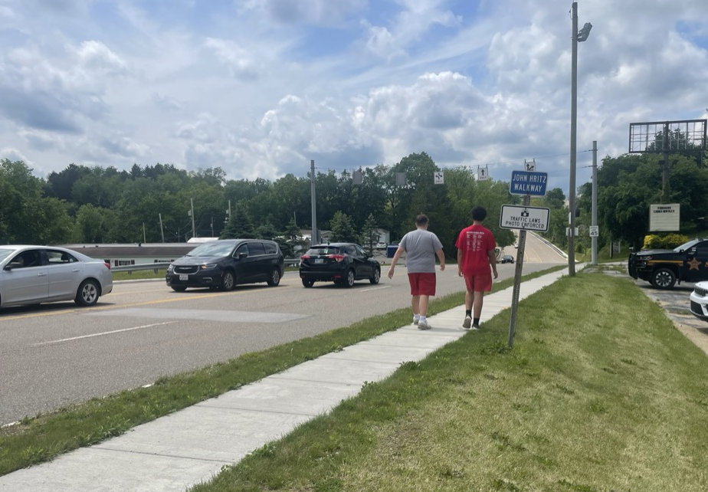
Study Purpose
Corridors were car-oriented with minimal pedestrian infrastructure
Many corridors had difficult terrain and constrained ROW
Known pedestrian activity on corridors
Need to balance:
  Safety
  Feasibility
  Stakeholder priorities
  Funding reality
Notes:
Cody

Slide 3
Study Corridors
8 corridors
4- Steubenville, 2- Wintersville, 2- Jefferson County
Major destinations
  Franciscan University
  Indian Creek High School
  Mobile home communities
  Mall
  Library
  Transit routes
Notes:
Cody

Slide 4
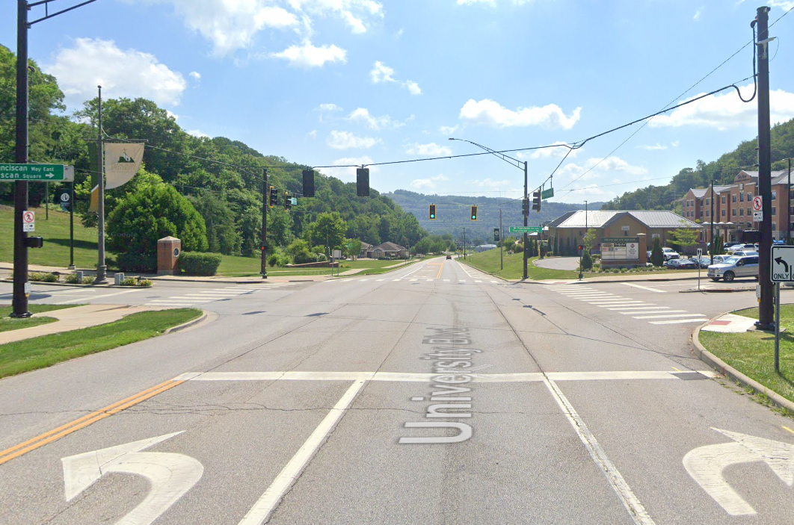
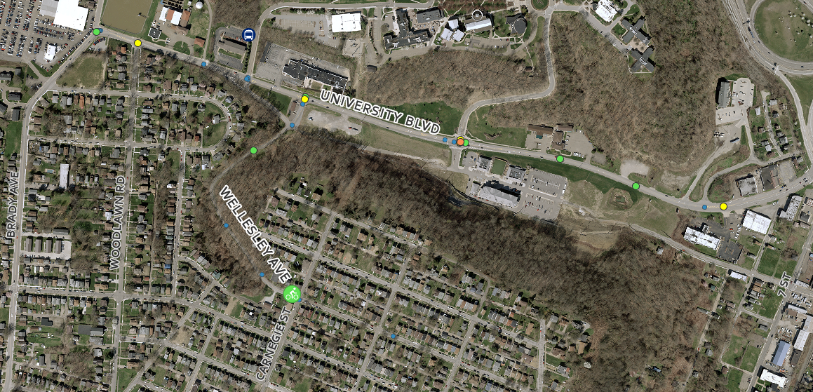
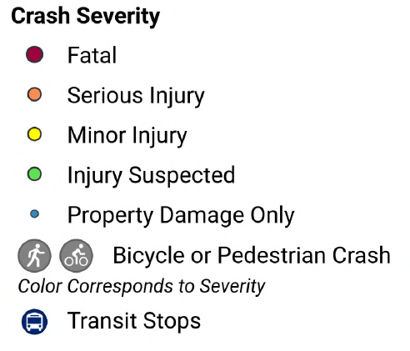
University Blvd and Wellesley Ave
University Blvd looking east at Franciscan Way
9 Crashes
1 Severe
2022, cyclist ran stop sign
High pedestrian traffic
Some midblock crossings on University Blvd
No sidewalk on Wellesley Ave
University Blvd speed limit: 35 mph
Wellesley Ave speed limit: 23 mph
Notes:
Cody

Slide 5
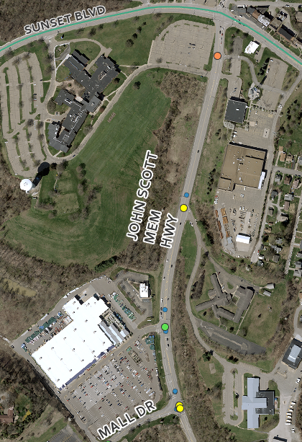
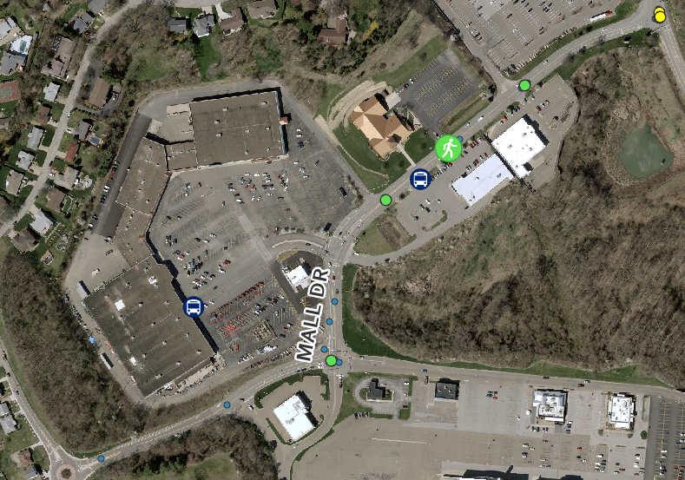
Mall Drive and John Scott Highway
US Bike Route 50
2021, midblock crossing no crosswalk
Bus Route on Mall Dr
No midblock crossings
No sidewalks
Mall Dr Speed Limit: 25 mph
John Scott Hwy Speed Limit: 35 mph
Notes:
Cody

Slide 6
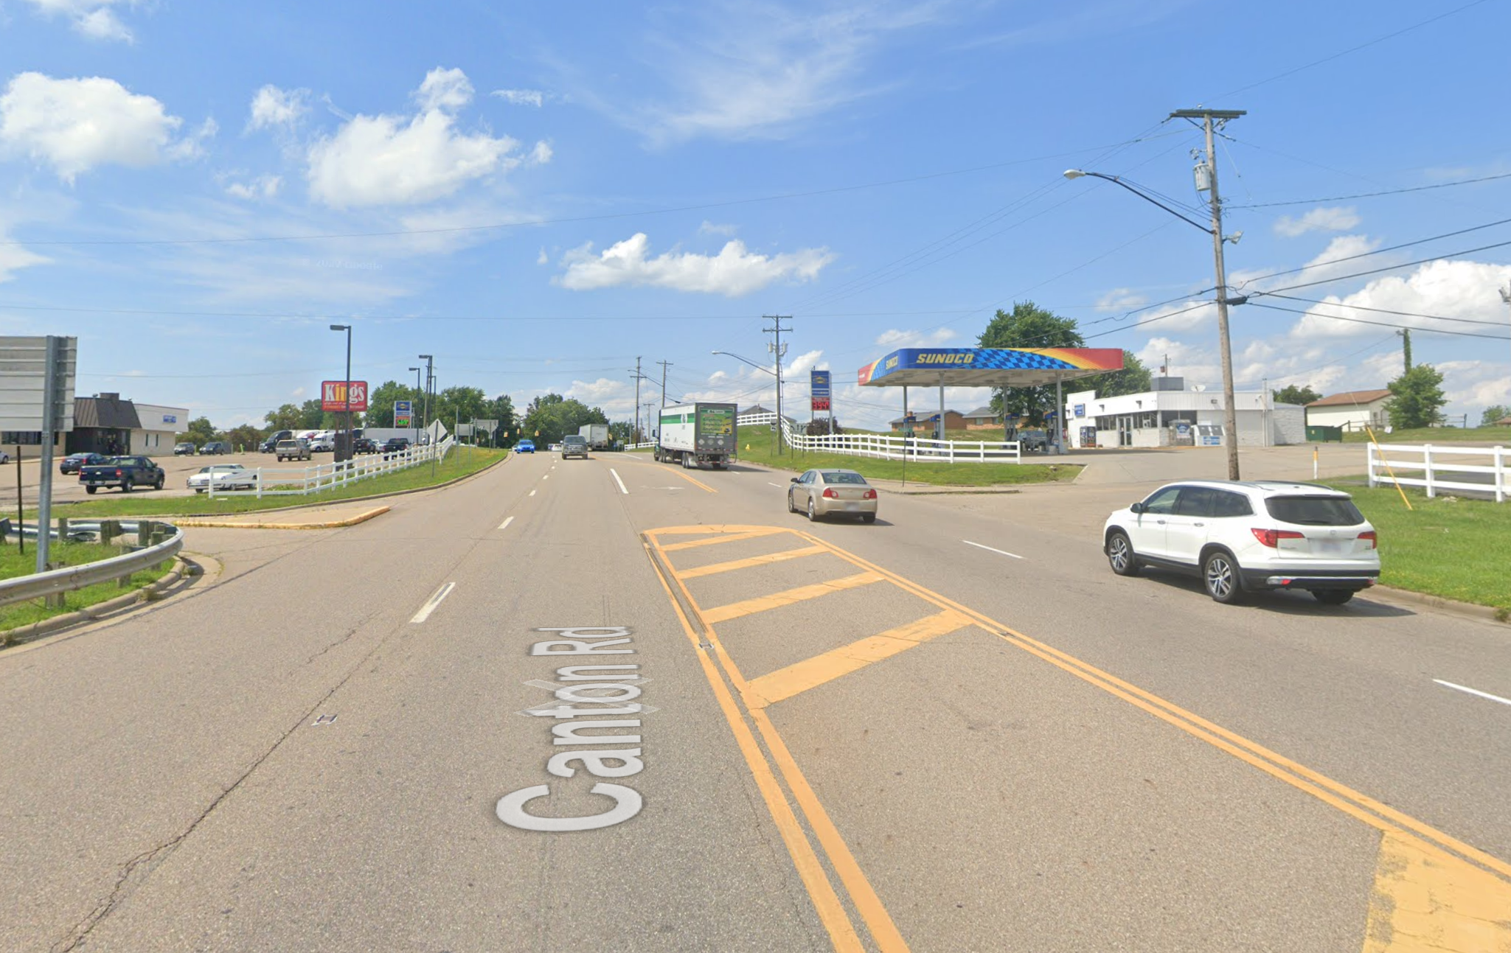
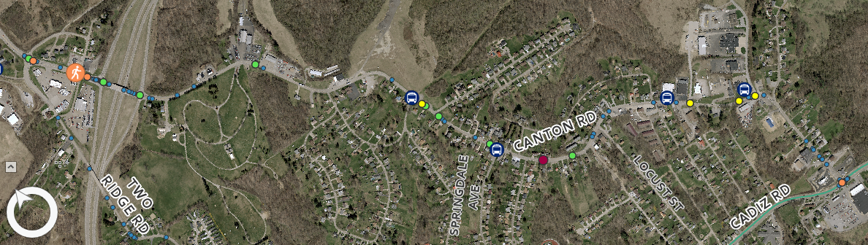


Canton Road
2023, serious injury, crossing Canton Rd
2022, fatal motorcycle crash
2 lanes
No sidewalks
Bus route
35 mph speed limit
Mix of single-family homes and businesses
Notes:
Cody

Slide 7
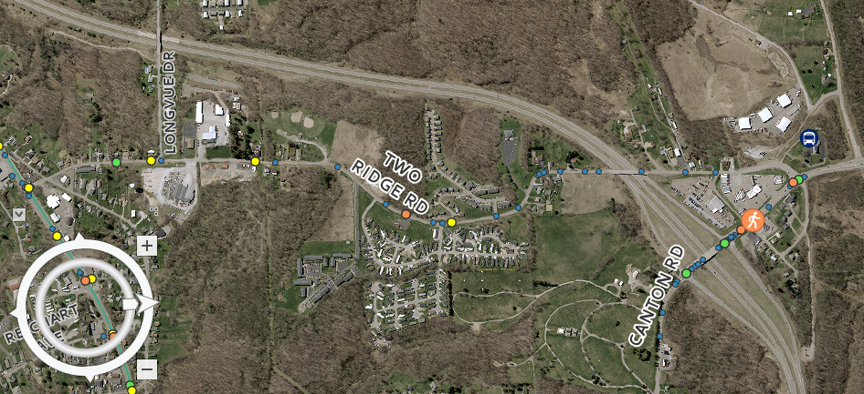
Two Ridge Road
2 lanes
35 mph speed limit
No sidewalks
2023 AADT: 4257
Mobile home community
Notes:
Cody

Slide 8
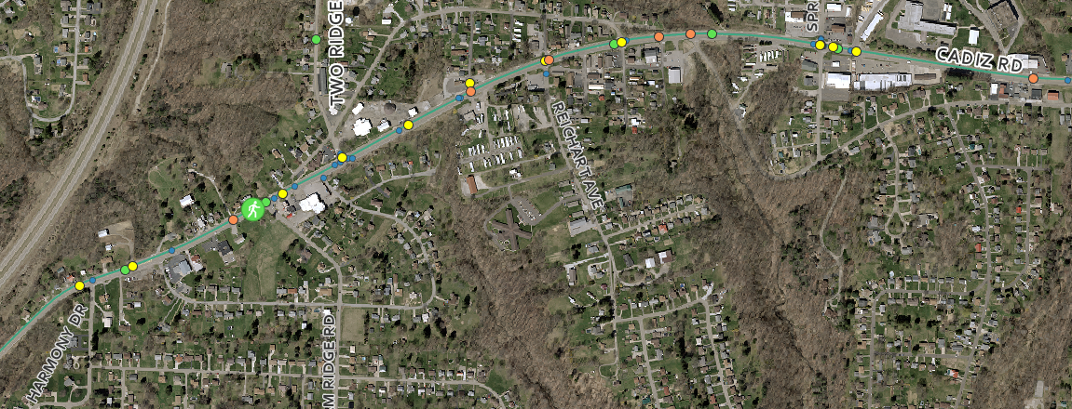

Cadiz Road
High school
2021, minor injury, ped crossing Cadiz Rd
Road Safety Audit 2013-18, Springdale to Two Ridge Rd, 3 ped crashes,1 fatal
6 serious injury crashes
Sidewalk on north side
5 lanes (CTL)
Limited crossings
35 mph Wintersville, 45 mph County
  85th Percentile: 47.5 mph
2023 AADT: 7375
US Bike Route 50
Notes:
Cody

Slide 9
Engagement Overview
2 Stakeholder Groups
  Steubenville
  Jefferson County and Wintersville
Agencies and Organizations Represented
  City and County Engineering
  ODOT
  City Parks
  Local School District
  University Representative
  Health Authority
  Board of Developmental Disabilities
  Police
Notes:
Ella

Slide 10
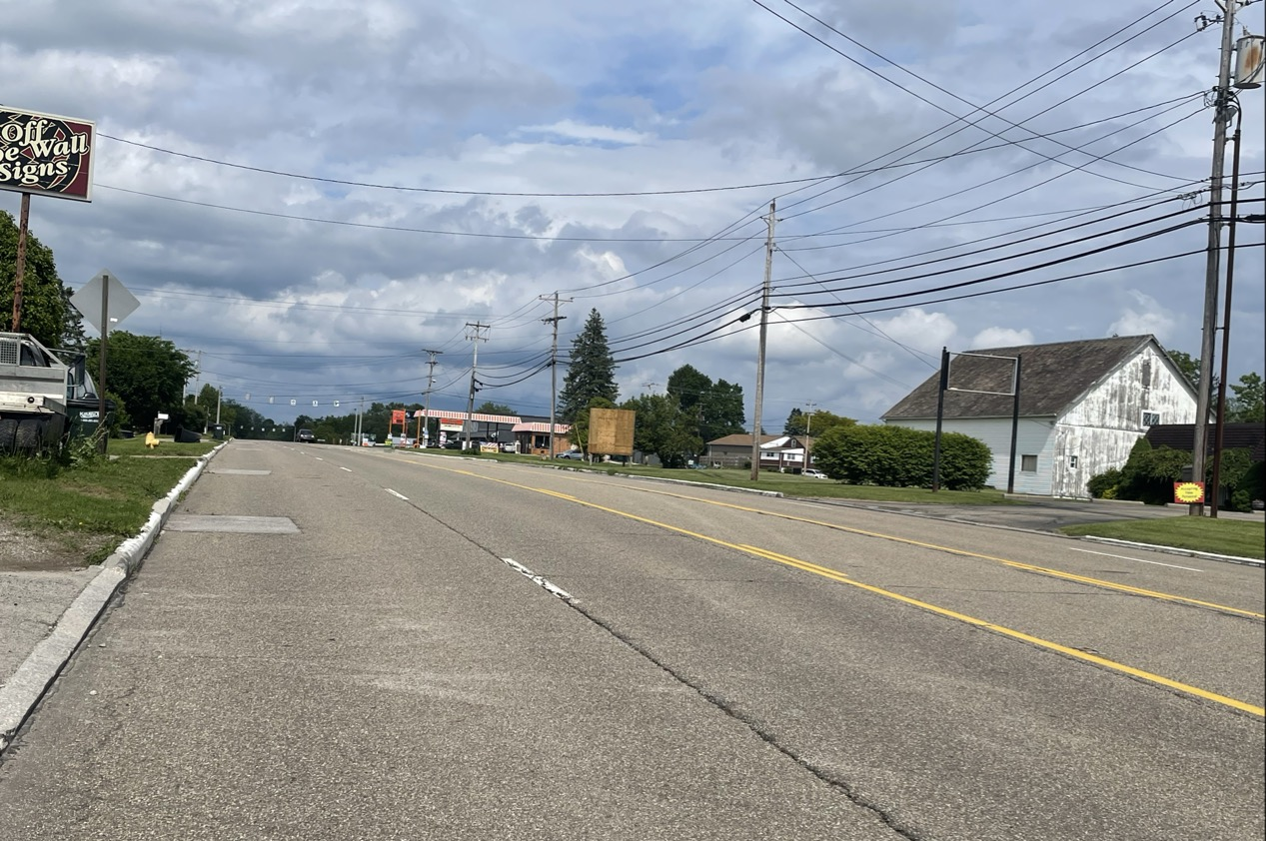
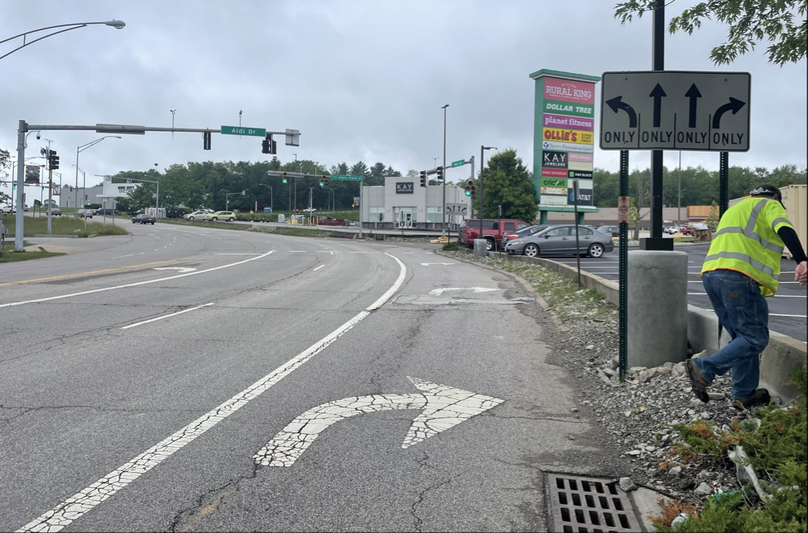
Walk Audits: Seeing the Corridors Firsthand
Identified gaps not obvious in GIS or crash data
Helped stakeholders experience conditions together
Created shared understanding of corridor challenges
Notes:
Ella

Slide 11
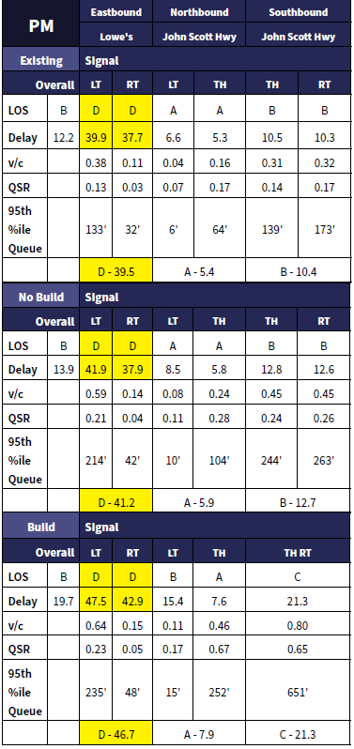
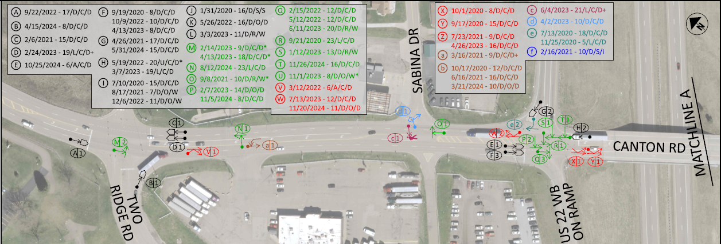
Analyses Conducted
Traffic Analysis
  Traffic counts collected
  Capacity analysis
Safety Analysis
  Crash data analysis
  ODOT Economic Crash Analysis Tool (ECAT)
    Determines Potential for Safety Improvement (PSI)
Notes:
Ella

Slide 12
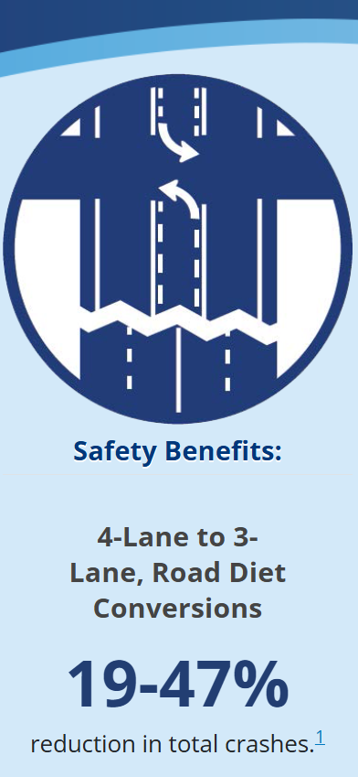
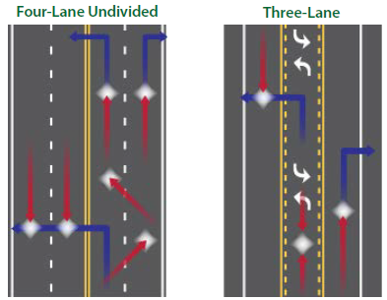
Why Road Diets Were Considered
Shorter crossing distance for pedestrians
Improve turning conflict management
Reduce vehicle speeds
Acceptable LOS maintained
Stakeholders hesitant
Notes:
Ella

Slide 13
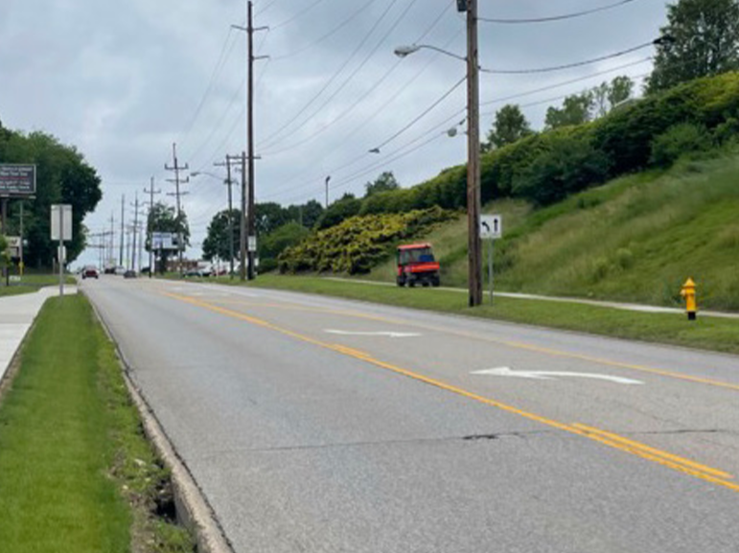
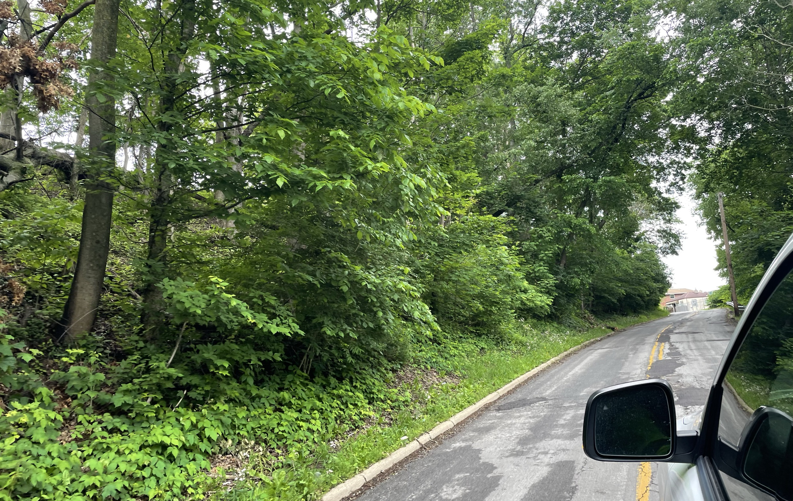
University Blvd and Wellesley Ave
Pedestrian demand from university growth
Sidewalk gaps and difficult terrain
Two alternatives:
  Retaining wall
  Slope stabilization
Currently programmed and scoped
Construction May 1, 2029
Notes:
Ella/Cody

Slide 14
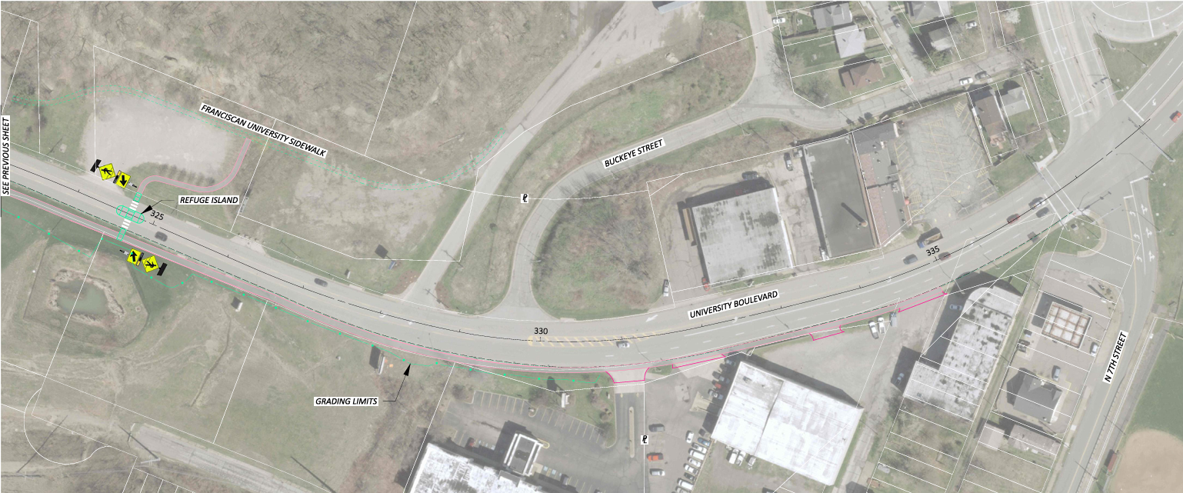
University Boulevard
Notes:
Ella/Cody

Slide 15
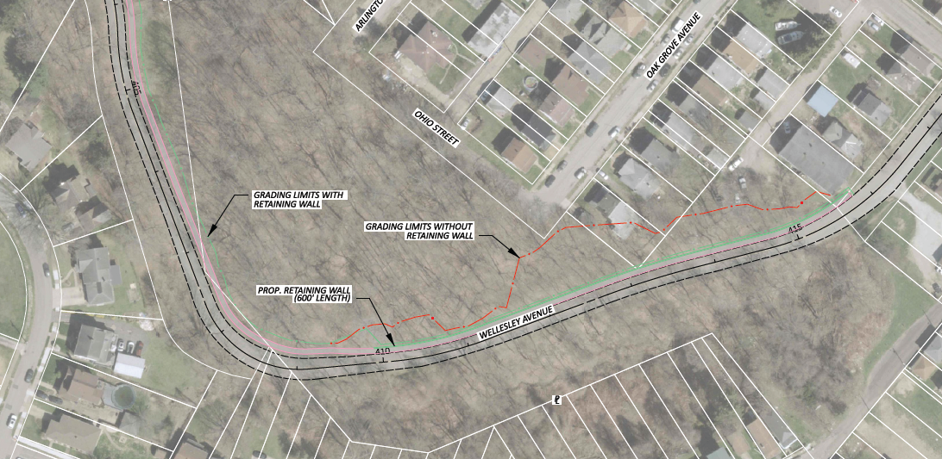
Wellesley Ave
Notes:
Ella/Cody

Slide 16
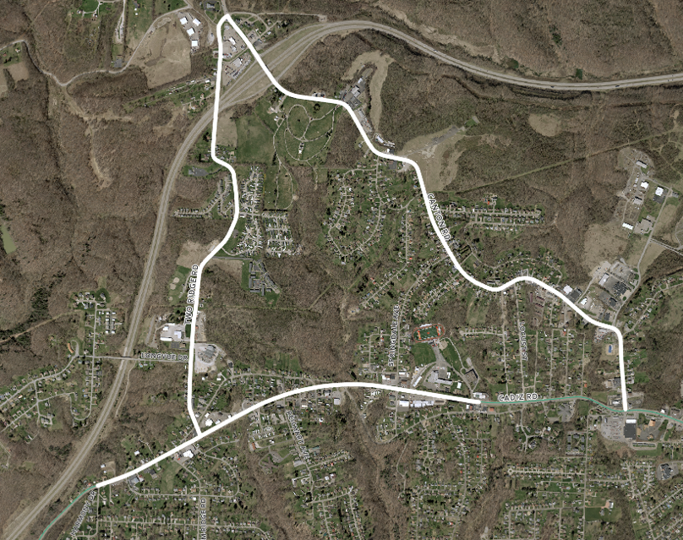
Shared-Use Path Connection
Canton Rd to Two Ridge Rd connection
Avoids dangerous highway overpass crossing
Uses existing ODOT ROW
Emerged from walk audit observations
Notes:
Ella

Slide 17
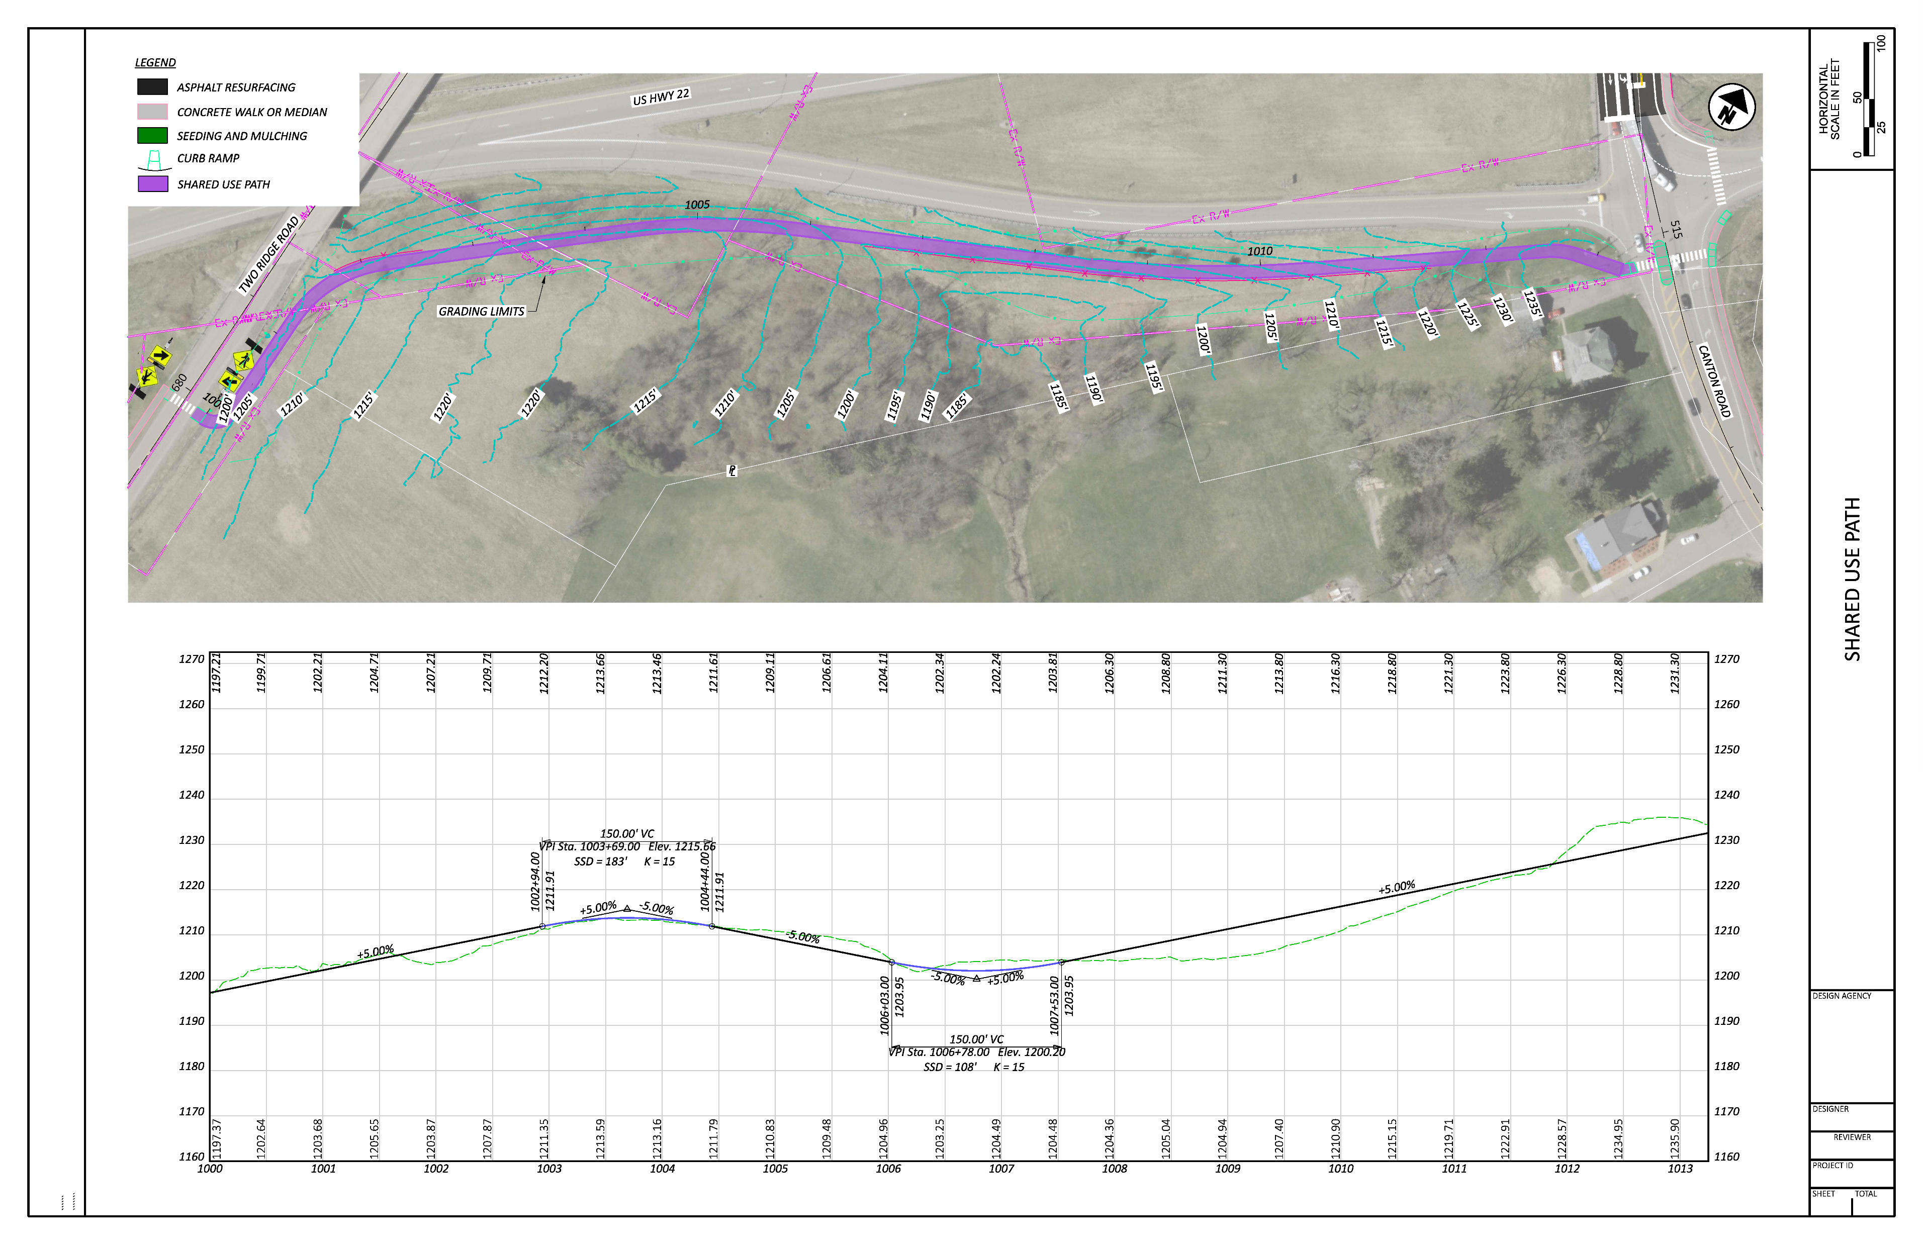
Shared-Use Path Connection

Slide 18
Shared-Use Path Connection

Slide 19
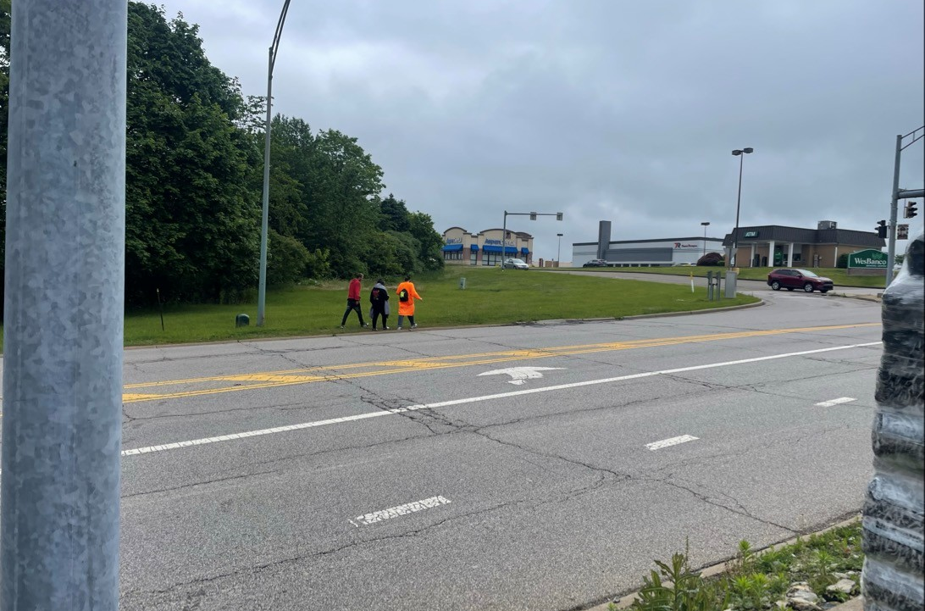
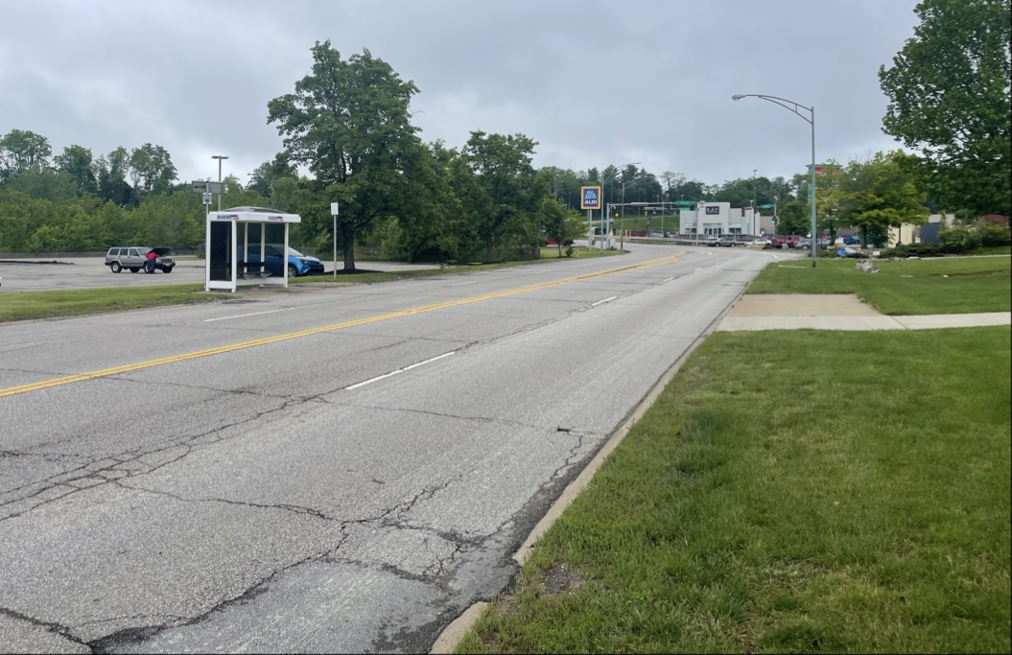
Mall Drive Road Diet
No sidewalks along corridor
Transit and retail destinations
Midblock crossing demand
Stakeholder concern about traffic impacts
Traffic analysis supported feasibility
Corridor felt uncomfortable on foot despite low-speed classification

Slide 20
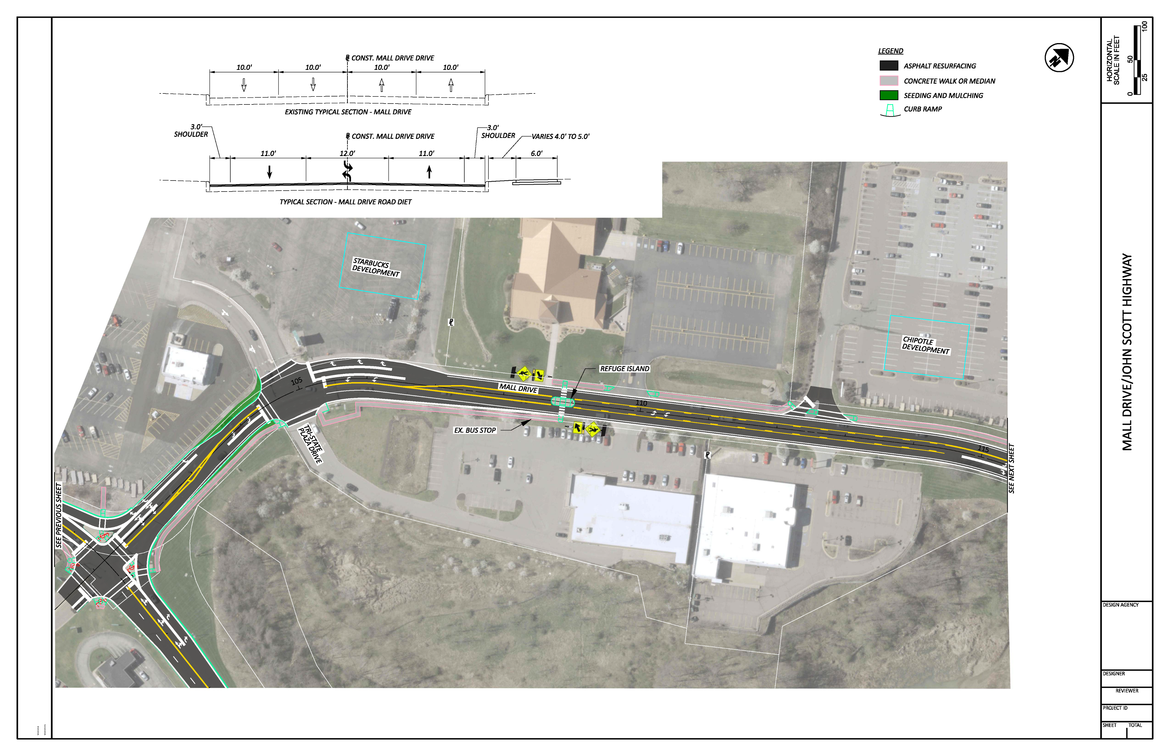
Mall Drive Road Diet

Slide 21
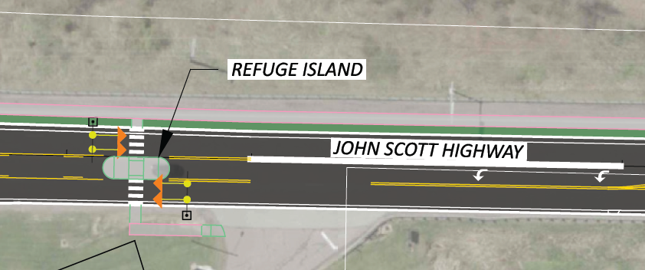
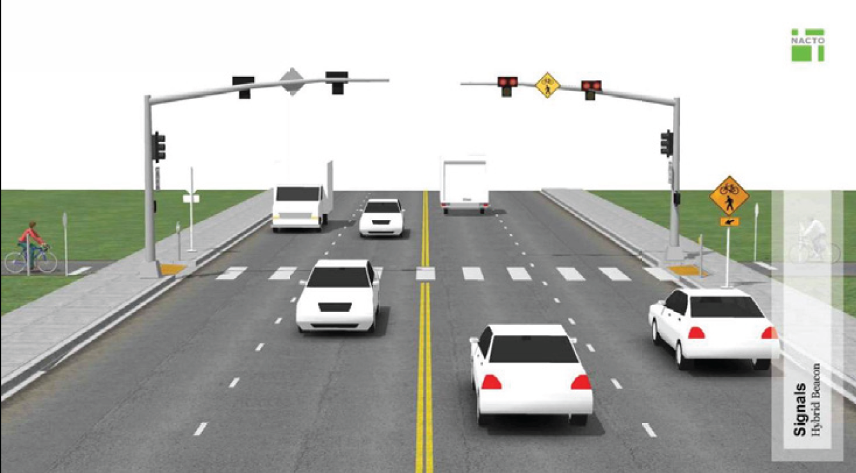
Crossings
8 RRFB Crossings Recommended
1 PHB Crossing- John Scott Highway
5 signals with pedestrian improvements
Notes:
School crossings tied to walk audit observations
Transit crossings connected to crash history
Commercial crossings from stakeholder requests
Midblock crossings addressing demand patterns
Each crossing linked to data and community input

Slide 22
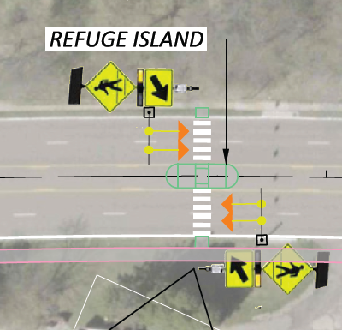
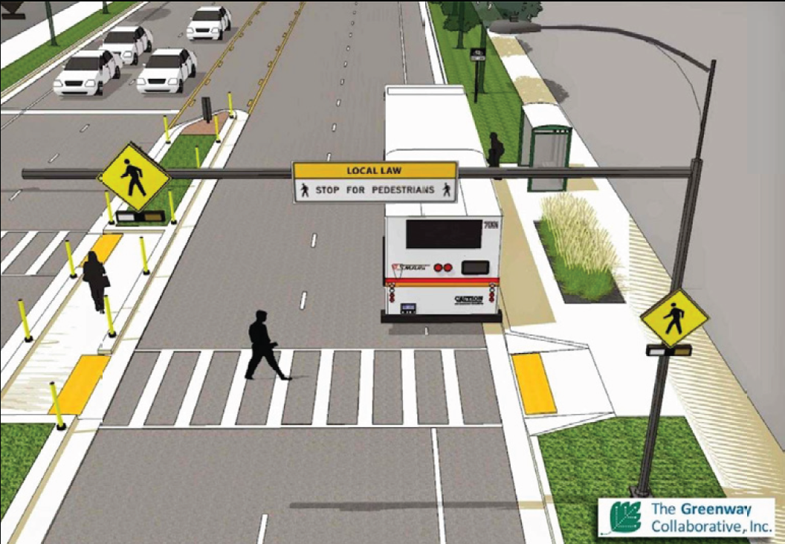
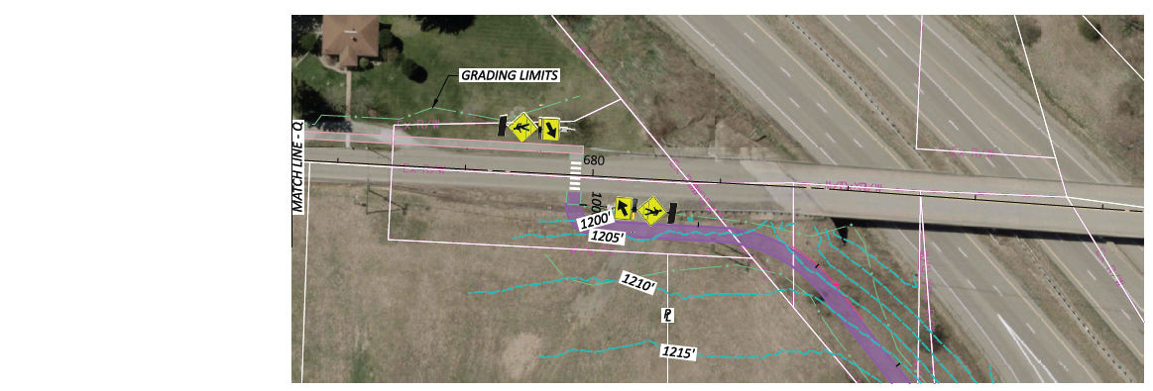
Crossings
8 RRFB Crossings Recommended
  High school
  University
  Library & grocery store at bus stop
  Long stretches without crossings
  Connections to recommended sidewalks
Notes:
School crossings tied to walk audit observations
Transit crossings connected to crash history
Commercial crossings from stakeholder requests
Midblock crossings addressing demand patterns
Each crossing linked to data and community input

Slide 23
Multiple Iterations Built Consensus
Progression:
  Initial observations from walk audits
  Early design concepts developed
  Stakeholder concerns addressed
  Revised concepts incorporating feedback
  Final recommendations
Key Concerns Navigated:
  ROW constraints, public opinion, traffic operations, maintenance, driveway access, cost

Slide 24
Positioning Projects for Funding
Study focused on implementable projects
Cost estimates developed for each concept
Safety justification aligned with ODOT/FHWA priorities
Ready-to-advance concepts for grant applications
Funding Alignment:
  Congestion Mitigation and Air Quality (CMAQ)
  Safe Routes to School (SRTS)
  Transportation Alternatives Program (TAP)
  Highway Safety Improvement Program (HSIP)
Notes:
Cody

Slide 25
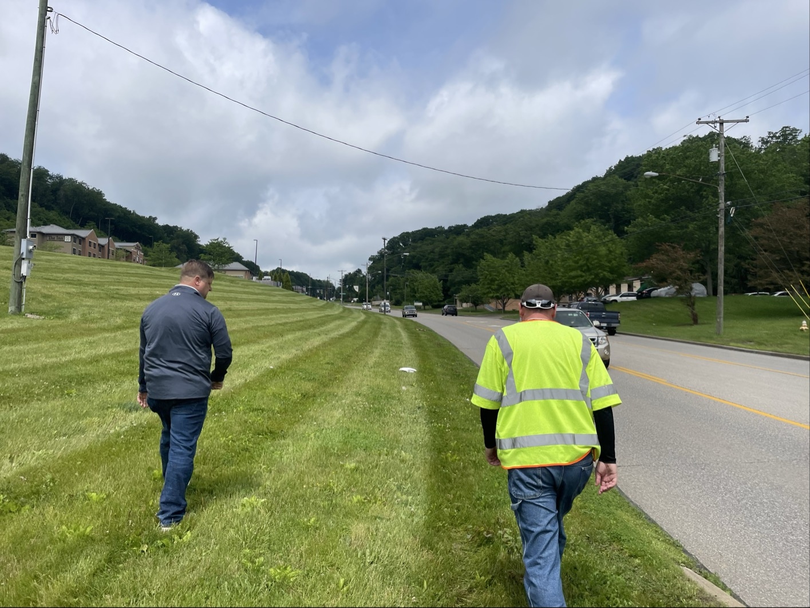
Lessons Learned
Walk audits created shared understanding
Stakeholder buy-in improved project quality
Technical analysis strengthened difficult conversations
Appalachian contexts require flexible solutions
Practical implementation solutions matter
Notes:
Cody

Slide 26
Questions?
Ella Donley, Transportation Planner
  Burgess & Niple
  Ella.donley@burgessniple.com
Cody Cresap, Transportation Study Director
  BHJ-MPC
  ccresap@bhjmpc.org

