Slide 1
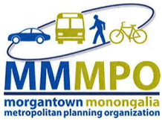
2055 Metropolitan Transportation Plan Minor Update
Jackie Peate & Jing Zhang, FAICP
Morgantown Monongalia Metropolitan Planning Organization (MMMPO)

Slide 2

Agenda
Overview (Purpose + Engagement)
Validation + New Needs
Project Highlights
Public Participation
Refine Priorities

Slide 3

Overview - Purpose
The Metropolitan Transportation Plan is developed and produced by the MPO with 20 years as its timeline/horizon.
  Updates every 5 years
Identifies how the region intends to invest in the transportation system.
Considers how roadways, transit, nonmotorized transportation, and intermodal connections are able to improve the operational performance of the multimodal transportation system.
  Freight is an important consideration in multimodal systems.
49 USC 5303(i) - This is the federal regulation that specifies what must be included in the MTP.
The MTP should include:
  Performance Measures
  Goals established in Federal Regulations
  Goals established by local stakeholders in the planning process

Slide 4
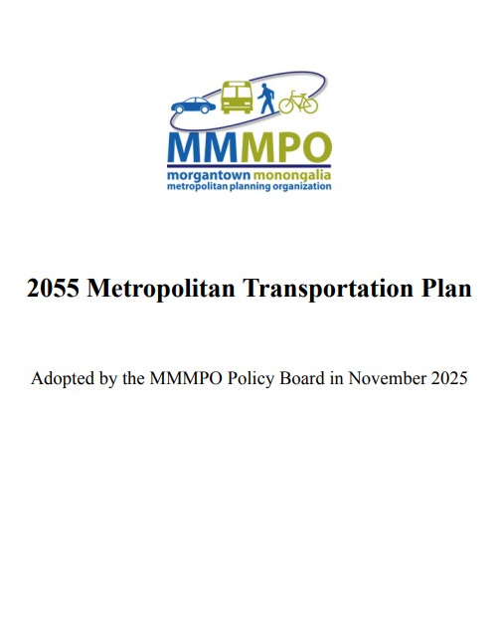
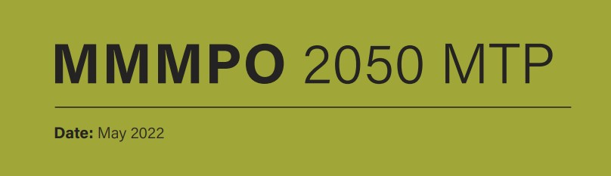
Overview - Components
In 2025, the Morgantown Monongalia Metropolitan Planning Organization (MMMPO) undertook a minor update of its long-range planning document, resulting in the 2025-2055 Metropolitan Transportation Plan (MTP).
This update was conducted in-house by MMMPO staff, serves as a strategic calibration of the previous 2050 MTP (formerly the Long-Range Transportation Plan), which was adopted in 2022.

Slide 5
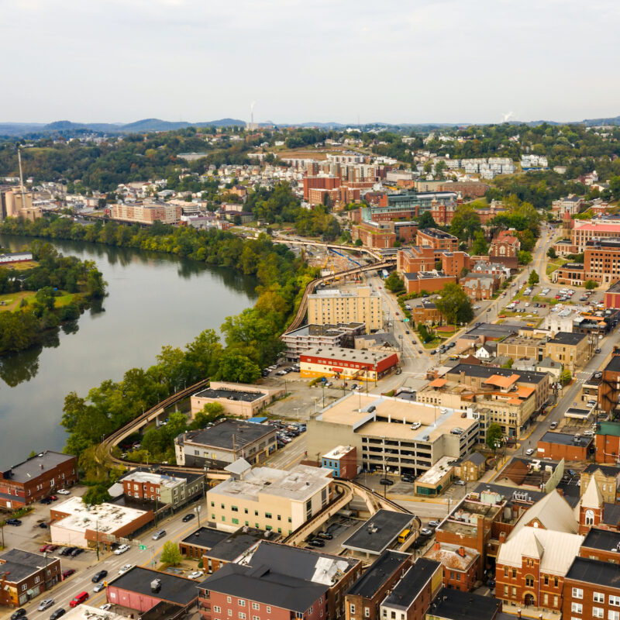
Overview - What Has Changed
New information, data, and analysis since the last MTP adoption in 2022:
DOT crash data 2019-2023, including non-motorized crashes.
Updated Travel Demand Model (TDM) from the MPO’s Downtown Traffic Study.
TransModeler Analysis from Downtown Traffic Study
Committed and ongoing TIP projects and county/municipal projects.
New land-use development in the MMMPO area
Other transportation-related plans include the WVDOH Morgantown Pedestrian Safety Study, EV Inventory & Preliminary New Location Study, Monongalia County 2023 Comprehensive Plan, and Morgantown 2033 Comprehensive Plan.
US Census and other federal data.

Slide 6

Overview - Timeline
Plan Development Schedule
Early January, Document/Data Review and Integration
August 19, First Public Meeting @ Mountain Line Transit Terminal
September 2, Pop-up Display @PRT Mountaineer Station
September 11, Second Public Meeting @ Morgantown City Hall
By the end of September, the draft MTP for comments
October 6, Steering Committee Meeting
October 22, Third Public Meeting @ Riverfront Historical Bus Depot
November 4th, 4pm - 7pm, Virtual Public Meeting via Google Meet
Submit for adoption by the MMMPO Policy Board at the November 2025 meeting or, if necessary, at the January 2026 meeting.
  MTP was recommended for approval by the TTAC and CAC at November meetings.

Slide 7

Public Participation - Events
Public Meetings:
August 19, First Public Meeting @ Mountain Line Transit Terminal
September 2, Pop-up Display @PRT Mountaineer Station
September 11, Second Public Meeting @ Morgantown City Hall
October 22, Third Public Meeting @ Riverfront Historical Bus Depot
November 4th, 4pm - 7pm, Virtual Public Meeting via Google Meet
Surveys:
Community Survey- This survey encouraged community members to share their vision for the future of transportation in our region and to tell us what matters most to you and how we can better serve the community. There were 120 responses.
Project Survey- This survey encouraged community members to share their preferences and comment on the recommended projects, and suggest any new ones. Their input will help identify and prioritize high-impact projects for funding. There were 28 responses.
Online Website:
Launched in late July of 2026. Had information on project purpose, dates and locations of upcoming meetings, meeting results, related documents, and ways to get involved with the update of the MTP.

Slide 8
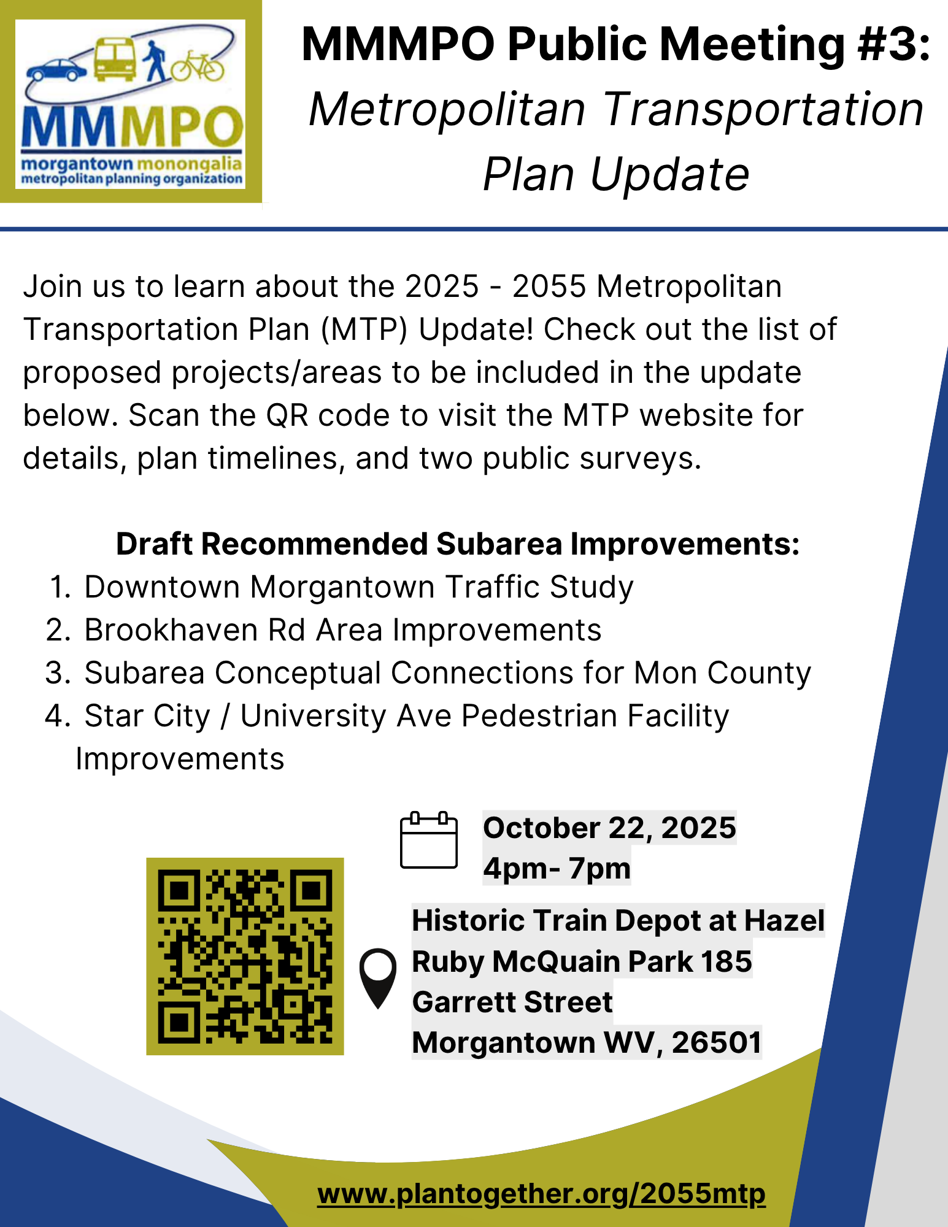
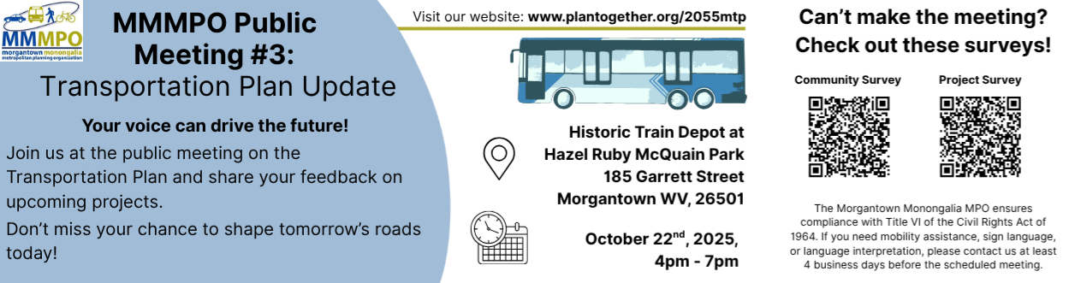
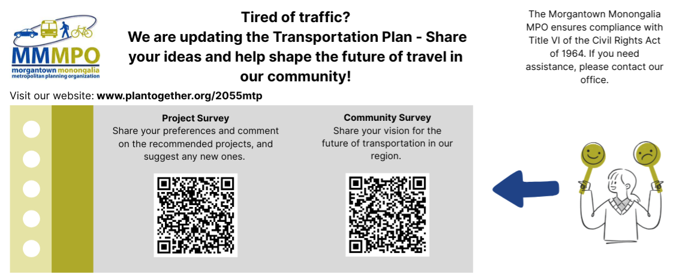
Public Participation - Examples

Slide 9
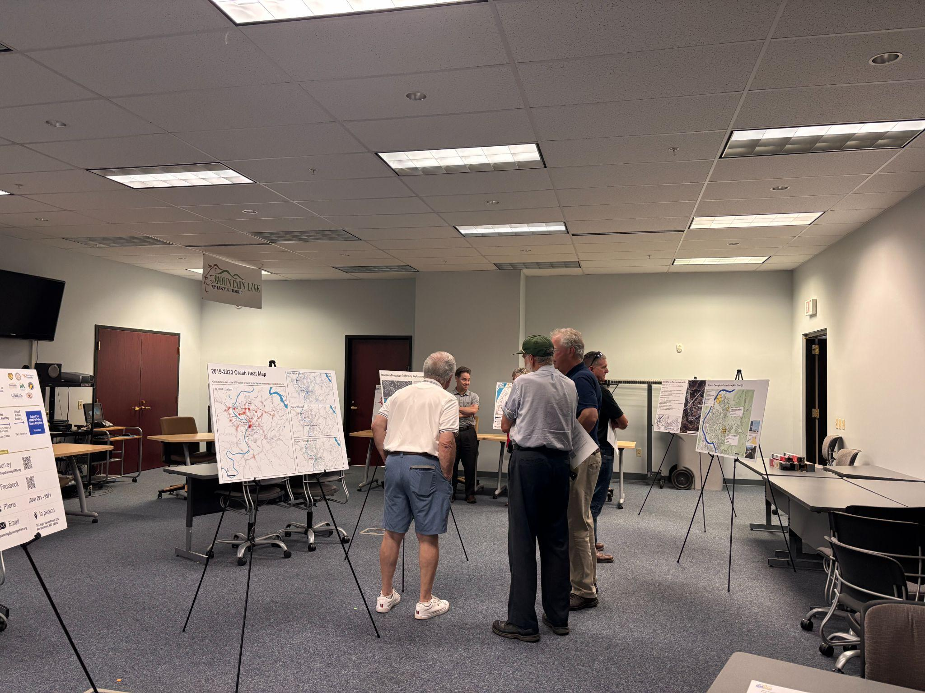
Public Participation - Feedback
Statistics
  159 total survey responses.
  Survey open for 134 days.
  A total of 49 people attended the in person public meetings.
Comments asked for a Greenbelt connection and pedestrian safety. There was a big concern with the amount of money potentially being spent on these potential projects. There was frustration with how car-centric cities can be and with the level of congestion when driving around the area. All comments and data from the surveys, meetings, and online are available in Appendix A: Public Participation Documentation

Slide 10
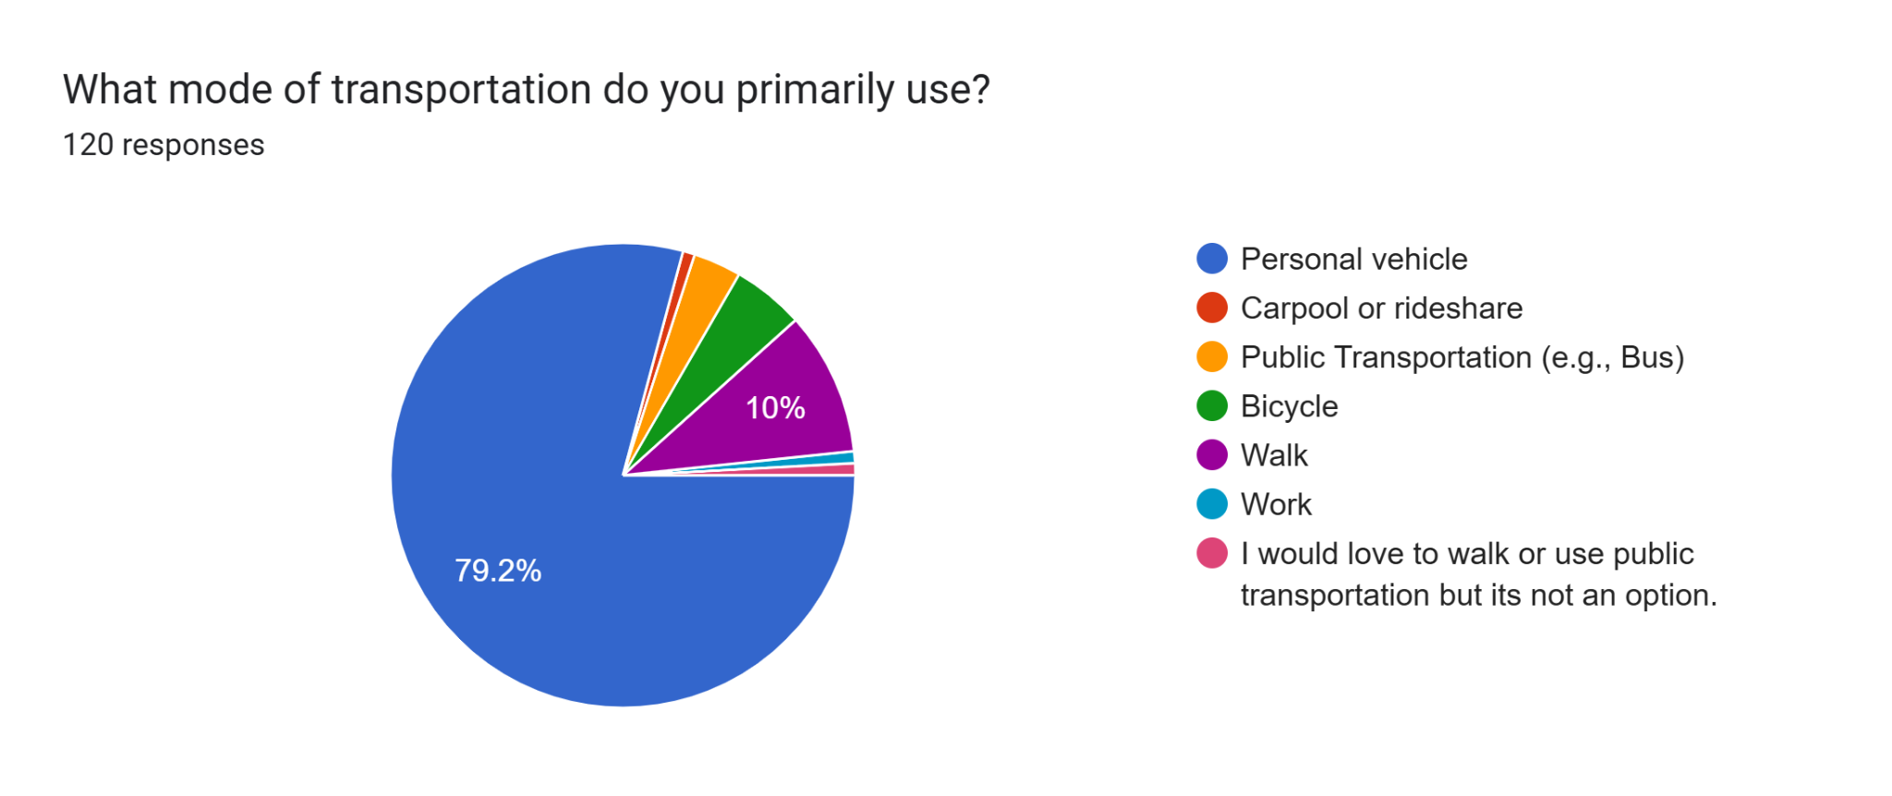
Public Participation - Responses

Slide 11
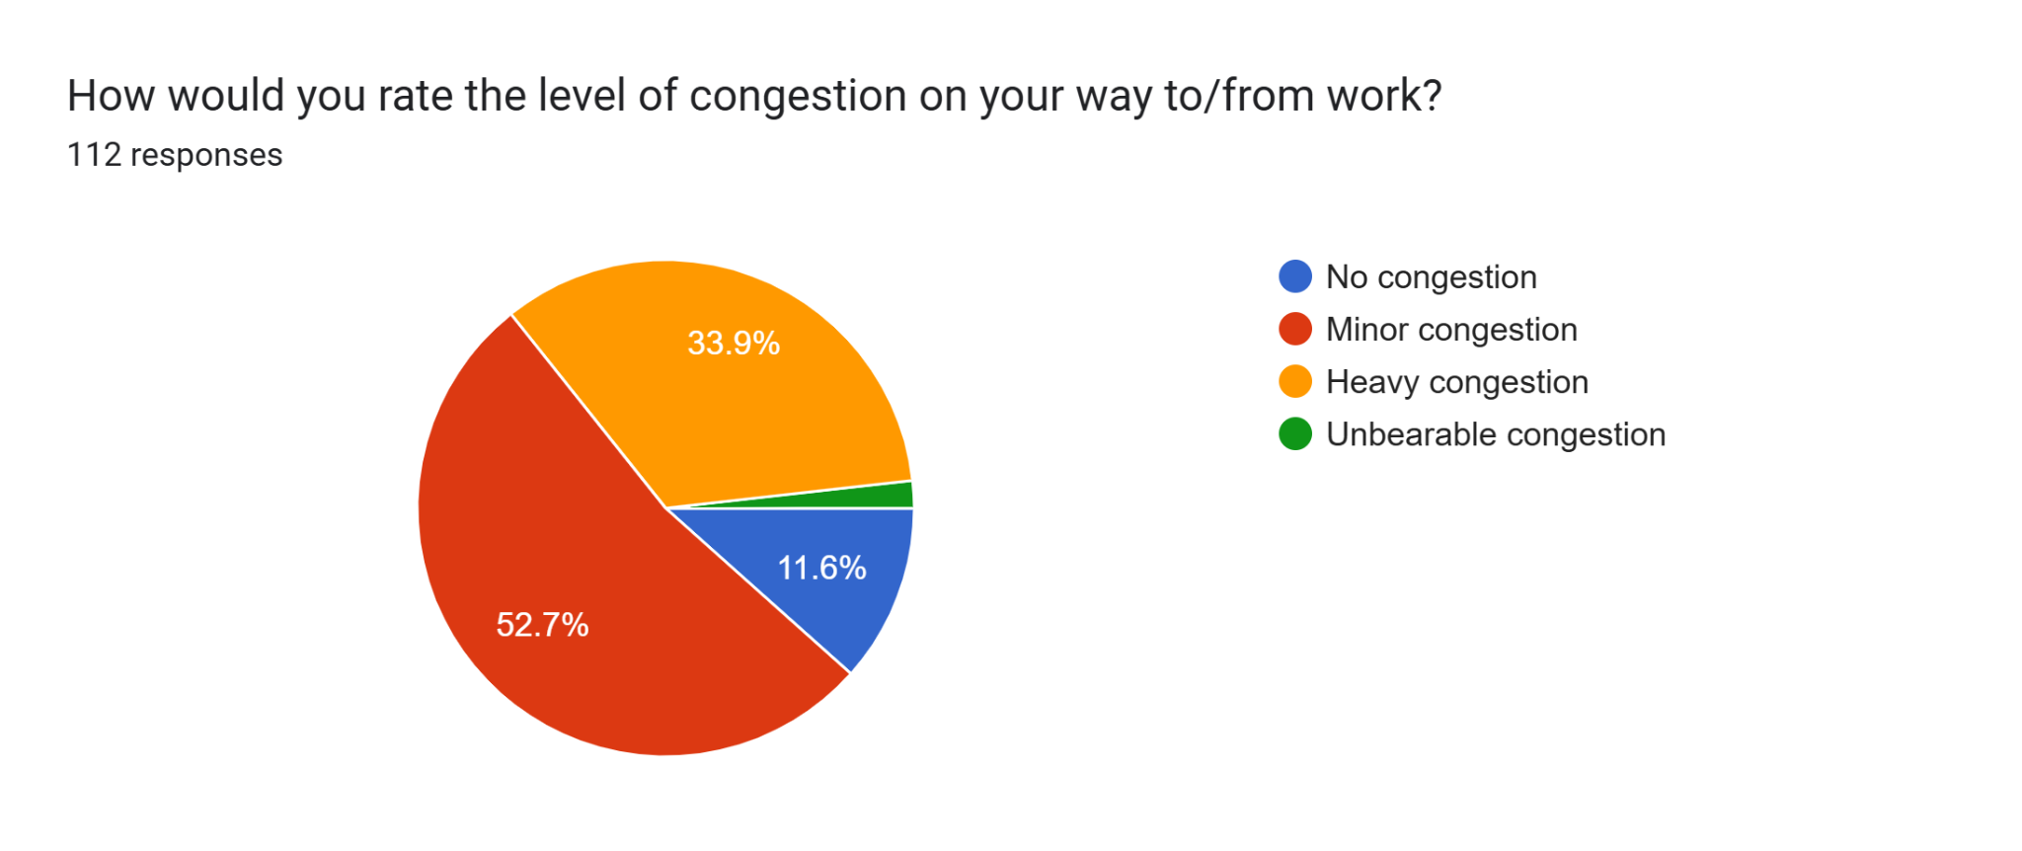
Public Participation - Responses

Slide 12
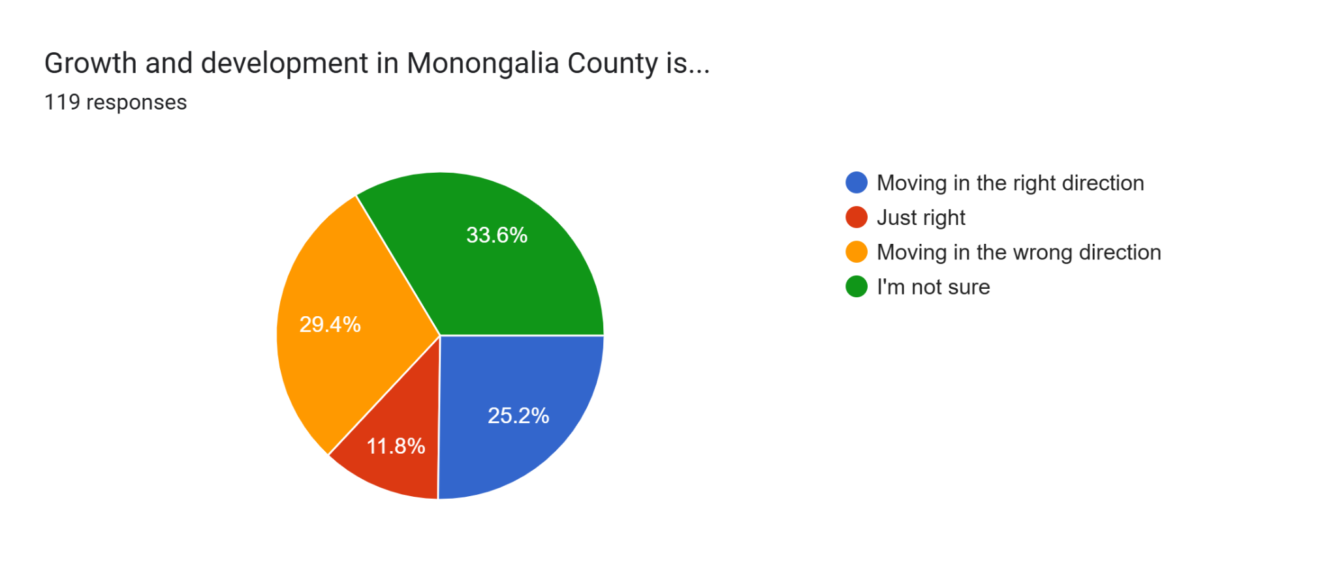
Public Participation - Responses

Slide 13
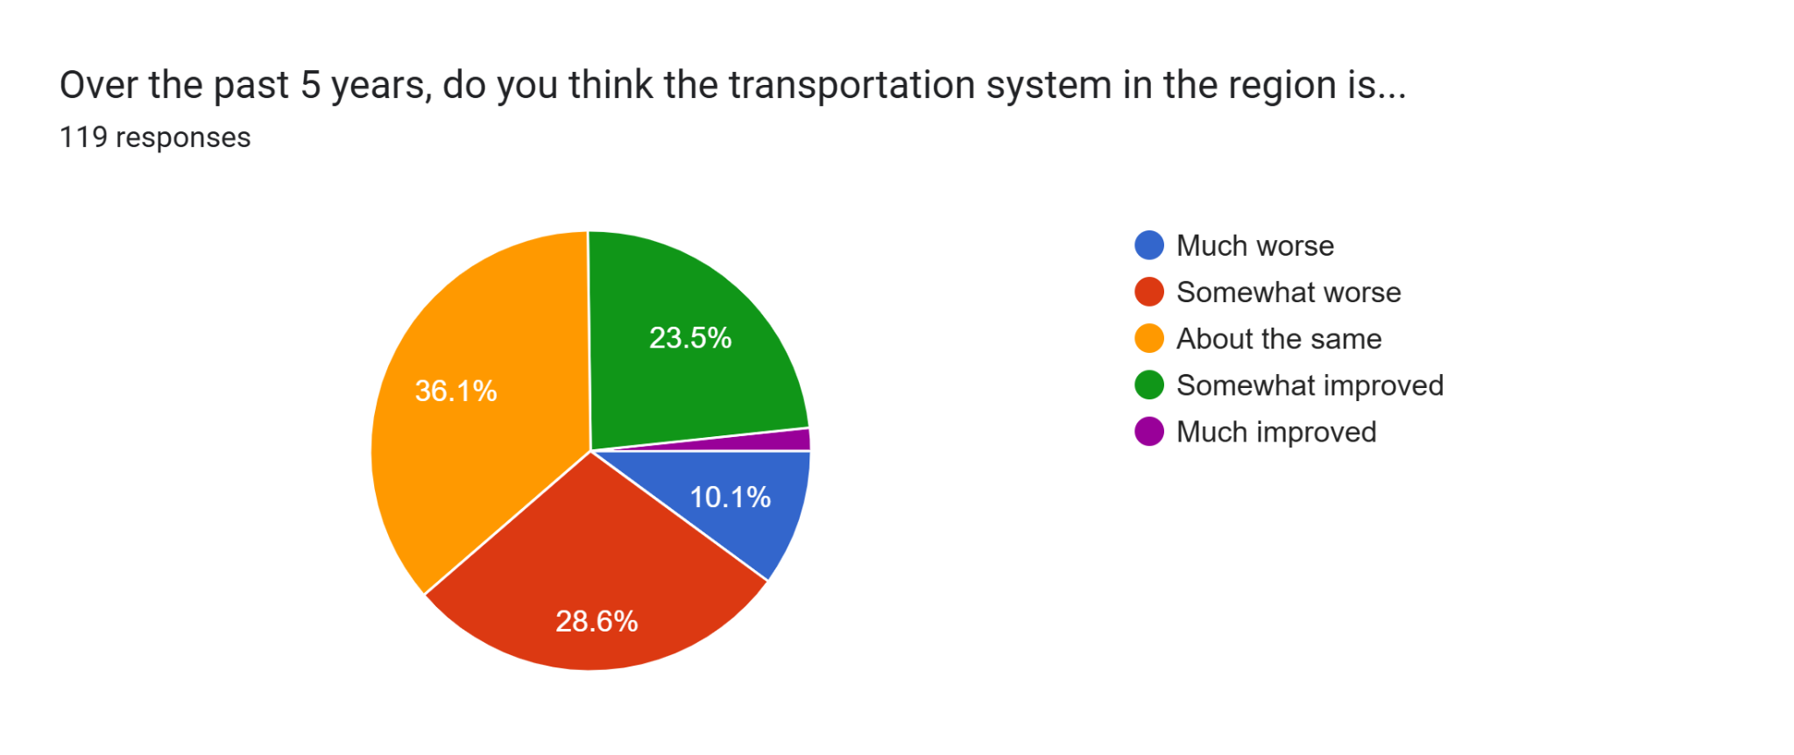
Public Participation - Responses

Slide 14

Public Participation - What We Learned
People respond less to open ended questions, but they do provide specific feedback with open ended questions.
Advertising on Social Media and the Dominion Post.
More feedback online versus in person.
Working with Partner Agencies to help spread the word.
Educate the public!
Next time-
  Work more with West Virginia University
  More Pop-Up events
  Engage public earlier

Slide 15
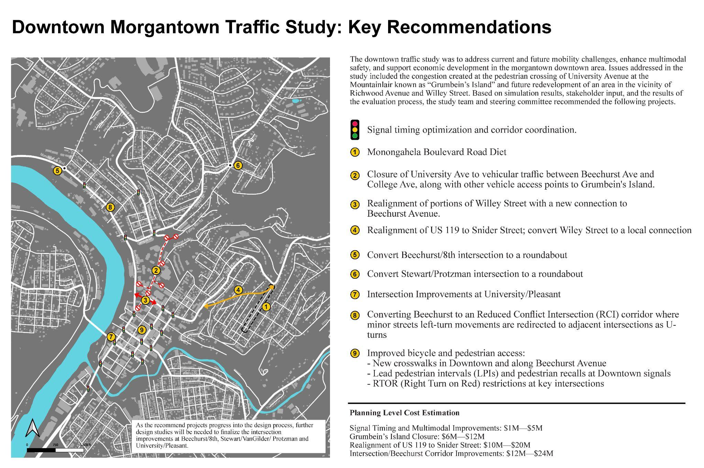
Validation + New Needs - New Projects (Downtown)
Final Recommendation:
• Signal optimization and multimodal improvements
• Grumbein’s Island closure
• Realignment of US 119 to Snider Street
• Intersection Improvements
Not recommended to be carried forward: One-way street conversions

Slide 16
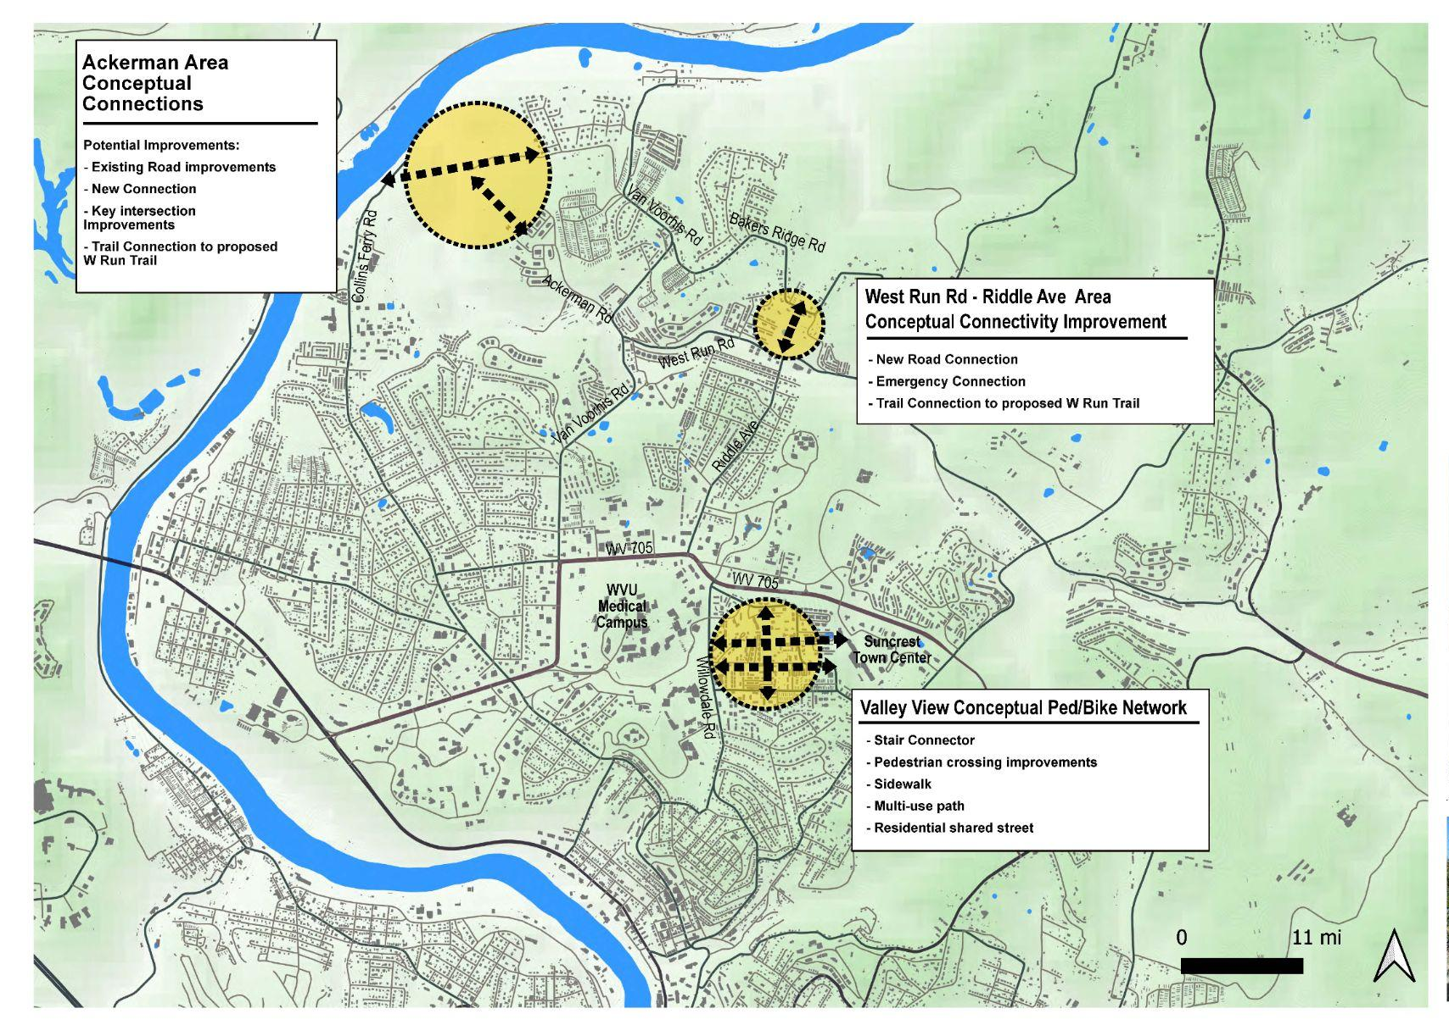
Validation + New Needs - New Projects (County)

Slide 17
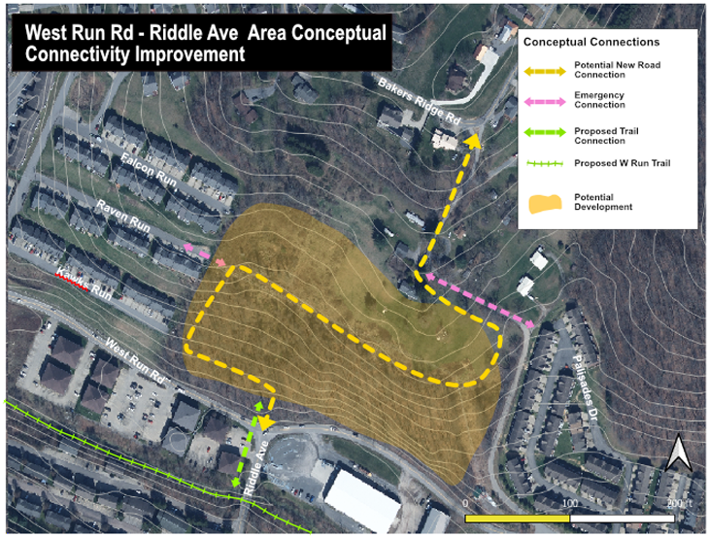
Validation + New Needs - New Projects (County)

Slide 18
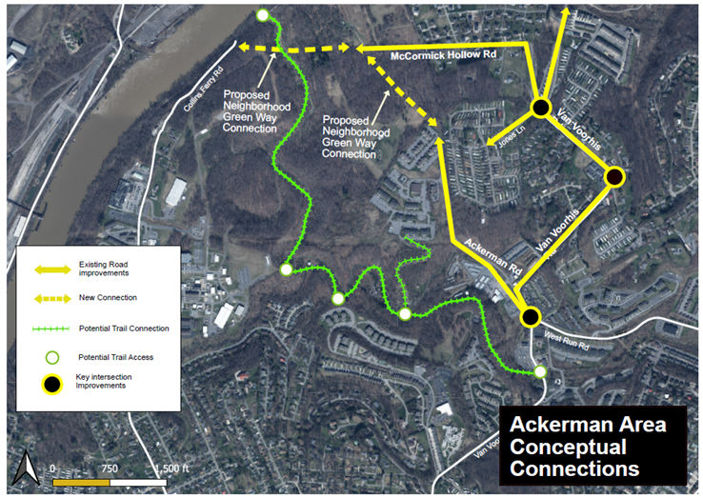
Validation + New Needs - New Projects (County)

Slide 19
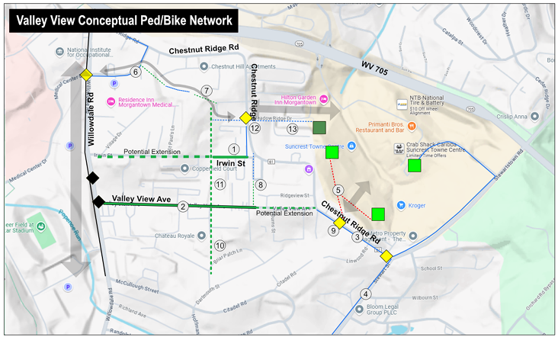
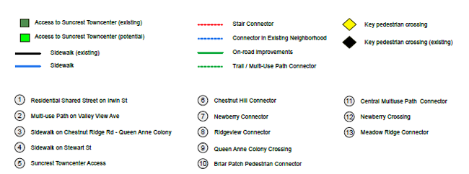
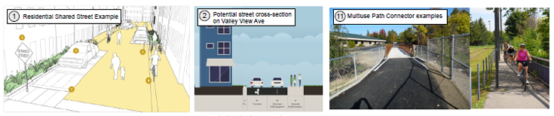
Validation + New Needs - New Projects (County)

Slide 20
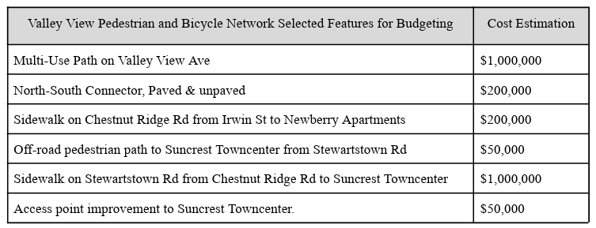
Validation + New Needs: Valley View Ped/Bike Improvements

Slide 21
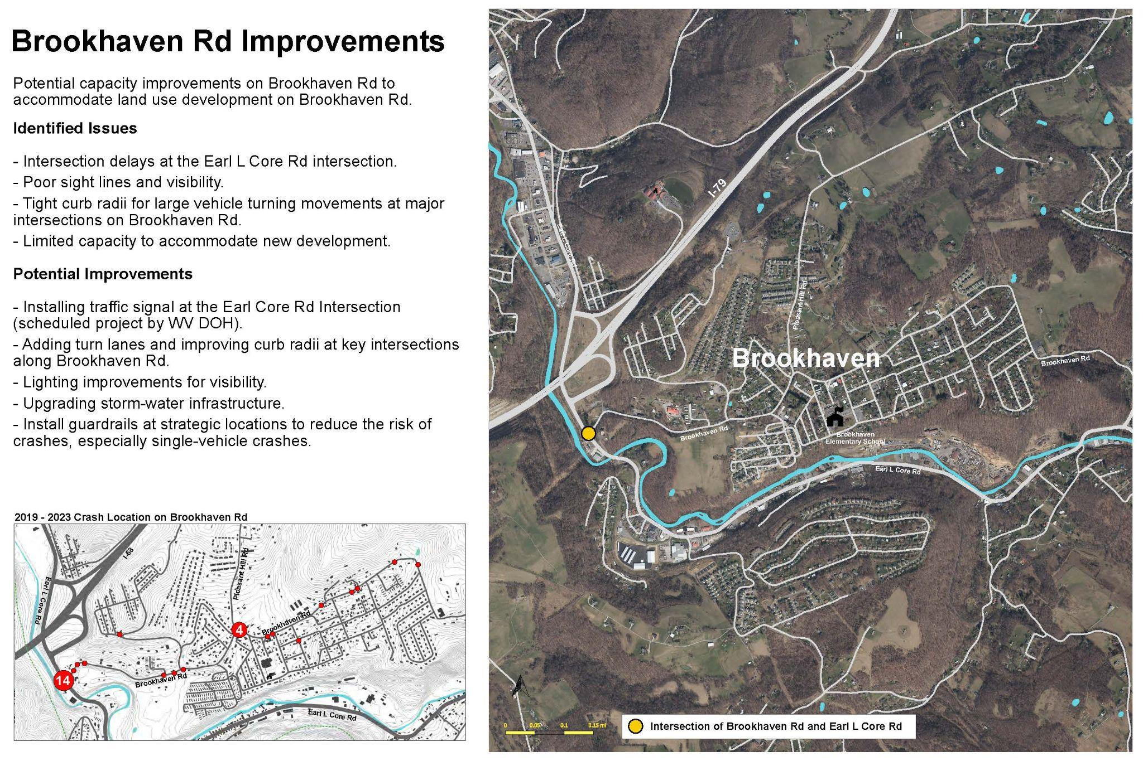
Validation + New Needs - New Projects (Brookhaven)

Slide 22
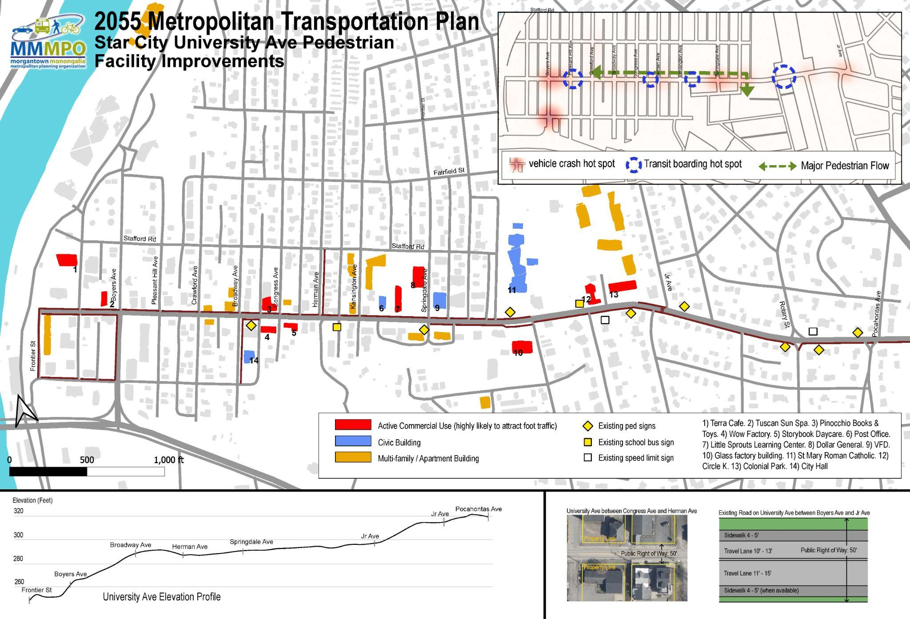
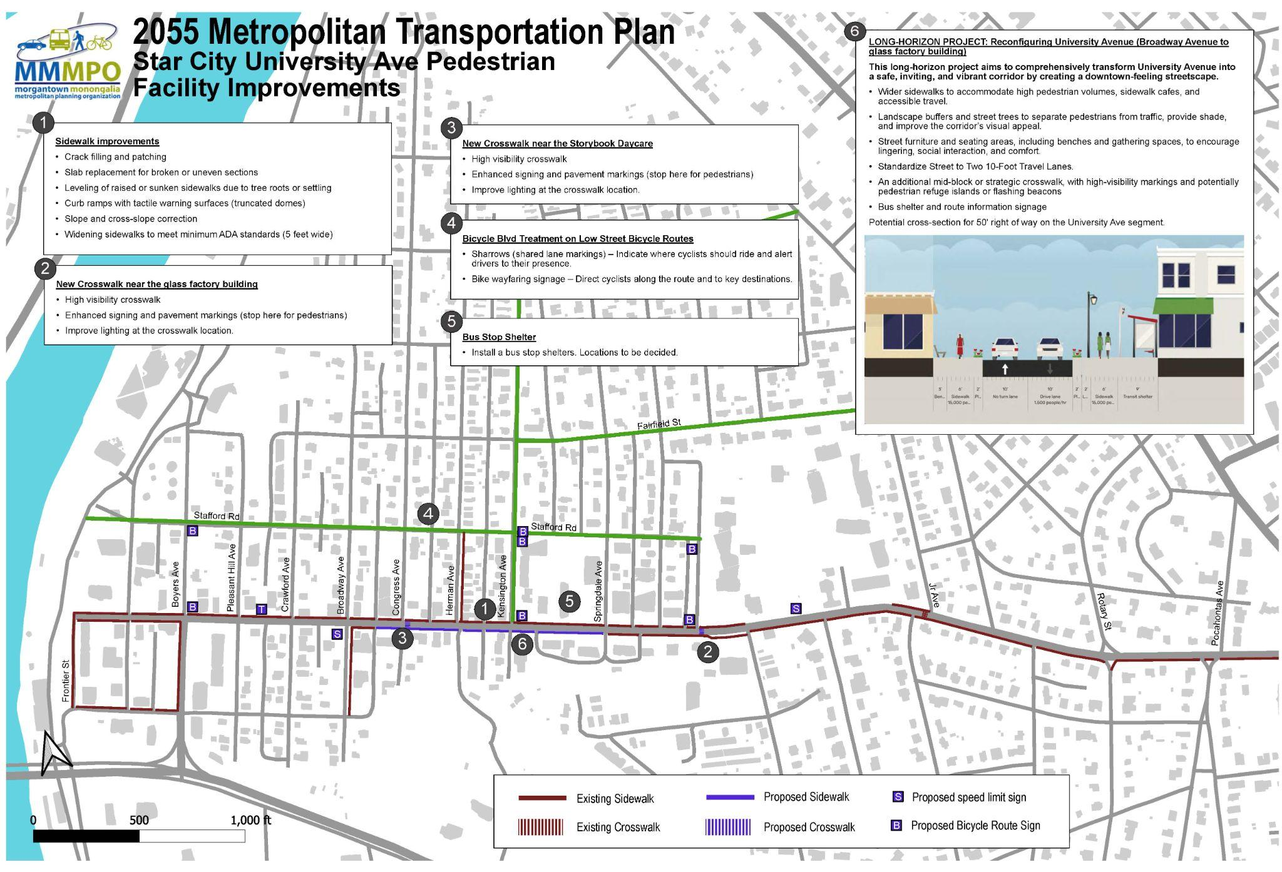
Validation + New Needs - New Projects (Star City)

Slide 23
Refine Priorities - New Considerations
Safety: 25% (+4%)
Reliability: 10% (-6%)
Maintenance: 10% (-5%)
Model Choice: 15% (+1%)
Local Priority: 20% (+6%)
Fairness: 10% (Same)
Consistency: 10% (Same)

Slide 24
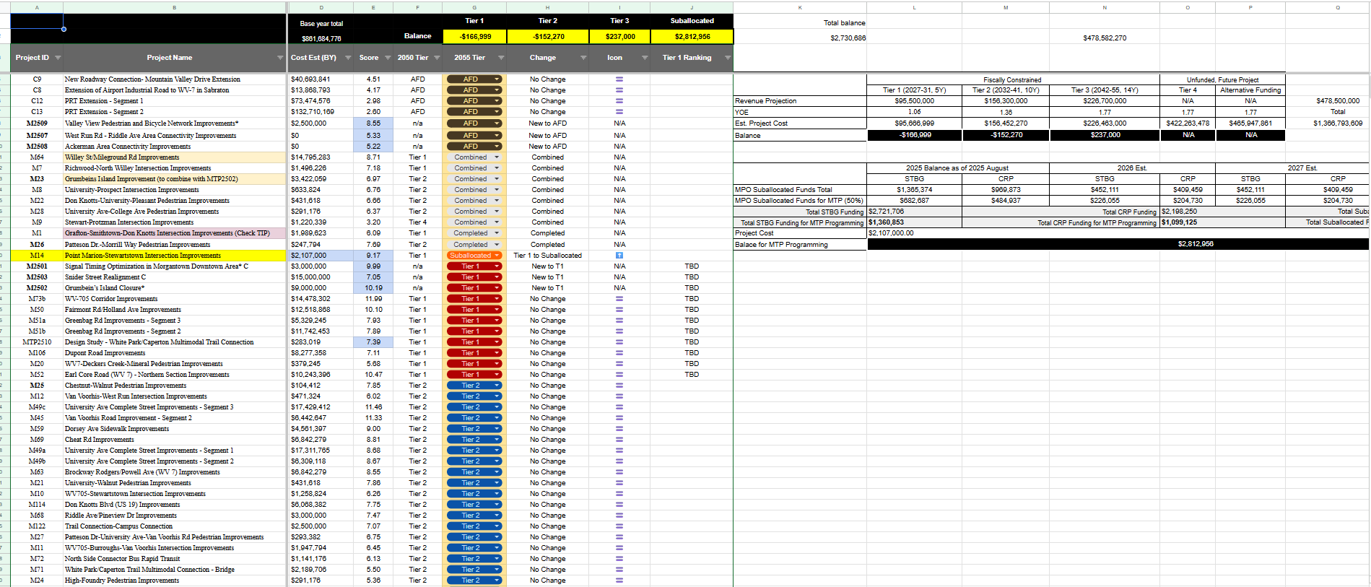
Refine Priorities - The Spreadsheet

Slide 25
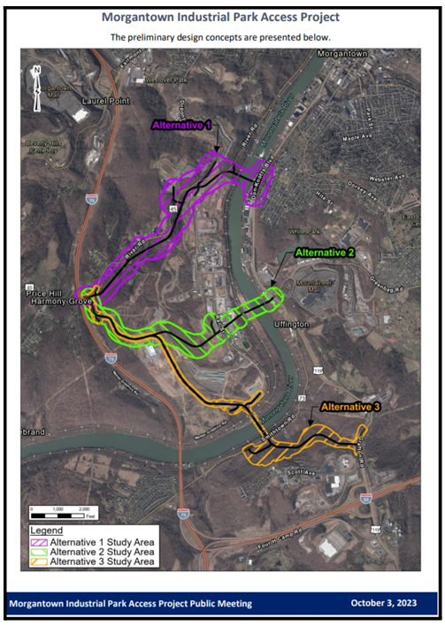
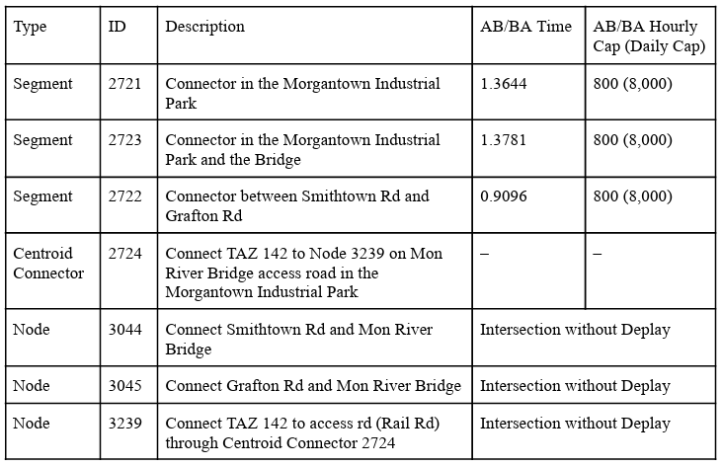
Final Product - TMD Updates

Slide 26
Final Product - Recommendations
Downtown Microsimulation Study Recommendations
Closure of Grumbein’s Island
Realignment of Willey Street to Snider Street
Coordination and optimization of the signal system including leading pedestrian intervals at crossings
Various intersection improvements
Actions to reduce speed and improve Beechurst Avenue operations
Brookhaven Road Improvements
These improvements are proposed in advance of anticipated growth along Brookhaven Road in the vicinity of WV 7.
Monongalia County Connectivity Improvements
These proposed projects were developed in coordination with Monongalia County Planning. The improvements identify anticipated opportunities for non-motorized improvements. It is anticipated that these projects will be implemented as part of the growth in the target area. The subject areas are identified as Ackerman Area, West Run Pedestrian improvements and Valley View area improvements.

Slide 27
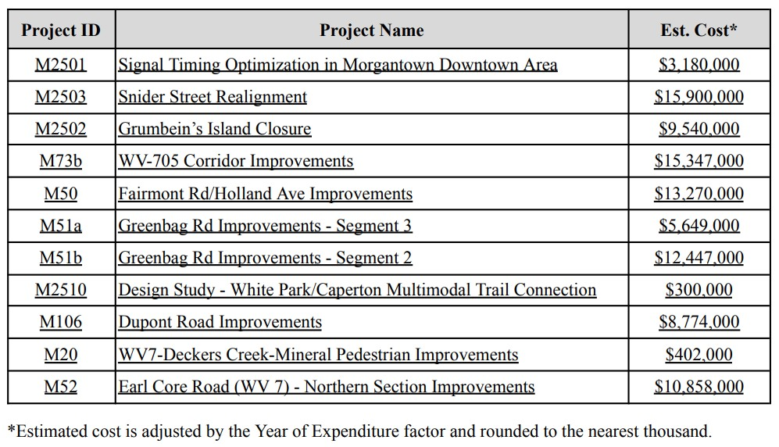
MTP 2055 Tier 1

Slide 28
Conclusion
This was a MINOR MTP Update done in-house by staff.
It validated the previous MTP while including new projects that arose.
Saved money and time.
Will help simplify next update.
Questions?

